Slide 1
Motivational theorists
Introduce the aims and objectives for the session.
Discuss in groups, what is motivation?
Explain Taylors motivational theory and give examples.
Complete a written description of Taylors motivational theory.
Discuss Mayo and Hawthorne’s experiments.
Show a YouTube video on the experiment’s.
Complete a quiz on Mayo and Hawthorne’s experiments.
Explain Maslow’s Hierarchy of needs and give examples.
Show a YouTube video on Maslow’s Hierarchy of needs.
Draw a Maslow’s hierarchy of needs and explain each section.
Recap the aims and objectives for the session.

Slide 2
Activity 1
Task:
What is motivation?
What motivates you to go to work or attend college?
Can you think of any motivational theorists?
Time: 5 mins

Slide 3
Motivational theories
Motivation theory examines the different ideas that have evolved or been proposed over the last century, each of which propose different methods and techniques of getting the best performance from the workforce.
Effective motivation creates the desire and energy to complete tasks involved in a job to the highest possible standard. Motivation creates commitment to the job and the employer.

Slide 4
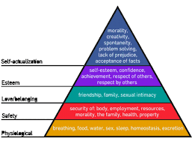
Motivational theorists
Taylors theory of scientific management.
Mayo and Hawthorne experiments.
Maslows hierarchy of needs.
Herzbergs two factor theory.
Vroom, Porter and Lawler’s expectancy theories.

Slide 5
Taylor’s theory of scientific management
The science of work Frederick Winslow Taylor, who wrote in the late nineteenth and early twentieth centuries, developed the idea of work study or time and motion study.
Taylor’s investigations into how jobs were performed allowed him to break tasks down into their basic components. He was then able to design jobs so that completion of the tasks was done in as simple and efficient a manner as possible.

Slide 6
In Taylor’s view, workers can produce more output if responsibility for decision-making and planning are removed. Workers should not have to think, they should just do.
His observations also indicated that a consistent approach by workers was the best way of achieving this. He argued that in each workplace the methods used by the most efficient workers should be utilised by all workers.

Slide 7
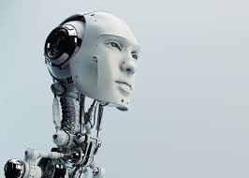
Therefore, workers should be trained to work to the model used by those who produce most output.
This idea of scientific management takes what is called a ‘task-orientated’ approach to managing workers. This means that the workers are just thought of as ‘machines’ for completing tasks.

Slide 8
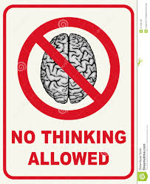
Scientific management in practice
Taylor’s ideas of scientific management based motivation on financial rewards. When applied to the workplace, there are several features that characterise scientific management. These are:
• workers are paid for carrying out specific tasks – they are not paid for thinking;
• they are paid for levels of output produced;
this involves the use of piece-rate payments;

Slide 9
• there is a tall hierarchy within organisations, with little scope for upward communication;
• the best (most efficient) method of working is to be adopted by all workers;
• close supervision of workers and monitoring of performance exists.

Slide 10
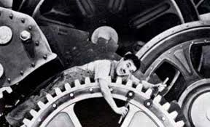
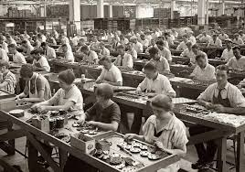
To quote from Taylor:
‘...what the workmen want from employers beyond anything else is higher wages: what employers want from workmen most of all is low labour costs in manufacture.’

Slide 11
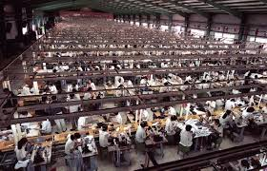
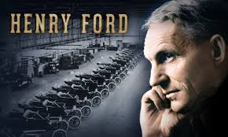
Taylor thought of scientific management as the best way of achieving this. The adoption of his methods led to large increases in productivity and was the foundation of the mass-production techniques applied by Henry Ford and many others.
We now, of course, realise that low-cost labour manufacturing may not be the only key to success with the much greater emphasis that is now placed on quality.

Slide 12
There is, nonetheless, still a role for scientific management. When competitiveness in labour-intensive industries depends on costs being kept to a minimum, then you will find that the ideas of Taylor are still being used today.
Consider fast-food chains, with their 100-page manuals on how to prepare a burger, with little or no responsibility placed on the worker apart from maintaining a level of output. Many global fast-food chains utilise a scientific management approach by producing the same product on high streets all over the world.

Slide 13
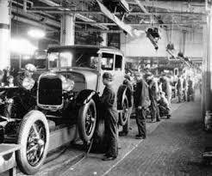
Activity 2
Task:
Written task – Taylors motivational theory.
Time: 20 mins

Slide 14
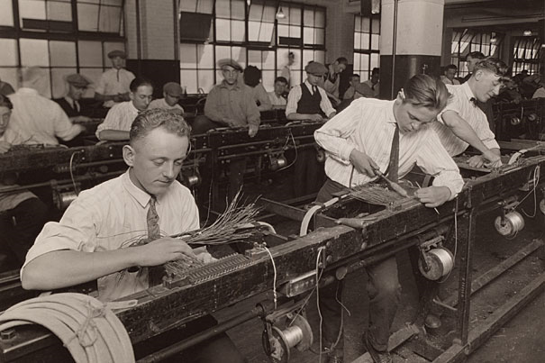
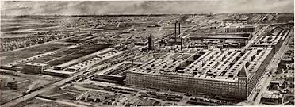
Mayo and the Hawthorne experiments
Elton Mayo and his team worked in the late 1920s and early 1930s at General Electric Company’s Hawthorne works.
In a workplace investigative study they were trying to develop Taylor’s scientific principles.

Slide 15
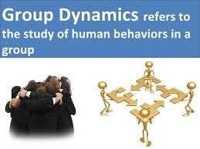
However, through their work they discovered that group dynamics could be more important than any form of financial motivation in determining the pattern of work and working practices.
This research also showed that the way groups of people are treated, and the way that they expect to be treated, affected the way that they worked.

Slide 16
The aim of the study was to establish the impact of different conditions of work on employee productivity. Initially, Mayo examined the effect of changes in the factory environment such as lighting and humidity.
He then went on to study the effect of changes in employment arrangements such as breaks, hours and managerial leadership. His main conclusion was that the prevailing view of the time, that people went to work purely for money, was flawed.

Slide 17
Work meant much more to people than simply earning money. It was first and foremost a group activity in which other people and their behaviour affected how well people worked.
Morale and productivity were affected not so much by the conditions in which people worked but by the recognition they received. The rises in productivity were achieved under the interested eye of the observers; not because the conditions made the workers feel good but because the workers felt valued.

Slide 18
As a result of the experiments Mayo suggested that motivation at work was promoted by such factors as:
• greater communication;
• better teamwork;
• showing an interest in others;
• involving others in decision-making;
• ensuring the wellbeing of others;
• making work interesting and non-repetitive.

Slide 19
Human relations school of motivation
From Mayo’s work the Human Relations School of motivation and management developed. The followers of this school of management regard workers and managers as interacting groups.
As long as the form of interaction is tailored to the dynamics of each group, then this interactive relationship can only be of benefit to the business. Communication is now seen as important – explaining the importance of workers’ roles and listening to their views.

Slide 20
The Human Relations School today
Group dynamics today have a very important part to play in the workplace. Managers have discovered that small groups with effective leaders are a way of transforming working practices within organisations.
Working as a team allows the breaking down of traditional hierarchies and allows each worker to feel part of a small work group, motivated to achieve within their own section of the business.

Slide 21
Managers who wish to fully gain from the benefits promised by the Human Relations School must develop an adaptive approach. This means that they must learn to treat different groups of workers in different ways.
They must apply approaches, motivational methods and communication systems suited to the needs of each group within their organisation.

Slide 22
Mayo and Hawthorne experiments
https://www.youtube.com/watch?v=rLVp-CrBnPo

Slide 23
Activity 3
Task:
Mayo/ Hawthorne quiz
Time: 10 mins

Slide 24
Maslow’s hierarchy of needs
All humans have needs. The basic needs are regarded as warmth, food, clothing and shelter. These basic needs used to be what we needed to survive and for many thousands of years it was all that most humans could hope to obtain.
The modern working man and woman are very different.

Slide 25
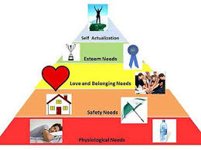
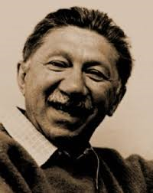
Abraham Maslow, an American psychologist who worked in the middle part of the twentieth century, argued that we all have a hierarchy of needs.
He proposed that we all wish to attain the highest level of this hierarchy. However, before we can reach this highest level the lower levels of needs must be securely in place.

Slide 26
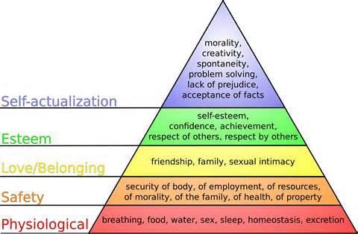

Slide 27
When this hierarchy is applied to the workplace managers must examine how they can satisfy the needs of employees. To satisfy the basic needs of food, warmth, clothing and shelter, workers must have an income; so a reasonable level of pay is a requirement to satisfy these needs.

Slide 28
The next level, security, means that workers must be able to predict their future with some degree of certainty. To allow employees to do this, managers should offer contracts of work, some form of sickness benefits and pension schemes.

Slide 29
The next level, love and belonging, can be satisfied by designing jobs so that they involve interactive work – this is group working again. There should be an opportunity for social interaction in the workplace, such as meeting places or provision of a social facility such as a club.
Workers also need to be able to spend time with their families, so social working hours and a decent holiday entitlement are a must.

Slide 30
The fourth level, esteem needs, can to an extent be satisfied by communication from managers assuring the workers that they are doing good jobs. There should be the opportunity for workers to be able to train, to improve their prospects and improve the quality of their work.
They must be able to give some input into the decision-making process. One way of achieving this is through participation in quality circles. Also job enrichment is an important part of satisfying this need.

Slide 31
At the highest level, self-actualisation, workers achieve what they are capable of doing. The key to this is promotion. Workers should be able to climb to a level within the organisation that enables them to demonstrate their talents in a job they are most suited to. They should be given as much freedom over their tasks as possible; they should be allowed to do the job in the way that they know best. The ideas of empowerment in the workplace relate to this.
Managers must consider whether
all workers need to have all levels
satisfied.

Slide 32
It would be an expensive business to satisfy all the needs of all employees, up to and including self-actualisation. What managers must be aware of is the trade-off between extra quality and output that comes with satisfaction of each level of needs, and the cost of satisfying these needs.
For example, it may be realistic to satisfy only basic and security needs for the mass of a business’s workers, and concentrate on satisfying the higher needs of those workers who are core to the future success of the business.

Slide 33
YouTube video – Maslow Hierarchy
https://www.youtube.com/watch?v=3St5OoLYTJ0

Slide 34
Activity 4
Task:
Draw a Maslow's hierarchy of needs and explain each section.
Time: 30 mins

Slide 35
Motivational theorists
Introduce the aims and objectives for the session.
Discuss in groups, what is motivation?
Explain Taylors motivational theory and give examples.
Complete a written description of Taylors motivational theory.
Discuss Mayo and Hawthorne’s experiments.
Show a YouTube video on the experiment’s.
Complete a quiz on Mayo and Hawthorne’s experiments.
Explain Maslow’s Hierarchy of needs and give examples.
Show a YouTube video on Maslow’s Hierarchy of needs.
Draw a Maslow’s hierarchy of needs and explain each section.
Recap the aims and objectives for the session.

