Slide 1
Management and leadership
Introduce the aims and objectives for the session.
Explain what are management and leadership.
Discuss the roles and objectives of management and leadership.
Arrange the advantage and disadvantages of management objectives.
Complete the written task on management of business by objectives.
Explain McGregor’s theory X and Y workers.
Show a YouTube video on McGregor’s theory.
Analyse McGregors theory in a written task.
Recap the aims and objectives for the session.

Slide 2
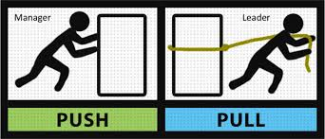
Management and leadership
Management and leadership are often grouped together in business and the qualities often attributed to leadership can also apply to managers.
However, there should be a distinction between the two different roles.

Slide 3
Management and leadership
Leaders may perform similar functions to managers, but in addition they also inspire and motivate the workforce, they consider long-term strategy, the challenges facing the business and how to overcome them.
Managers control and direct the workforce to follow the principles or values that have been established by the leaders.

Slide 4
Some leaders will not manage in the workplace they may rely on a deputy or a team of managers to do this on their behalf, to ensure that the right staff are recruited, products or services are produced and the business is profitable.

Slide 5
Strong leadership
A successful business owner should be both a strong leader and manager to get their workforce to follow them towards their vision of success.
Being a good leader involves getting people to understand and believe in your vision to work with you to achieve your goals, whereas managing is more about administering and making sure the day-to-day things are happening as they should.

Slide 6
The functions of management
Managers:
Plan
Functional e.g. HR/sales etc.
Control
Coordinate
Organise
Lead

Slide 7
The roles of management
Interpersonal roles - hiring, ﬁring, training, motivating and organising.
Information roles - acting as a channel for information to ﬂow between divisions/departments within an organisation.
Decision-making roles - the access to information that managers have enables them to use their formal authority to make decisions.

Slide 8
Management by objectives (MBO)
Management by objectives is a philosophy of management designed by Peter Drucker.
Objectives are defined within an organisation so that the management and workers agree to the objectives and understand what they need to do in order to achieve them. It involves the breaking down and subdivision of the aims and goals of an organisation into targets and objectives for divisions, for departments, for managers and finally for workers.

Slide 9
The passing down and subdivision of objectives down the hierarchy should produce an end result where the targets and objectives for each individual within the organisation, when all added together, equal the same as the targets and objectives for the whole organisation.

Slide 10
Drucker suggested that by working together to meet the same objectives, owners, managers and workers would have a clear structure and long-term strategy that give clear goals to all stakeholders in the organisation.

Slide 11
An important aspect of MBO is the participative setting of objectives and planning a course of action to achieve the objectives. By including employees with the goal setting and the course of action to reach those objectives, they are more likely to be motivated and carry out their responsibilities to the best of their abilities.
When the plans have been carried out it is essential that the work is monitored to measure the actual performance against the actual standards set.

Slide 12
Management by objectives process
Review objectives for the whole business (corporate objectives)
2. Set objectives for the management of the diﬀerent functions of the business
3. Set objectives for individual departments and workers

Slide 13
4. Monitor progress – managers and workers check to see if the objectives are being reached
5. Evaluate performance and give reward if the objectives were reached

Slide 14
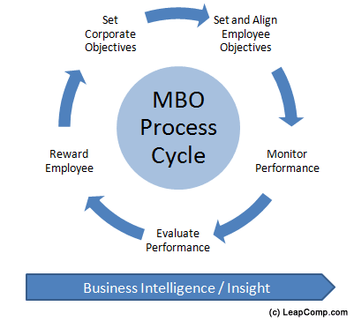

Slide 15
Advantages of management by objectives (A04)
• Improved management control of the organisation. Managers know who is doing what and what they are supposed to be achieving. Clarity of goals.
• Improved financial control. Part of the setting of the objectives process is monitoring expenditure and revenues. Any changes from (variances from) budgeted amounts need to be explained and reacted to.

Slide 16
• The work of departments and managers are co-ordinated. Everyone is working together towards a common goal.
• It can motivate the workforce. When managers at all levels are involved in setting and agreeing objectives they will have a commitment to ensuring that objectives and goals are achieved. Involving all employees in the whole process of goal setting will give employee empowerment. This increases employee job satisfaction and commitment.

Slide 17
• It allows managers to be aware of their responsibilities. Managers are aware of what they should be achieving and how their role fits in with organisational objectives.
• It can improve communication systems within the organisation. The process of setting and agreeing objectives will itself involve communication both up and down the hierarchy.

Slide 18
Disadvantages management by objectives (A04)
• Management time is spent on the process of setting objectives rather than managing the organisation.
• The ever-changing business environment or context in which the goals are set may change over time making the objectives unrealistic.
• Demotivation and breakdown of working relationships. If all levels of hierarchy are not involved in setting objectives, then they may not be committed to them.

Slide 19
• Objectives can be seen as a form of management control.
• A situation may arise where managers ‘cannot see the wood for the trees’. This loss of focus means managers concentrate on short-term objectives at the cost of ignoring the long-term goals.

Slide 20
YouTube video
Management by objectives (Drucker)
https://www.youtube.com/watch?v=MX7sserktdY

Slide 21
Activity 2
Task:
Arrange the advantage and disadvantage cards – Management objectives.
Time: 15 mins

Slide 22
Activity 3
Task:
Exam question – Management of business objectives
Time: 20 mins

Slide 23
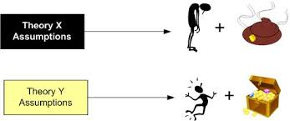
McGregor’s Theory X and Theory Y
Douglas McGregor put forward the idea that there are two broad types of manager :
Theory X managers
Theory Y managers

Slide 24
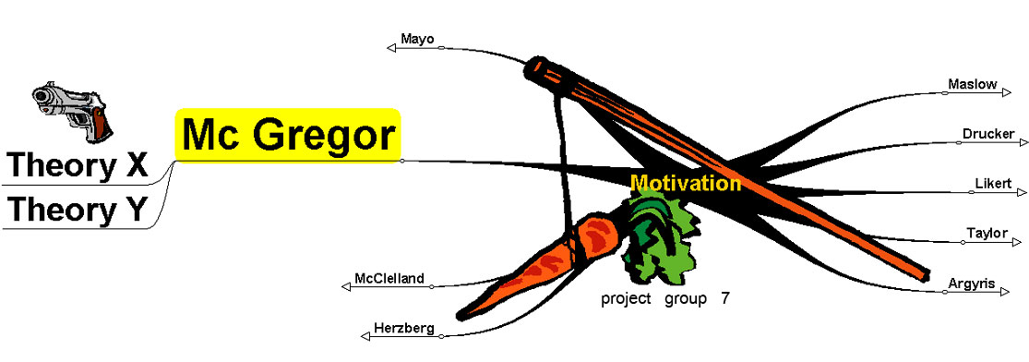
Theory X managers
The first of these management styles, is founded upon the ‘assumption of the mediocrity of the masses’.
Managers see workers as machines and have little input into
The organisation unless forced or supervised.

Slide 25
The Theory X type of manager makes several assumptions about employees:
• workers must be supervised or quality and quantity of output will fall;
• workers only respect the type of manager that tells them what to do and does so with complete authority;
• money is the only motivator;

Slide 26
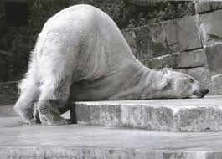
The Theory X type of manager makes several assumptions about employees:
• workers do not want to be involved in the decision-making process;
• workers wish to remain faceless and unknown to management;
• workers have little ambition

Slide 27
Consequences of Theory X management (A04)
If managers are employed who believe that workers have little or no ambition, wish to be left alone, must not be involved in the wider business environment and must be supervised if they are to maintain quality and quantity of work, then this has major impacts on job design and control.

Slide 28
• strict control of formal methods of communication;
• tasks must be designed so they are broken down into their simplest units;
• responsibilities must be clear and unambiguous;
• supervisors must maintain quality;
• high level of dependence on the decision-making of senior management

Slide 29
Theory Y managers
Theory Y managers believe that the reverse is true. They start with several positive assumptions about employees:
• Workers cannot be motivated by money alone – they seek more than financial satisfaction from their jobs;
• Workers are ambitious, willing to train and contribute to improve their chances of promotion;

Slide 30
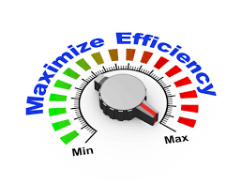
• Workers will be more efficient if they are left to their own devices – trust breeds responsibility;
• Workers want to contribute to improving efficiency – they want to be seen, be noticed, rewarded and appreciated when they work well.

Slide 31
Consequences of Theory Y management (A04)
Theory Y managers are likely to create an open structure, with both formal and informal paths of communication and delegated powers. Workers will be given responsibilities and a wider range of tasks.
Theory Y managers are facilitators. It is likely that managers will adopt a democratic style – this is based on encouraging participation in decision-making.

Slide 32
• Requirement for training;
• Use of cell working – restructuring of production and service methods;
• Setting up of formal communication channels, with both vertical and lateral communication;
• Promotion structures;
• Flexible working practices.

Slide 33
MC Gregor Theory X and Y conclusion
An important part of this theory of management is that the managers will, over a period of time, influence how workers behave.
So if we have a Theory Y manager placed in a business where workers have previously behaved within the Theory X pattern, it is quite possible for change to take place.

Slide 34
The existing workers may be transformed from being uncooperative, demotivated and unconcerned with the success of the business into contributors who are motivated to improve quality and ambitious for personal and company success.

Slide 35
It also follows from this that lack of motivation amongst workers and poor quality of output is a management created problem.
It is the role of management to create methods of production and management of human resources that will allow these resources to realise their full potential.

Slide 36
YouTube video
YouTube video – Mc Gregor Theory X and Y
https://www.youtube.com/watch?v=NK8-LhqF4N0

Slide 37
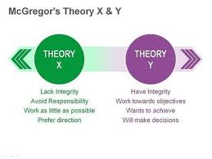
Activity 4
Task:
Exam question – McGregor X/Y
Time: 25 mins

Slide 38
Management and leadership
Introduce the aims and objectives for the session.
Explain what are management and leadership.
Discuss the roles and objectives of management and leadership.
Arrange the advantage and disadvantages of management objectives.
Complete the written task on management of business by objectives.
Explain McGregor’s theory X and Y workers.
Show a YouTube video on McGregor’s theory.
Analyse McGregors theory in a written task.
Recap the aims and objectives for the session.

