Slide 1
Trade unions/ ACAS – Objectives
Introduce the aims and objectives for the session.
Explain trade unions and industrial action.
Show a YouTube video on industrial action.
Complete a written task on trade unions.
Discuss the role of ACAS and give examples.
Complete a Kahoot quiz on trade unions.
Explain the role of ACAS and discuss with the group.
Recap the aims and objectives for the session.

Slide 2
What are trade unions?
Trade unions were traditionally organisations that represented workers in a particular trade, industry or occupation.
More recently we have seen the growth of general trade unions (e.g. Unite), representing a wide range of workers. All sorts of occupations are represented by trade unions, including manual and professional workers.

Slide 3
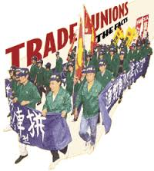
Their purpose is to protect and improve their members’ terms and conditions of employment. An individual worker alone has very little power to influence decisions, but by joining together, workers have more chance of having a voice and influence.
This is known as collective bargaining.
Trade unions also campaign for laws
and policies which will benefit
working people.

Slide 4
Trade unions
Trade unions are financed and run by their members. Many were formed over 100 years ago. Almost every working person has the legal right to join or not to join a trade union.
The Trades Union Congress (TUC) is made up of representatives of most of the major unions and has a role in national negotiations with employers and the government.

Slide 5
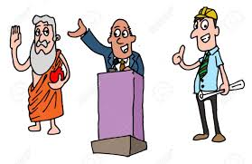
Why do people join unions?
• Representation. This means that unions represent members faced with redundancy, a grievance, disciplinary procedures and legal action.
• Negotiation of pay and conditions with employers. This is ‘collective bargaining’, and benefits workers. About half of the UK workforce is covered by collective bargaining arrangements. Negotiation does not have to be done on an individual basis but through a representative of a large section, or even the whole, of the workforce.

Slide 6
Help ensure high standards of health and safety. The provision of a network of health and safety representatives in Britain’s workplaces.
Union members can benefit from a wide range of services which are not directly related to the workplace. These include financial, legal and welfare services.

Slide 7
• Unions support the development of equal opportunities policies. Most large companies, and many smaller ones, now operate policies which attempt to eliminate discrimination at work.
Trade unions have not only supported their members who have been discriminated against but also helped the workforce to understand the policies.

Slide 8
Trade union advantages (employers)
• Collective bargaining assists employers because it simplifies the process of negotiating with workers. Negotiation does not have to be done on an individual basis, which would be very time consuming and disruptive.
• Trade unions can also help ensure that agreements are complied with by workers and can assist with communication between management and workers.

Slide 9
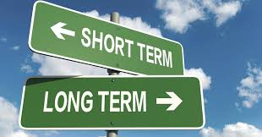
Trade unions are able to take a longer term view than individuals and are therefore able to see why difficult decisions have to be made.
Individual workers may be blinded by short-term desires such as improving their pay, when raising costs may make the business uncompetitive.

Slide 10
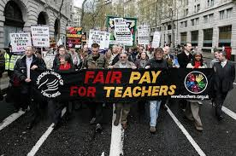
What is the role of trade unions in
industrial disputes?
When disagreements between employers and employees occur they need to be resolved fairly and swiftly.
Good industrial relations contribute to the smooth running of business – so disputes between managers and employees should be avoided whenever possible.

Slide 11
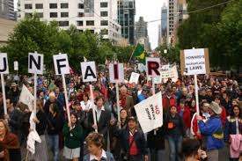
Even so, disagreements between employers and employees can occur for a wide range of reasons.
These include disputes over wages, hours and conditions of work, the introduction of new machinery, new work rotas, overtime, job losses, redundancies, health and safety issues and equal rights.

Slide 12
If there is a disagreement on any of these issues, it is often the unions’ local representative, the shop steward, who will negotiate with the management.
When an agreement between management and the local union representatives cannot be reached straight away, the national trade union officials may be consulted and involved in negotiations.

Slide 13
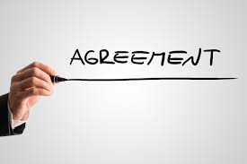
On the whole, differences are sorted out without any industrial action being taken. There may even be a national agreement in place which the employer and employees are bound by – this agreement can then be used to resolve issues.

Slide 14
However, there are occasions when the two sides cannot agree. In these cases, a trade union will use a number of strategies before calling a strike.
Strikes are often in the news but they are rare in most workplaces. Many more working days are lost through work-related sickness than through strikes.

Slide 15
Types of industrial action
• An overtime ban – workers just work basic hours and refuse to do any extra work. This is a useful tactic if the employer has a lot of work on and is trying to meet high levels of demand.
• A work-to-rule – workers stick very closely to every rule in the workplace, especially health and safety rules. This slows down production and reduces output.

Slide 16
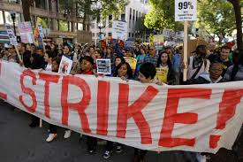
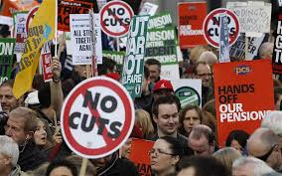
• Strikes – a withdrawal of labour. An all-out strike is called as a very last resort. Both sides have much to lose – the workers’ income and the employers’ profits.
Letting down customers can have a lasting impact on a business as they may seek alternative suppliers and never return.

Slide 17
There is no doubt that the British record on industrial action has improved dramatically over the last 30 years: this new realism by trade unions is probably more the result of trade union legislation, limiting the powers of trade unions, than any other factor.

Slide 18
YouTube videos
Your task is to decide as a group whether industrial action should have been taken or not?
Christina McAnea, Head of Health for UNISON, explains why UNISON’s members working in the NHS are taking industrial action.
https://www.youtube.com/watch?v=bz_nCcKsQeQ
Midwifery strike action.
https://www.youtube.com/watch?v=NIKQyNbOufI

Slide 19
Activity 1
Task:
Your task is to complete the trade unions written task.
Time: 20 mins

Slide 20
ACAS
Sometimes an outside body is called in to arbitrate (try to bring the two sides together) during employer/ employee negotiations.
The Advisory, Conciliation and Arbitration Service (ACAS) is often used to help find a solution which is acceptable to both sides. ACAS plays an important role in settling disputes but only has a role to play when it is invited by both sides to conciliate (offer and suggest solutions) or arbitrate (when ACAS’s solution will be accepted by both sides).

Slide 21
The advisory role of ACAS
Employment law is complex. The advisory role is to give employers and employees a point of contact so that issues regarding employment law and procedures can be made clear.
Any employer or employee can contact
ACAS to gain advice, or to discuss
appropriate steps to take to help
resolve employment issues.

Slide 22
The conciliation role of ACAS
The conciliation process involves an invited independent ACAS conciliator discussing disputed workplace issues with both parties in order to help them reach a better understanding of each other’s position and underlying interest.

Slide 23
The impartial conciliator tries to encourage the parties in dispute to come to an agreement between themselves and so avoid the disruption and expense of progressing the dispute through industrial action.
With conciliation, the recommendations and advice given is in no way binding on either side.

Slide 24
The arbitration role of ACAS
Arbitration involves an impartial ACAS advisor being asked to make a decision on a dispute. The arbitrator makes a firm decision on a case, based on the evidence presented by the parties.
Arbitration is voluntary, so both sides must agree to go to arbitration; they should also agree in advance that they will abide by the arbitrator’s decision. Arbitration is often used in collective employment-related disputes

Slide 25
For example, a trade union might be in dispute with an employer over the annual pay rise.
The union could agree with the employer to ask ACAS to appoint an independent arbitrator from their panel to hear the two sides’ cases and then make an independent and impartial decision.

Slide 26
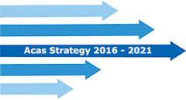
Arbitration can also be used to settle individual disputes. For example, an individual and an employer might decide to go to arbitration to avoid the stress and expense of employment tribunal.

Slide 27
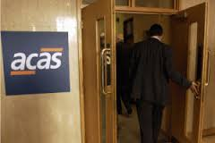
Activity 2
Task:
Your task is to complete a written description of the role of ACAS.
Time: 20 mins

Slide 28
Activity 3
Task:
Kahoot quiz – Trade unions and ACAS
Time: 10 mins

Slide 29
Trade unions/ ACAS – Objectives
Introduce the aims and objectives for the session.
Explain trade unions and industrial action.
Show a YouTube video on industrial action.
Complete a written task on trade unions.
Discuss the role of ACAS and give examples.
Complete a Kahoot quiz on trade unions.
Explain the role of ACAS and discuss with the group.
Recap the aims and objectives for the session.

