Slide 1
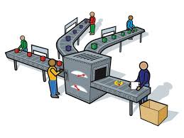
Added value/ Production
Introduce the aims and objectives for the session.
Explain added value and calculate added value.
Calculate added value using a new example.
Explain the difference between added value and profit.
Discuss the various methods of production and give examples.
Show a YouTube video on production methods.
Summarise key points from each production method.
Arrange production method definition cards.
Answer the Kahoot quiz questions.
Introduce the aims and objectives for the session.

Slide 2
Added value
During the production process a business adds value to the raw materials which it uses when making a product. Calculation of added value – the difference between the cost of purchasing raw materials and the price for which the finished good is sold for.
Added value = Cost of purchasing raw materials – price of finished good.

Slide 3
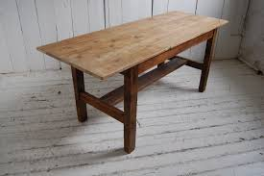
Manufacturing a table
Raw materials (inputs)
Wood – £20
Brackets – £2
Screws – £0.50
Paint – £1
Varnish – £0.50
Total raw materials cost = £24

Slide 4
Processes (Carpenter)
Cutting
Sanding
Joining
Painting
Varnishing
Added value = £80
Finished product output = £24 + £80 = £104

Slide 5
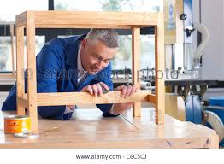
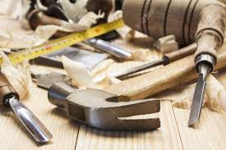
In the example a carpenter uses inputs such as wood, screws and other raw materials to make a table. The total cost of all the materials adds up to £24.
In order to make the table the carpenter has carried out a variety of processes. The final output – the table – is sold for £104. The added value in this case is £80 (£104 – £24 = £80).

Slide 6
Added value and profit
Added value is not to be confused with profit.
Out of the £80 added value in this example the wages of the carpenter plus any overheads his business may have, such as transport and insurance, must be deducted.
Then a profit figure can be calculated.

Slide 7
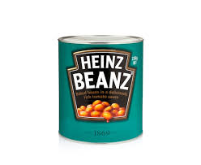
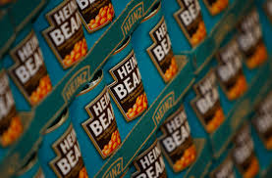
Added value provision of services
Added value does not only apply to the production of goods – it also applies to the provision of services.
For example, when a wholesale business buys a thousand tins of baked beans from a manufacturer it will sell the beans on for more than it paid for them. This difference in price is regarded as added value.

Slide 8
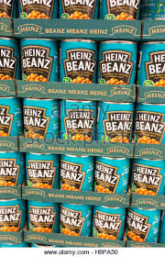
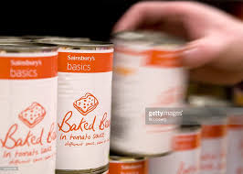
The wholesaler has provided a service and has therefore added value by making it convenient for local retailers to come to the warehouse and pick up the amount of baked beans they need to sell to their own customers in their shops.

Slide 9
How might added value be increased?
• Purchasing cheaper raw materials – however, care must be taken that quality is not compromised when doing this. As a business grows it may be able to take advantage of purchasing economies of scale and achieve greater added value as a result.
• Improving the efficiency of the production process – for example, this may be achieved by purchasing up-to-date machinery or by training the workforce.

Slide 10
Raising the price of the product – price elasticity of demand is a key issue here. If the business raises the price of a product, the demand for which is price sensitive, it will result in a fall in overall revenue – which is clearly something it would not want to do.
Achieving brand status for a product can create added value. Chanel perfume sells for a great deal more than the majority of its competitors, but the processes involved in production will be virtually identical.

Slide 11
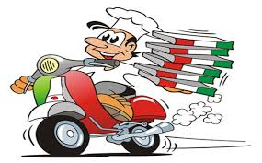
• Offering additional services with a product can result in added value. A telephone helpline to help with technical questions, or the willingness to install new equipment and ethically dispose of old equipment are examples of this.
• Improving customer access or convenience is a well-proven method of adding value. Drive-through fast-food outlets and home-delivery pizza are typical examples.

Slide 12
Activity 1
Task:
Calculate added value.
Time: 10 mins

Slide 13
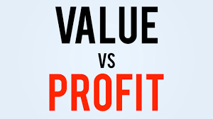
Activity 2
Task:
Explain the difference between added value and profit – written.
Time: 10 mins

Slide 14
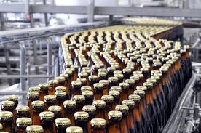
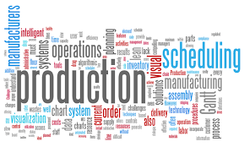
Production
There are a number of different ways that a business can organise how it produces its products.
The method which the business operates will depend on many factors including cost, volume, quality and the skills of its workforce.

Slide 15
Types of production
There are three types of production – ways of producing goods.
Job production
Batch production
Flow or mass production

Slide 16
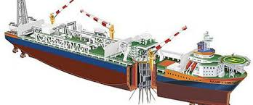
Job production
Single items, usually to the buyer’s specification, are made using job production. This method produces unique products and they are made one at a time. Job production is labour-intensive and produced by skilled workers.
Examples of goods made by job production are wedding dresses and tailor-made suits. Other, largescale examples may include buildings, bridges and ships.

Slide 17
Job production results in high-quality products that are matched to customer needs. Employees producing goods using job production can be highly skilled and have interesting and challenging jobs.
Design is flexible and can be adapted to customer needs.

Slide 18
However, goods made using job production methods can take a long time to make compared to goods made using mass production.
Prices of any goods produced are also likely to be a great deal higher, as skilled workers will command higher payments for their time and expertise.

Slide 19
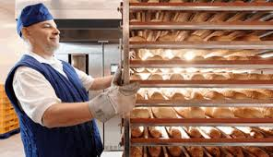
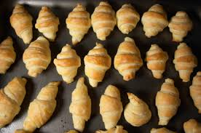
Batch production
This is the method which involves manufacturing a limited number of identical products. At each stage of the production process work will be completed for the whole batch before the next stage is begun.
A typical industry using batch production is baking.

Slide 20
Batch production example
For example, stage one would involve mixing sufficient dough for 500 granary loaves. Stage two might require leaving the dough to rise for a period of time.
Stage three would be to divide the dough into loaves, stage four to bake the loaves, stage five to slice the loaves and stage six would be the packaging. Batch production is also often used by potters and furniture manufacturers.

Slide 21
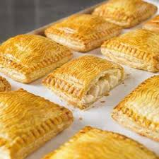
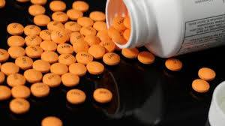
Batch production will have lower unit costs and higher output than job production. Employees are likely to be semi-skilled and there can be a reliance on capital investment.
Batch production allows businesses to aim at niche markets, using the same assets or capital equipment to produce a range of goods.

Slide 22
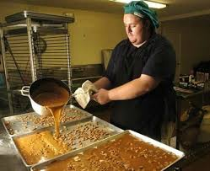
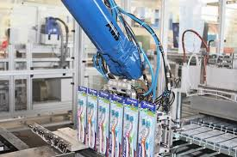
Time is lost when machines have to be reset for new production and the business may not be equipped to deal with large scale orders.
However, some economies of scale will be gained when compared with job production.

Slide 23
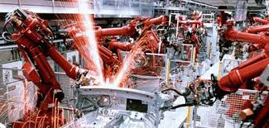
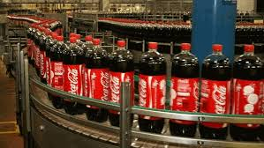
Flow or mass production
Flow production involves the production of products on production lines.
There is a continuous process – the product flows from one stage of production to the next. This method allows identical products to be made in large volumes.

Slide 24
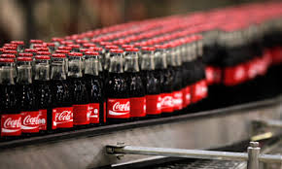
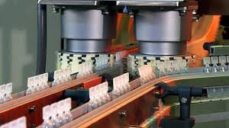
The production process is broken down into a number of small, simple tasks enabling machines or robots to be utilised.
The production of the products is much faster than job or batch production so a business can meet the demand of large quantities.

Slide 25
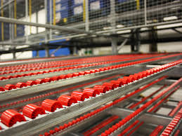
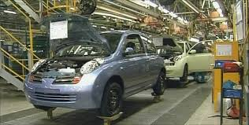
Workers, when used, can be unskilled or have skills limited to particular simple tasks. This can lower labour costs, although motivation can become difficult.
There are often large amounts of capital investment involved through high set-up costs – production line machines/robotics can be very expensive.

Slide 26
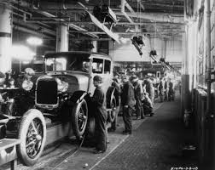
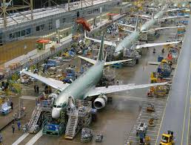
Also breakdowns and hold-ups can be very expensive. However, unit costs are low and businesses will benefit from economies of scale, thereby reducing costs.
The products produced through flow production are identical and this method does not allow for a wide product range.

Slide 27
Type of production will depend
on a number of factors
• the product being produced;
• the cost of labour;
• the cost of capital;
• the availability of money for investment;

Slide 28
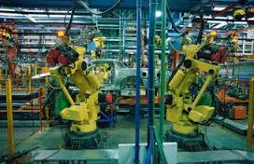
technology;
• the skills of labour;
• the size of the market;
• customer requirements

Slide 29
YouTube videos - Production
Job production:
https://www.youtube.com/watch?v=u2rujM6QKJ8
Batch production:
https://www.youtube.com/watch?v=XKGak-4yh-8
Mass production:
https://www.youtube.com/watch?v=VreG1iC65Lc

Slide 30
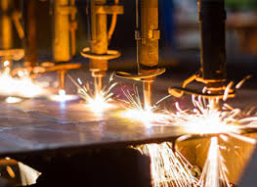
Activity 3
Task:
Summarise key points from each production method.
Time: 20 mins

Slide 31
Activity 4
Task:
Arrange production definition cards.
Time: 10 mins

Slide 32
Activity 5
Task:
Kahoot quiz – Added value/ production
Time: 10 mins

Slide 33
Added value/ Production
Introduce the aims and objectives for the session.
Explain added value and calculate added value.
Calculate added value using a new example.
Explain the difference between added value and profit.
Discuss the various methods of production and give examples.
Show a YouTube video on production methods.
Summarise key points from each production method.
Arrange production method definition cards.
Answer the Kahoot quiz questions.
Introduce the aims and objectives for the session.

