Slide 1
Productivity – Objectives
Introduce the aims and objectives for the session.
Define productivity in groups.
Explain productivity and calculate productivity.
Describe the advantages of productivity.
Calculate productivity and discuss with the group.
Discuss capacity, spare capacity and give examples.
Complete a written description of productivity, capacity utilization and spare capacity.
Answer quiz questions on productivity and Kahoot quiz questions.
Recap the aims and
objectives for the session.

Slide 2
Activity 1
Task:
What is productivity?
Time: 5 mins

Slide 3
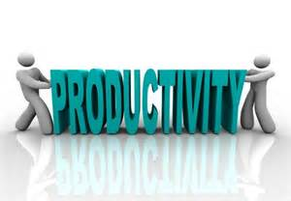
Productivity
Productivity is a measurement of the efficiency with which a business turns production inputs into output.
Labour productivity (output per worker) is the most common measure of productivity.

Slide 4
Labour productivity
Labour productivity =
Output (per period) / number of employees (per period)

Slide 5
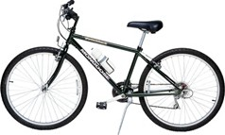
Labour productivity example
If a factory produces 1000 bicycles a day and employs 100 workers, then productivity is 1000 bicycles/100 workers = 10 bicycles per worker per day.
The fixed measure of input does not have to be labour – it could be a value of capital (output per £1000 of capital invested), or of machines used (200 pairs of shoes per machine per day).

Slide 6
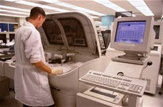
Capital productivity
Capital productivity =
Output / capital employed

Slide 7
Productivity retail
Productivity in retailing can be measured through sales per square foot. If a department store has sales of £3 000 000 in a week, and the square footage of the shop is 20 000, then sales per square foot are £150.
The higher the productivity, the more efficient production or sales generation is.

Slide 8
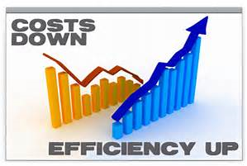
Activity 2
Task:
Calculate productivity.
Time: 10 mins

Slide 9
How to improve productivity
in manufacturing
Technology
Lean production
Training
Workforce reorganisation

Slide 10
Advantages - high productivity
Increased economies of scale
Increased competitiveness
Spreading of fixed costs over higher output
Lower unit costs
Performance bonuses to
workers - motivation

Slide 11
Capacity utilisation
It is normally only when the economy is booming and demand is buoyant that businesses are able to operate at full or near full capacity.
Full capacity means that all employed factors of production are being used to their optimum level of efficiency – producing the maximum level of output, given the business’s current investment levels.

Slide 12
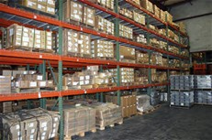
Capacity utilisation
At most other times in the economic or business cycle businesses will be operating below full capacity.
This means that they have the capability to produce greater levels of output than they are actually producing – therefore spare capacity exists.

Slide 13
Spare capacity
To measure spare capacity we look at output as a % of total capacity.
If a factory is capable of producing 2000 car exhausts per day and is only producing 1700, then spare capacity is 300.

Slide 14
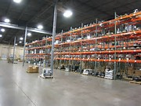
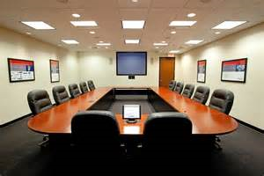
Spare capacity
This represents 15% of maximum capacity and the business is therefore operating at 85% of full capacity.
In this case resources are underused, or underutilised.

Slide 15
Problems of spare capacity
If the level of spare capacity is significant (i.e. large enough to be of concern), then this underutilisation of factors of production can have major effects on businesses.

Slide 16
Spare capacity effects
Demotivation of staff. Overtime is probably not available, bonuses will be limited and there may be a threat of redundancy.
Reduced profits. This will limit capital for investment and research and development, causing a reduction in long-term competitiveness.

Slide 17
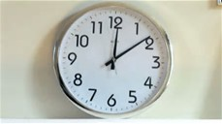
Spare capacity effects
Increased costs to the business. Businesses may be forced to make workers redundant and redundancy payments will have to be made. Also management time will need to be spent on reorganisation.

Slide 18
Lack of return on investment capital. Producer goods will continue to depreciate, even though they are not being used to full capacity. Technology will move on, putting pressure on businesses to replace fixed assets that otherwise have plenty of productive potential.

Slide 19
Resolving problems of capacity
Underutilisation – spare capacity
Businesses have several options open to them:
Subcontracting of production
Rationalisation
Increase use of assets

Slide 20
Subcontracting of production
If there is low utilisation then it might make sense to subcontract to another business. This means getting someone else to produce the goods for you.
By using subcontractors there is a reduction in risk to the business.

Slide 21
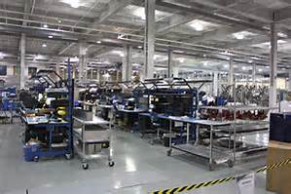
This risk reduction is achieved through a reduction in capital investment required. If the business is not making the goods it does not have to buy the machines to make the goods, lease the factory space or employ and train the workers.

Slide 22
Subcontracting problems
Firstly, there is a lack of control – especially with regard to quality.
Secondly, if there are a limited number of potential subcontractors then prices of the goods can become prohibitively high – reducing profitability.
In addition, there can be delays in delivery, leading to customer dissatisfaction.

Slide 23
Rationalisation
This means concentrating on core products or services and disposing of those products or services that are not seen as profitable or necessary to the business’s long-term success.

Slide 24
There can be costs to rationalisation, such as writing down (reducing) the book value of assets, but it does allow management to concentrate and focus upon the business strengths.

Slide 25
There is a risk, however, that customers will be lost. Some customers, especially business customers, who bought into the business’s whole package of products, may be less loyal when ‘one-stop shopping’ is not now available.
Rationalisation also implies redundancy costs.

Slide 26
Increasing the use of assets
This is potentially the most attractive option as it removes many of the costs associated with the other methods of rationalisation.
Retailers can sublet some of their shop floor space – for example, supermarkets could include hairdressers or chemists.

Slide 27
Manufacturing businesses can expand their ranges by looking for new markets or market niches (although development and marketing investment costs must be considered).
They could possibly act as subcontractors for other producers. This increased use of investment goods is often referred to as ‘making your assets sweat’.

Slide 28
Because of the short-term expense of solving problems of spare capacity, businesses often try to ride out this type of situation in the expectation that the market in which they operate will recover and demand will increase.

Slide 29
Problems with working
at full capacity
Possible fall in quality
Lack of flexibility
More breakdowns/machine failures
Pressure on staff
Full capacity problems

Slide 30
Activity 3
Task:
Explain productivity, capacity utilization and spare capacity.
Time: 30 mins

Slide 31
Activity 4
Task:
Quiz – Productivity methods
Time: 15 mins

Slide 32
Activity 5
Task:
Kahoot quiz – productivity
Time: 10 mins

Slide 33
Productivity – Objectives
Introduce the aims and objectives for the session.
Define productivity in groups.
Explain productivity and calculate productivity.
Describe the advantages of productivity.
Calculate productivity and discuss with the group.
Discuss capacity, spare capacity and give examples.
Complete a written description of productivity, capacity utilization and spare capacity.
Answer quiz questions on productivity and Kahoot quiz questions.
Recap the aims and
objectives for the session.

