Slide 1
Technology – Objectives
Introduce the aims and objectives for the session.
Discuss in groups, what is technology.
Explain CAD, CAM, computer modelling, robotics and IT usage.
Describe why companies use technology.
Complete a description of CAD, CAM, computer modelling, robotics and IT usage.
Watch Amazon using technology video.
Recap the aims and
objectives for the session.

Slide 2
Activity 1
Task:
What is technology ?
How has it influenced production?
Time: 5 mins

Slide 3
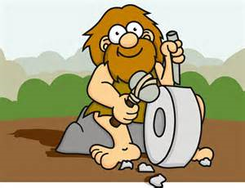
Technology
Technology has been used in making things ever since the first caveman or cavewoman sharpened a piece of flint to make an arrowhead with a second piece of flint.
Of course things have moved on a little since the Stone Age and when we talk about modern technology today we think of computerisation, robots and digital communication.

Slide 4
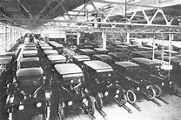
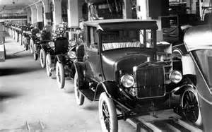
The effective use of new technology by businesses has changed the way we live our lives. The development of mass production methods reduced the price of goods like cars in the 1920s, making them affordable to
the middle classes.

Slide 5
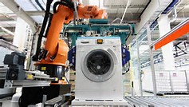
By the 1950s consumer durables like cars, washing machines and fridges were available at affordable prices to the mass of the population.
Technology in production improves efficiency and forces down prices.

Slide 6
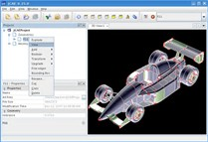
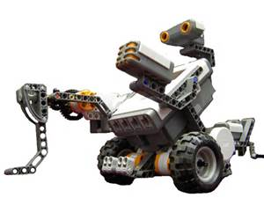
Technology
CAD
Computer modelling
CAM
IT
Robotics

Slide 7
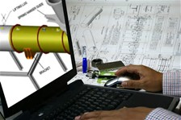
Computer-aided design (CAD)
Computer-aided design is an interactive computer system which is capable of generating, storing and using computer graphics.
It assists design engineers in solving design problems.

Slide 8
CAD has reduced the length of time between the initial design concept and actual production. The shorter the time between an original idea and getting a product on the shelves or into the showroom, the more competitive the business can be.

Slide 9
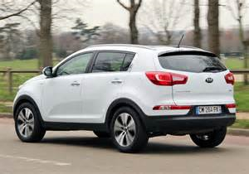
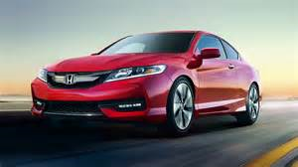
In the 1970s it could take five years from the initial car concept to actual production. Businesses like Kia and Honda can now do the same thing in 14 months.
Computer-aided design also allows an infinite variation on design themes, allowing all possibilities to be tested.

Slide 10
Modifications or changes can be easily made, without having to go back to the ‘drawing board’.
Also CAD can identify design problems at an early stage, preventing the need for expensive reworking of ideas and reducing the chance of faulty products reaching the market.

Slide 11
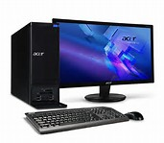
Computer-aided manufacture
(CAM)
The use of computers in production occurs in all sorts of industries.
There is the obvious example of robotic welders in vehicle production.

Slide 12
Another, more unusual example is the use of CAM in packaging vegetables for supermarkets, where machines digitally photograph every vegetable and then automatically sort them into bags based on size and shape.
These sorting machines always produce output of the same quality, day in day out, guaranteeing customer satisfaction.

Slide 13
The use of CAM can also aid flexibility in production. For example, reprogramming a welding machine is quite simple, but training a welder may be a great deal more complex and expensive.
CAM can even cut costs in small businesses. Tailors and dressmakers use CAM machines to cut material in the most economical way, ensuring that waste is minimised.

Slide 14
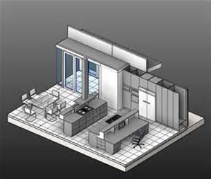
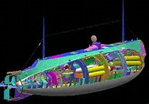
Computer modelling
Computers with the right information input can be used to model anything from wear and tear of a pair of shoes to the electricity generated from a wind turbine in different wind conditions.
Using computer models allows businesses to perfect their products and continually improve efficiency of production.

Slide 15
Use of modelling allows developers to try a huge range of ‘what if’ scenarios, such as ‘what happens to the life of the shoe when we change the stitching?’, or ‘what will happen to the efficiency of the wind turbine if we alter the angle of the blades by a few fractions of a degree?’.

Slide 16
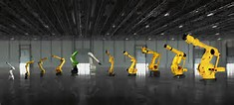
Robotics
It is difficult to define exactly what a robot in manufacturing is – when does a machine become a robot? The basic rule is that a robot is defined not by its appearance but by how it is controlled.
The more automated it is and the more it can determine its own behaviour, the more likely it is to count as a robot. For businesses robots have huge potential.

Slide 17
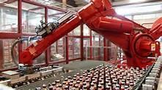
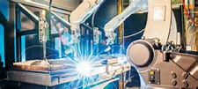
For example, robots with machine vision can check to see that bottles and jars are filled to the right level so that the tops and caps fit and that the right labels are correctly stuck on.
Robots put chocolates into boxes, sort apples and make salads without having to take a rest or visit the toilet.

Slide 18
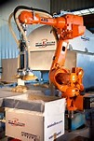
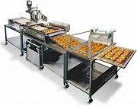
Robots even work in bakeries slicing cakes because they are more accurate than people – if you make thousands of cakes a day all those wasted crumbs add up.

Slide 19
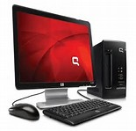
Information Technology (IT)
IT is used throughout businesses increasing their productivity in a number of ways.
Secretaries have preformatted letters, databases are held on customers improving customer relations, cash flow is modelled so improving financial efficiency, bar codes and EPOS systems are used to manage stock – and these are just the tip of the iceberg.

Slide 20
Marketing is a key aspect of the effective use of information technology. Most businesses have a web presence.
In its simplest form it may be ‘how to find or contact us’; in its most complex form the web is used to gather detailed customer profiles to build a database and an attempt is made to match these profiles.

Slide 21
The internet allows a much wider geographical market to be targeted, cheaper advertising and improved customer convenience.
Information gathered from browsing and purchasing habits allows sophisticated targeted marketing to take place, generating potential sales automatically.

Slide 22
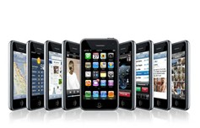
The digital revolution has had a huge effect on the business world – social networking is now a well-established marketing tool, tablets and portable devices are used in offices, and mobile phones are used to buy products online.

Slide 23
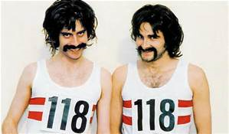
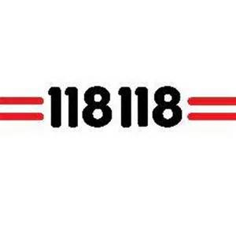
Communications technology allows flexibility in the location of services and customer relations centres. Calls to the directory enquiries number 118118 are answered in Cardiff during the day and in the Philippines during the night.
Costs are therefore reduced and service standards improved.

Slide 24
Technology advantages
•Improved quality – thanks to their high precision and the ability to do the same thing in the same way day after day, robots and CAM processes have the ability to consistently produce top-quality products and accurately perform repetitive tasks;
•Faster innovation – it is much easier, and less expensive, to model and test new products using CAD and computer modelling;

Slide 25
• More effective marketing and sales – marketing new products encourages consumers to dump old products and buy new ones on a regular basis;
•Less dependency on labour – this is important to the business in reducing costs, especially if workers had used their bargaining power to push for higher wages and improved conditions;

Slide 26
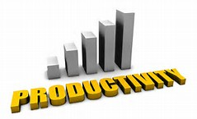
•Increased productivity;
•reduced waste and costs;
•Improved communications.

Slide 27
Disadvantages of technology
All technology costs money and to build a state-of-the-art car plant costs hundreds of millions of pounds. There is always pressure to buy the latest machine, the fastest computer or the newest robotics.
Also technology does not always work, or there are huge cost overruns. In addition, there are a number of different labour costs related to the implementation of technology.

Slide 28
Some workers are likely to lose their jobs, especially those who are not adaptable, cannot be retrained or do not have specialised skills.
Workers who remain after redundancies have occurred may feel less secure and less motivated in their work and may need retraining, which will cost the business. There will, of course, be new opportunities for workers with the skills now needed to run the latest technology.

Slide 29
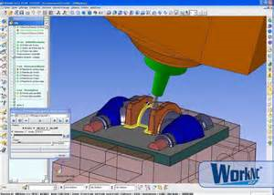
Activity 2
Task:
Explain difference between CAD/CAM and robotics.
Time: 20 mins

Slide 30
Activity 3
Task:
Technology quiz
Time: 15 mins

Slide 31
Amazon – Technology
https://www.youtube.com/watch?v=RXLAlziEzAE

Slide 32
Technology – Objectives
Introduce the aims and objectives for the session.
Discuss in groups, what is technology.
Explain CAD, CAM, computer modelling, robotics and IT usage.
Describe why companies use technology.
Complete a description of CAD, CAM, computer modelling, robotics and IT usage.
Read an article on robotics taking over jobs from manufacturing.
Recap the aims and
objectives for the session.

