Slide 1
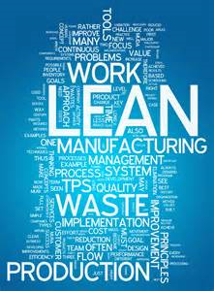
Lean production – Objectives
Introduce the aims and objectives for the session.
Discuss lean production, JIT and Kaizen production methods.
Give examples of each method.
Complete a written evaluation of each method of production.
Discuss the key points of Kaizen production in groups.
Recap the aims and
objectives for the session.

Slide 2
Lean production
The idea of lean production encompasses theories of modern Japanese industrial management that are all designed to achieve the reduction and removal of waste within a business.

Slide 3
Lean production is a term that has come into widespread use within UK industry over the last 25 years.
Lean production methods teach us that waste is any process that does not give ‘added value’ to a product.

Slide 4
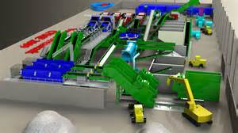
• Raw materials lying around unused can be seen as waste.
• Work in progress which is sitting in parts bins waiting to be used in production can be seen as waste.

Slide 5
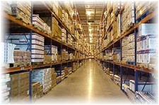
• The finished product sitting in a warehouse waiting to be delivered to customers is an example of waste.
• Skills and knowledge of workers not being used by management is an example of waste.

Slide 6
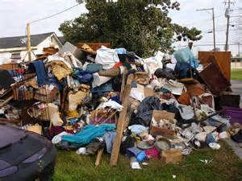
Lean production aims to remove all these elements of waste from the production process and as a result increase productivity and reduce costs.

Slide 7
Lean production in practice
For lean production to work there must be a complete change of business approach, away from the traditional hierarchical, function-centred business (so typical of many UK businesses) to a more modern, flexible, people-based structure.
Also a number of complex systems must be adopted before effective lean production can take place.

Slide 8
Components of lean
production
The most important component parts of an effective lean production system are:
•Just-in-time;
•Kaizen;
•Cell production;
•Time-based management methods.

Slide 9
Just-in-time
Perhaps the best known of the lean production processes is just-in-time.
Just-in-time (JIT) tries to ensure that parts, raw materials and components are received and products are made only when there is demand for the parts and demand for the products. In other words; ‘If it isn’t wanted don’t order it; if it isn’t sold don’t make it’.

Slide 10
Just in time tools
Management understanding
Supplier relationships
Customer relationships
Employee involvement
Kanban

Slide 11
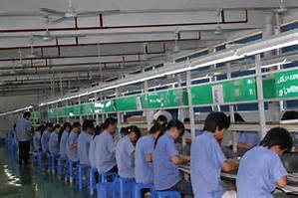
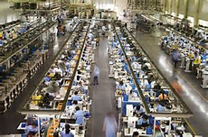
Management understanding
The first stage in incorporating an effective just-in-time programme is a full understanding of the production process.
Managers must ‘walk the line’ (follow the whole production process from start to end) to understand the processes used to complete the finished product.

Slide 12
Only when managers fully understand the production process can just-in-time be incorporated.
It may seem surprising that managers do not fully understand the production process, but it is not unusual.

Slide 13
Supplier relationships and
stockholding
Effective incorporation of just-in-time systems requires that relationships with suppliers are strong and communications systems are effective.
There is no point in reducing stockholdings if stock cannot be topped up at the appropriate time.

Slide 14
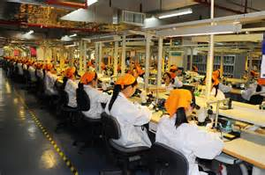
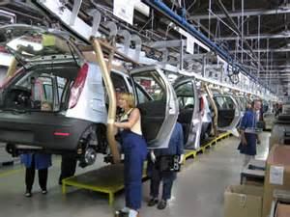
Suppliers must be told when stock is needed and how much stock is required. Many businesses have bar codes on work in progress, which are read as the product moves along the production line.
These bar codes, when read, automatically order stock from suppliers at the appropriate time.

Slide 15
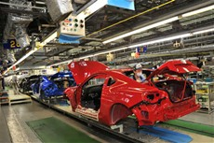
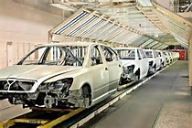
Some car manufacturers use such sophisticated just-in-time systems that suppliers can be automatically notified when a car starts on the production line, so that components can be delivered to the production line at exactly the right time.

Slide 16
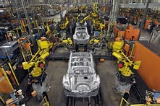
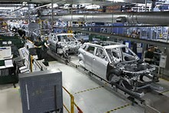
The effectiveness of such a process would of course depend on proximity and flexibility of suppliers and the use of electronic ordering systems.

Slide 17
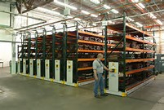
Kanban
Another example of a just-in-time system is the idea of Kanban. This involves the use of order cards to ensure a regular and timely supply of components.
It is not unusual when using a Kanban system to find an employee of the supplier continually working on a shop floor, ensuring that the parts arrive in the right place and at the right time.

Slide 18
Employee involvement
Another key element of just-in-time is a strong relationship with employees.
Cells of production are an important part of this process. Cell working will encourage the use of job enrichment.

Slide 19
There must be a people-centred approach from managers.
Employees must be trained to use the systems of lean production effectively and understand their role in ensuring that the system continues to work.

Slide 20
There will be more employee control over tasks. This helps ensure employee commitment to the JIT system.
It is always worth involving employees when designing a just-in-time system, as employees often understand their part of the process of manufacturing better than management.

Slide 21
There is a strong relationship between the use of just-in-time and the use of the latest motivation theories and human resource management principles.
Flexible working practices must exist within the organisation and the view must be held that quality and production problems are best solved by workers and management together.

Slide 22
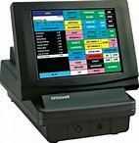
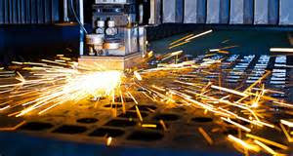
Customer relationships
The final part of incorporating a just-in-time system is strengthening relationships with customers.
Often customers are able to use electronic point of sales systems (EPOS), and these can be tied in with the manufacturing process.

Slide 23
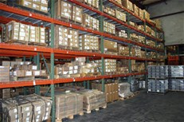
Orders can be placed electronically so that finished product can go straight from the production line to delivery, rather than being stored in a warehouse where storage can lead to loss of value.

Slide 24
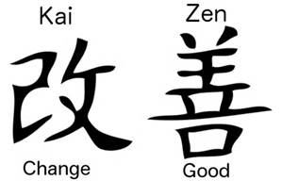
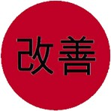
Kaizen
Kaizen is a Japanese word meaning continuous improvement.
Continuous improvement is an important aspect of lean production and is a theme of all world-class businesses.

Slide 25
These world-class businesses take the view that one of the main objectives of their existence is to be continually making small incremental steps in the improvement of quality, design and waste reduction.

Slide 26
Before Kaizen
Before the use of Kaizen became widespread amongst leading British businesses, improvements in quality of output were made in large one-off steps.
These stepped improvements were often forced upon businesses because of the actions of competitors.

Slide 27
Therefore, a business would be under competitive pressure to invest in retooling the workplace or to purchase new technology: thereby creating a one-off improvement in productivity.
Things would then remain pretty much the same until external pressures forced a new process to be implemented or staff to be retrained etc.

Slide 28
The problem with this approach was that businesses were often playing ‘catch-up’ in terms of quality and productive efficiency.
As soon as businesses had finished implementing new processes that were supposed to make them competitive, the competition had already moved on.

Slide 29
This was because the competition, often foreign, was using the idea of continuous improvement.
Also British businesses had other problems which resulted from using the stepped approach.

Slide 30
Large-scale changes in production processes often meant lower demand for workers, which led to redundancies. This, in turn, led to a breakdown in relationships with trade unions and caused large-scale disruptions in the workplace.
Also because of the high cost of the large one-off improvements, implementing these depended on raising finance and this was often expensive or unobtainable.

Slide 31
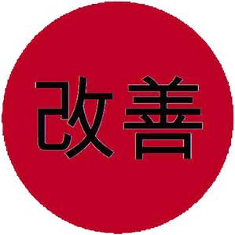
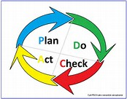
Using and applying Kaizen
The main working element of Kaizen is the use of Kaizen groups.
These are groups of workers who have a common stake in part of the production process.

Slide 32
For example, a Kaizen group may involve the designer of a component, the installation workers from the production line and the production managers.
These groups will meet regularly to discuss problems and to suggest improvements.

Slide 33
Often improvements can be made at nil or minimal cost. This means that over time the whole cost base of the business can be reduced whilst indicators of quality and levels of production increase.
All this is achieved with minimal capital investment.

Slide 34
A motivated workforce – the workers must be committed to the business.
A management with belief in the capabilities of the workforce.
A trained workforce – the workers must have the ability to understand their roles and complete their tasks efficiently.

Slide 35
• Effective communication systems – workers must be able to communicate suggestions to superiors and other relevant employees. This can be done through Kaizen groups, but other methods of communication must also be available.

Slide 36
• Security of jobs. Workers will not suggest process improvements if their jobs are threatened by these improvements. Kaizen does suggest that demand for labour will fall, although this should be achieved through natural wastage.

Slide 37
Management must have a clear understanding of the production processes in order that they can organise, control and plan to enable workers to meet the needs and quality requirements of the ‘customers’ within the organisation.

Slide 38
Key elements of Kaizen
•All employees, from the managing director down to the shop floor workers, should be asking, ‘How can I do what I do better’? – ‘How can we do what we do better’?
•Kaizen does not ignore the need for new technology or large-scale capital investment: however, it does recognise that these are not the only methods of achieving increased competitiveness.

Slide 39
Benefits of Kaizen
Improved labour relations
Increased competitiveness
Reduction in waste
Less large-scale investment
Improved motivation
Increased productivity
Improved quality

Slide 40
Activity 1
Task:
Explain Just in time and lean production
Time: 20 mins

Slide 41
Activity 2
Task:
Kaizen – quiz
Time: 10 mins

Slide 42
Cell production
With cell production the production line is subdivided into a number of cells. These cells are groups of workers involved in related tasks.
The workers are trained so that they can fulfil a number of tasks within the cell, and this allows job rotation.

Slide 43
The skills of the workers mean that they can each play a role in improving quality, and also creating flexibility in the production process.
Also communication is improved, and the job enrichment and enlargement elements of cell design improve motivation.

Slide 44
It is possible for cells to be self-managing with regards to many human resource management issues such as shift arrangements, breaks and holidays.

Slide 45
Time-based management
methods
With this approach time is regarded as a key business resource.
Speed of development, speed of response and speed of delivery are becoming increasingly important.

Slide 46
Speed adds value, as we can witness in the battle between internet retailers when seeking to get their products to their customers’ doorsteps as quickly as possible.

Slide 47
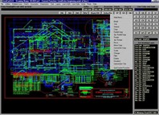
With time-based management, emphasis is placed on reducing time taken in all aspects of the whole production process.
It involves concepts such as just-in-time, the use of CAD (computer-aided design) and CAM (computer-aided manufacture), critical path analysis and simultaneous engineering.

Slide 48
When engaging in simultaneous engineering, emphasis is placed on carrying out, as near as possible at the same time, the functions involved in designing, producing and marketing a product.

Slide 49
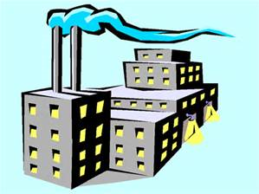
Obviously it is impossible to manufacture a product before it has been designed, but it may be possible to get the production lines ready or to work out at least the basics of a marketing plan.
This strategy can be effective in
reducing the time a product
takes to reach the market
and is of increasing
importance as product
life cycles continue to shorten.

Slide 50
For simultaneous engineering to be effective, there must be effective communication between the functional departments involved, as well as regular product meetings involving all those taking part in the product development.

Slide 51
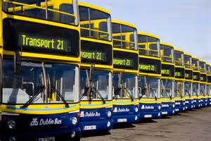
Project teams are created from the different business and engineering functions.
Specialists drawn from R&D, design, transport, market research, accounting etc., work together to ensure that activities are carried out in conjunction with one another.

Slide 52
YouTube video
Cell and time based video
http://www.youtube.com/watch?v=uufjHlLLnE4

Slide 53
Activity 3
Task:
Written task – Cell and time based.
Time: 20 mins

Slide 54
Lean production – Objectives
Introduce the aims and objectives for the session.
Discuss lean production, JIT and Kaizen production methods.
Give examples of each method.
Complete a written evaluation of each method of production.
Discuss the key points of Kaizen production in groups.
Recap the aims and
objectives for the session.

