Slide 1
Quality – Objectives
Introduce the aims and objectives for the session.
Discuss quality in groups.
Explain the benefits of quality and quality assurance.
Complete a written evaluation of Quality and quality assurance.
Discuss the importance of team work and benchmarking.
Answer the revision questions as a group.
Explain quality control and TQM.
Show a YouTube video on quality control.
Compete a written evaluation of how stakeholders affect quality.
Recap the aims and objectives for the session.

Slide 2
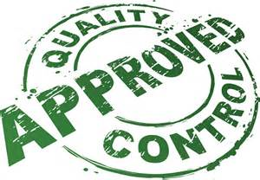
Activity 1
Task:
What is quality?
Time: 5 mins

Slide 3
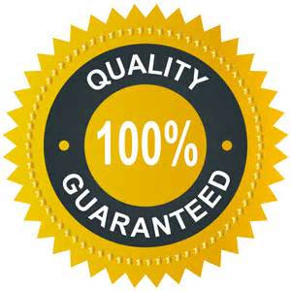
What is quality?
Quality is a difficult concept to define.
W. Edwards Deming, the American quality guru, stated that ‘quality is defined by the customer’. Customers may require certain specifications or demand exceptional levels of comfort.
It is true to say that consumers are increasingly conscious of quality and this is reflected in the mission statement of the successful computer manufacturer Dell. It states: ‘Customers must have a quality experience and be pleased, not just satisfied’.

Slide 4
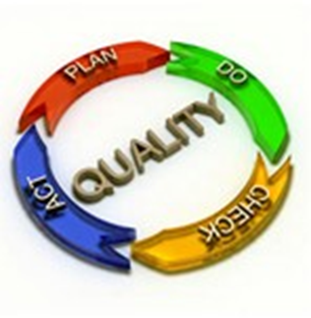
Quality is often defined simply as ‘fitness for purpose’. After all, if the product does the job it was designed to do, it must therefore have some level of quality.
Another way to define quality could be the features of a product or service that allows it to satisfy customers’ wants.

Slide 5
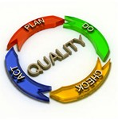
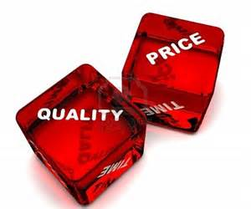
Whichever way we choose to define ‘quality’ the importance of the concept continues to grow.
Businesses are placing greater and greater emphasis on trying to provide quality goods and services in an increasingly competitive global marketplace.

Slide 6
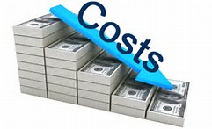
Benefits of quality
Increased sales
Market orientation
Reduced waste
Customer satisfaction
Reduced costs

Slide 7
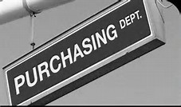
Achieving quality
For large manufacturing and service companies, achieving quality is a complex task which combines the work of several separate functional departments within an organisation.
These departments typically include:
•Purchasing – ensuring that the right quantity and quality of raw materials or components are available for the production process.
•Operations – structuring and managing the manufacturing process.

Slide 8
•Finance – ensuring that capital is available for appropriate investment.
•Human Resources – ensuring that the factor of production labour is available in the right quantities with the right skills.
•Marketing – providing market research information in order that customer wants can be satisfied.

Slide 9
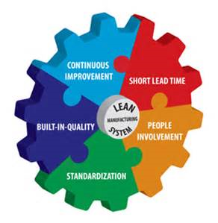
Quality assurance
It is the view of world-class manufacturers that quality must be ‘built in’. This means that when the finished goods roll off the production line, management is confident that there is no need to check quality.
Inspection is carried out during the production process. The emphasis is placed on preventing the production of poor quality products, as opposed to checking quality at the end of the production line.

Slide 10
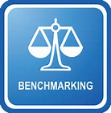
Quality assurance methods
Recognised standards
Team working
Product design checking
Production control
Bench-marking

Slide 11
Team working
A team is responsible for a production process, such as the installation of a conservatory. The team is empowered to check the quality of raw materials, interact during the installation process and check the quality of the finished product.
This implies that responsibility lies with the team – we know exactly where the ‘buck stops’. Team work can build trust and morale, whilst improving communication between members. It is regarded as a key element in achieving quality.

Slide 12
Product design checking
In addition to monitoring raw materials and components, the total design of the product must also be checked for quality. The failure of the Mercedes A Class to reach independent test standards is an example of poor design. The problem has since been rectified, but only at great cost, both financially and with regard to corporate image.

Slide 13
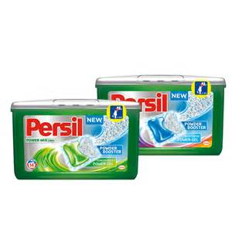
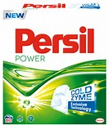
Another example was Persil Power washing powder, which was so powerful that it seemed to shred and dissolve clothes – a serious design problem!
Time, effort and money must be put into product design.

Slide 14
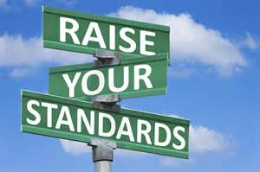
Benchmarking
If the highest standards are to be achieved, what standards are to be targeted? There is no point in saying that we intend to improve our standard from one fault in 50 to one fault in 100, if our competitors are achieving one fault in 1000. This is where benchmarking comes in.
Benchmarking is the process of setting standards of quality and output which are based on the best that competitors can offer.

Slide 15
The first stage in the benchmarking process is discovering the appropriate figures for competitors.
This information may be hard to come by, but research organisations may be able to produce figures on competitors’ levels of sales, quality and consumer satisfaction.

Slide 16
Benchmarking
The second stage in the benchmarking process is setting new targets to be achieved in the manufacturing process which match those of the best competitor.
Methods of production need to be designed which ensure that the benchmark levels of productivity and quality are achieved.

Slide 17
The key stage in benchmarking is gaining a commitment from the whole work force. All levels of hierarchy must be committed to the achievement of these standards.
The great advantage of benchmarking is that targets set are based on the activities of competitors. This increases the focus on the market and so increases market orientation.

Slide 18
Application of recognised
standards
The use of recognised standards such as ISO 9000 is widespread amongst businesses. Achievement of these standards by businesses is often an indication of achievement and maintenance of quality.
ISO 9000 is supposed to guarantee quality of management of the whole organisation. Achievement of this standard depends on proving that quality targets for all parts of the organisation have been met.

Slide 19
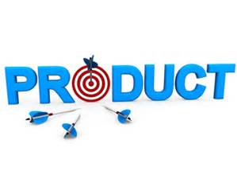
However, critics often state that if low target levels are set then there is no real guarantee of quality.
Another failing of using recognised standards to achieve quality is that unless targets are related to external benchmarks then the quality process only results in increased product orientation – when often what is required is increased market orientation.

Slide 20
Production control
This is the method of ensuring that standards set, and processes designed to meet these targets, are actually being used in the workplace.
Production control involves:
• monitoring of costs through use of budgeting and variance analysis;
•control of operations through use of critical path analysis and monitoring of individual processes;

Slide 21
•supervision of output (now largely replaced by cell and teamwork);
•feedback methods, involving the monitoring of customer satisfaction, and the feedback of problems to the relevant department.

Slide 22
These methods of control have now spread from the manufacturing industry to service industries and have found a new home in call centres.
Call centres are centralised departments that deal with customer enquiries.

Slide 23
Each worker will have a requirement to answer calls in a specific period of time, spend a certain amount of time on each call and achieve a targeted level of sales.
Information Technology (IT) allows the performance of each worker to be monitored and any variation from required standards and targets will be responded to by management. Workers will be retrained to ensure that standards can be met.

Slide 24
Activity 2
Task:
Written evaluation – Quality/ assurance
Time: 20 mins

Slide 25
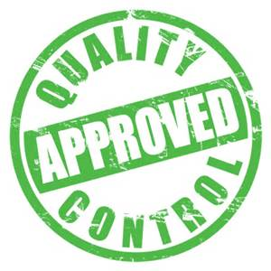
Quality control
Quality control is a system of maintaining standards in manufacturing by testing a sample of the output against expected standards.
The data collected from the sample is then used to make judgements on action to be taken. The sample may indicate that quality is of the required standard, or the reverse may be found.

Slide 26
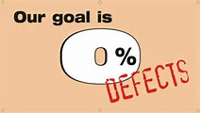
If standards have not been achieved then appropriate steps to achieve standards must be made – for example, defective units must be repaired or rejected.
If too many failures to achieve standards occur, a plan must be devised to improve the production process.

Slide 27
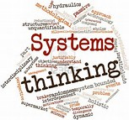
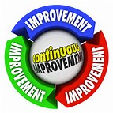
Total quality management TQM
Total quality management is an operations management system that creates structures within an organisation that satisfy internal and external customers and suppliers.
It creates quality through continuous improvement, development of systems and products and by creating an organisational culture of quality.

Slide 28
T stands for Total – it is the integration of the staff, suppliers, customers and other stakeholders.
These are all seen as part of a single system, an unbroken chain of production – a chain of quality.

Slide 29
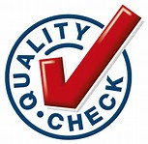
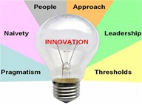
Q stands for Quality – quality can be the speed in which a service is delivered. It can be consistency. It can be innovation. It can be reflected in low maintenance or favourable repair history.
According to W. Edwards Deming (one of the founders of the TQM system), ‘a product or service possesses quality if it helps somebody and enjoys a good and sustainable market.’

Slide 30
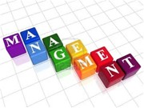
M stands for Management – The need is for management to improve processes and to monitor them continually in order to identify improvement opportunities. The responsibility for ensuring the improvement of the processes in an organisation lies with top management.
As part of the management of quality the system includes ‘process owners’ who coordinate the various functions and work activities at all levels of a process. Process owners have the authority to make changes in the process as required – they manage the process end to end so as to ensure optimal overall performance.

Slide 31
How does TQM work in practice?
For TQM to be effective a number of production management and control methods need to be used:
• Quality chains are based on cross-functional teams where processes involve internal customers. The next person in the production process is treated as a customer and customer satisfaction is the objective.
• Empowerment – giving workers control
over tasks completed.
• Monitoring – checking that standards at each link in the chain are being achieved and the use of statistical tools to measure levels of failure to achieve quality.

Slide 32
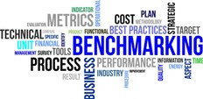
• Teamwork – cells of production and a team approach to product or service improvement.
• Quality circles – Employee involvement in the decision-making and product-improvement process. Employees meet to identify and solve problems.
• Zero defects – attempting to achieve perfect product quality, time after time.
• Benchmarking – standards based on the best of the competition.

Slide 33
Lean production and quality
https://www.youtube.com/watch?v=CCyziyskYuE

Slide 34
Stakeholders and quality
The view that the quality control department takes care of all problems of quality has largely changed – now all employees are responsible and this puts pressure on employees to adapt.
When quality is the responsibility of the process operators, jobs may become more stressful. Often a TQM-based product is cheaper to produce because there is no need to repair or scrap the end product.

Slide 35
The quality of the final output produces a more marketable product, meaning that consumers of the product will benefit. Management now have to communicate the aims of the organisation to all members of the organisation and this may be difficult for ‘Theory X’ managers to adapt to.
The traditional structure of many manufacturing businesses has changed, resulting in less management control and the loss of power of traditional groups such as unions.

Slide 36
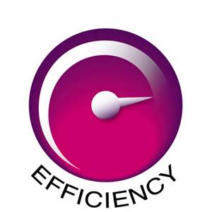
Achieving quality is a complex task. We have seen that effective quality control involves the monitoring of the whole production process, feedback of requirements from marketing, management of resources and the use of external standards.
The overall objective is greater efficiency, achieving product quality and improving productivity – all of which help the business achieve customer satisfaction.

Slide 37
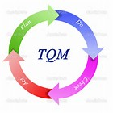
Activity 3
Task:
Written – What is TQM?
Time: 20 mins

Slide 38
Activity 4
Task:
Complete a quality quiz.
Time: 10 mins

Slide 39
Quality – Objectives
Introduce the aims and objectives for the session.
Discuss quality in groups.
Explain the benefits of quality and quality assurance.
Complete a written evaluation of Quality and quality assurance.
Discuss the importance of team work and benchmarking.
Answer the revision questions as a group.
Explain quality control and TQM.
Show a YouTube video on quality control.
Compete a written evaluation of how stakeholders affect quality.
Recap the aims and objectives for the session.

