Slide 1
Research and development – Objectives
Introduce the aims and objectives for the session.
Explain research development and innovation.
Give examples of research and development methods.
Complete a research and development written task.
Discuss your task answers with the group.
Answer the research and development quiz questions.
Discuss in groups, what is technology.
Explain CAD, CAM, computer modelling, robotics and IT usage.
Describe why companies use technology.
Complete a description of CAD, CAM, computer modelling, robotics and IT usage.
Watch Amazon using technology video
Recap the aims and objectives for the session.

Slide 2
Activity 1
Task:
A3 paper and pens.
What is Research and Development?
Why is it important to businesses?
Time: 10 mins

Slide 3
Research and development
Research and development (R&D) is essential today for businesses to compete in a dynamic marketplace. It involves the identification of new ideas and turning them into products, services and processes.
Businesses who invest in R&D are considered to be innovative and always looking to bring new ideas and products to the market.

Slide 4
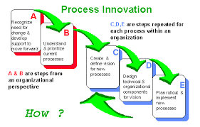
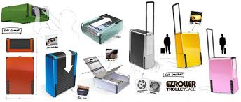
Innovation
The commercial exploitation of an invention.
Bringing a new idea to the marketplace is known as ‘product innovation’.
Doing so in the workplace is known as ‘process innovation’.

Slide 5
Innovation is not cheap and resources have to be committed by the businesses to bring new products to the marketplace.
Governments try to encourage innovation within the business community because an innovative culture will help grow the whole economy, creating both employment and wealth.

Slide 6
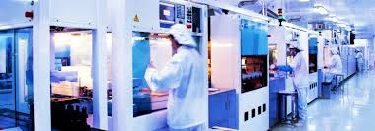
Research
Research is the inquiry into, and discovery of, new ideas.
Methods used to generate new ideas include:
• Pure research – research just to find out how or why, with no product objective. This type of research is often carried out by universities or research institutes.

Slide 7
Research methods
• Laboratory research – for example, the testing of new pharmaceutical compounds on animals.
• Evaluation of existing products – are there problems with this product? How can such problems be resolved?
• Brainstorming using discussion groups – thinking outside of the box, novel ideas for solving existing problems.

Slide 8
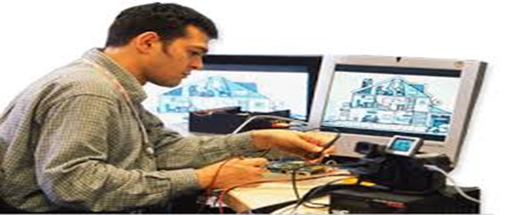
YouTube Video
Research and development
https://www.youtube.com/watch?v=8r-gMydBlfI

Slide 9
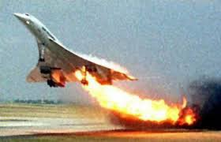
Development
Development is the process which changes ideas that result from the research process into commercially viable products or processes.
Development is a costly and complicated process, which for some products may take many years.

Slide 10
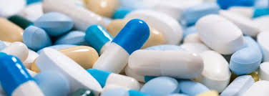
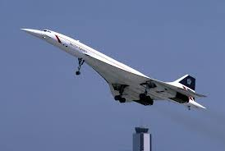
Concorde was originally conceived in 1962, but it did not enter regular service until 1975. (Development 13 years)
Development of pharmaceuticals can take years as they progress through different stages of testing until approval is achieved.

Slide 11
It is important that businesses reduce the development time of new products. Shorter product life cycles are now the norm.
Prior to the turn of the century, with a few cosmetic adjustments, a car model could last a decade. Now, for motor manufacturers to stay competitive, a new model launch or major revamp of an existing model three times a decade is the norm.

Slide 12
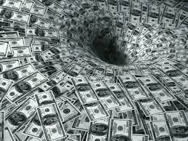
Development can be phenomenally expensive (A04), costing hundreds of millions of pounds for car manufacturers, and even then success is not guaranteed (A04).

Slide 13
The product design and
development process
1. Identification of problem
2. Research
3. Development of ideas and solutions to solve the problem
4. Development of prototypes
5. Final design
6. Testing
7. Manufacturing and launch.

Slide 14
Benefits of R&D (A04)
Reduction in costs and improves the company's image
Improves the working environment – making it safer and cleaner
Beneﬁts consumers with a greater variety of goods and services
Launch new products in order to gain a competitive edge

Slide 15
Research and development
Research and development is needed by businesses because in most markets there is a constant requirement for invention and innovation to keep up with competition and attract customers.
New products are required not only for a business to grow, but also to survive.

Slide 16
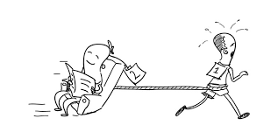
It is often the case, however, that other businesses can wait for others to take the risk (Samsung) of launching new products or technologies and then move into the market once an idea has been proven.
The expression, ‘it is the second mouse that gets the cheese’, is one that is worth remembering and copycat behaviour is often well rewarded.

Slide 17
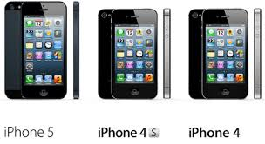
Which type of companies rely on R&D?
For pharmaceutical, aircraft and electronics companies R&D is their lifeblood – without new products they will die.
This is because their existing products are guaranteed to be redundant within a relatively small number of years as customers demand new and improved versions.

Slide 18
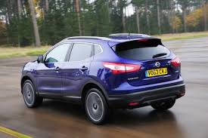
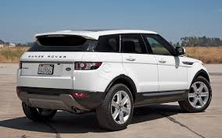
For a second group, which include car manufacturers and the construction industry, R&D has an important role to play, but in these industries there can be an element of waiting to see what the competition are up to.
For example, it was only with the launch of the first successful SUV (Sports Utility Vehicle) that design departments in major motor companies throughout the world suddenly became covered in drawings of the Qashqai, Duster, Evoque and the like.

Slide 19
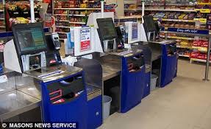
For a third group R&D can take a back seat – instead marketing comes to the fore. This group of industries includes retailers, who often just borrow ideas from each other.
E.G – Club card, self scan checkouts etc.

Slide 20
UK businesses and R&D
In the past Britain had been a world leader in research.
One study showed that of all the inventions and resulting products of the last 60 years that had a major effect on people’s lifestyles, over 50% were originally conceived by British businesses, British inventors or British research scientists.

Slide 21
However, research and development has to be budgeted for as it is a highly expensive business activity (A04).
Companies must reinvest profits into R&D to grow. For many years Britain has had a poor investment record in this area, with many companies looking for short-term gains and profits.

Slide 22
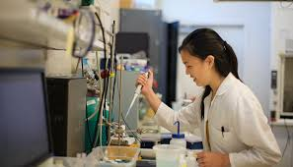
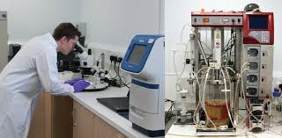
Such companies turned away from organic growth (growing from within) to easier external growth (takeovers and mergers). More recently there has been some reversal of this trend.
Businesses have started to link with universities, providing funding and research fellowships, so that the latest science and technology can be used in R&D.

Slide 23
Money is now more often used for pure research and many universities now have science parks attached to their campus, where small companies develop ideas that are based on university research work.

Slide 24
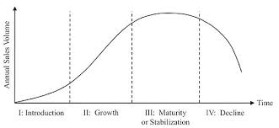
Product life cycles and R&D
Effective research and streamlined development shortens life cycles and is also used in a response to shorter life cycles.
The example of cars used above demonstrates how R&D allows businesses to stay competitive, but also forces continually higher spending on R&D.

Slide 25
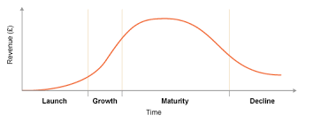
One effect of this shortening of product life cycles is that small businesses find it hard to survive because of the resulting R&D costs.
In the UK, Lotus, Rolls Royce and Aston Martin have all become parts of larger motor groups as a direct result of being unable to afford the increased costs of R&D spending, which were necessary if they were to stay competitive.

Slide 26
Market research and R&D
Market research can be the foundation of targeted R&D.
If latent (unfulfilled) demand is discovered, then products need to be developed to meet this demand. This product development to satisfy market demand is part of being market-orientated.

Slide 27
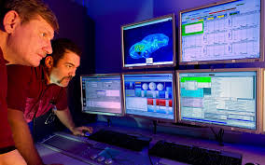
Also, market research is used to help develop existing products. Market research is continuously being carried out, with the objective of discovering consumer attitudes to products.
Product revamps and redesigns often occur as a direct response to market research findings.

Slide 28
A common error learners make is to confuse research and development with market research. They are very different things, even though market research may lead on to R&D taking place.
Learn the definitions thoroughly and you will not make this mistake.

Slide 29
Activity 1
Task:
Research and development Exam question.
Time: 20 mins

Slide 30
Activity 2
Task:
Research and development quiz
Time: 10 mins

Slide 31
Activity 3
Task:
What is technology ?
How has it influenced production?
Time: 5 mins

Slide 32
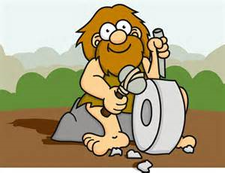
Technology
Technology has been used in making things ever since the first caveman or cavewoman sharpened a piece of flint to make an arrowhead with a second piece of flint.
Of course things have moved on a little since the Stone Age and when we talk about modern technology today we think of computerisation, robots and digital communication.

Slide 33
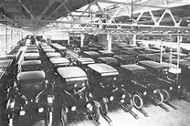
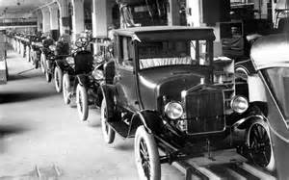
The effective use of new technology by businesses has changed the way we live our lives. The development of mass production methods reduced the price of goods like cars in the 1920s, making them affordable to the middle classes.

Slide 34
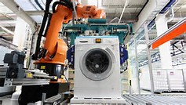
By the 1950s consumer durables like cars, washing machines and fridges were available at affordable prices to the mass of the population.
Technology in production improves efficiency and forces down prices.

Slide 35
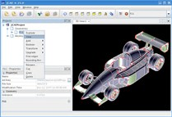
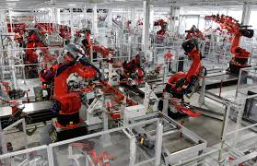
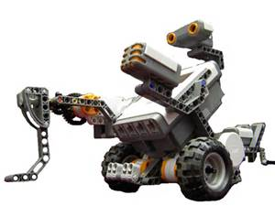
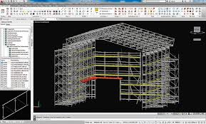
Technology
CAD
Computer modelling
CAM
IT
Robotics

Slide 36
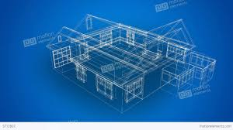
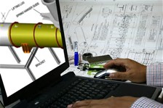
Computer-aided design (CAD)
Computer-aided design is an interactive computer system which is capable of generating, storing and using computer graphics.
It assists design engineers in solving design problems.

Slide 37
CAD has reduced the length of time between the initial design concept and actual production.
The shorter the time between an original idea and getting a product on the shelves or into the showroom, the more competitive the business can be.

Slide 38
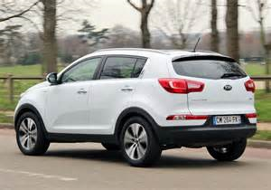
In the 1970s it could take five years from the initial car concept to actual production. Businesses like Kia and Honda can now do the same thing in 14 months.
Computer-aided design also allows an infinite variation on design themes, allowing all possibilities to be tested.

Slide 39
Modifications or changes can be easily made, without having to go back to the ‘drawing board’.
Also CAD can identify design problems at an early stage, preventing the need for expensive reworking of ideas and reducing the chance of faulty products reaching the market.

Slide 40
YouTube video
CAD
https://www.youtube.com/watch?v=ETz67OUsXC0

Slide 41
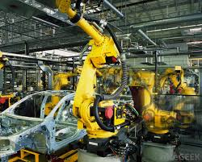
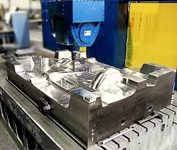
Computer-aided manufacture
(CAM)
The use of computers in production occurs in all sorts of industries.
There is the obvious example of robotic welders in vehicle production.

Slide 42
Another, more unusual example is the use of CAM in packaging vegetables for supermarkets, where machines digitally photograph every vegetable and then automatically sort them into bags based on size and shape.
These sorting machines always produce output of the same quality, day in day out, guaranteeing customer satisfaction.

Slide 43
The use of CAM can also aid flexibility in production. For example, reprogramming a welding machine is quite simple, but training a welder may be a great deal more complex and expensive.
CAM can even cut costs in small businesses. Tailors and dressmakers use CAM machines to cut material in the most economical way, ensuring that waste is minimised.

Slide 44
YouTube video
Computer aided manufacturer demo
https://www.youtube.com/watch?v=qjc1WEDDPhI

Slide 45
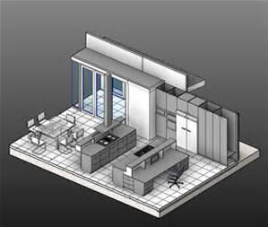
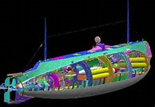
Computer modelling
Computers with the right information input can be used to model anything from wear and tear of a pair of shoes to the electricity generated from a wind turbine in different wind conditions.
Using computer models allows businesses to perfect their products and continually improve efficiency of production.

Slide 46
Use of modelling allows developers to try a huge range of ‘what if’ scenarios, such as ‘what happens to the life of the shoe when we change the stitching?’, or ‘what will happen to the efficiency of the wind turbine if we alter the angle of the blades by a few fractions of a degree?’.

Slide 47
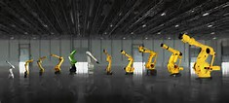
Robotics
It is difficult to define exactly what a robot in manufacturing is – when does a machine become a robot? The basic rule is that a robot is defined not by its appearance but by how it is controlled.
The more automated it is and the more it can determine its own behaviour, the more likely it is to count as a robot. For businesses robots have huge potential.

Slide 48
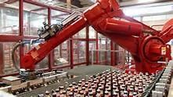
For example, robots with machine vision can check to see that bottles and jars are filled to the right level so that the tops and caps fit and that the right labels are correctly stuck on.
Robots put chocolates into boxes, sort apples and make salads without having to take a rest or visit the toilet.

Slide 49
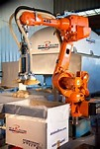
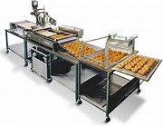
Robots even work in bakeries slicing cakes because they are more accurate than people – if you make thousands of cakes a day all those wasted crumbs add up.

Slide 50
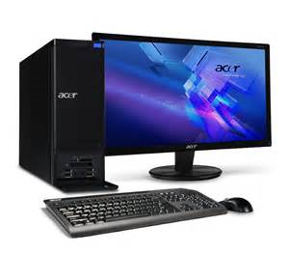
Information Technology (IT)
IT is used throughout businesses increasing their productivity in a number of ways.
Secretaries have preformatted letters, databases are held on customers improving customer relations, cash flow is modelled so improving financial efficiency, bar codes and EPOS systems are used to manage stock – and these are just the tip of the iceberg.

Slide 51
Marketing is a key aspect of the effective use of information technology. Most businesses have a web presence.
In its simplest form it may be ‘how to find or contact us’; in its most complex form the web is used to gather detailed customer profiles to build a database and an attempt is made to match these profiles.

Slide 52
The internet allows a much wider geographical market to be targeted, cheaper advertising and improved customer convenience.
Information gathered from browsing and purchasing habits allows sophisticated targeted marketing to take place, generating potential sales automatically.

Slide 53
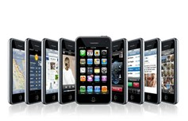
The digital revolution has had a huge effect on the business world – social networking is now a well-established marketing tool, tablets and portable devices are used in offices, and mobile phones are used to buy products online.
24 hour marketing tool.

Slide 54
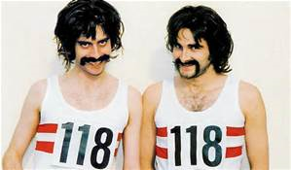
Communications technology allows flexibility in the location of services and customer relations centres. Calls to the directory enquiries number 118118 are answered in Cardiff during the day and in the Philippines during the night.
Costs are therefore reduced and service standards improved.

Slide 55
Technology advantages (A04)
•Improved quality – thanks to their high precision and the ability to do the same thing in the same way day after day, robots and CAM processes have the ability to consistently produce top-quality products and accurately perform repetitive tasks;
•Faster innovation – it is much easier, and less expensive, to model and test new products using CAD and computer modelling;

Slide 56
• More effective marketing and sales – marketing new products encourages consumers to dump old products and buy new ones on a regular basis;
•Less dependency on labour – this is important to the business in reducing costs, especially if workers had used their bargaining power to push for higher wages and improved conditions;

Slide 57
•Increased productivity;
•Reduced waste and costs;
•Improved communications.

Slide 58
Disadvantages of technology (A04)
All technology costs money and to build a state-of-the-art car plant costs hundreds of millions of pounds. There is always pressure to buy the latest machine, the fastest computer or the newest robotics.
Also technology does not always work, or there are huge cost overruns. In addition, there are a number of different labour costs related to the implementation of technology.

Slide 59
Some workers are likely to lose their jobs, especially those who are not adaptable, cannot be retrained or do not have specialised skills.
Workers who remain after redundancies have occurred may feel less secure and less motivated in their work and may need retraining, which will cost the business. There will, of course, be new opportunities for workers with the skills now needed to run the latest technology.

Slide 60
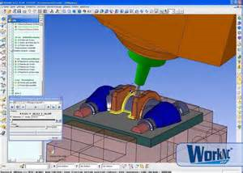
Activity 2
Task:
Explain difference between CAD/CAM and robotics.
Time: 20 mins

Slide 61
Activity 3
Task:
Technology Kahoot quiz.
Time: 15 mins

Slide 62
Homework - Amazon – Technology
https://www.youtube.com/watch?v=RXLAlziEzAE
How its made Coca Cola
https://www.youtube.com/watch?v=7V6JO0Rfgas

Slide 63
Research and development – Objectives
Introduce the aims and objectives for the session.
Explain research development and innovation.
Give examples of research and development methods.
Complete a research and development written task.
Discuss your task answers with the group.
Answer the research and development quiz questions.
Discuss in groups, what is technology.
Explain CAD, CAM, computer modelling, robotics and IT usage.
Describe why companies use technology.
Complete a description of CAD, CAM, computer modelling, robotics and IT usage.
Watch Amazon using technology video
Recap the aims and objectives for the session.

