Slide 1
NPTC Group Refurbishment of G block

Slide 2
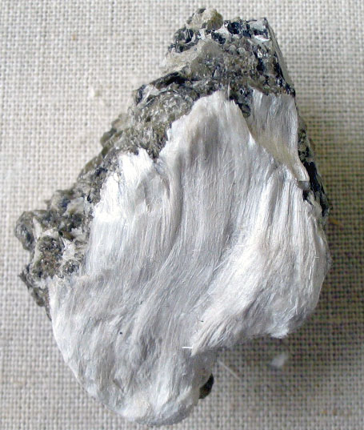
P7 Explain the implications of environmental issues and legislative constraints on building construction
What is Asbestos?
Asbestos is a highly heat resistant fibrous silicate mineral that can be used in fabrics etc.
There are 3 main types of asbestos that were in the UK these are:
Crocidolite (Blue asbestos)
Amosite ( Brown asbestos)
Chrysotile (White asbestos)
Asbestos was banned because it is highly dangerous when the dust is breathed in because it can attach to the lungs and cause cancer later in life.

Slide 3
Asbestos
Sample

Slide 4
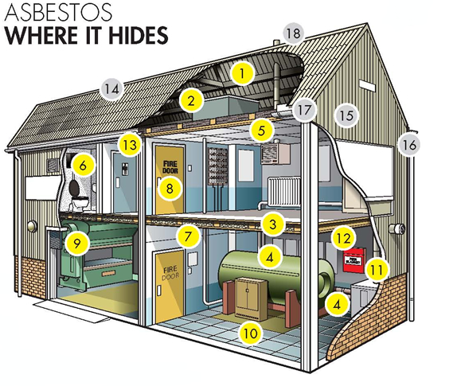
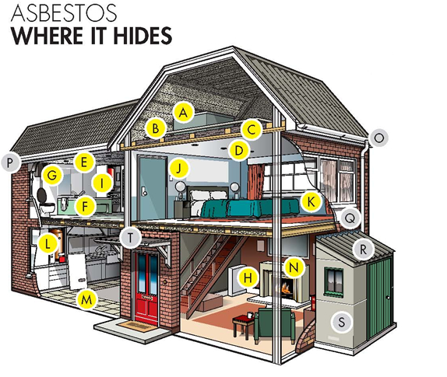
Where you can find asbestos?
Asbestos can normally be found in older building because the use of asbestos was band in the UK on the 24th of august 1999 preventing the use of it in any new buildings past this time.
Asbestos can be found in any industrial or residential building built or refurbished before the year 2000. It is in many of the common materials used in the building trade that you may come across during your work. These materials may include:
Loose fill insulations
Asbestos cement roof
Asbestos cement tiles/panels

Slide 5
Why is asbestos dangerous
Asbestos is dangerous to begin with because you cannot see it, taste it or smell it this means it is very hard to identify and this is what makes it so dangerous. It is the hidden killer.
Asbestos can affect any tradesperson and people die due to asbestos every week, it is made dangerous when it is moved or disturbed because this releases asbestos fibres which can be breathed in and attach to your lungs and this is what gives you cancer.
If asbestos is disturbed then work on that area should immediately be stopped and everyone should be evacuated from the area until the asbestos has been contained or removed by a specialist team.

Slide 6
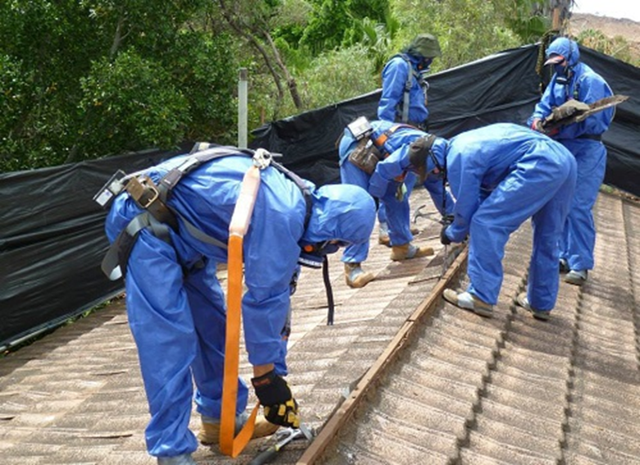
How to deal with asbestos removal
When dealing with asbestos removal or containment we must be very careful that are using the right equipment to keep everyone safe. The equipment we should use when we are working with asbestos are:
FFP3 rated mask to prevent dust form entering your lungs.
Lace less boots so no fibres are left on your laces.
Disposable overalls that must be thrown away in bins after the work is done.
Another thing we should do is keep the dust levels down by keeping the area wet if we have a bucket of water we can make sure to keep the dust levels down at all times. This makes the work safer to do.
Lastly we should clean up all of our equipment before we leave to make sure no fibres are left on any of our tools etc.

Slide 7
How will asbestos affect a construction project
The reason asbestos would affect a construction project is because it would slow down the whole project. We would have to pay a lot of money to do things like asbestos surveys as this is a specialist job and specific surveyors would have to come in and identify where in the building the asbestos was located and how to dispose of it.
We would also need to have specific amenities on site to do the work on asbestos removal, we would need amenities like showers on site and a disposable area to dispose of the overalls and masks used when the work is done.
The last thing that would affect our site in terms of asbestos is just the date the project must be completed by because the asbestos takes time to remove as it must be taken very seriously.

Slide 8
Legislation - wildlife
In England and Wales, the relevant legislation is the Wildlife and Countryside Act (1981) (as amended); the Countryside and Rights of Way Act, 2000; the Natural Environment and Rural Communities Act (NERC, 2006); and by the Conservation of Habitats and Species Regulations (2017).
When working on older or abandoned building we must take things wildlife into consideration. When we find wildlife on the initial survey of a building we want to start construction on we must look at the legislation involved and what animals are actually inside the building as some animals are protected legally as they are endangered like bats and other endangered speices . When these animals are encountered we need to look at the legislation involved and how to take care of these animals and how to move them off site so construction can begin.

Slide 9
How to deal with bats on site
When we are working on a building site and we discover bats we should immediately stop work because they are an endangered species and are protected under law by the legislation the Wildlife and Countryside Act (1981).
We should have specialist surveyors who do bat surveys on site to analyse where exactly in the building the bats are living and how to get them out safely.
Before we move the bats out of the building we are legally required to build new homes for the bats so we must build bat boxes outside the site for the bats to live when the site is being demolished ready for a new build.
The bats must be safely taken care of throughout this process and cannot be harmed or moved in any way before new homes have been made for the bats.

Slide 10
CDM regulations (construction design management)
As a construction company we must follow the CDM (Construction Design and Management) and the purpose of the regulations is to make the construction site safer and to improve the safety of a site. The CDM came into force in 1994 but since then has been changed 2007 but the modern recommended CDM came into force in 2015.
The CDM regulations have improved over the years so that construction sites are safer because over recent years an example is in 2005/2006 there were 32% of all worker fatalities on site and 77 people were killed. The regulations make the site safer by co-ordinating between everyone on site for example between managers and workers and managers with the heads of companies. The new regulations will help us increase safety on site because they organise our site in the following ways:
To plan the work of a whole project so we can monitor where we are.
We must make sure all workers are competent in there given areas for there tasks.
Work with the client to achieve the expected finish.
Have people capable of carrying out risk assessments for each job to show what the risks for each job are so we can avoid them.
Have daily meeting with workers to discuss the dangers of there jobs that day to limit accidents on site.

Slide 11
P8 Explain the purpose of the various parts of the infrastructure required to support the construction process
The scenario I have is that Neath Port Talbot College would like to convert a storage area into a brick layering department into a classroom. We need to lower the energy need to run the building so we would like new state of the art equipment to be installed in the classroom run of a renewable source. The department we are converting contains asbestos which we have mentioned before. We would like to keep the building aesthetically sound by using portal frame. We would like to complete the project over the summer holidays so we must use the following infrastructure to make the site efficient.

Slide 12
Infrastructure needed for the site?
The infrastructure we would need to keep the construction process running efficiently are:
Hoardings
Sealed skips
Toilet facilities
Signs
site cabins
scaffolding
canteen
Disposable overalls
Showering facilities

Slide 13
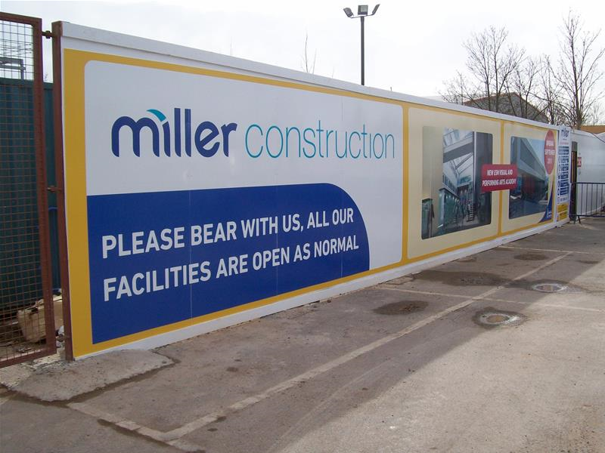
HOARDINGS
A hoarding is a temporary board fence erected round a building site. Hoardings can be seen as a temporary boarding that are erected around a site boundary to prevent anyone from entering the site. We also use hoardings as the site boundaries so we know when we enter the hoardings we are on site and must use our PPE to stay safe.
I believe hoardings are a very important part of infrastructure that the school needs as it helps prevent students from entering the site and risk being hurt. Without hoarding the students would be completely unaware that the area was having work done and that it was dangerous in this area.

Slide 14
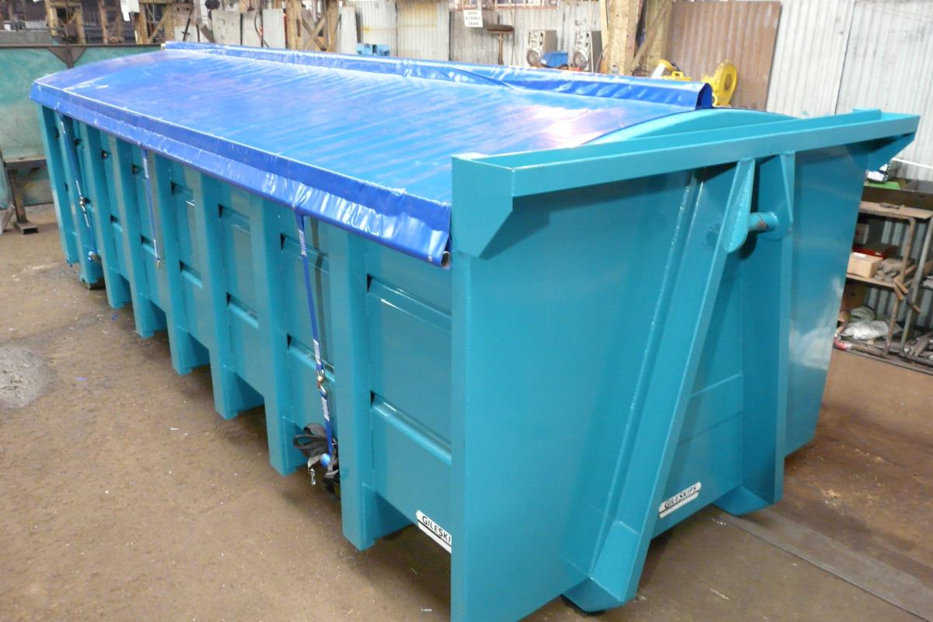
Sealed skips
As we know the site we are working on contain asbestos so we would need to contain sealed skips to keep the harmful dust particles from leaving the skip and contaminating the air around the college putting everyone in danger. Asbestos can cause diseases like lung cancer which are deadly and can take lives, for this reason we must insure that sealed skips are used so that the air is not contaminated and affecting peoples health causing serious problems.
If we just used normal skips and dumped asbestos into them then dust particles would be released into the air everywhere and when a student or labourer was walking past then they would inhale these particles and possibly have a very bad illness so using sealed skips is a lot better for safety reasons.

Slide 15
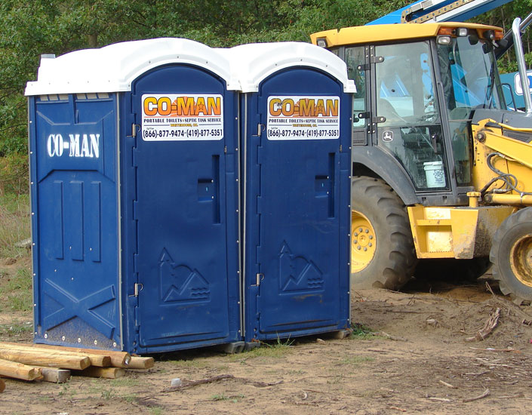
Toilets
On site we are require to provide labourers with both male and female toilets, the purpose of this is to insure that the labourers on site have constant access to the toilets so that they are of the best health possible on site. If toilets were not provided on site then the labourers could damage there health or it could be unhygienic unless they leave site to find a toilet which takes a lot of time out of there timetable which is allocated for work.

Slide 16
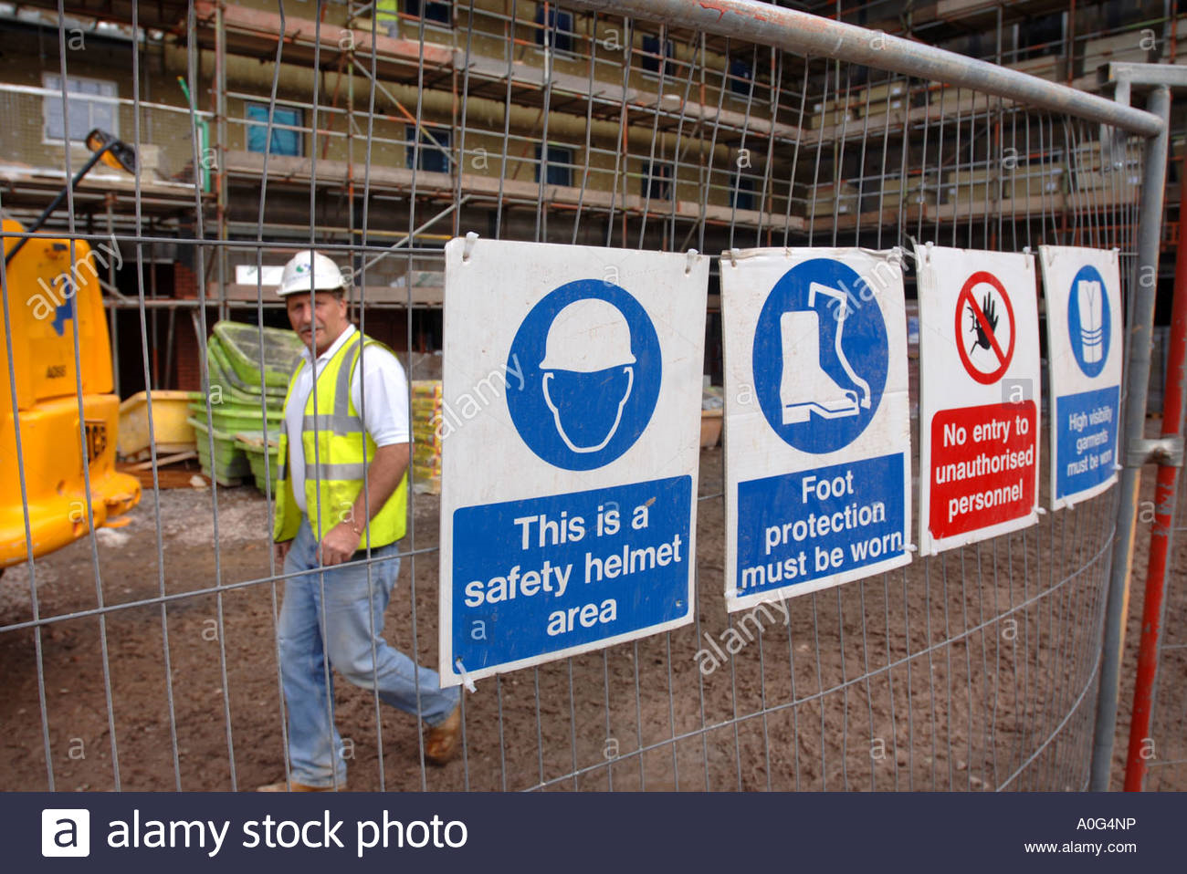
signs
We are required by law under the health and safety at work regulations 1999 to provide signage around the site to alert students and labourers of the dangers that are on site. The sites that I believe the site should include are:
We she have signs outside the site on the hoarding etc to show people that the site is dangerous as a whole and no one should enter the site without the correct PPE to keep people safe when on site.
Signs to show the danger of specific dangers related to construction, this includes Asbestos, moving vehicles or falling objects etc.

Slide 17
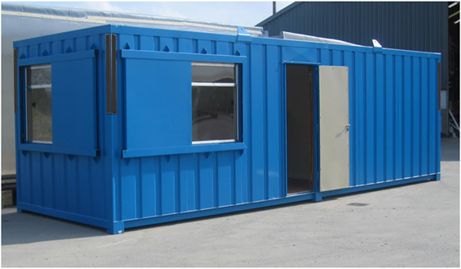
Site cabins
Site cabins can also be seen as site offices as they are a clean workspace for people like site managers and project managers plan certain parts of the project an arrange certain jobs for that day. This will be important on the NPTC site because the project manager would need a safe place to keep all of the important documents like risk assessments about asbestos etc. Without a site cabin the project managers would have nowhere to do work unless they had offices offsite which would not allow them to overview the project at all time which would result in them being unorganised.

Slide 18
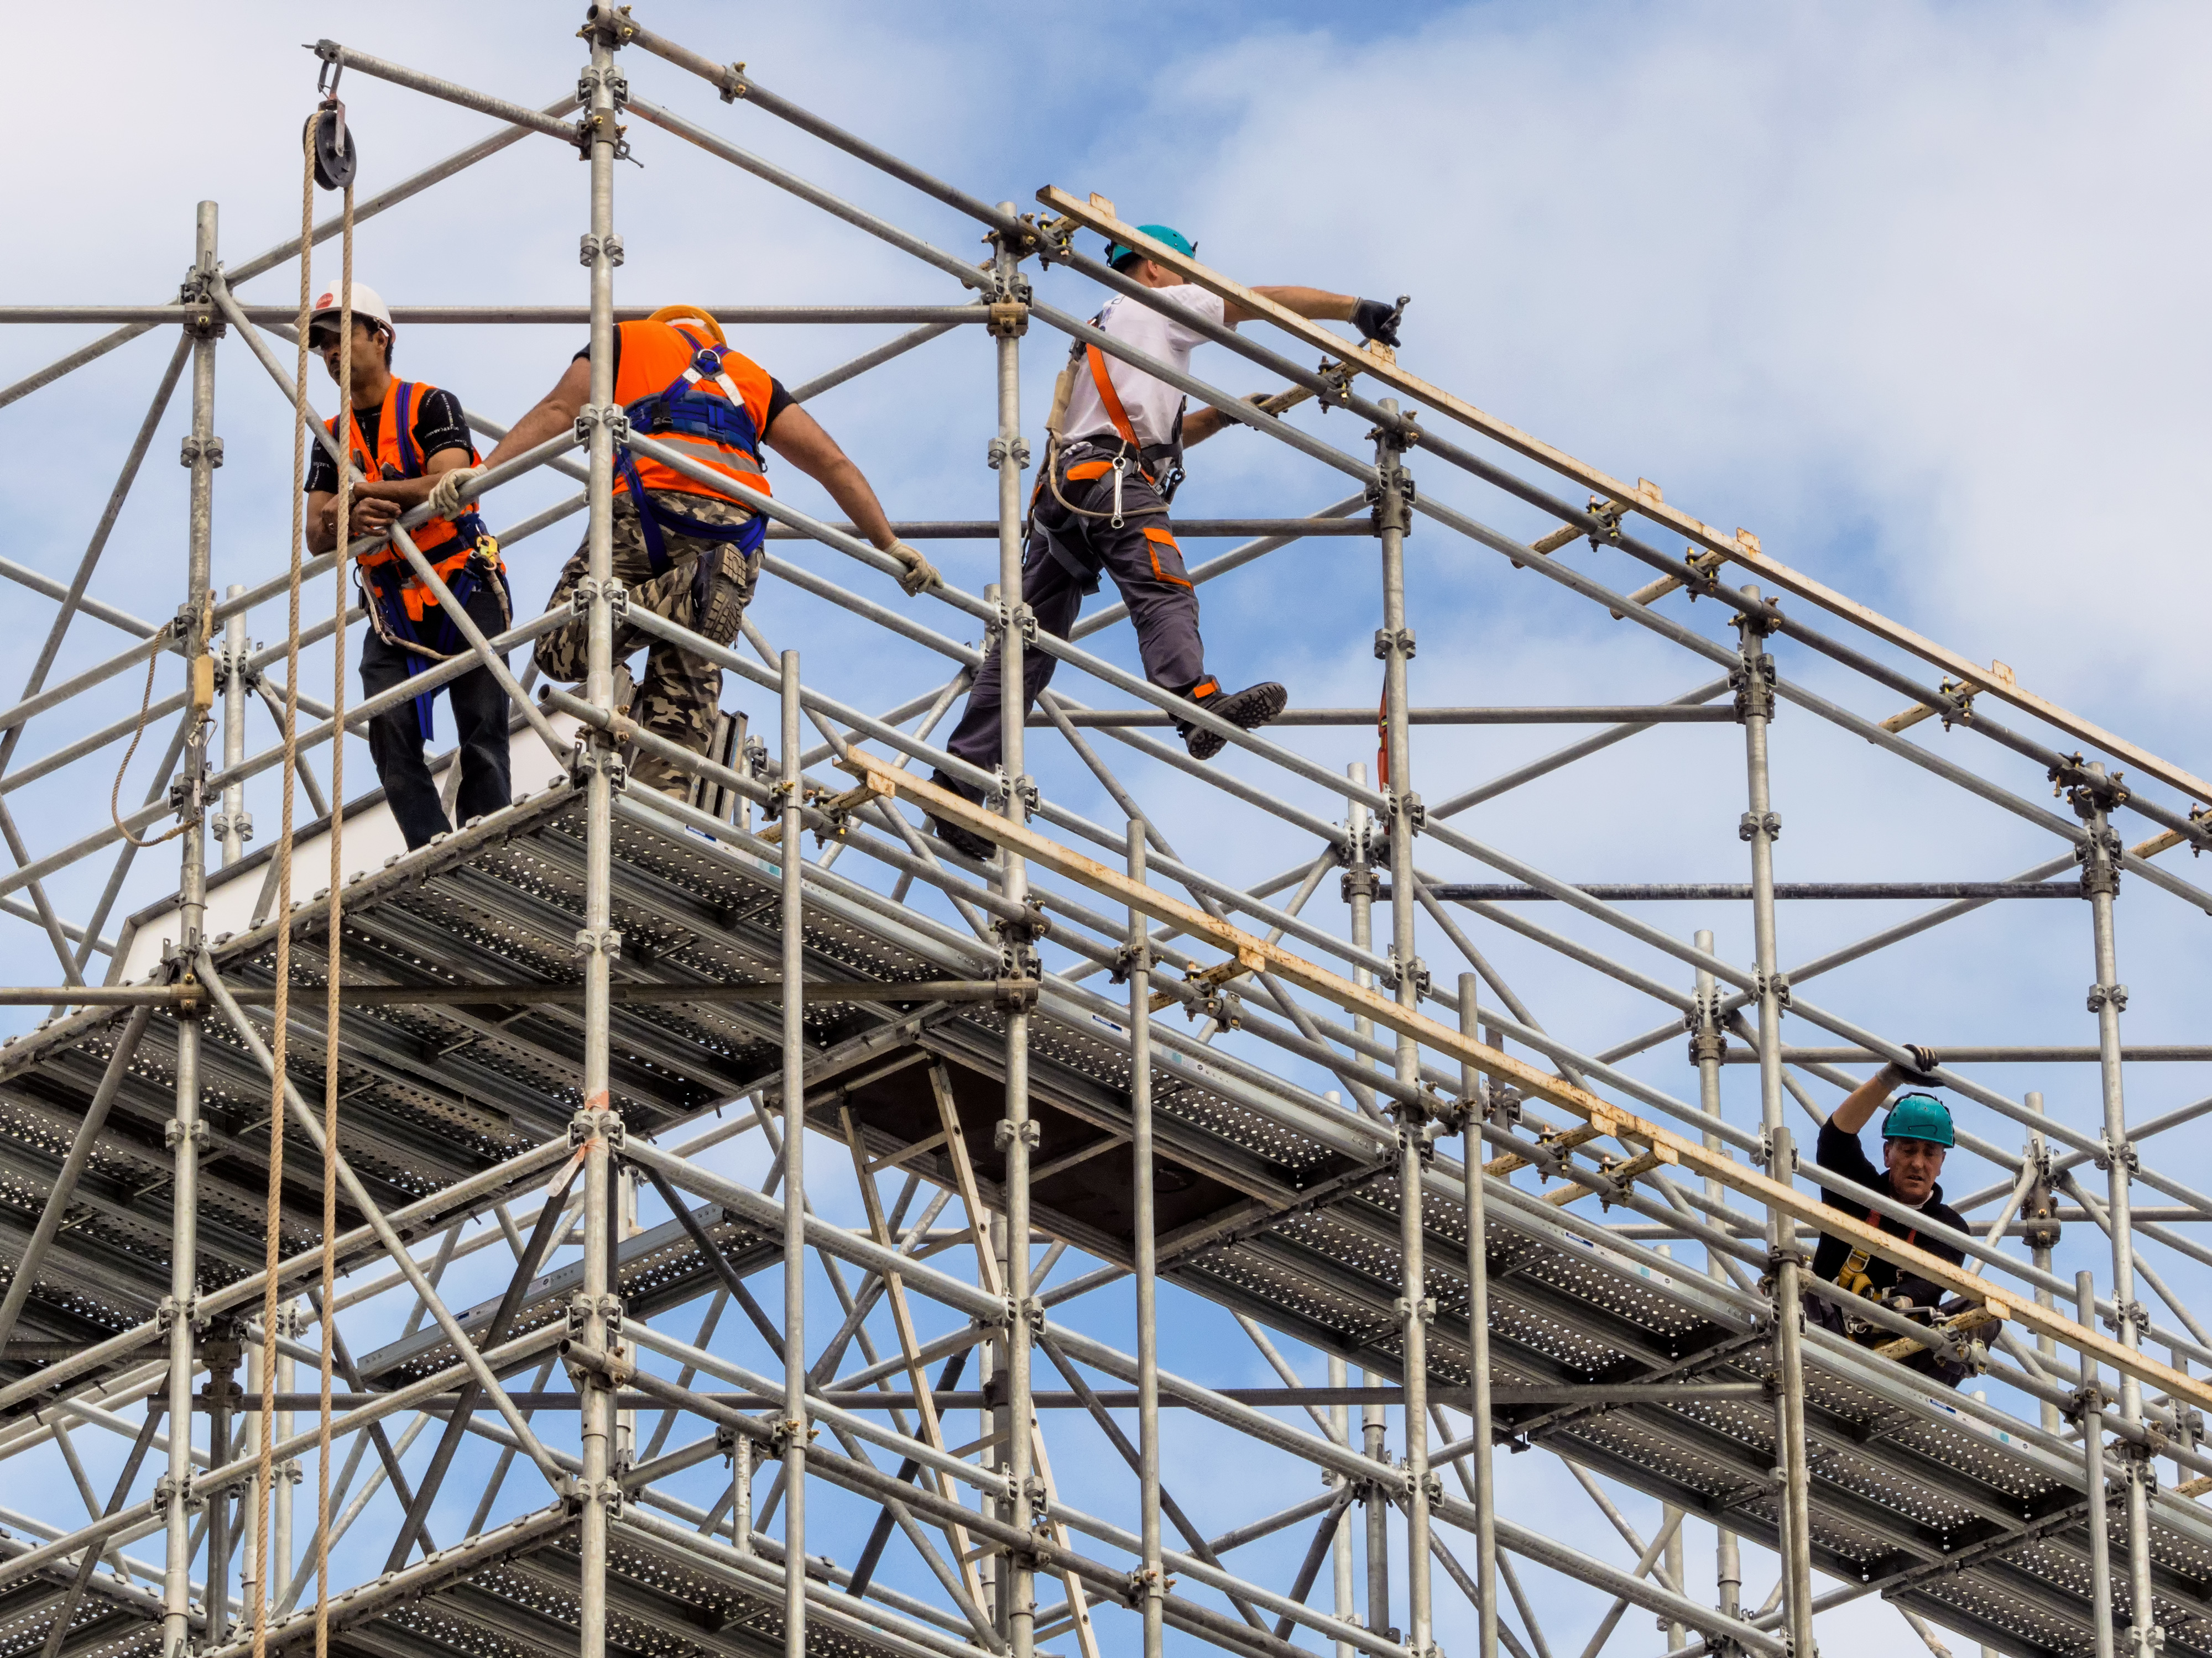
scaffolding
Scaffolding is important on site because it allows us to work at height on site. The proposed classroom for the school will be at a height of less than 3 floors under the working at heights legislation. We must install scaffolding to protect the people on site that are working at these heights. The purpose of scaffolding is to prevent working from falling form a high and being injured so we install scaffolding as a safe way to work at the level we are so no one is in danger of falling creating a safe working environment.

Slide 19
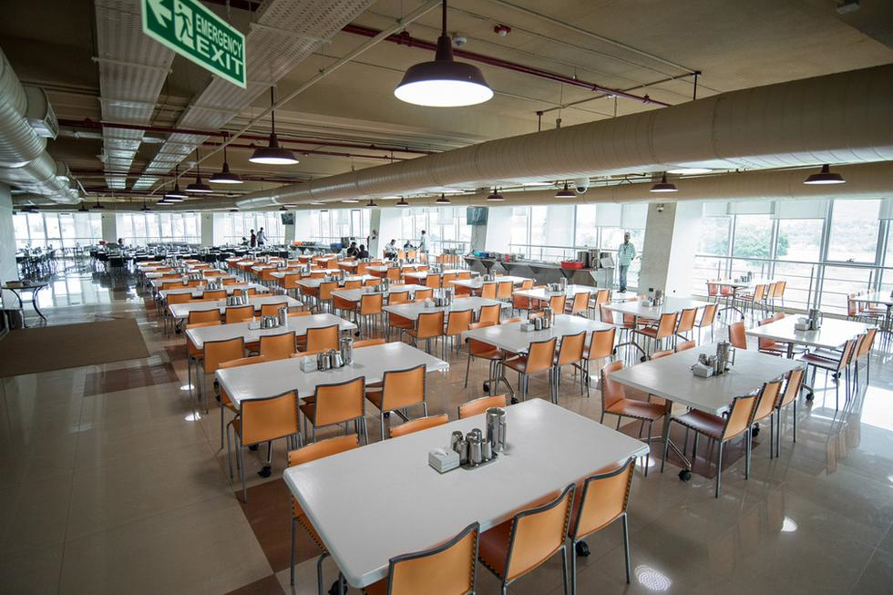
canteen
On site we require a canteen to feed the employees. The purpose we have for a canteen on site is to provide the workers food o time and so they can stay on the site so they will be back on time for work. If we did not have a canteen on site then the workers would have to go elsewhere and this would then result in the workers coming back later and not being in work on time.

Slide 20
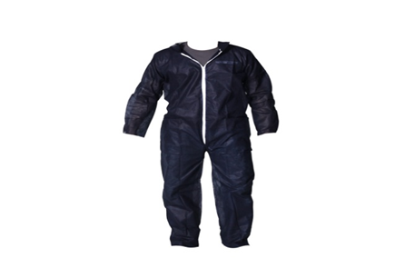
Disposable overalls
As we have been told the bricklaying department have asbestos located in the walls which will have to be removed before we begin working on converting it into a classroom. To do this job we must wear the correct PPE to be safe for the job and to protect the workers from inhaling and of the dust particles left behind by the asbestos. The Correct PPE would be :
FP3 rated dust mask
Disposable overalls
Lace less boots
The reason these must be warm is to limit the chance of someone absorbing any particles so all f the equipment must be thrown away after the job is done on that day.

Slide 21
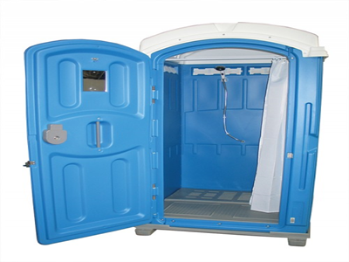
Showering facilities
We must add showering facilities on the site because of the asbestos removal from the site. After workers have disposed of the disposable overalls they must then shower to make sure no fibres or dust particles are left on the worker.
The shower would then help to get rid of any other dust particles. We will not always be 100% sure that all the dust particles are off so all workers must shower before they leave work to make sure they don’t go home with any dust particles on them.

Slide 22
M3 Evaluate three pieces of legislation applicable to the construction process in terms of the relevance of the legislation and the stage at which each applies.
There are 3 legislations we must follow when converting the storage area into a classroom. These 3 legislations include:
• Working at heights legislation.
• The control of Asbestos legislation 6 April 2012
• CDM legislation 2015
The legislations we have to look at are in place to make the construction environment safer to work on and to lower the risks of accidents and the amount of accidents that take place. A construction company has to take health and safety seriously as they can e liable for accidents on site which may affect there reputation and to avoid receiving fines.
I will be evaluating these 3 pieces of legislation in terms of the relevance in the construction industry and where the legislation will be in place when we are building the classroom.

Slide 23
Working at heights legislation (20o5) Positives
When we are doing the job of creating a classroom we will be working at height over certain periods of the job, the working at height legislation will be used when:
We will be using scaffolding on the job when we are working at height. The scaffolding is important to be used safely because if not and if not checked before every use then a large amount of money would be spent on court cases from people falling and compensation would have to be payed as the construction company would be liable.
By following the working at height legislation we will make the site a much safer place and much less accidents will occur.
Many lives are taken every year because of people falling from height so following this legislation will help us have less serious accidents and less deaths on site.
Work can be completed faster and more efficiently as we will be working on safer equipment so it will be easier to complete.
When we follow this legislation we will have less accidents on site which will give us a much better reputation as client will see few serious accidents happen on site so the company is reliable.
The company will avoid any prosecution in terms of fines/prison sentences because they are not liable when the legislation is being followed.

Slide 24
Working at height legislation (2005) Negatives
When looking at the working at heights legislation it can also have negative effects for the construction company for the following reasons:
When someone is working at height on a ladder or scaffolding they need to be supervised so this is an extra cost for the company as an extra worker is needed to supervise at all times and must be payed for this.
When we are working at height we need to erect the scaffolding which can be expensive when a company has to pay for all of the equipment.
Scaffolding should be checked every time before it is used so we can ensure we are working safely. Due to always checking before we begin work this can take time out of the timetable.
The legislation states that we cannot work at height in adverse weather conditions so this an bring added costs and we lose time to work and may cause us to miss the deadline.
To work at height a labourer will have to be trained, this would cost money for the worker to be trained and he would need time off work to train.

Slide 25
Working at height legislation (2005) when we would need to follow it
We will need to follow the working at height legislation during these stages in the process of building the classroom:
• Using a ladder/scaffolding to paint the room after it is completed, we would need to use this equipment to reach the higher parts of the room.
• Using a ladder/scaffolding to plaster the room after it has been completed, once again we would have to use these to reach the ceiling etc.
• Using a ladder/scaffolding to remove asbestos from the walls, this would make sure we are working safely and the work is being done safely as asbestos is very dangerous we should be able to see it.
• Using scaffolding to remove the roof and replace it with a new one, we would need the scaffolding to have a safe level to work off and place a new roof.
• Using scaffolding to install the solar panels on to the roof.

Slide 26
The control of Asbestos Legislation (6 April 2012) Positives
The Control of asbestos legislation is important to a company because:
The control of asbestos legislation is in place to attempt to reduce the number of workers who are affected by asbestos related illnesses form being around asbestos on site without knowledge, infrastructure or the correct PPE to protect them and enable them to work with asbestos. If this legislation was not followed then there would be a lot more asbestos related illnesses caused on site and the company would have to pay a lot of money in compensation, sick pay and lose a lot of it reputation if the workforce was repeatedly sick. The reason we follow this legislation is to protect the workforce from these illnesses.
The legislation also makes the site a safer working place. Labourers will be more comfortable working on a site where they know they are safe from these illnesses.
Asbestos related diseases can range from minor to very severe such as lung cancer which can be life changing for anyone. The reason we follow the legislation is to save lives on site because without them many more could be potentially lost. When a life is lost the moral on site can be extremely low from losing a friend and this will sow work down greatly and the level of work mat also be lower. As a result we must always follow this legislation to not have these risks.

Slide 27
The control of Asbestos Legislation (6 April 2012) negatives
The control of asbestos legislation can also have negative effects for the construction company because:
The cost of facilities like showers and the correct PPE such as disposable overalls, masks and lace less boots for every worker can be extremely expensive for smaller companies.
A special surveyor that does asbestos surveys must survey the site. This takes time as it is very dangerous so time on the project is lost and money may have to be spend on specialist contractors to remove the asbestos if present.
The staff working with the asbestos must be wearing this PPE at all times, this will require supervision to make sure everyone is working safely at all times so will require time and the companies resources.
All members on site should have special training which prepares them to work with asbestos, this will require special contractors who work with asbestos which can be expensive.

Slide 28
The control of Asbestos Legislation (6 April 2012) Where would we need to follow it
We would follow the control of asbestos legislation during these periods of work on site:
Asbestos may be used as insulation in some buildings so we would need to follow this legislation then.
Whenever someone is disposing of materials with asbestos or the disposable overalls used for jobs in sealed skips.
When we are knocking through walls because we wont know what's behind them.

Slide 29
CDM legislation (2015)positives
The CDM legislation is important because it was created to make construction sites safer. Instances in which it would make the site safer include:
The legislation will ensure that all labours on site have the correct training, skills, knowledge and experience to carry out there job on site. If the labour was not competent for their specific job then labourers could hurt themselves.
The legislation is used to identify possible hazards before work begins on site. By finding hazards before work begins we are limiting the chance of them actually occurring on site. This would make the site safer before work begins.
The CDM Legislation is extremely important to follow because every project is required to follow them by UK and EU law.
Under the legislation it aims to reduce accidents on site by insuring labourers are competent to carry out there specific role on site that day. It should ensure everyone is aware of all the hazards on site before the project actually begins.
The legislation allows us to reduce the amount of accidents on site by making sure all workers have the correct training and have a safety talk about the site each day. These make the workers aware of any new hazards found.

Slide 30
CDM legislation (2015) negatives
The CDM Legislation can also have negative effects for the construction company because:
For large projects such as the current one at NPT group a CDM coordinator may need to be employed, this can be very expensive as they are very important.
Many companies are not aware of the updated legislation from 2015 where there are different regulations, this means many companies are unaware of the changes and can be breaking the law every day.
If you want to promote someone to be a CDM coordinator they will need to be trained and these courses may be expensive and they will require time of work to be trained.
Each day new hazards may arise on site from the work being done so new risk assessments will have to be made. This requires time resources and money to make it as accurate as possible but is worth the time spent.

