Slide 1
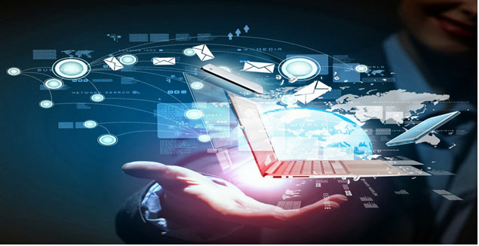
Unit 2: Technology Systems
BTEC Level 1 / Level 2 First in Information and Creative Technology

Slide 2
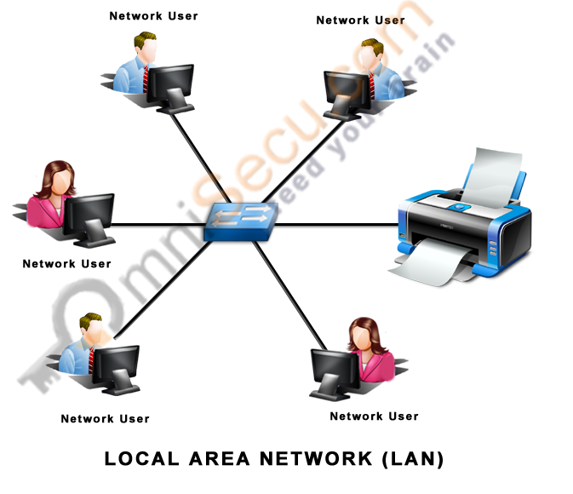
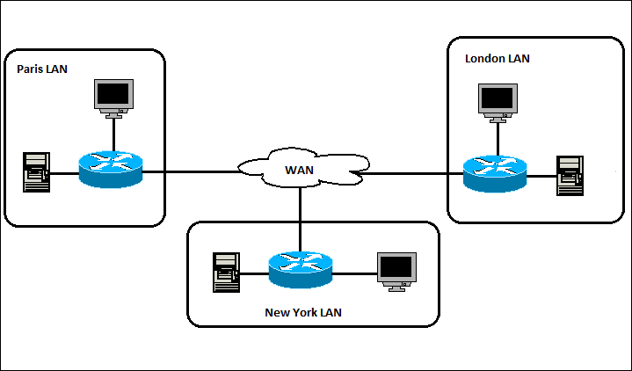
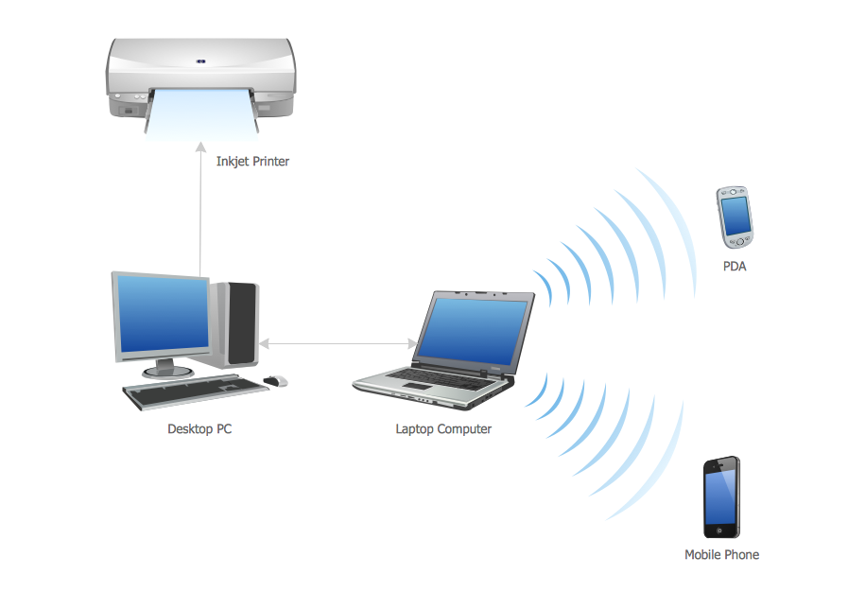
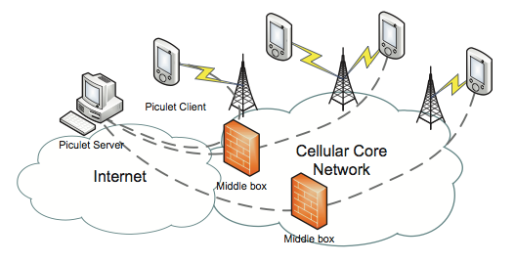
Types of Network

Slide 3
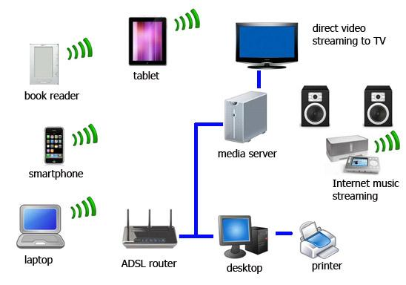
Uses of network systems
Sharing
Networks are used to share data and resources so that anyone who is logged onto the network and has authorisation to access them can do so.
Networked resources include printers, the internet and your document space on a network server. E.g. shared data is held on the network of an organisation so that staff can see and change information about clients and for other collaborative work such as working on documents.
Communication
Networks are great for communication – email, instant messaging and video conferencing are available for users to share ideas and reduce the need for travel.

Slide 4
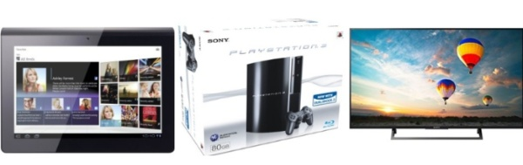
Uses of network systems
Entertainment
Networked systems provide the infrastructure to connect with people or online services anywhere in the world. You can stream files or listen to radio stations live hundreds or thousands of miles away, or you can join in online gaming communities and play with other players from different parts of the country or the world.
You can also get up-to-the-second news updates and updates from friends via social networking or microblogging sites such as Facebook, Google+ and Twitter.
Online gaming is a form of entertainment that uses networked systems to connect to the other players through the internet, e.g. Unreal Tournament.
Many people enjoy LAN parties, where people bring their computers together to play games such as Need for Speed using a LAN.

Slide 5
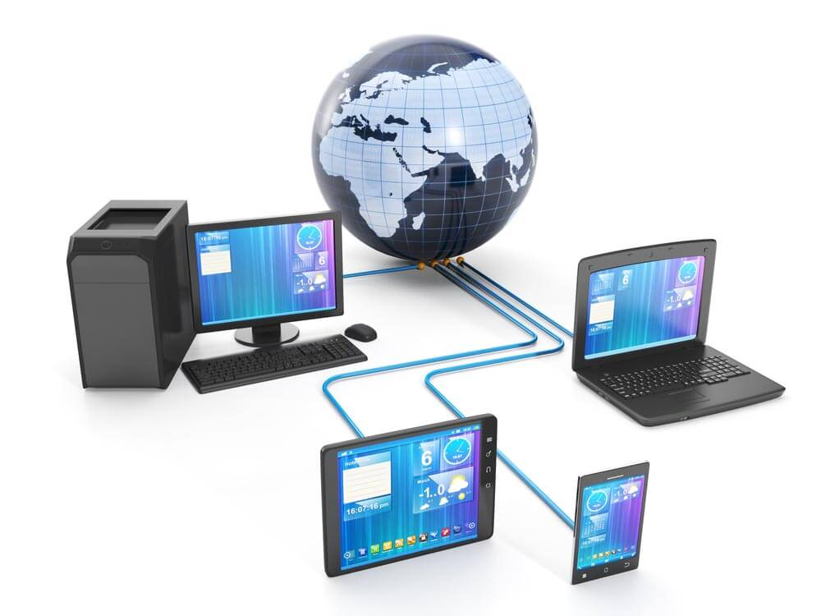
Benefits of networking computers
Networking computers can save money by allowing people to share resources.
Networks can enhance how people work by improving communications and giving them the ability to share documents.
Employees can access networks from home and many other places, so people have less need to attend the workplace. This save the organisation time and also reduces pollution caused by commuting to and from the workplace.
What disadvantages can you think of?

Slide 6
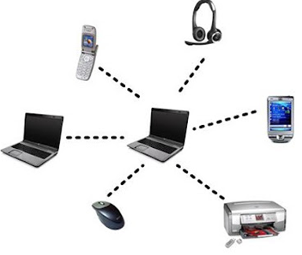
Synchronising data
If you have information on different devices, you will need to synchronise this data using Bluetooth, Wi-Fi, infrared or cable to connect the devices.
The devices can be connected to form a PAN to update older information to the most recent.
Synchronising data can bring calendars on two different devices up to date by making appointments and reminders the same on both.
Other data that might need synchronising could be texts, email messages, music, videos, podcasts or anything else held on these devices.

