Slide 1
Unit 2: Technology Systems
BTEC Level 1 / Level 2 First in Information and Creative Technology

Slide 2
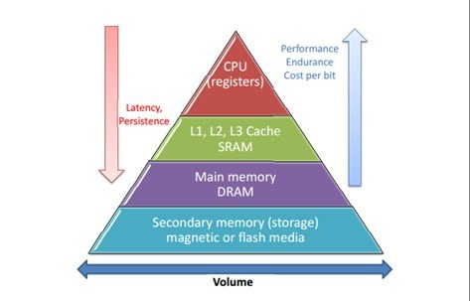
Memory & Storage
The performance of memory and storage devices comes form their speed and storage capacity.
Faster speed and lots of storage space make for a better user experience.

Slide 3
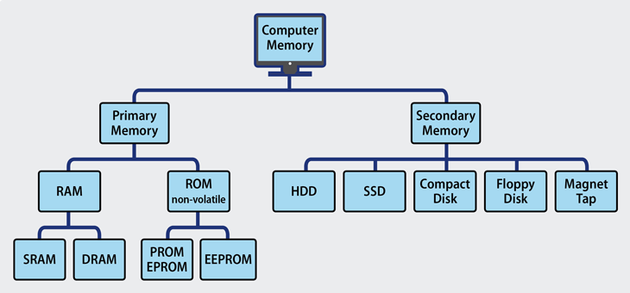
Computer Memory
Computer memory, like cache, Random Access memory (RAM) and Read Only Memory (ROM) is solid state, which means they are microchips with no moving parts.
Different types of computer memory are used for different purposes.

Slide 4
Computer Memory
RAM is used to store programs and data that the CPU is processing and that the user has accessed.
PCs, laptops and some game consoles generally use dynamic RAM – this uses a type of transistor (an electrical component contained within microprocessor) that needs a constant electrical power source to store data. Therefore, when a computer is switched off, any data stored within RAM is lost (deleted).
Mobile phones, digital cameras and some games console devices generally use static RAM (flash memory). This technology uses a type of transistor that retains its state (on or off), so it stores data, even after the power supply is disconnected.
Static RAM is more expensive and physically larger than dynamic RAM but it uses less power and is faster, which makes it more suitable for smaller portable devices.

Slide 5
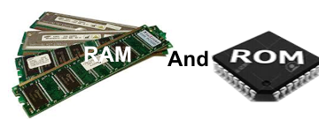
Computer Memory
Read-Only Memory (ROM) is memory that keeps the contents when the power is switched off.
PCs have ROM on the motherboard to keep setup information such as the boot sequence to control whether he computer starts with the hard drive (normal) or the DVD drive (to reinstall the operating system.
There are five basic ROM types – ROM; PROM; EPROM; EEPROM and flash memory.
Each type has unique characteristics, but they are all types of memory with two things in common:
Data stored in these chips is non-volatile - it is not lost when power is removed.
Data stored in these chips is either unchangeable or requires a special operation to change (unlike RAM, which can be changed as easily as it is read).
This means that removing the power source from the chip will not cause it to lose any data.

Slide 6
Performance
The overall performance of a computer is dependent on a number of different factors, including clock speed, memory size, number of processors, bus capacity and storage type.
It is the combination of different components and hardware devices that determines the overall performance and cost of the computer
Interaction between CPU, RAM and HDD:
CPU
RAM
HDD
Calculating results
Saving documents
Programs and data
Starting programs and opening documents

Slide 7
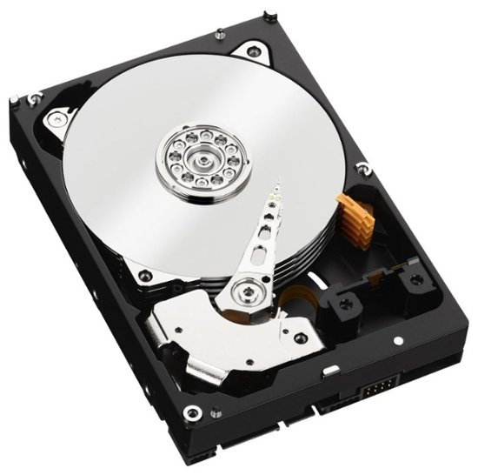
Storage Devices
Storage devices are used to keep data and documents saved from RAM, so when the computer is switched off they are kept safe for another time.
They are also used to keep programs for loading into RAM when they start so the CPU can run them.
Hard disk drives (HDD) – these are magnetic data, as they use tiny magnetic spots on a disk surface to store data. The disk spins round using circular tracks to organise the magnetic spots, with a read/write head moving over the disk surface between tracks to use them.
Optical drives – items such as DVDs and CDs are used to install new software and to make backups of hard disks.

Slide 8
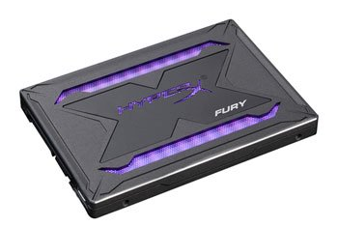
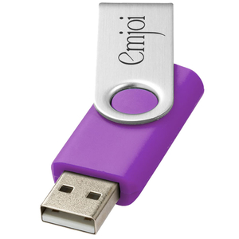
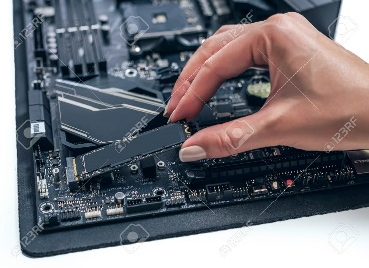
Storage Devices
Solid state drives (SSD) – these store data in flash memory microchips, which contain transistors that retain their state (on or off) and store the data, even when there’s no electrical power supply.
Although currently HDD are generally cheaper and have larger capacities, this is beginning to change and SSD is becoming increasingly popular and more common.
SSDs are the same physical size as a HDD, with the same connections and functions, but they do not have any moving parts so are a lot faster, quieter and more reliable than HDD.
A USB (Universal Serial Bus) device is a similar storage device using flash memory, but it is slower and less reliable than SSD.

Slide 9
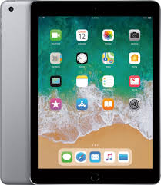
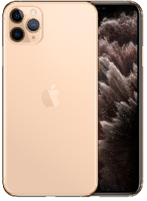
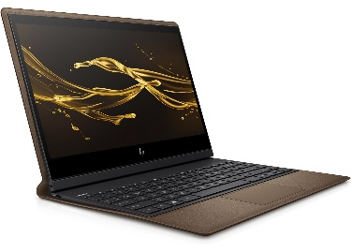
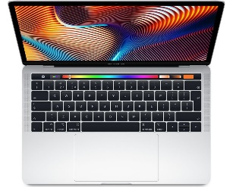
Mobile devices
We use a wide range of technological devices and systems to communicate and share data. While the components are similar, how they are used and perform can differ a little.
The features on a mobile device affect both the performance and user experience. More powerful features provide a better experience but reduce the battery life.
Modern devices use system on a chip (SoC) technology to combine the CPU and GPU onto a single chip. This has many benefits, including making the device smaller, easier to manufacturer, faster and needing less power.
The battery life for a mobile device is important, as people need to be able to use it for at least a day and preferably for a week or more. Recharging batteries takes time, inconveniences the user and reduces mobility. Designers therefore take a lot of care to design mobile devices with just the right mix of processing power and battery life.
The amount of electrical power the processing consumes is not such an issue with a traditional platform such as a desktop PC, as ,mains electricity is plentiful and there is little extra cost involved in running a powerful computer.
The size and weight are also less of a concern than for mobile devices, which need to be portable and convenient to use.

