Slide 1
Unit 2: Technology Systems
BTEC Level 1 / Level 2 First in Information and Creative Technology

Slide 2
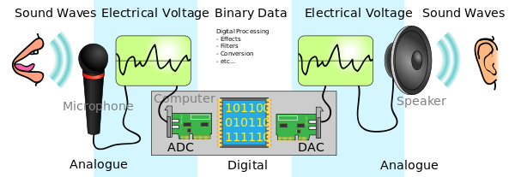
Analogue and digital data
There is a need to convert analogue signals, such as the human voice, to digital signals so that computers can process and interact with the natural world.
Digital transmissions are able to check for errors, so that there is no change or distortion in the data being transmitted.
Sometimes computers encrypt digital transmissions to make them more secure, so if anyone is able to intercept the transmission they will not be able to understand the data.

Slide 3
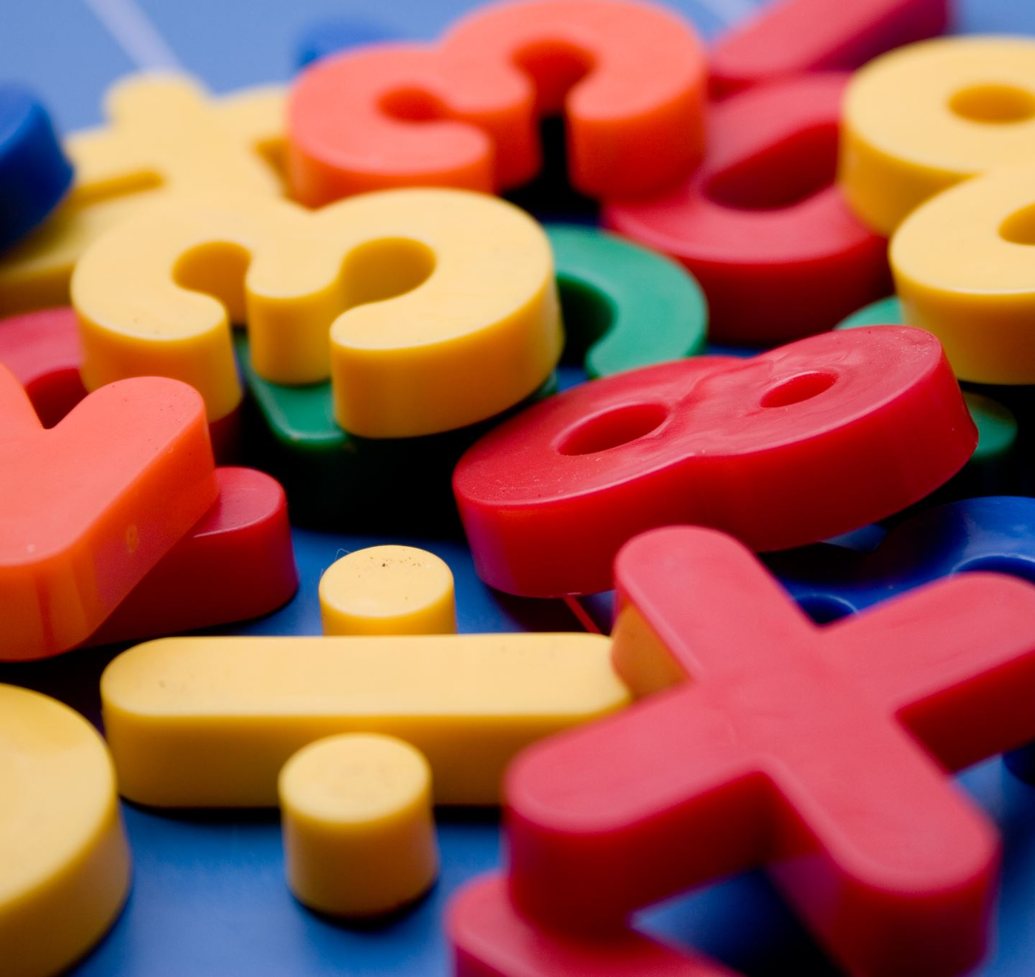
Decimal/Denary
Base 10
Numbers we use in everyday life
Place Value: Each digit in a decimal number has a place value based on powers of 10. Starting from the right, the first digit is in the "ones" place, the second digit is in the "tens" place, the third digit is in the "hundreds" place, and so on.
Counting: When you count in decimal, you go through all the single-digit numbers (0 to 9), and then you carry over to the next place when you reach 10. For example:
1, 2, 3, 4, 5, 6, 7, 8, 9

Slide 4
Decimal Continued
Representing Numbers: Any whole number can be represented using the digits 0 to 9. Larger numbers are created by combining these digits in various ways. For example, the number 365 is made up of 3 hundreds, 6 tens, and 5 ones.
Decimal Point: Decimal numbers can also have a decimal point, which indicates a fraction of a whole. For example, 3.14 represents three whole units and 14 hundredths.
Fractional Numbers: In addition to whole numbers, decimal notation allows us to express fractional parts of numbers easily. For instance, 0.5 represents half of a whole, and 0.25 represents a quarter.

Slide 5
Decimal is the most common number system in our daily lives because we have ten fingers, and it's easy for us to count and work with.
It's used in mathematics, everyday calculations, money, measurements, and much more. When you see numbers in books, on your phone, or anywhere else, they're usually in the decimal system.
This Photo by Unknown Author is licensed under CC BY-NC-ND

Slide 6
Binary
Binary is a base 2 number system composed of 1s and 0s, whereas the number system that we use everyday is called denary (base 10).
In order for a computer to process data from the natural world, it converts data, such as denary numbers and text, into binary values. This is why it is important for you to understand the process.
In binary each digit represents an increasing power of 2, with the rightmost digit representing 2⁰, the next digit representing 2¹, then 2², and so on.
The smallest single unit of information possible in a computer is a binary value or either 0 or 1, and is called a bit.

Slide 7
Binary
The use of binary notation works very well in every part of a computer, which is why binary numbers represent all data within a computer.
In RAM, binary notation is represented in transistors as with electrical charge (1), without electrical charge (0)
In a hard disk drive, binary notation is represented in the magnetised surface of the disk as North (1) or South (0)
In a DVD, binary notation is represented in the reflective surface of the disk to a laser as reflective (1) not reflective (0)

Slide 8
Binary
Binary equivalents of denary numbers 0 – 10:
Denary number | Binary number
 | 8 | 4 | 2 | 1
0 | 0 | 0 | 0 | 0
1 | 0 | 0 | 0 | 1
2 | 0 | 0 | 1 | 0
3 | 0 | 0 | 1 | 1
4 | 0 | 1 | 0 | 0
5 | 0 | 1 | 0 | 1
6 | 0 | 1 | 1 | 0
7 | 0 | 1 | 1 | 1
8 | 1 | 0 | 0 | 0
9 | 1 | 0 | 0 | 1
10 | 1 | 0 | 1 | 0
The binary column headings always start on the right with 1, each column to the left is double the number to the right of it.
To calculate the denary equivalent of any binary number, just add together the numbers in the heading row for every bit with a value of 1.
For example:
1001 = (8 + 1)
= 9

Slide 9
Converting Binary & Decimal
You can see that binary notation increases by the power of two: 1, 2, 4, 8, 16, 32, 64 and so on.
This is an important concept in computing, as computer memory is designed by using binary logic.
It is also used to determine the size of data that a processor can process most efficiently and the number of bits used to represent memory addresses.
Early processors were typically 8-bit or 16-bit, whereas today many processors are 128-bit or 256-bit, with the most powerful being 512-bit. Therefore they have more memory.

Slide 10
BIT is the abbreviation for binary digit. The BIT is the smallest binary information unit, which can accept a signal status of “1” or “0”.
BYTE – For a unit of 8 binary characters, the term BYTE is used. A byte has the size of 8 bits.
WORD – A word is a sequence of binary characters, which is regarded as a unit in a specific connection. The word length corresponds to the number from 16 binary characters. With words, the following can be represented:
A word also has the size of 2 bytes or 16 bits.

Slide 11
Word and word length – please read individually
A word is the term used to describe the number of bits, e.g. 32bits – used by a particular processor.
A word is a fixed sized group of bits (binary data that is handled as a group by the instruction set and the CPU (e.g. for registers).
A processor usually runs instructions that are a fixed length, typically corresponding with the word size or a fraction / multiple of a word in each clock cycle.
The size of the word length is important in processor design, it affects the processing power of the computer.
The larger the word length the greater the processing power of the microprocessor and the more memory that can be addressed.
In a memory subsystem, such as the data bus between the CPU and RAM, the amount of data transferred in a clock cycle is typically a word – the larger the word length the greater the amount of data that is transferred per clock cycle, so the greater the processing power of the computer.

Slide 12
ASCII
ASCII is a system used to represent characters in binary format.
It uses byte values:
48 – 57 represent the numbers 0 – 9
65 – 90 represent upper case letters A – Z
97 – 122 represent lower case letters a – z
Other byte values are used for punctuation etc.
Notes:
2. Text in Binary: You can also represent text in binary by assigning a unique binary code to each character. The most commonly used system for this is ASCII (American Standard Code for Information Interchange). In ASCII, each character is represented by a 7 or 8-bit binary code.
For example, the letter "A" in ASCII is represented as:
Binary: 01000001
This binary code corresponds to the letter "A."

Slide 13
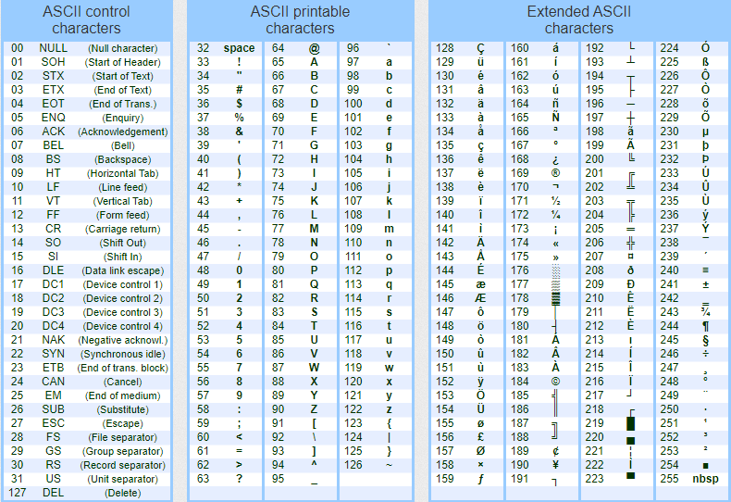
Table of ASCII characters assigned

Slide 14
Convert ASCII denary to binary
A = 65 (ASCII)
Binary = 01000001
If ALE = 65,76,69 how would ALE be written in binary?
01000001,????????,????????
128 | 64 | 32 | 16 | 8 | 4 | 2 | 1
0 | 1 | 0 | 0 | 0 | 0 | 0 | 1

Slide 15
Images in Binary
Images can be represented in binary
Each pixel in an image is assigned a binary value based on its colour of brightness
Consider a 4 x 4 black and white image where each pixel can be either black (1) or white (0)
How would the last two lines be written in binary?
1 0 0 1
1 0 0 1
? ? ? ?
? ? ? ?

Slide 16
File Storage
All the files on your computer, whether they are documents, images, music, or videos, are stored as binary data.
For example, a text document is stored as a series of 0s and 1s, where each character and line break has a corresponding binary code.

Slide 17
Binary Bits ‘n’ Bytes
A bit is a single binary digit (1 or 0)
4 bits are sometimes called a nibble
A kilobit (kbit) is 1024 bits
A byte is used to describe the size or capacity of memory and data storage and is 8 bits
A kilobyte (Kb) is 1024 bytes (a thousand bytes)
A megabyte (Mb) is 1024 kilobytes (a million bytes)
A gigabyte (Gb) is 1024 megabytes (a thousand million bytes)
A terabyte (Tb) is 1024 gigabytes (a million million bytes)
A petabyte (Pb) is 1024 terabytes (a thousand million million bytes)

Slide 18
So what is your maths like?
How many decimal (1000) kilobytes are there in a gigabyte?
How many binary kilobytes are there in a gigabyte?

