Slide 1
Unit 2: Technology Systems
BTEC Level 1 / Level 2 First in Information and Creative Technology

Slide 2
Programming Concepts
Professional programmers use specialised skills and creativity to write programs.
There is a hierarchical structure for software in a computer system. This enables different types of programs to work together to control the computer hardware.

Slide 3
Application Software
A general-purpose application package is a type of software that can perform many different related tasks, such as word processors, spreadsheets, databases, graphics and presentation software.
This is the end result of programming. When an application is running, the user interface is what you see and interact with by typing or using buttons.
Application software packages are created by programming with a high-level programming language, and are used to solve problems and to entertain.

Slide 4
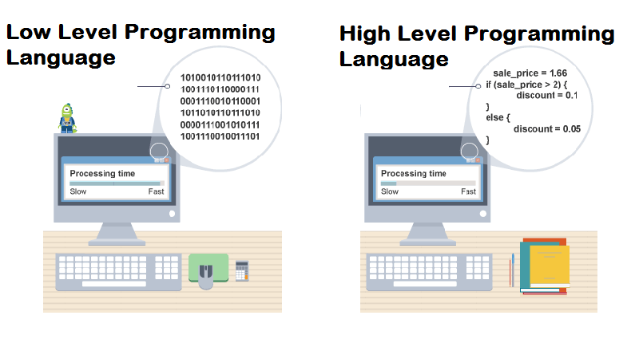
High-level programming
Most programmers use a high-level programming language to write their programs – e.g. C#, C++, Java, Visual Basic
High-level programs have much clearer structures when repeating code or making decisions.
High-level programming languages are powerful and easy to understand.
Programs written in a high-level language are much closer to spoken language than low-level, as well as being a lot more intuitive to use.

Slide 5
Characteristics of high-level programming languages
Imperative code – this is used in most languages (both older and modern). In this type of code, each program statement is a step towards handling the inputs, processing and outputs.
Procedural programs – these have definite start and end points. These languages were normal before GUI operating systems, as they usually have a single starting point then follow a sequence. Modern programs respond to events so can have many start points within the code.
Event-driven programs – these respond to events such as a mouse click. These are the current approach for modern programming because they need to produce responses to the great variety of events that GUI operating systems provide.
Object-orientated programs (OOP) – these view programs as a collection of objects, such as a database record, and not as a list of tasks in procedural programming. Each object can be viewed as an independent ‘machine’ with a distinct role or responsibility, which is capable of receiving messages, processing data and sending messages to other objects.

Slide 6
Low-level programming
Low-level programs usually have a very large number of lines of code because each instruction only does a small action, so it can be difficult to see the overall structure among so much detail.
Low-level programs are written in situations where precise control is needed over the processing and where speed is essential.
Although a low-level program will have a large number of lines in the code (written by the programmer) when it gets assembled into machine code this is a lot smaller than an equivalent program written in a high-level language.
This is because a line of code written using a high-level language will create a lot of machine code to allow for the many ways the high-level code instruction could be used.

Slide 7
Characteristics of low-level programming languages
Assembly language is written using an assembler, which helps the programmer by checking for errors in the mnemonics before compiling the program into machine code.
Assembly language consists of a number of mnemonics, abbreviations such as MOV – move instruction.
Each mnemonic is equivalent to a machine code instruction.
Machine code is binary bytes, so could be written without an assembler by typing binary numbers directly into memory. However, this would be difficult, as the programmer would only see the program as numbers.
The mnemonic abbreviations in assembly languages make understanding the program much easier.

Slide 8
High and Low Level Programming Languages

