Slide 1
Building in Construction Produced and presented by Erfyl Hughes
For P5 and M3. Aim: learners must be able to explain the principles of superstructure design. This should convey an understanding of the underlying principles that influence the design, such as the external envelope’s need for weather resistance, and knowledge of the elements that make up a building

Slide 2
Feasibility and design stage
During the early stages of the feasibility period many issues need to be considered. Space, design, ground conditions, building position, topography, Health and safety, logistics such as site access and sustainability to name a few. At this stage design will be immensely important as it will impact on all the other issues. The building will have to be ‘ fit for purpose’. Therefore all the above issues and more will influence the design principles and will have to be considered by the client and his design team.

Slide 3
Site investigation
Surveys
Foundation Type
Walk over survey
Desk top survey
Trial pits
Auger boring
Laboratory tests
Strip
Raft
Pad and beam
Piled

Slide 4
Loads in Construction
Dead loads
Roofs
External walls
Floors
Imposed Loads
Wind
Snow
Furniture
Vehicles

Slide 5
Building loads
Wind loads etc.
Dead and imposed loads

Slide 6
Well being

Slide 7
Well being at work
Healthy employees are happy employees. And happy employees are productive employees.
That's the kind of conventional wisdom that everyone knows, but we also know how challenging it can be to keep your employees motivated and engaged with your organisation.

Slide 8
Space
When designing the building the client and principal designer will have to consider the footprint of the building in comparison to the area and shape of the parcel of land that is available. Consideration should be given to adjoining structures or trees etc. Will there be a need for parking for the people who will use the building? Should space be made available for external leisure where individuals who use the building or visitors to the development can sit outside during the summer or spring during down time.

Slide 9
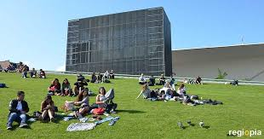

Slide 10
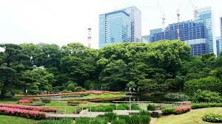

Slide 11
Design
Will the building be fit for purpose? There is sometimes a possibility that a building will become obsolete shortly after being commissioned. Will the building serve it’s function and the client’s needs? Planning consent will have to be considered. Will the external aesthetics meet with the approval of the local authority planning department. Will the design meet the challenges of loads, compressive and tensile loading?

Slide 12
The Building’s Fabric
Primary, secondary and finishing elements

Slide 13
Elements of a building
Primary elements
Secondary elements
Floors
External walls
Roofs
Stairs
People
Furniture
Fittings
Motor vehicles
Partition walls
Windows and doors

Slide 14
Weatherproofing a building
External cladding

Slide 15
Frames?

Slide 16
Roof covering

Slide 17
Finishes
External render
Ceilings
Roof coverings
Internal render
Decoration
Tied floors/walls

Slide 18
The CDM Regulations? M2

