Slide 1
Computational thinking
What information is relevant to solving a particular problem?
What computations need to be performed in order to solve the problem?
How can we be sure that the problem has been solved?

Slide 2
A1 Computational thinking skills Decomposition – assessment criteria
identifying and describing problems and processes
breaking down problems and processes into distinct steps
describing problems and processes as a set of structured steps
communicating the key features of problems and processes to others as relevant.

Slide 3
Video
https://www.youtube.com/watch?v=8HFqzzZxV9k
Notes:
https://www.youtube.com/watch?v=8HFqzzZxV9k

Slide 4
Computational Thinking
Decomposition
Computational Thinking
Representation of problems elements
Pattern recognition
Pattern generalisation and abstraction

Slide 5
Cup of tea
Notes:
Can you talk me through making the cup of tea.

Slide 6
Bigger problem – calculating net pay per month
1. Calculate net pay per month from annual salary
1.1 Get annual salary
1.2 Calculate gross per month
1.3 Calculate deductions
1.4 Calculate net pay per month
1.2.1 Divide annual salary per month
1.3.1 Calculate taxable income
1.4.1Subtract all deduction from gross pay per month
1.3.2 Calculate income tax
1.3.3
Calculate National Insurance
Notes:
It is a bigger problem but actually same steps are being followed – breaking down the bigger problem into a series of chunks, more manageable tasks. Identifying small steps makes the big tasks easier to tackle and find solutions. Think about family meals, the recipes books actually a big book of decomposition and algorithms to follow when preparing meals.

Slide 7
Decomposition
Breaking down a complex problem or system into smaller parts that are more manageable and easier to understand
Notes:
7
7

Slide 8
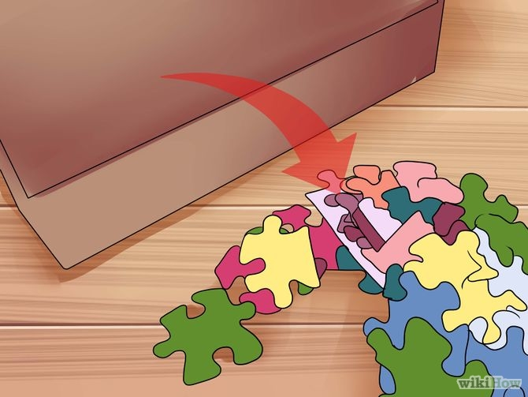
The Jigsaw Puzzle
Solving a jigsaw puzzle requires computational thinking.
How would you complete a jigsaw puzzle?
Notes:
What steps can you take to solve the jigsaw puzzle?
8
8

Slide 9
Step 1
Find all the edge pieces
Notes:
9
9

Slide 10
Step 2
Group all the colours (such as sky and grass pieces)
Notes:
10
10

Slide 11
Step 3
Place the sections where they seem to go
Notes:
11
11

Slide 12
Step 4
Fill in the gaps
Notes:
12
12

Slide 13
Step 5
… until you complete the puzzle
Notes:
13
13

Slide 14
Decomposition Steps
Identifying and describing problem.
Using language that is appropriate for a given scenario (think about the example from the previous slide)
Breaking down problems and processes into distinct steps
Just like in our example you have been decomposing one task to number of smaller tasks, until reaching the acceptable level of detail – calculate deductions for example)

Slide 15
Decomposition Steps
Describing problems and processes as a set of structured steps
The documentation of problems and processes shall be written in a way that can be followed by others.
Communicating the key features of problems and processes to others.
At that stage you may talk to your team or the client to look if, for example you could identify any repeating patterns. Depending on who you communicate with you need to use the appropriate level of language, avoid jargon.

Slide 16
Activity 1
Using the London Underground tube map, describe steps of getting from the Nothing Hill Gate to the Green Park station.
Is there more than one route?
What knowledge you need to chose the appropriate route?
Can you navigate the route from Paddington to Covent Garden Station.

Slide 17
London Underground
Notes:
17
17

Slide 18
Notting Hill Gate to Green Park
Notting Hill Gate > Bakerloo line (Brown) > Bond Street
Bond Street > Jubilee line (Grey) > Green Park
Notes:
18
18

Slide 19
Activity 2
https://studio.code.org/hoc/1
Notes:
(linked to pattern recognition)

