Slide 1
A1 Pattern recognition

Slide 2
A1 Computational Thinking Skills – Pattern recognition – assessment content
identifying common elements or features in problems or systems
identifying and interpreting common differences between processes or problems
identifying individual elements within problems
describing patterns that have been identified o making predictions based on identified patterns.

Slide 3
Thinking like a computer scientist
https://www.youtube.com/watch?v=zdndxMg6L7s&index=2&list=PLcvEcrsF_9zLzxML51z6gkmkBcUZy7eCo

Slide 4
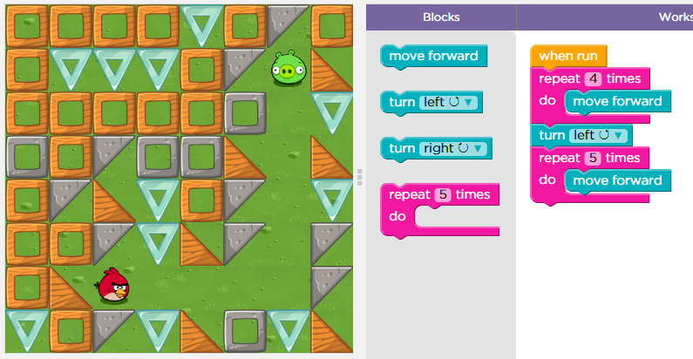
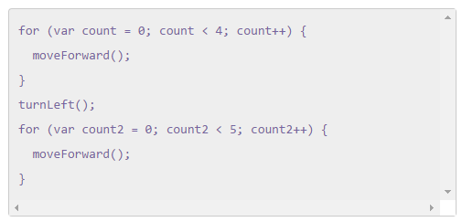
Pattern – repetition
Repetition allow for a portion of an algorithm or computer program to be done any number of times
An occurrence of repetition is usually known as a loop
Notes:
You may first let them do the game on https://studio.code.org/hoc/1
4
4

Slide 5
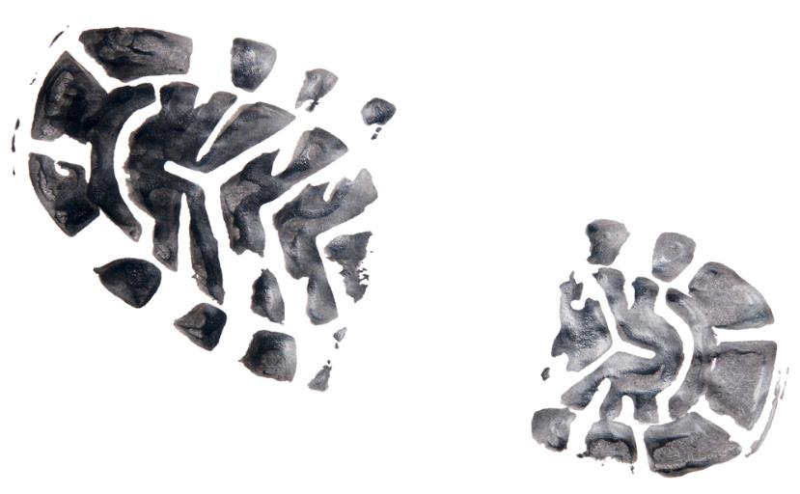
Pattern recognition
This involves removing details until the problem reduces to one which has already been solved
What do maps of a town, of the ocean floor, of a country, have in common?
What do fingerprint recognition, iris scanning, footprint scanning, text recognition, number plate recognition, have in common?

Slide 6
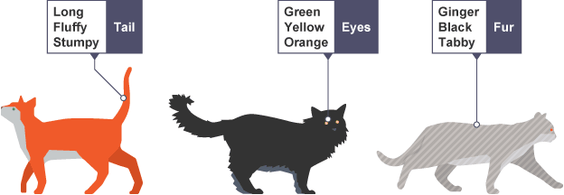
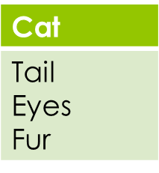
Pattern recognition
We often find patterns among the smaller problems we create. The patterns are similarities or characteristics that some of the problems share.
Objects have….
Attributes
or….
Properties
Notes:
6
6

