Slide 1
A1 Computational Thinking
Patterns recognition and Abstraction

Slide 2
Pattern generalisation and abstraction
Ignoring - the characteristics that we don't need in order to concentrate on those that we do.
Notes:
2
2

Slide 3
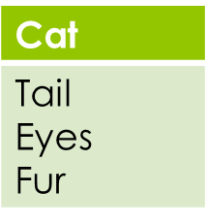
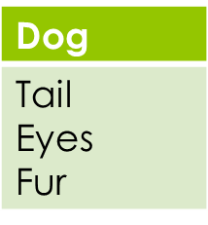
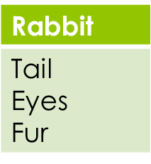
If we have other animals that have the same characteristics, we can simplify them with an abstraction.
Notes:
3
3

Slide 4
Abstraction
If you are learning to drive a car, you concentrate on the function of the steering wheel, accelerator, brakes and so on
If you are learning to be a mechanic, you will concentrate on how these things actually work

Slide 5
Thinking abstractly
Abstraction typically involves:
devising a model that represents the reality – for example, think of a simple queue, or something as complex as a climate change model
removing details that are not relevant to the problem
Activity
What details about a queue are irrelevant to figuring out how many tills are needed in a new store?
Notes:
What are relevant factors in determining how many tills – for example, average number of items, average speed of cashier, acceptable waiting time (an issue of understanding human behaviour), average number of problems that need a supervisor to be summoned, etc.
Irrelevant details are:
all personal details about the shopper
Whether they are a regular customer, how often they shop, what they buy, etc.
Think about how the data for the model will be gathered. Probably by a combination of numerical data on how many transactions are put through the till in each hour, and the average number and value of the transactions, and having someone observe what goes on at certain tills for several hours over a period of time.

Slide 6
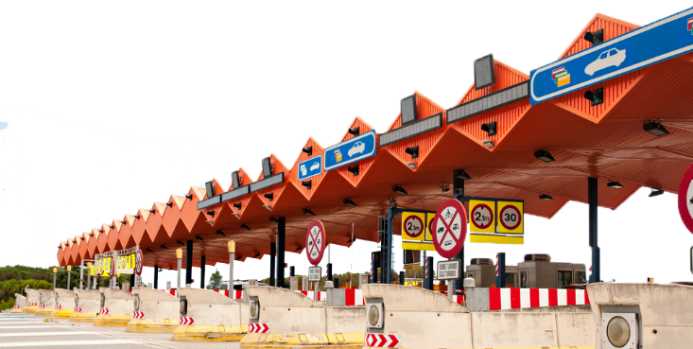
Another queueing problem
Suppose you are trying to find a solution to the problem of bottlenecks at toll booths on a motorway
What factors would be relevant, and what
would be irrelevant?

Slide 7
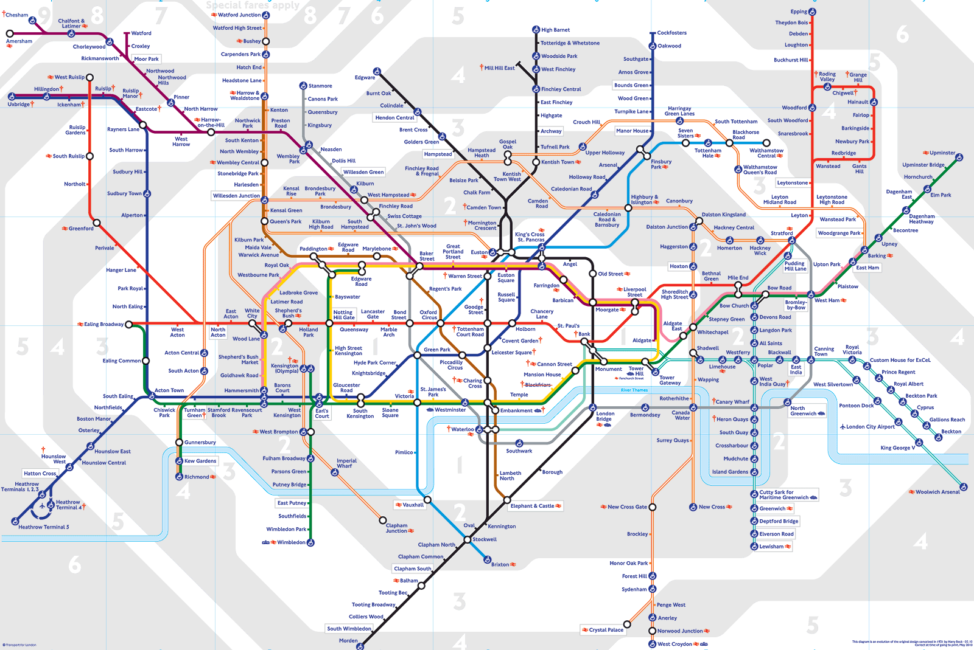
Abstraction and reality
Notes:
Abstraction is an important tool in problem-solving
All the details that do not contribute to the essential characteristics of the problem are omitted
The London Underground map is a good example of information hiding
Can you think of others?

Slide 8
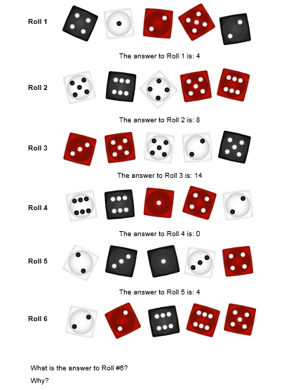
Complete Abstraction Worksheet and upload on Moodle
Notes:
Can you solve the puzzle?
If students are stuck, give them a hint “petals around the rose” , ask: what elements have you removed?
Do you look at the dices or the dots on the dice itself?

