Slide 1
A1 Computational thinking
Representing parts of the problem or system in general terms

Slide 2
Program Planning
Before starting writing the program you need to understand what the program is designed to do
The program asks the user to enter the cost of two items, adds the two costs and if the cost is greater than £10.00, displays a message “Sorry, too much”. Otherwise it displays the change due from £10.00
Complete activity on Moodle

Slide 3
Representing parts of the problem or system in general terms.
Identifying parts of a program:
Variables
Constants
Key processes
Repeated processes
Inputs
Outputs
Notes:
3
3

Slide 4
Variables
Variables can be changed and manipulated as the program runs so to keep the track of them, you need to give them suitable names or identifiers.
As the programs may contain many variables, it is important to have a meaningful identifiers
x=10
or
distanceToSchool = 10

Slide 5
Few golden rules for choosing variable names
Keep it short; long names can be easy misspelt
Longer identifiers can be used if describing data
Check that you do not use any reserved words (these are reserved in different languages)
In many languages the identifiers cannot begin with a number.
camelCase or snake_case: firstName or first_name

Slide 6
Constant
Values that cannot be changed while the program is running.
Constants also have identifiers
Example of a constant is a VAT rate;
vatRate = 0.20

Slide 7
Key processes and repeated processes
Some of them identified in the first tasks.
Key processes are critical to understand the problem and for the program to work correctly.
That may be include validation of data entry, for example in the password checker the system will authenticate/check the password before allowing entry
Repeated processes occur multiple times within the program
All processes has specific names and you will learn about these later.

Slide 8
Worked example
Length and width inputs of a rectangle will be stored as variables
The key process is the calculation of the area of a rectangle.
The calculated area is then displayed {output} to the user

Slide 9
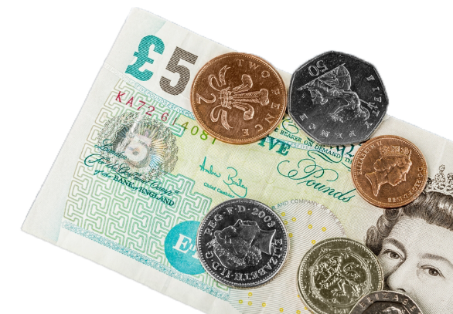
Parts of the program
Identify parts of the following program
The program asks the user to enter the cost of two items, adds the two costs and if the cost is greater than £10.00, displays a message “Sorry, too much”. Otherwise it displays the change due from £10.00
Variables
Constants
Key processes
Repeated processes
Inputs
Outputs
Notes:
That activity can be either conducted as a group or individually an discussed with the lecturer.

