Slide 1
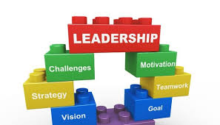
Chapter 21 – Leadership styles
TASKS:
Answer quiz questions on Management by Objectives as revision.
Read the effective manager traits and leadership styles slides.
Watch YouTube’s video on leadership styles and example leaders.
Read the leadership style case study.
Answer the Kahoot quiz on leadership styles (code will be posted).
Complete an exam question of the various leadership styles.

Slide 2
Activity 1
Task:
Answer the quiz questions and submit your answers
What is management by objectives?
Who proposed the management by objectives theory?
3) Discuss the management by objectives process?
4) Explain the advantages and disadvantages of
management by objectives?

Slide 3
5. What does McGregor's management theory suggest?
6. Explain McGregor's theory X? – Give an example of a business?
7. Discuss McGregor's theory y ? – Give an example of a business?
8. What are the main differences between the managements assumptions?
9. Which theory suggests works see work as just a job?
10. Which theory suggests workers see work as a career?

Slide 4
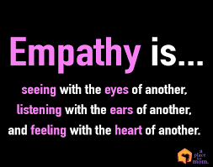
Character traits of effective managers
A number of character traits of effective managers have been identified:
Empathy
Hardworking
Enthusiasm
Inspirational
Self awareness

Slide 5
Leadership
Leaders may perform similar functions to managers, but in addition they also inspire and motivate the workforce, they consider long-term strategy, the challenges facing the business and how to overcome them.
Managers control and direct the workforce to follow the principles or values that have been established by the leaders.

Slide 6
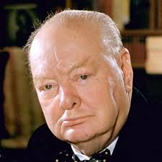
Leadership
Being a good leader involves getting people to understand and believe in your vision to work with you to achieve your goals.
Good leaders also have charisma, then inspire people to follow them E.G:
Winston Churchill / Steve jobs (WATCH)
https://www.youtube.com/watch?v=jnmq3iW45xE
https://www.youtube.com/watch?v=spSCnp4VjXw

Slide 7
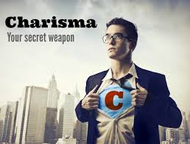
Charismatic leadership
Charismatic leadership is the process of encouraging certain behaviours in others via force of personality, persuasion and eloquent communication.
Charismatic leaders inspire their followers to do things or to do things better; this is done by conjuring up enthusiasm in others for a stated vision or goal.

Slide 8
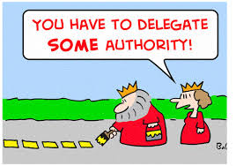
Role of leaders
Create visions and aims
Create new roles and jobs
Decide on structures
Anticipate problems
Establish objectives
Empower and delegate

Slide 9
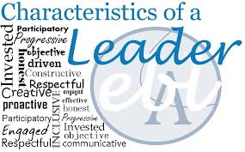
Role of leaders
Because leaders need to lead and fulfil a number of challenging roles, a leader needs to have a number of characteristics that will help them lead their business.

Slide 10
Leadership characteristics
These might include the following:
• intellectual skills;
• interpersonal skills;
• realistic aspirations;
• vision;
• communicative skills;
• creativity;
• innovation;
• commitment;
• identify and respond to changes.

Slide 11
It is unlikely that any leader will have all of these characteristics – indeed no single one of these characteristics is essential for a leader to be successful.
A good leader is the one that adapts to the needs of the employees through identifying problems and creating solutions.

Slide 12
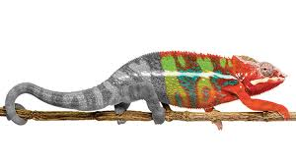
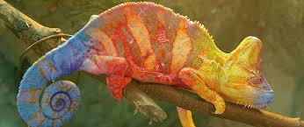
Leadership styles
In the long run, there is no one leadership style that suits any particular organisation. Market circumstances change, internal circumstances change, external pressures change, or alternatively there may be a period of stability.
These factors mean that as the business adapts to these different circumstances, then the type of leader that is best suited to the business will also alter.

Slide 13
The type of leadership required to force through restructuring or rebranding of an organisation will be very different from the leader who most effectively oversees a period of stability.
The leadership styles we examine below may then be broadly suited to a particular business form or structure but there will be times when the style is easily transferable to organisations that have previously been run in different ways.

Slide 14
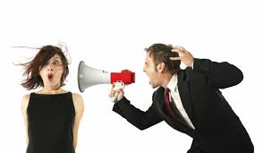
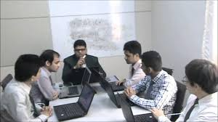
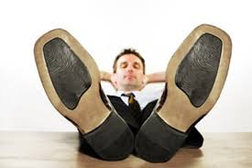
Different types of leadership styles
Autocratic
Paternalistic
Democratic
Laissez-faire
Bureaucratic

Slide 15
YouTube video
YouTube video – Leadership styles:
https://www.youtube.com/watch?v=1AZMiq6Mg-k

Slide 16
Hitler Obama Ghandi

Slide 17
Autocratic leadership
This style of leader gives orders which are to be obeyed without question. Probably a Theory X manager, who has no time for consideration of Maslow’s higher needs or Herzberg’s motivating factors.
This type of manager can be effective when rapid restructuring is required but to be effective he/she will rely upon a strictly hierarchical organisational structure. There is no employee involvement in the decision-making.

Slide 18
Paternalistic leadership
These leaders are similar to autocratic leaders in that they make all the decisions and there is no employee involvement.
However, paternalistic leaders may attempt to persuade the employees that the decisions made are in the best interest of all concerned. Paternalistic leaders will consider the welfare of the employees.

Slide 19
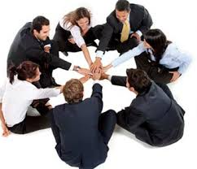
Democratic or participative leadership
This type of leader consults with subordinates in the decision-making process. Subordinates are involved with managers in designing their jobs and the tasks involved.
This philosophy is ideally suited to the implementation of ‘soft’ HRM policies. Democratic leaders will need to communicate effectively with employees in order to consult, persuade and receive feedback.

Slide 20
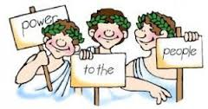
A democratic style of leadership can result in a workforce that is motivated and committed to the organisation and can also promote creativity and better quality decisions.

Slide 21
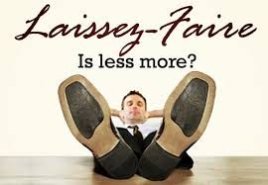
Laissez-faire leadership
This occurs when the leader has minimal input and subordinates are largely left to get on with their jobs.
Minimum guidance is offered and workers are given a great deal of scope to demonstrate their capabilities. The danger with this style of leadership is that if workers are not motivated or committed to their work, their productivity can be low.

Slide 22
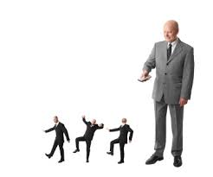
Bureaucratic leadership
Bureaucratic leaders focus on developing the specialisation of jobs and departments. They have a reliance on formal procedures and clearly-marked status definitions.
Bureaucratic leadership operates within hierarchical structures. Employees are allowed to use discretion only within delegated limits. Job roles are defined formally by the use of clear job descriptions, and an obligation to stick to these job descriptions severely limits the employees’ ability to act in situations that are unusual or unexpected.

Slide 23
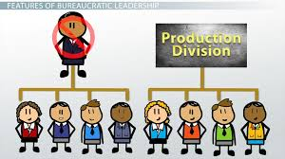
It is argued that in a bureaucracy each employee within the organisation knows precisely what their duties are (A04) and therefore many tasks will be performed a lot quicker and more efficiently.
Another advantage is that workers who are secure in their roles are, therefore, more likely to cooperate with other workers. The main disadvantage of this type of leadership is the discouragement of innovation and the ability to adapt to change. (A04)

Slide 24
What makes successful leadership? (A03)
What makes successful leadership is open to question. Different styles suit different circumstances and the same leader can use different styles with different groups of workers.
A good leader is one who can adapt their style or approach to different situations; this is known as a contingency approach to leadership. Leaders can be task or people-orientated and this orientation will dictate their approach to control, job design and motivation.

Slide 25
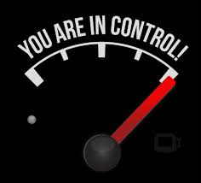
Leaders must plan, motivate and control, but how they best do this is a question of circumstance.
Using an autocratic style with a group of computer games developers may be a mistake but using the same style within the armed forces makes a great deal of sense.

Slide 26
Activity 2
Task:
Read Leadership styles – Case study.
Time: 10 mins

Slide 27
Activity 3
Task:
Kahoot quiz - leadership styles
Time: 15 mins

Slide 28
Activity 4
Task:
Exam question - leadership styles
Time: 30 mins

Slide 29
Chapter 21 – Leadership styles
TASKS:
Answer quiz questions on Management by Objectives as revision.
Read the effective manager traits and leadership styles slides.
Watch YouTube’s video on leadership styles and example leaders.
Read the leadership style case study.
Answer the Kahoot quiz on leadership styles (code will be posted).
Complete an exam question of the various leadership styles.

