Slide 1
Chapter 21 – Management and leadership
Fiedler contingency model, Wright and Taylor
Tasks:
Watch the video on Fiedlers contingency model.
Read Fiedlers contingency model and consider the questions throughout.
Complete ‘Fielders Least Preferred Co worker scale’ and submit your answers.
Watch the Youtube videos attached.
Answer the Fiedlers contingency model quiz question, answers will be posted at the end of the session.
Read Wright and Taylors views on leadership theory and consider the questions throughout.
Answer the Kahoot quiz questions on Leadership and management and submit your answers.
Complete the exam questions and submit.

Slide 2
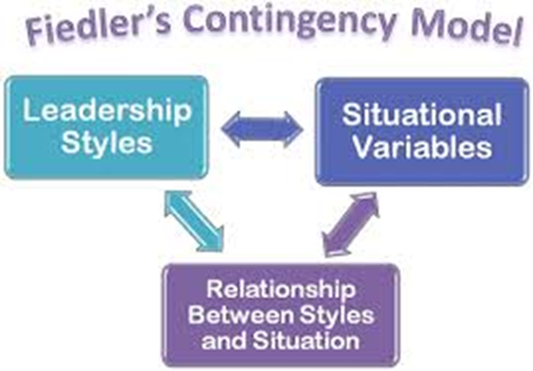
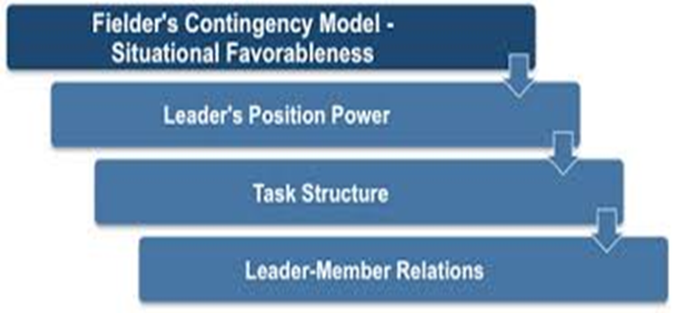
Activity 1 YouTube video
Fielders contingency model - Watch it:
https://www.youtube.com/watch?v=1eO5j2w03uI
Q – Why don’t company founders lead their organisations?

Slide 3
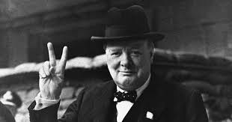
Fielder’s contingency model
Fiedler believed that the quality of leadership was the most important factor affecting the success or failure of an organisation.
He realised that most people are effective in some situations but not in others.
Q – Could you provide some examples of successful and unsuccessful leaders?

Slide 4
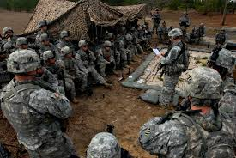
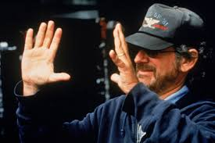
A successful military leader (Autocratic) would probably not be good directing a research laboratory (Democratic) or a film director would not make a very good manager of an accounts department.
Fiedler devised a way of helping people decide what type of leader they are in order to help them become more effective.
Q – What type of manager would you be? Were would you best fit?

Slide 5
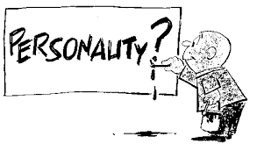
Fiedler’s contingency model states “that the effectiveness of a group or an organisation depends on two interacting or ‘contingent’ factors.
The first factor is the personality of the leaders which determine their leadership style.
Q – How did the personality of Hitler or Stalin effect their style?

Slide 6
The second factor is the amount of control and influence which the situation provides leaders over their group’s behaviour, the task and the outcome. This factor is called ‘situational control’.
Q – How do the skills of your workforce impact this?

Slide 7
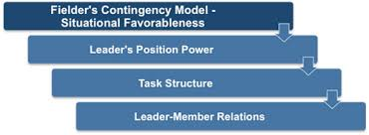
For more details, see the following publication:
F. E. Fiedler, M. M. Chemers and L. Mahar, Improving Leadership Effectiveness: The Leader Match Concept (John Wiley and Sons, New York, 1976).

Slide 8
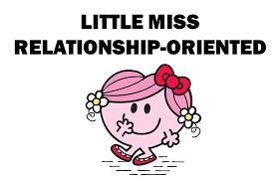
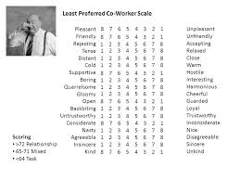
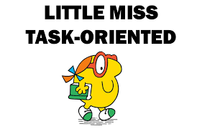
Least preferred co-worker (LPC) scale
In order to identify a manager’s leadership style Fiedler got them to fill in a questionnaire about the person they would least like to work with.
This was known as ‘The Least Preferred Co-worker (LPC) Scale’. This scale was used to identify two types of leadership style.
Q – Which two styles did it identify?

Slide 9
Activity 2
Task:
Complete Fielders scale (ON MOODLE) and analyse your findings.
You will need to submit your question answers only on your word document.

Slide 11
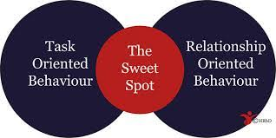
Least preferred co-worker (LPC) scale
A high score of 64 or more indicated a high LPC person; such a person is called relationship-motivated.
A score of 57 or below indicated a low LPC person. This type of individual is called task-motivated. An in-between score makes it difficult to identify which group the individual belongs to.
Q – What if you are positioned in the middle you are mix of….?

Slide 12
The high LPC leader sees other people as relatively pleasant, industrious or sincere even if they find it difficult to work with them.
The low LPC person, who sees their co-worker in negative terms, is determined to get the job done and believes that a poor co-worker is bad in almost every possible respect.
Q – What therefore motivates a high and low LPC worker?

Slide 13
Relationship orientated leaders
Relationship-orientated leaders (high LPC) are most effective in less extreme circumstances.
That is, in situations that are neither favourable nor unfavourable or situations that are only moderately favourable or moderately unfavourable.
Q – What would this leader participate in?
Q – Are they able to motivate staff?

Slide 14
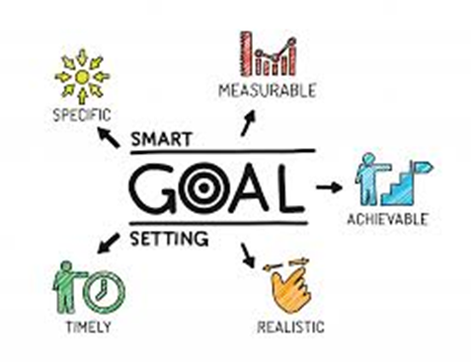
Task orientated leaders
Task-orientated leaders are most effective when facing a situation that is either extremely favourable or extremely unfavourable.
Q – What would this leader participate in?
Q – What is their skill is it necessarily motivate staff?

Slide 15
In the case of an extremely favourable situation, they are effective:
• when there is enormous trust, respect and confidence; when the task is very clear;
• when followers accept the leader’s power without question.
Q – Which style would they therefore adopt?

Slide 16
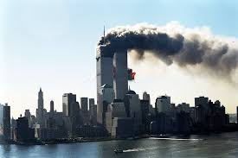
In an extremely unfavourable situation, they are effective:
When trust and respect do not exist; When the challenge people face is vague and undefined; When the atmosphere is anarchic or even rebellious (for example, an emergency or crisis – terror attack ).
Q – Would this leader be able force change? Do they inspire?
Q – Which type of leader would you want in the Covid
19 crisis or to lead during a fire?

Slide 17
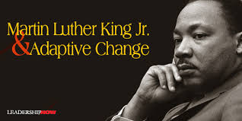
Fielder model conclusion (A04)
Fielder did not believe that leaders were very good at changing or even adapting their style, making it difficult for leaders to alter their approach to suit changing circumstances.
HUGE PROBLEM! – Q – Is he correct?

Slide 18
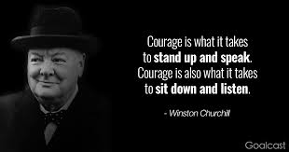
Fiedler’s model gives organisations a way to identify the best potential leaders for a particular situation, group of workers or task.
This approach also gives individual leaders an idea as to which types of situation they are best suited for. He called his approach the ‘leadership match concept’.
Q – How important is having the correct leader in the correct situation – think current situation and WW2?

Slide 19
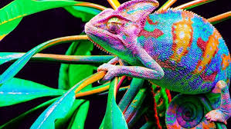
Not everything was black and white for Fiedler as he appreciated that there is a great deal of middle ground in ‘The Least Preferred Co-worker’ scale, which makes it difficult to be clear if a particular leader is task focused or relationship-focused.
Q – However these would suggest that leader can…….?

Slide 20
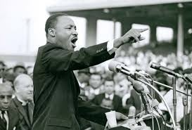
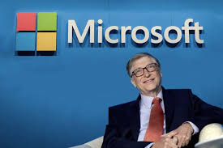
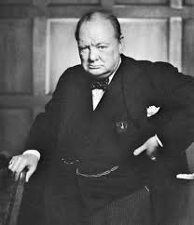
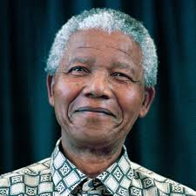
Fiedler has been criticised because he does not give enough credibility to the flexibility of leaders, since there is evidence that many leaders are quite good at adapting to changing circumstances.
(I agree)
Q – Could you provide any examples to support?

Slide 21
Activity 3 - YouTube video’s
Watch the videos below:
Nelson Mandela – The man who changed the world:
https://www.youtube.com/watch?v=tPW8iYHoy18
Churchill – The man who saved the free world
https://www.youtube.com/watch?v=uuxMZL6ieWM
Q – Ask yourself can leaders adapt to changing market circumstances?

Slide 22
Activity 4
Task:
Quiz to be completed:
‘Fielders contingency model – Please see Moodle’
Time: 10 mins

Slide 23
Wright and Taylor
P. Wright and D. Taylor believed that a lot of leadership theory was theoretically correct but did not actually show leaders how they could improve the way that they worked.
They believed that it is possible to improve a leader’s performance and that this could be done through education.
Q – What types of training could be offered? How does this impact the motivation of the worker?

Slide 24
Wright and Taylor identified two specific gaps in existing approaches to the study of leadership.
Firstly, there is not enough emphasis on what leaders actually do when they interact with their subordinates.
Secondly, the element of skill is largely ignored.
Q – If you talents were ignored how would this make you feel?

Slide 25
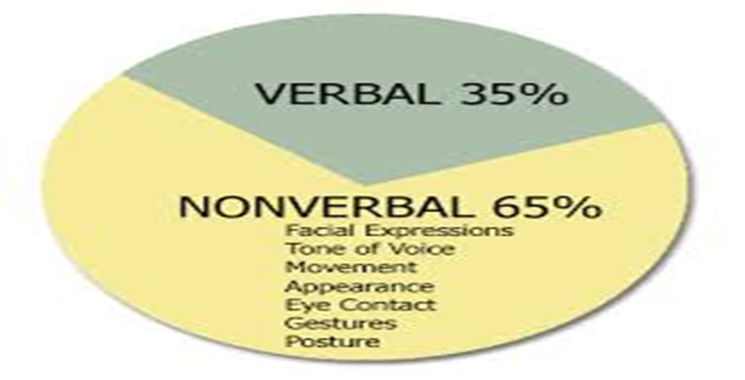
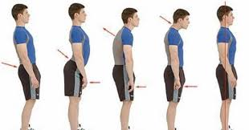
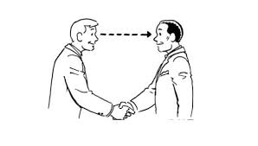
In answer to these deficiencies Wright and Taylor were concerned with improving leadership skills. The way that they did this was by providing a checklist for improving work performance.
The skills that leaders needed to learn are both verbal and non-verbal. At the same time leaders need to improve their ability to diagnose what needs to be done in any particular work situation and also to develop an accurate perception and evaluation of people and events.
Q – What is the importance of your non verbal actions?

Slide 26
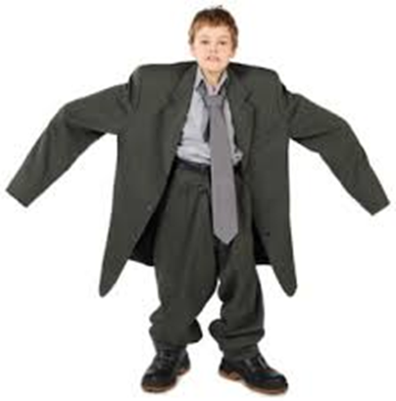
In other words they did not believe that it is possible to have a ‘one size fits all’ type of solution. Every situation requires a different and appropriate response by leaders in order to improve the performance of their followers.
Q – Therefore do they agree or disagree with Fielder?

Slide 27
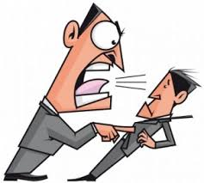
Whilst Wright and Taylor refer to autocratic and democratic leaders they believed that most people would rather work for interpersonally skilful leaders, irrespective of his or her leadership style.
Q – Therefore leadership is about ……….. Your workforce and having …?

Slide 28
Wright and Taylor – Key factors
As far as improving an individual’s performance goes, Wright and Taylor believed that ability and motivation are the key factors. An individual will not perform a task well unless they want to do it and have the necessary ability to do it.
Q – If you respect and look up to your leader you will…..?

Slide 29
If an individual is not performing well the leader will need to talk to them to find out why, then he or she will need to find skilful ways of influencing their behaviour. They recognised that this process should nearly always involve encouragement rather than punishment.
Q – How does this link to motivation?

Slide 30
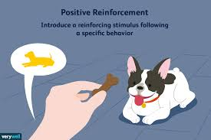
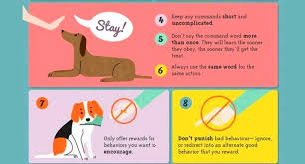
YouTube video
Watch it - The Big Bang theory – Positive reinforcement
https://www.youtube.com/watch?v=JA96Fba-WHk
Q – How did they use encouragement rather than punishment?
Q – How can this be achieved in the workplace?

Slide 31
Wright and Taylor checklist
Wright and Taylor devised the following checklist in order to help leaders analyse performance problems.
They did not expect that the checklist would, in itself, find the solution to the problem since it is likely that more information would be required.
Q – However it is a ………….. point?

Slide 32
Its main purpose is to provide a means of thinking over a problem systematically.
They also stressed that any potential solution should be considered on a cost-benefit basis since there would be no point in spending more on it than the likely savings that would be generated by it.
Q – The decision would come down to where it would increase…?

Slide 33
Checklist for improving work performance
1. What is the problem in behavioural terms? What precisely is the individual doing or not doing which is adversely influencing his or her performance?
2. Is the problem really serious enough to spend time and effort on?
3. What reasons might there be for the performance problem? (See column 1)
4. What actions might be taken to improve the situation? (See column 2)

Slide 34
5. Do you have sufficient information to select the most appropriate solutions? If not, collect the information required e.g. consult records, observe work behaviour, talk to person concerned.
6. Select most appropriate solution(s).

Slide 35
7. Is the solution worthwhile in cost benefit terms? a. If so, implement it. b. If not, work through the checklist again, or relocate the individual, or reorganise the department/ organisation, or live with the problem.
8. Could you have handled the problem better? If so, review own performance. If not, and the problem is solved, reward yourself and tackle next problem.

Slide 36
Possible reasons for the performance problem | Possible solution
Goal clarity Is the person fully aware of the job requirements? | Give guidance concerning expected goals and standards. Set targets. MBO.
Ability Does the person have the capacity to do the job well? | Provide formal training, on the job coaching, practice, secondment, etc.
Task difficulty Does the person find the task too demanding? | Simplify task, reduce work load, reduce time pressures etc
Intrinsic motivation Does the person find the task rewarding in itself? | Redesign job to match job-holders needs
Extrinsic motivation Is good performance rewarded by others? | Arrange positive consequences for good performance and zero or negative consequences for poor performance.
Feedback Does the person receive adequate feedback about his/her performance? | Provide or arrange feedback.

Slide 37
Activity 5
Task:
Kahoot quiz – Wright and Fiedler
Post your scores in Teams.

Slide 38
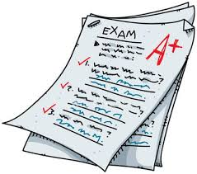
Activity 6 – Exam question’s
Task:
Your task is to complete the exam questions posted on Moodle.
Make sure you submit both in one word document please.

Slide 39
Chapter 21 – Management and leadership
Fiedler contingency model, Wright and Taylor
Tasks:
Watch the video on Fiedlers contingency model.
Read Fiedlers contingency model and consider the questions throughout.
Complete ‘Fielders Least Preferred Co worker scale’ and submit your answers.
Watch the Youtube videos attached.
Answer the Fiedlers contingency model quiz question, answers will be posted at the end of the session.
Read Wright and Taylors views on leadership theory and consider the questions throughout.
Answer the Kahoot quiz questions on Leadership and management and submit your answers.
Complete the exam questions and submit.

