Slide 1
AS Business – Unit 1 – Business Opportunities
Introduce AS Business – Examinations/ Module handbook.
Discuss the various sectors of the economy with examples.
Research the amount of SME’s in the UK and discuss your findings with the group.
In groups differentiate between needs and wants.
Show a YouTube video on entrepreneur characteristics.
Explain and discuss the key characteristics of entrepreneurs.
Complete a group Kahoot quiz on entrepreneurs and SMEs.
Read a case study on James Dyson with the group.
Research two examples of successful entrepreneurs and discuss your findings with the group.
Complete an examination question on entrepreneurs.

Slide 2
Activity 1
Task:
Introduce the structure of A Level business to the group.
Time: 10 mins

Slide 3
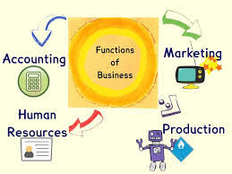
A Level Business
Examinations (AS):
Unit 1 - Business Opportunities
Daniel Tregoning/ Nicola Hunter - 40% of AS grade
1.15 mins examination – May 2021
Unit 2 - Business Functions
(Dan Tregoning/ Nicola Hunter) – 60% of AS grade.
2.00 hour examination – May 2021

Slide 4
Unit 3 - Business Strategy
Nicola Hunter – 50% of A2 grade.
Examination – 2.15 mins – June 2021
Unit 4 - Business in a Changing World
Daniel Tregoning – 50% of A2 grade.
Examination - 2.15 mins – June 2021

Slide 5
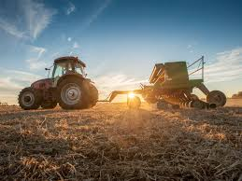
Activity 2
Task:
What are the three sectors of the economy?
Time: 5 mins

Slide 6
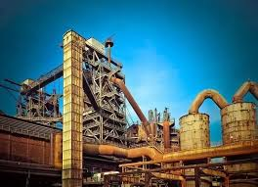
Enterprise and business planning
Business activities have a major impact on our lives – both as consumers and employees.
Business is in every sector of the economy:
Q – What are the three sectors of the economy?
Q – Is anyone an employee and a consumer?

Slide 7
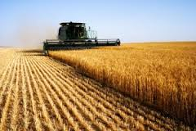
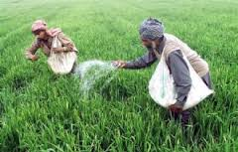
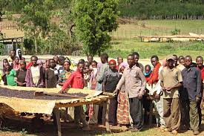
Sectors of enterprise
In the primary sector :
Enterprises provide the food we need, farming, supplying the power we use through mining or extracting oil from the North Sea.
Q – Where would you find these activities? Why?
Q – Are the employees always treated fairly?

Slide 8
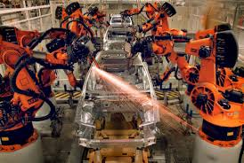
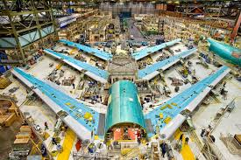
In the secondary sector :
Private enterprises provide us with a massive amount of consumer goods; manufacturing cars, processing food, making clothes, designing and producing consumer electronics, in fact all the goods that surround us in the shops we visit, that help satisfy our every want.
Q – Where is most of the global manufacturing done? Why?
Q – Do we use robotics/ humans currently?

Slide 9
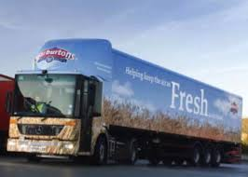
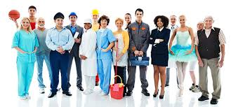
Sectors of enterprise
In the tertiary (service) sector :
Private companies provide gyms, oﬀering ﬁnancial advice, operating ﬂeets of buses and trucks, prepare marketing campaigns and so much.
Q – Where is this sector in growth?
Q – Which sector do your parents work in?

Slide 10
SME’s in the U.K
• In the UK there are almost 5 million separate businesses, employing a total of 24 million people.
• Of these businesses, over 3.3 million are sole traders.
• There are around 500,000 businesses that are partnerships.
• There are also 1.2 million registered limited companies.
• SMEs (small and medium-sized enterprises) employ around 14.4 million people and have a combined turnover of £1,600 billion.

Slide 11
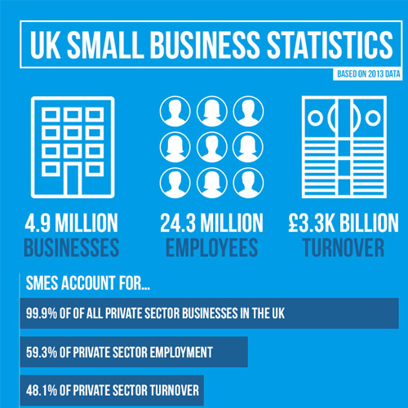
Activity 2 – Research Task
Your task is to research: (Task sheet)
How many small businesses are their in the UK/ Wales?
How many people in the UK are employed in SME’s?
3. What is the combined turnover of SME’s?
4. How many sole traders there in the UK?
5. What percentage of businesses are sole traders?
Time: 10 mins

Slide 13
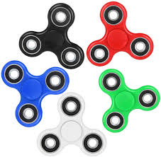
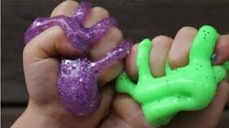
Needs and wants
Needs and wants are not fixed: they can change quickly as fashions and lifestyles change and also over the longer term as incomes increase and population changes. This means that markets are always changing. The business world does not stay still – new opportunities are constantly arising.
An entrepreneur with an idea, commitment, funds and a little luck can succeed even in the most competitive of markets.
Q – Are these on trend - Fidget spinner, Facebook (demographic), Slime?

Slide 14
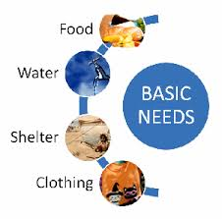
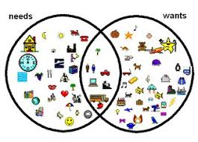
Needs and Wants
Needs:
Economists say that needs are what people require to survive.
For example, food, warmth, shelter and clothing. We could also include education, healthcare and security – being safe.
Q – What else do you consider as your basic needs?

Slide 15
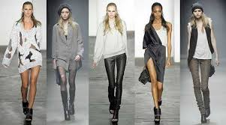
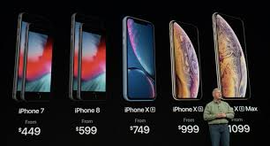
Wants
What we desire, what we would like to have.
For example, nicer clothes, not just basic functional items, a new phone every year, a massive flat screen TV, a detached house with pool, holidays in the Maldives etc
Q – What do you want? – Do you need this to survive?
Q – During Covid-19 – What was in highest demand?

Slide 16
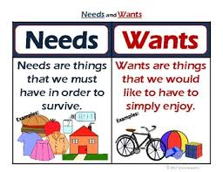
Activity 3
Task – Needs vs Wants
You will need to organise the needs and wants.
Group discussion – Discuss your findings with the group.
Time: 10 mins

Slide 17
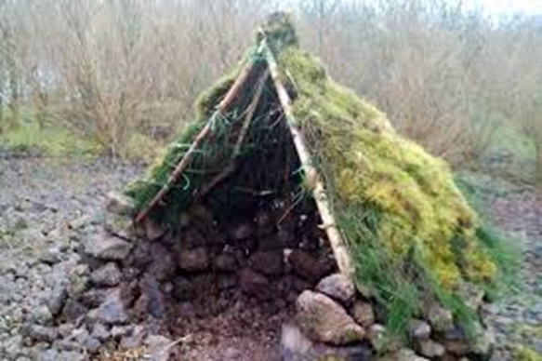
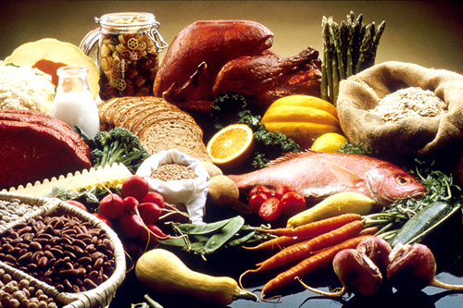
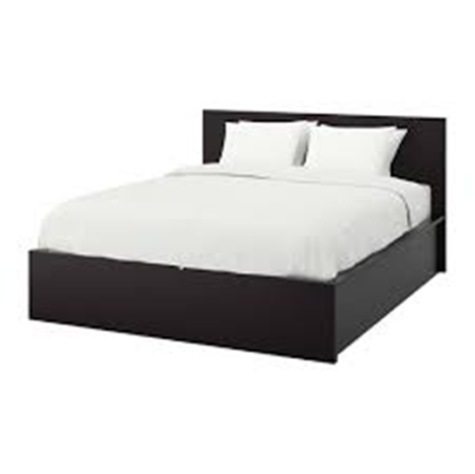
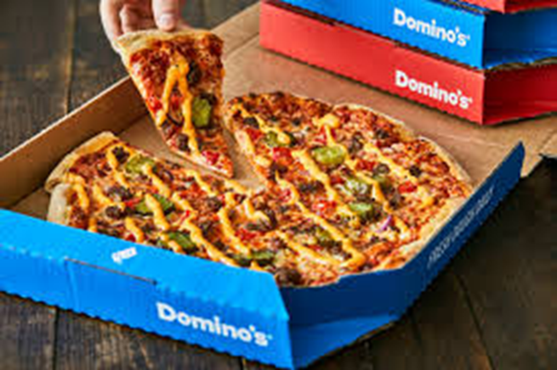
Needs
Wants

Slide 18
What is an entrepreneur ?
An entrepreneur is someone who starts and runs a business. Perhaps he or she makes a product and then sells that product, or perhaps they provide a service.
They quite possibly employ people and, of course, try to make a profit.
Q – How many small businesses fail in the first year?
Q – You have an idea but have not yet started – are you an ent?

Slide 19
Activity 4 - YouTube video’s
What is an entrepreneur:
https://www.youtube.com/watch?v=92ZmzD70sOU
Follow Your Dreams Be an Entrepreneur:
https://www.youtube.com/watch?v=udPDEXVkpSg

Slide 20
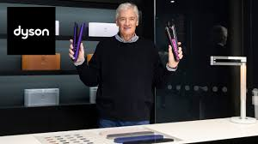
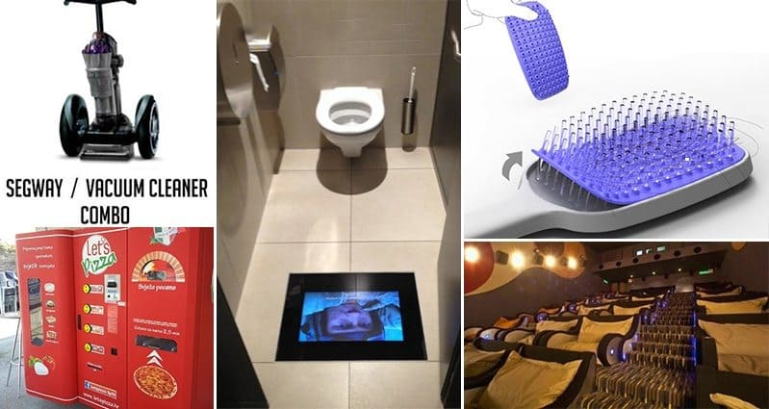
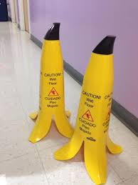
Entrepreneurs
Many countries and governments place great value on entrepreneurs and how they create wealth in an economy.
Without entrepreneurs creating innovative ideas and new
Business opportunities the economy would remain stagnant
and not grow.
Q – Could you provide any examples of entrepreneurs?

Slide 21
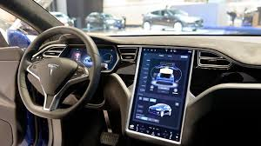
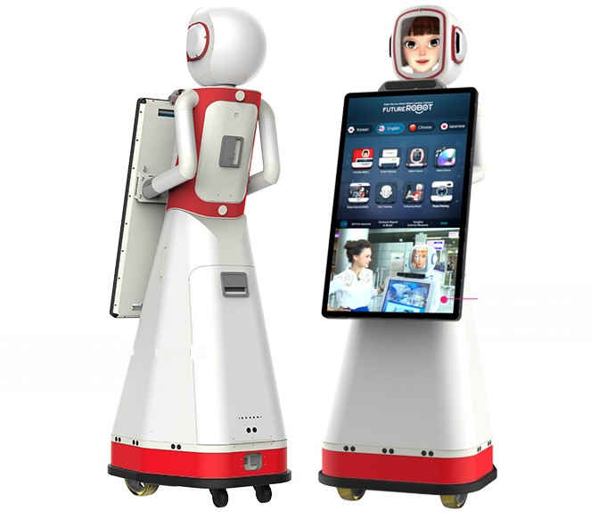
Many entrepreneurs are innovators. They bring new ideas to the market and drive the development of new technologies.
James Dyson, of Dyson vacuum cleaner is a classic example of an entrepreneur, bringing a range of new products to the market.
Q – What products do Dyson sell?
Q – Can you think of any other examples?

Slide 22
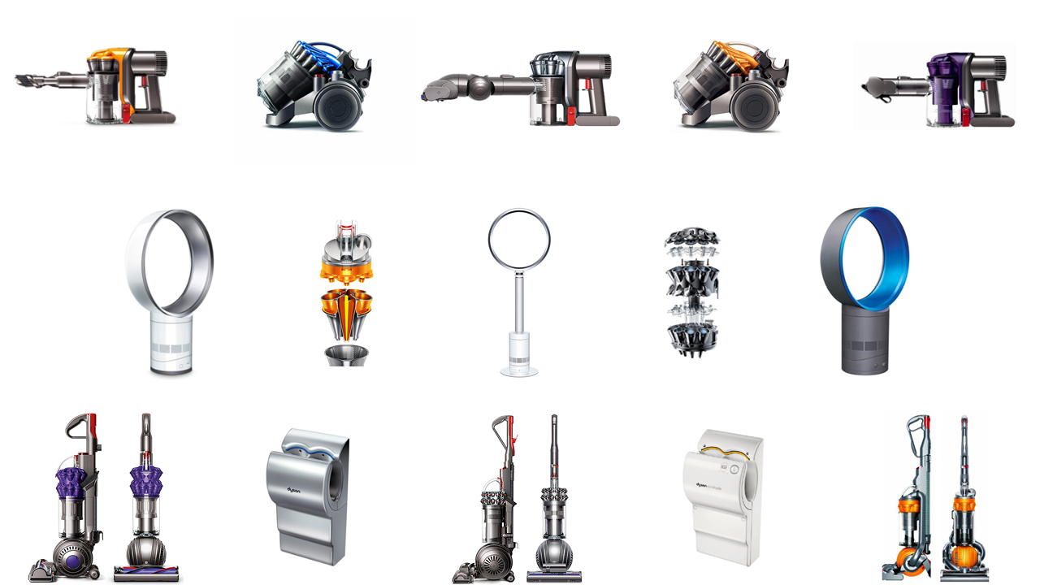
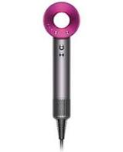
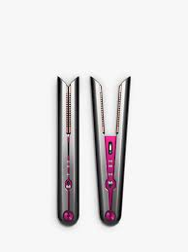
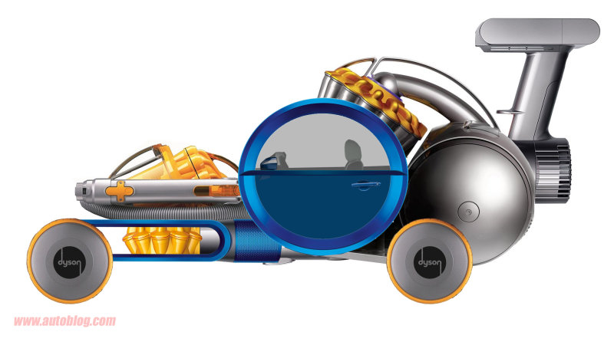
Dyson – Product portfolio
Q – Electric car for 2020? Hairdryer? Straighter?

Slide 23
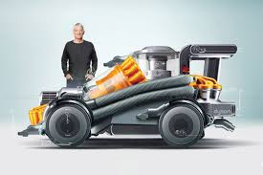
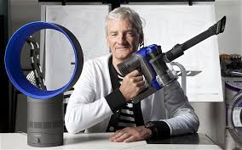
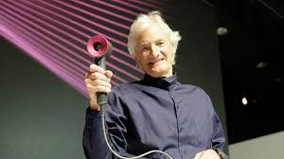
Activity 5
Task:
Read a case study on James Dyson. Use Mobile – Access via Moodle/ Teams
James Dyson – Revolutionizing the automobile:
https://www.youtube.com/watch?v=QpXKNxslr84
Time 10 mins

Slide 24
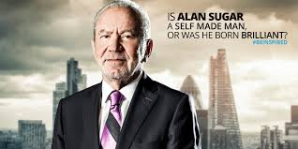
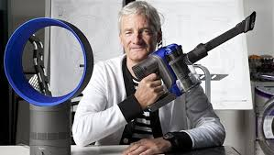
Activity 6 – Research task
Task: (A3 paper and pens)
In groups you are required to research two entrepreneurs
and present your findings to the group:
A task sheet will be provided.
Time : 10 mins and 10 mins presentations.

Slide 25
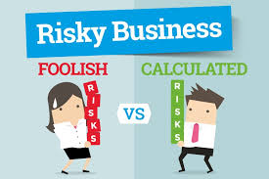
Being a risk taker (Calculated)
Entrepreneurs are not always about new products or new ideas. They are often just doing things better than they were done before.
However, they are all risk takers – they risk capital and their own time to try to create profits. They may remortgage the house, borrow from friends and family, or give up well-paid jobs to try to make a success out of their business idea.
Q – Why would you give up a well paid job to start a business?

Slide 26
Taking the initiative and being proactive
Successful entrepreneurs are able to take the initiative when required.
They do not panic and allow events to overwhelm them they are proactive and able to change as needed.
Q – How important is it to be proactive? If you do not change your business will…….?
Q – How is James Dyson proactive?

Slide 27
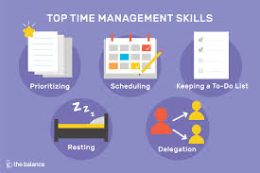
Being an effective organizer
An ability to organise effectively is central to running a business effectively.
The entrepreneur may need to undertake a wide range of activities; from hiring labour and buying inputs, such as raw materials, to producing the finished product for sale.
Q – Therefore entrepreneurs must be …………….?
Q – What can you do to help?

Slide 28
Having creativity and being innovative
Creativity in business means the ability to come up with innovative concepts and ideas, or developing a better way of doing things. Two American college students working in their college dorm in 2003 had the view that there had to be a more efficient way of gathering data for internet search engines – we now have Google, one of the biggest brands in the world!
Q – Therefore ………. can become an ….?
Q – If the idea sounds crazy then this is usually a good/ bad idea?

Slide 29
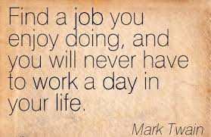
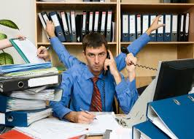
Being hard working
Successful entrepreneurs are, generally, hard working. It is estimated that entrepreneurs in the UK work for around an average of 52 hours a week, plus another 40 hours thinking or worrying about their business venture. Compare this to the average working week of 38 hours for an employed person.
Q – Do they enjoy this hard work?
Q – Does this spur them on to achieve more?
Q – What drives them to keep working?

Slide 30
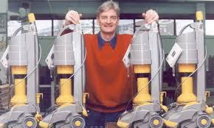
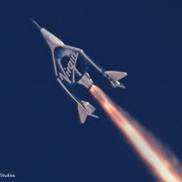
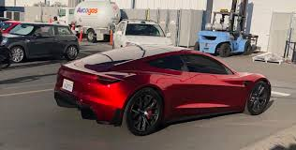
Being determined and having perseverance
Entrepreneurs also need to be determined, as new businesses have low success rates.
Entrepreneurs must also have considerable
perseverance, and be willing to keep trying if initial ideas fail.
Q – How many businesses fail in the first year?
Q – How many prototypes did James Dyson make?

Slide 31
Activity 7 - YouTube video
15 signs that you are an entrepreneur
https://www.youtube.com/watch?v=Jj1898au6C4
Q – Hands up – Who thinks they hold some of
these characteristics?

Slide 32
Activity 8
Task:
Kahoot quiz questions – Entrepreneurs
Time: 10 mins

Slide 33
Activity 9
Task:
Past paper questions – Entrepreneurs
Time : 20 mins

Slide 34
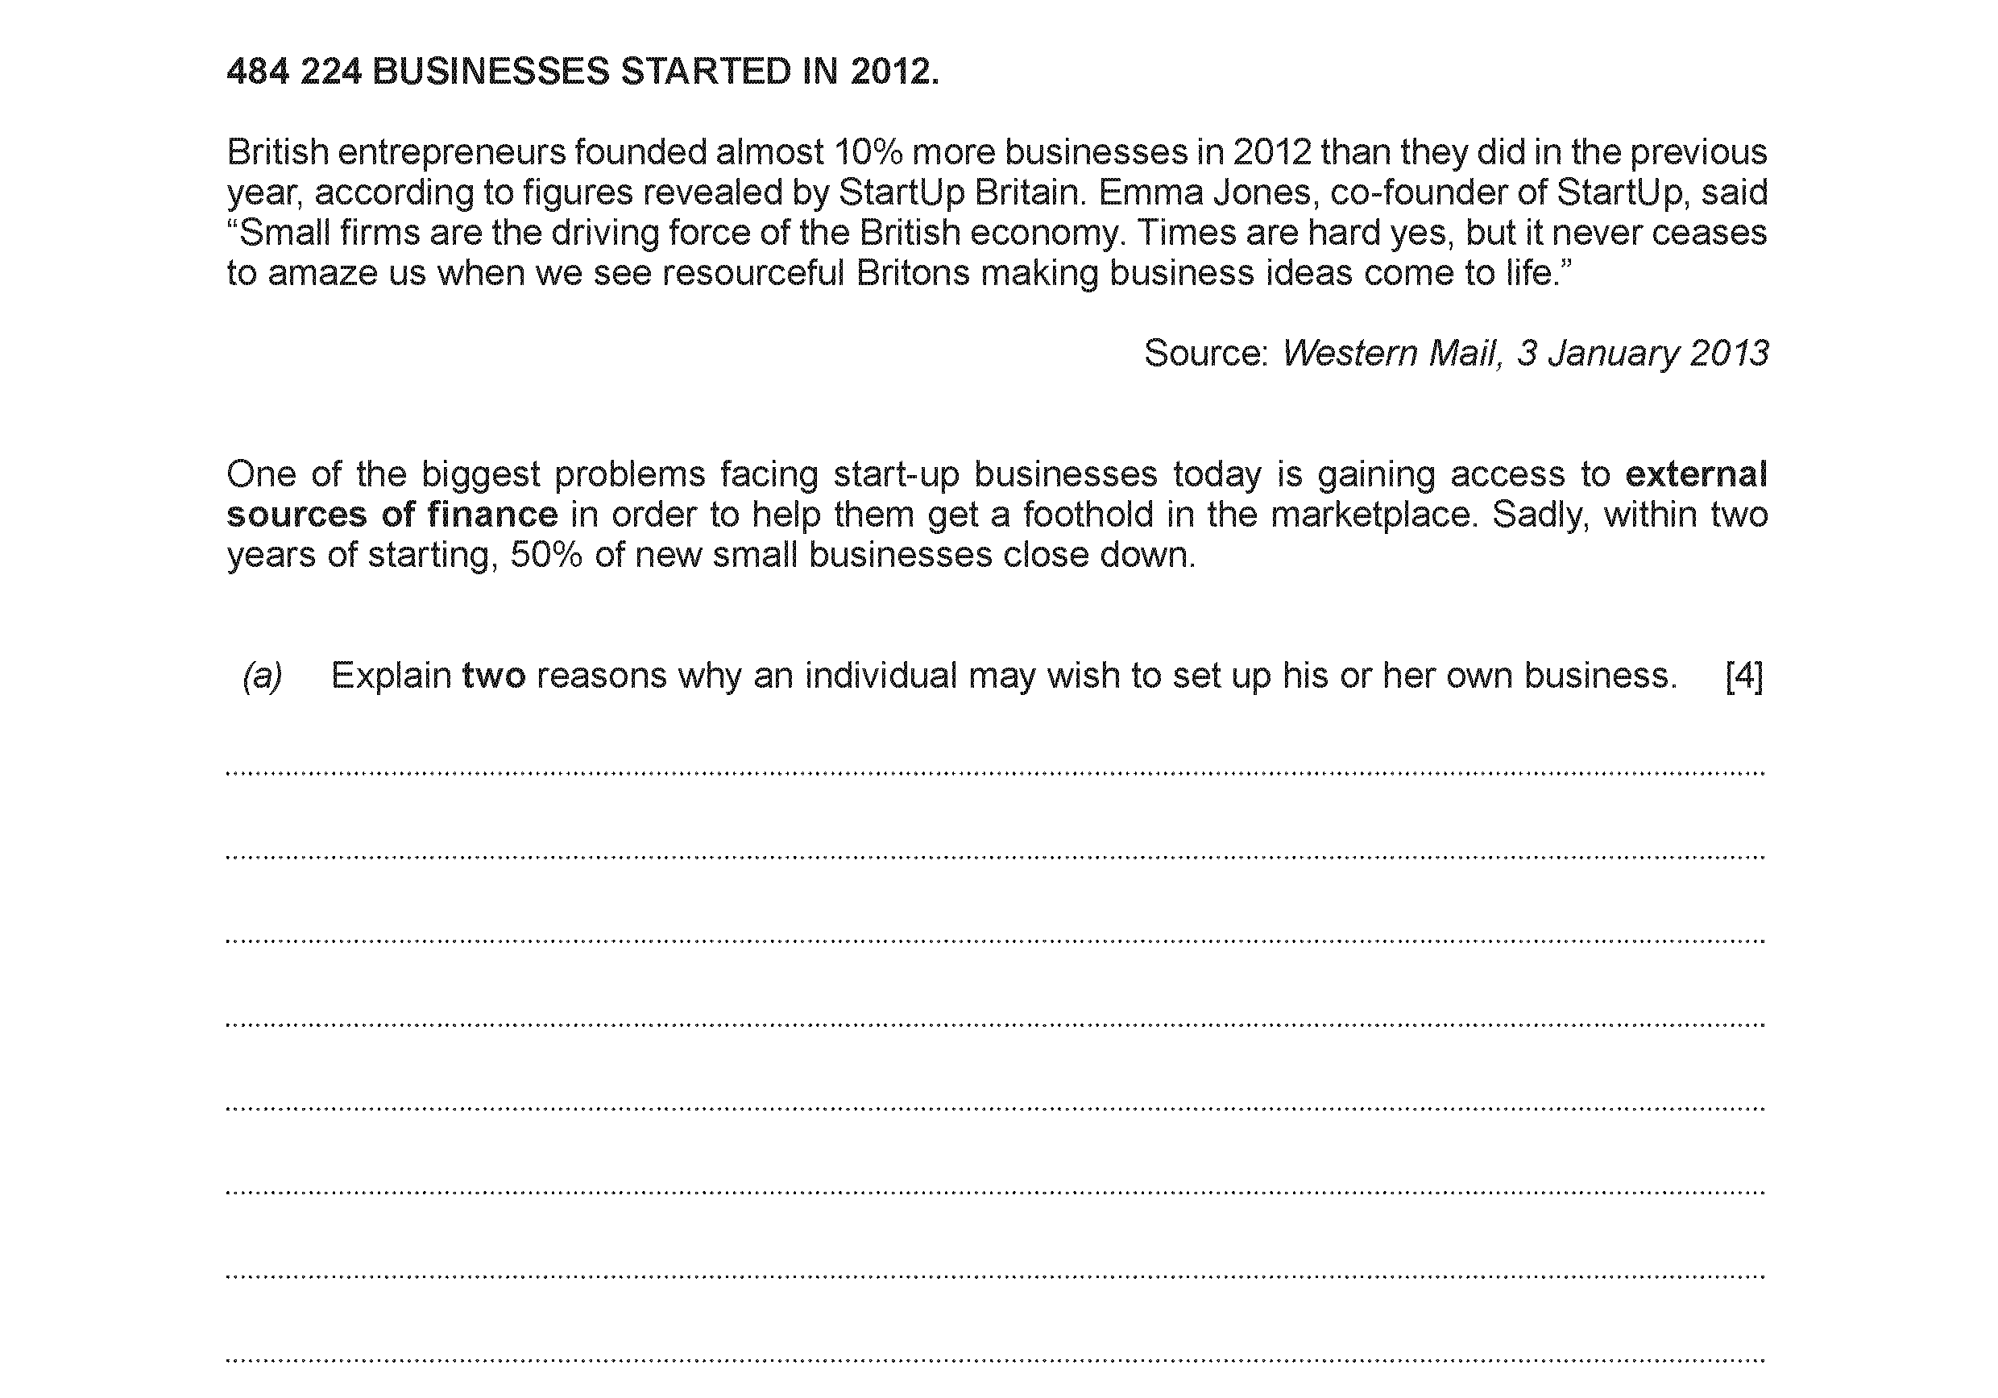

Slide 35
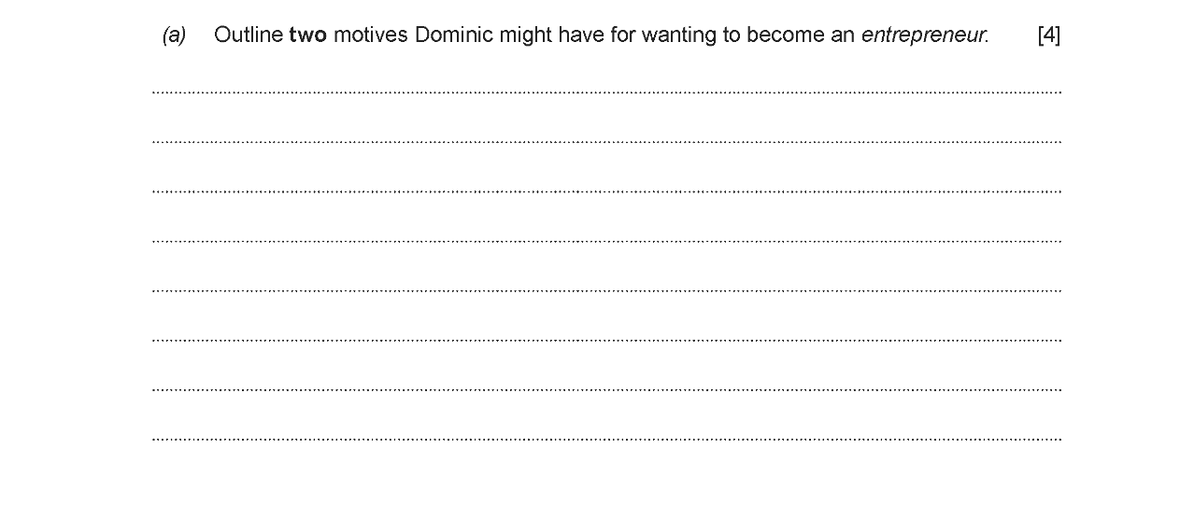

Slide 36
Homework tasks/ Online
Tasks:
Complete an Exam question and submit your answers
in next weeks session.
2. Read – Two entrepreneur examples – Lord Sugar/ Duncan Bannatyne

Slide 37
AS Business – Unit 1 – Business Opportunities
Introduce AS Business – Examinations/ Module handbook.
Discuss the various sectors of the economy with examples.
Research the amount of SME’s in the UK and discuss your findings with the group.
In groups differentiate between needs and wants.
Show a YouTube video on entrepreneur characteristics.
Explain and discuss the key characteristics of entrepreneurs.
Complete a group Kahoot quiz on entrepreneurs and SMEs.
Read a case study on James Dyson with the group.
Research two examples of successful entrepreneurs and discuss your findings with the group.
Complete an examination question on entrepreneurs.

