Slide 1
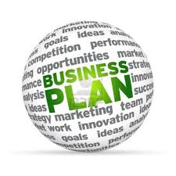
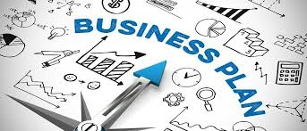
Chapter 2 – Business planning
Answer the entrepreneur revision buzzer quiz questions.
Discuss how to spot and analyse business opportunities.
Research business opportunities in the local area.
Explain the importance of business planning and discuss the key elements of a business plan.
Show YouTube video’s on how to create a business plan.
Discuss Business Wales guide to business plans.
Answer the Kahoot quiz questions on business plans.
Read the two articles on business planning.
Evaluate business planning by completing a business plan past paper question.

Slide 2
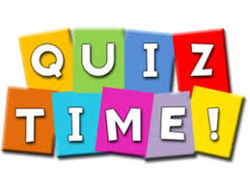


Activity 1 - Buzzer quiz (Recap)
What is an enterprise? (1)
What is an SME? (1)
Why are SMES important to the U.K economy? (2)
What is the difference between a need and a want? (2)
Provide an example of an entrepreneur and
explain how they started their business? (2)
6. What are the key characteristics of an entrepreneur – Explain each? (2)

Slide 3



Identifying business opportunities
Potential business opportunities occur when a market need exists. This market need is preferably one that has not yet been targeted or not yet been targeted effectively.
Therefore, a new entrepreneur wanting to start and run a successful business will need to find a product or service that isn’t already available, or one that can be improved on. A starting point might be to find out what is missing in the local area.
Q – How could you improve the car/ mobile phones/ games console?

Slide 4

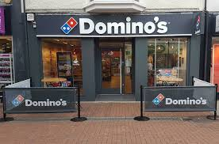
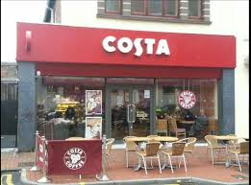
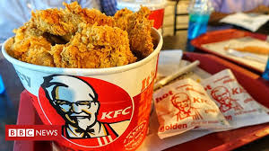

Activity 2
Task: Using your mobile phone – Analyse the Neath Market:
What is missing?
What could you change?
3. Have any businesses recently joined or left the market?
4. Is there room for a product/ service?
Each group presents findings
Time: 10 mins

Slide 5


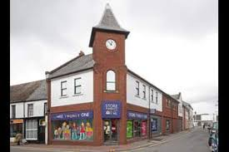

Another way of investigating opportunities might be to ask the question: ‘What can be offered to other businesses that would help them increase their sales, improve their service, or reduce their costs?’
A business can service other businesses. These other businesses have customers who are different businesses. They may supply office equipment, cleaning, marketing services, transport, IT services, financial services etc.
Q – THINK – Port Talbot – TATA/ Hairdressers, corner shops etc?

Slide 6


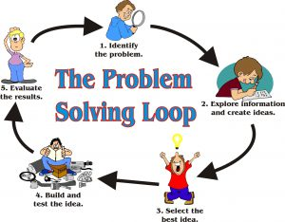


Sometimes identifying a potential business opportunity can occur through word of mouth OR personal experience.
Are people complaining about lack of access to a product, or describing a need, or criticising a business? All of these could present an opportunity.
Q – Can you think of an issue you could solve?

Slide 7
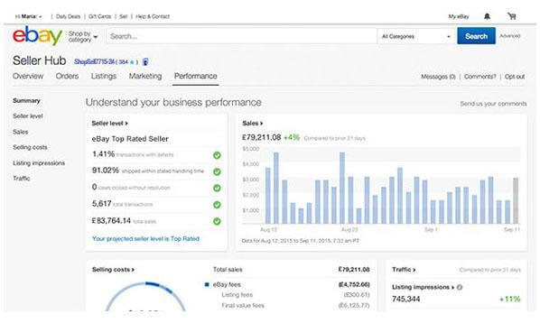
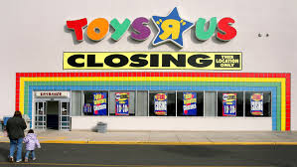

Many new businesses are based on accessing customers through new market places – products or services can be bought here.
Moving away from bricks and mortar reduces costs and allows prices to be cut. Obviously the internet is the best example of this – Amazon and Ebay are prime examples of new businesses which are based on price, buying opportunities and convenience.
Q – Has anyone ever sold on Ebay/ Amazon?

Slide 8



However, it is not only big businesses who can succeed through this method.
The example of Foulgers Dairy shows how a small firm targeting a specific market (raw milk) can take advantage of new ways of accessing customers nationwide.
Q – How difficult is it to set up an Ebay account and start business?

Slide 9
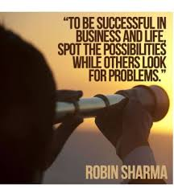

Activity 3 – YouTube videos
Entrepreneurship – Spotting opportunities:
https://www.youtube.com/watch?v=cBGPd2PV_jA
Entrepreneurship is about spotting opportunities:
https://www.youtube.com/watch?v=LctfWCH5j0w
Q – Do entrepreneurs ever stop looking for opportunities?

Slide 10
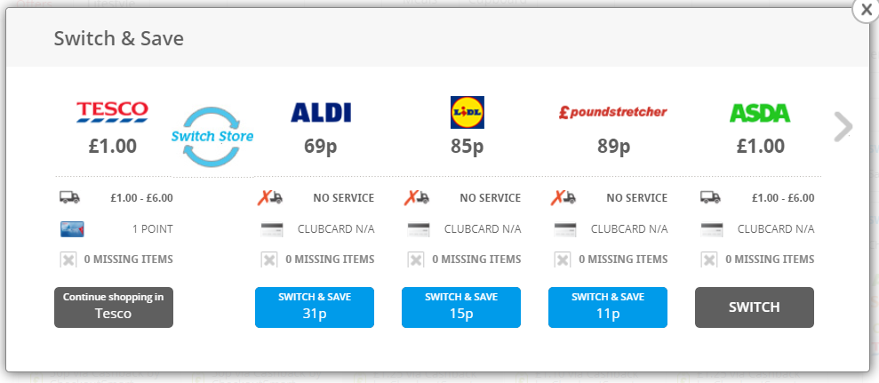

Often new businesses are founded on the idea of how innovative methods could help meet a need.
For example, is there a kind of website or app that would improve what is already available or make it a more efficient process? Comparison websites have changed the way people buy insurance, book holidays and hotels, choose electrical goods etc.
Q – Have you ever used a price comparison website?
Q – What want did this fill?

Slide 11

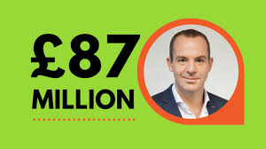

MoneySavingExpert, which covers the whole range of financial services and shopping, was founded by a sole trader – Martin Lewis. The site is focussed on allowing consumers to access the best deals on everything from buying cars to the weekly shop.
Martin Lewis founded MoneySavingExpert.com in 2003 for £100. It’s now the UK’s biggest money site, with over 14 million monthly users.
Q – What did Martin spot?
Q – What characteristics did/does he possess?

Slide 12
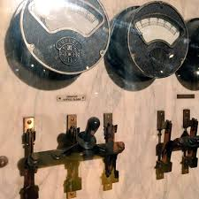
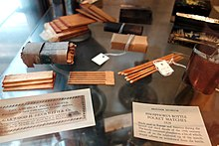

Finally, business opportunities can come from an entirely new product developed by the entrepreneur/ inventor.
Fortunes used to be made by inventors working with limited resources, but times have changed, with most new consumer products now coming from mega corporations.
Q – Why are big corporations now taking control?

Slide 13
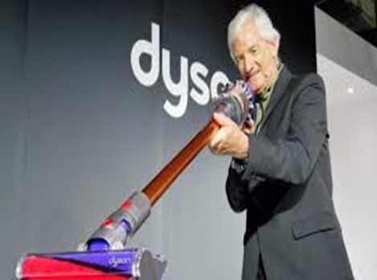



However, exceptions still occur. Worldwide success and the rapid growth of small businesses (or even one-man bands) have come through using marketing platforms such as the ITunes Store and the Android Market to promote and sell apps.
Q – Has anyone developed or has an idea for a new app?

Slide 14
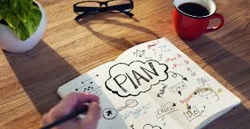

We have seen then that there are a number of ways of identifying where the potential lies when establishing a business. But whatever the business and however the opportunity has arisen, the next stage for the budding entrepreneur is to prepare a business plan.
Q – Can you succeed in business without a business plan?
Q – Does it increase the chance of success?

Slide 15

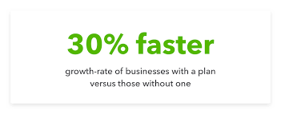
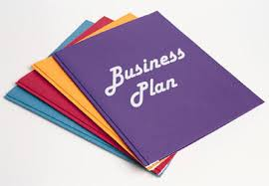
Activity 4
Task: Using A3 paper and pens answer the following questions:
What is a business plan ?
What are the key sections of a business plan ?
(Explain each section)
3. What are the advantages and disadvantages of business planning?
Time : 10 mins

Slide 16
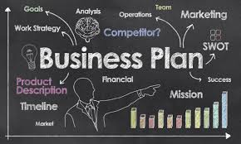
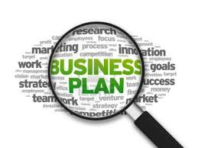

Developing a business plan
The business plan makes clear the objectives of the business and how the business intends to achieve these objectives. A business plan is often likened to a map.
This road map analogy is important – business plans are not to be written and forgotten, they are ongoing.
Q – Why are business plans ongoing?
Q - What if the are to rigid and do not adapt to change?
Q – Do they guarantee success?

Slide 17
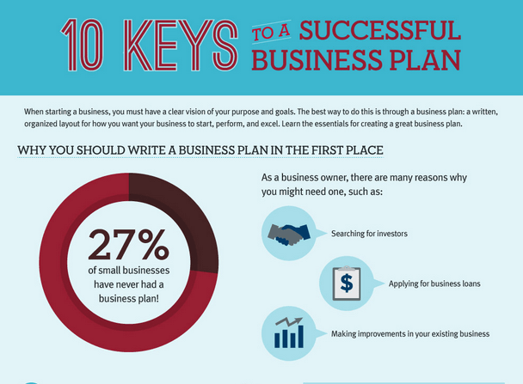
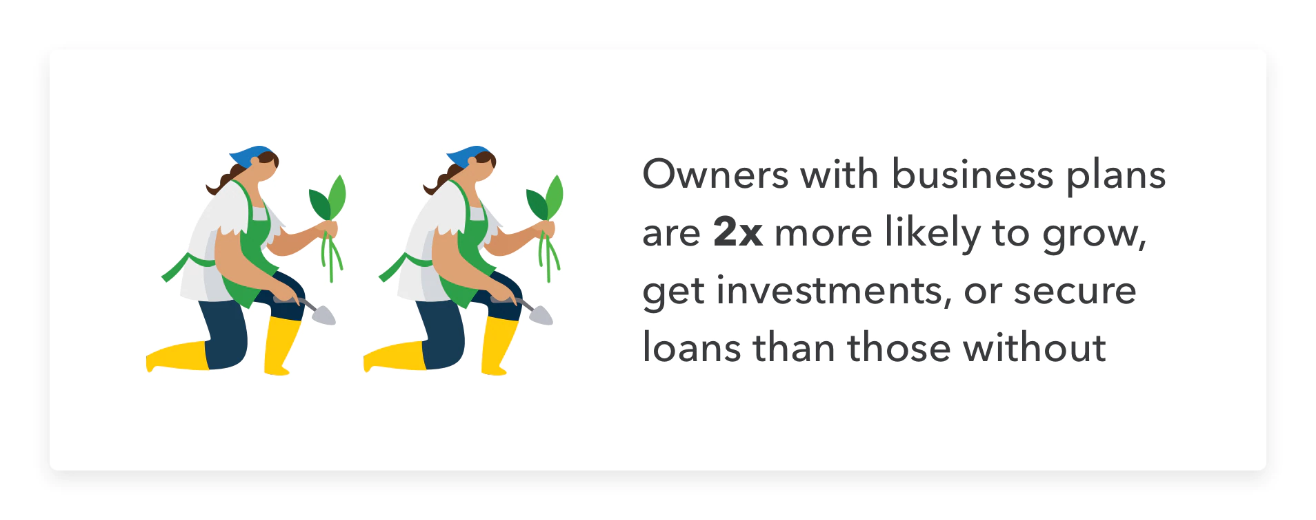
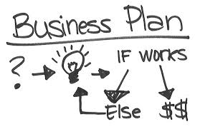
Developing a business plan
The objectives that are set – whether financial, sales, marketing or production – are there for future guidance and not to be ignored.
Start-up businesses that develop and follow a business plan are more likely to survive than those who do not.
Q – Do they guarantee success?
Q – What is the point then? – Investment, tracking goals?

Slide 18

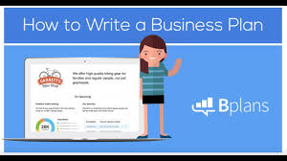
Activity 5 - YouTube video’s
How to write a business plan:
https://www.youtube.com/watch?v=PDWvcsTloJo
How To Write a Business Plan To Start Your Own Business:
https://www.youtube.com/watch?v=Fqch5OrUPvA
Q – Has anyone ever written a business plan (parents)?

Slide 19

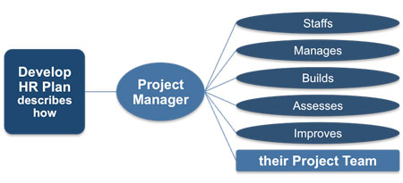

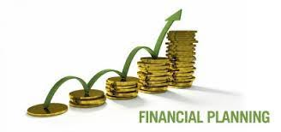
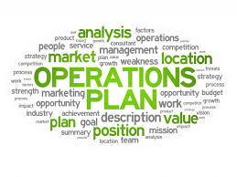
Business plan key sections
Executive summary
Marketing plan
Operations plan
Human resources plan
Financial plan

Slide 20


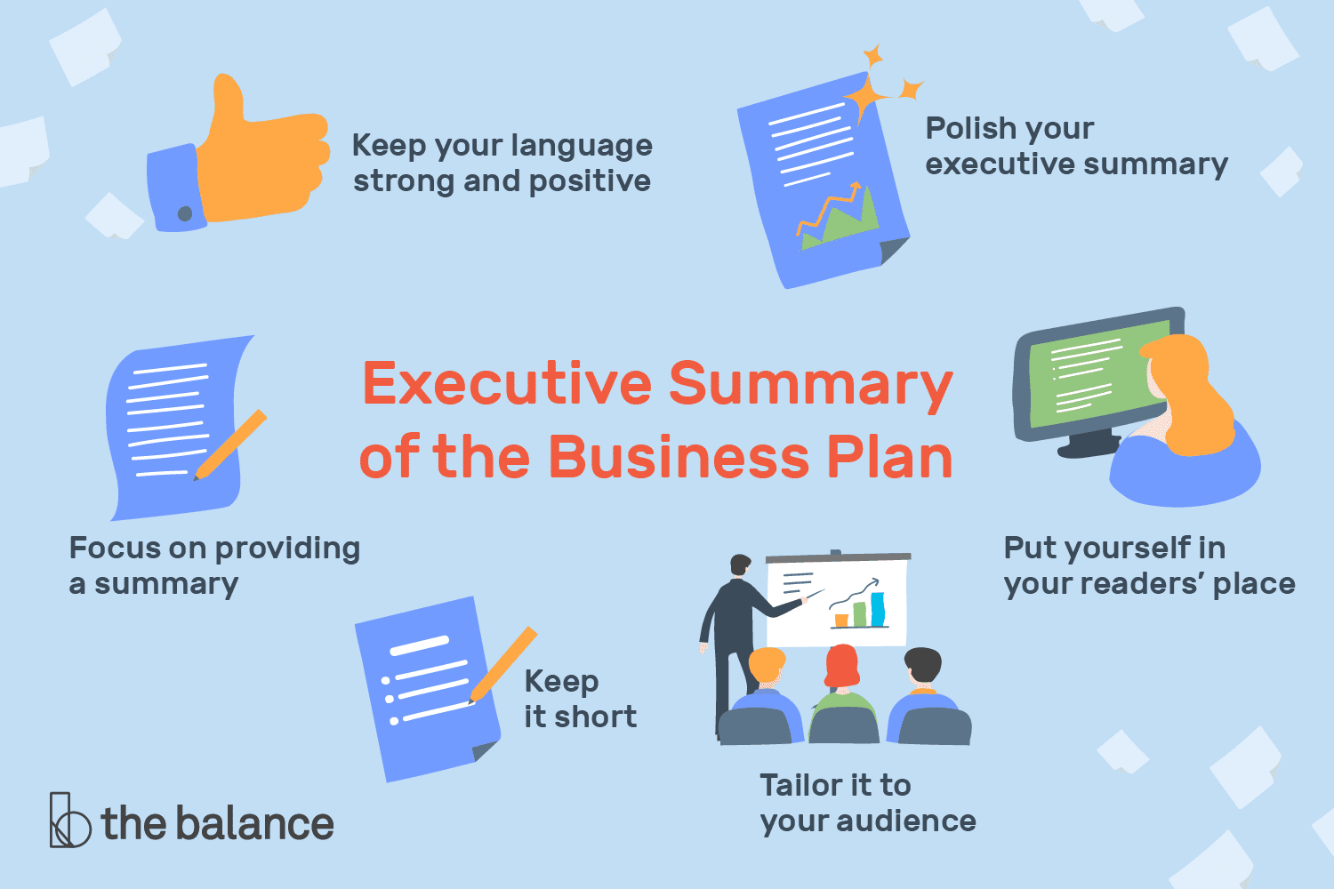
Executive summary
When preparing a business plan the entrepreneur should first of all clearly describe the business idea. This overview of the business will briefly describe the business opportunity that is to be exploited.
It should summarise the strategies that will be employed and how finance will be obtained.
Q – How important is this section?
Q – When should it be written?

Slide 21


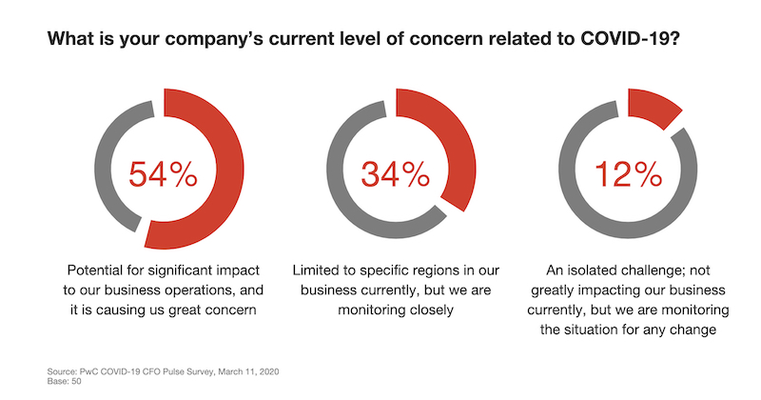
Executive summary
This overview is very important in setting out the overall aims and objectives of the business. There is no set pattern for a business plan but there are key elements that need to be included.
The plan needs to be flexible and able to adapt to changing market circumstances.
Q – What external factors can businesses react to?

Slide 22
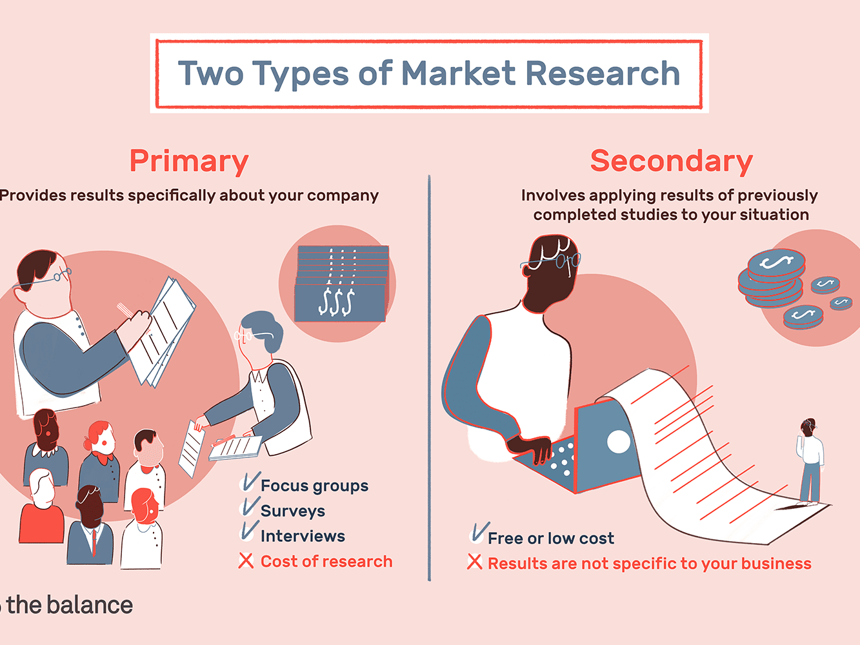

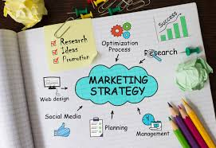
The marketing plan
This is an important part of any business plan and it should be based on both field and desk research.
The market research carried out needs to establish if possible the size of the market, the needs of the customers and the level of competition.
Q – Can you provide examples of field and desk research?
Q – Which would you undertake first? Which is more important?

Slide 23
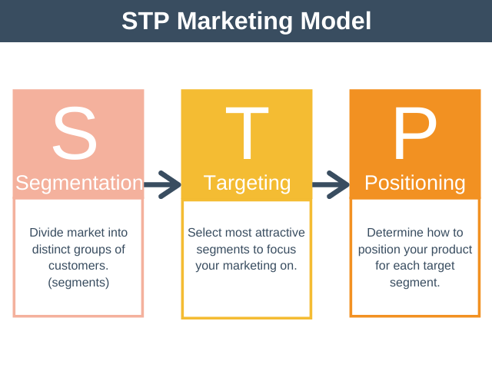

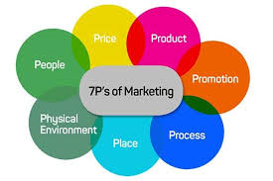
The marketing plan
Once market research findings have been examined then the marketing plan (strategy) can be prepared.
If market research has identified weaknesses with the initial idea, this may be the time to adapt the product to more closely meet the needs of the customer or clearly differentiate it from the competition.
Q – What are the 4/7Ps of marketing?
Q – Therefore you product/ service must have a U..…?

Slide 24


The operations plan
This will include details of where the business will be located, production methods and any equipment needed.
In addition, information on the costs of production and where the business will buy supplies may also be included.
Q – Whatt is the benefit of working from home?
Q - Why would you have alternative suppliers?
Q – Does all of your equipment need to be brand new?

Slide 25

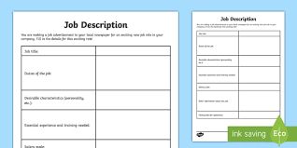

The human resources plan
The number of employees and the skills, experience and qualifications they require will be outlined.
Any management team will also be identified.
Q – What documents would be included?
Q – Would a sole trader require a management team?

Slide 26




The financial plan
A variety of forecasting will be necessary:
A sales forecast indicating potential revenues
A cash flow forecast for the first 12 months
A profit and loss and balance forecast for the end of the first year
A break even analysis.
Q – What is turnover/ Revenue? What is break even?
Q – The financial plan is based on………?

Slide 27
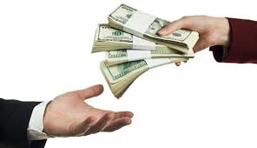

The financial plan
In addition, information should be provided on where the finance for starting and running the business will come from.
This will indicate the available start-up capital as well as any potential borrowing.
Q – What sources of finance are available?

Slide 28

Activity 6
Tasks:
Read - Importance of business planning article.
Access help available for business planning:
https://www.gov.uk/write-business-plan
http://business.wales.gov.uk/starting-business/starting-business-0/
preparing-business-plan
Time: 10 mins

Slide 29

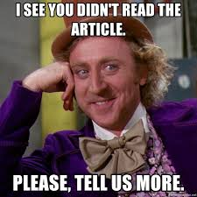
Activity 7
Task:
You are required to read the two articles below:
‘15 reasons why you need a business plan’.
‘14 pros and cons of a business plan’.
Use your mobile to access article via Moodle.
Highlight the key points – Read in pairs
Time: 10 mins

Slide 30
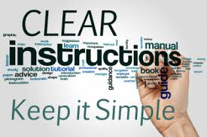
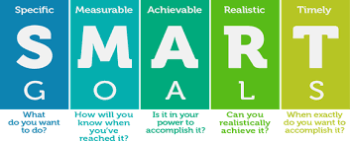
Advantages of a business plan
When complete the business plan presents the business owners with a clear set of instructions on how to run the business.
Q – Could these be out of date when written?
Q – How do you overcome this?
A comprehensive business plan will allow business owners to check progress against objectives, monitor cash flow and take action when objectives are not being achieved.
Q - What if the objectives are unrealistic?
Q – Objectives should always be SM……?

Slide 31


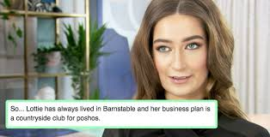
Business owners can clearly see when things are going wrong. A business plan is also needed for potential investors or when seeking finance from banks. Without a business plan it is highly unlikely that capital could be attracted from people or institutions outside of the business.
Q – How can you increase the chances of investment?
Q – Are you guaranteed to get finance? Does it increase the chance?

Slide 32


Disadvantages of a business plan
Market research costs time and money, resources which might be better spent elsewhere in the business.
Q – Can you succeed without undertaking market research?
For many start-up businesses this will be the hardest part of preparing a business plan. How do you predict what your income will be? Market research should provide an idea, but how reliable is the data?
Q – What if you did not have any aims or objectives?

Slide 33



Disadvantages of a business plan
The estimate of sales revenue, money flowing into the business, should be based on accurate market research, but the truth is that most new businesses will at best be making an educated guess on how much money will be generated. The need for this guesswork is a potential weakness of any business plan.
Q – How likely are you to receive finance without a business plan?

Slide 34
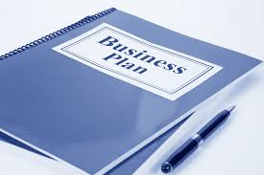
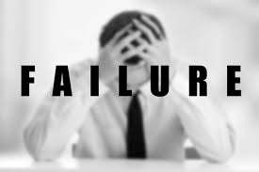
Inaccurate business plans
An inaccurate business plan with unachievable objectives can give entrepreneurs false hope, leading to failed investments.
Some experienced entrepreneurs have enough market and business knowledge to move from year to year without reference to marketing plans, or financial forecasts, and they do happily survive.
Q – Therefore do you NEED a business plan to start a business?

Slide 35
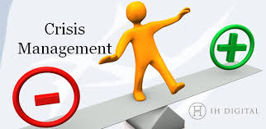

Business plans
However, for such businesses growth is unlikely without forward planning. Identifying and adapting to change in the market may then result in crisis management.
Q – Does a business plan guarantee success?
Q – Are they worth it in the long run?

Slide 36


Activity 7
Task:
Answer a Kahoot quiz on Business planning.
Time: 10 mins

Slide 37


Activity 8
Task:
Complete a business plan past paper question.
Hand in your work to be marked at the end of the session.
Time: 30 mins

Slide 38
Chapter 2 – Business planning
Answer the entrepreneur revision buzzer quiz questions.
Discuss how to spot and analyse business opportunities.
Research business opportunities in the local area.
Explain the importance of business planning and discuss the key elements of a business plan.
Show YouTube video’s on how to create a business plan.
Discuss Business Wales guide to business plans.
Answer the Kahoot quiz questions on business plans.
Read the two articles on business planning.
Evaluate business planning by completing a business plan past paper question.

