Slide 1
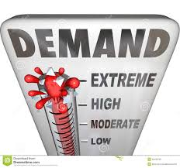
Demand and supply - Aims and objectives
Discuss the definition of demand and the law.
Explain the law of demand and show a demand curve.
Show YouTube videos to help explain the law of demand.
Discuss in groups the definition of supply and the law.
Explain the law of supply and show a supply curve.
Show how to calculate the market equilibrium price.
Research factors that have recently impacted demand.
Describe how the STIGCAP factors affect demand. curve.
Show a YouTube video analysing the factors that affect the demand curve.
Examine and evaluate how the STICAPEW factors
affect demand by completing an exam question.
Answer Kahoot quiz questions on demand and supply.

Slide 2
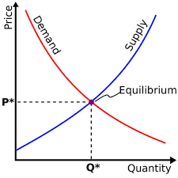
Activity 1
Task: (A3 paper and pens)
What is demand?
What is the law of demand?
Draw a demand curve and label the diagram.
Time : 10 mins

Slide 3
Demand
Demand is the amount of a product that consumers are willing and able to purchase at any given price. It is assumed that this is effective demand, i.e. it is backed by money and an ability to buy.
Q – What are you willing and able to purchase – Is there a difference?

Slide 4
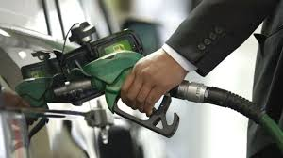
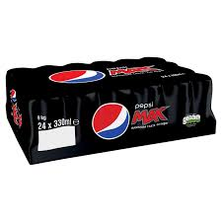
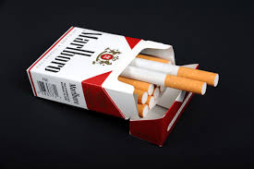
The law of demand
The law of demand states that:
The higher the price, the lower the quantity demanded; and the lower the price, the higher the quantity demanded.
Naturally, consumers are willing and able to buy less as the price rises.
Q – Does this law work with all goods?

Slide 5
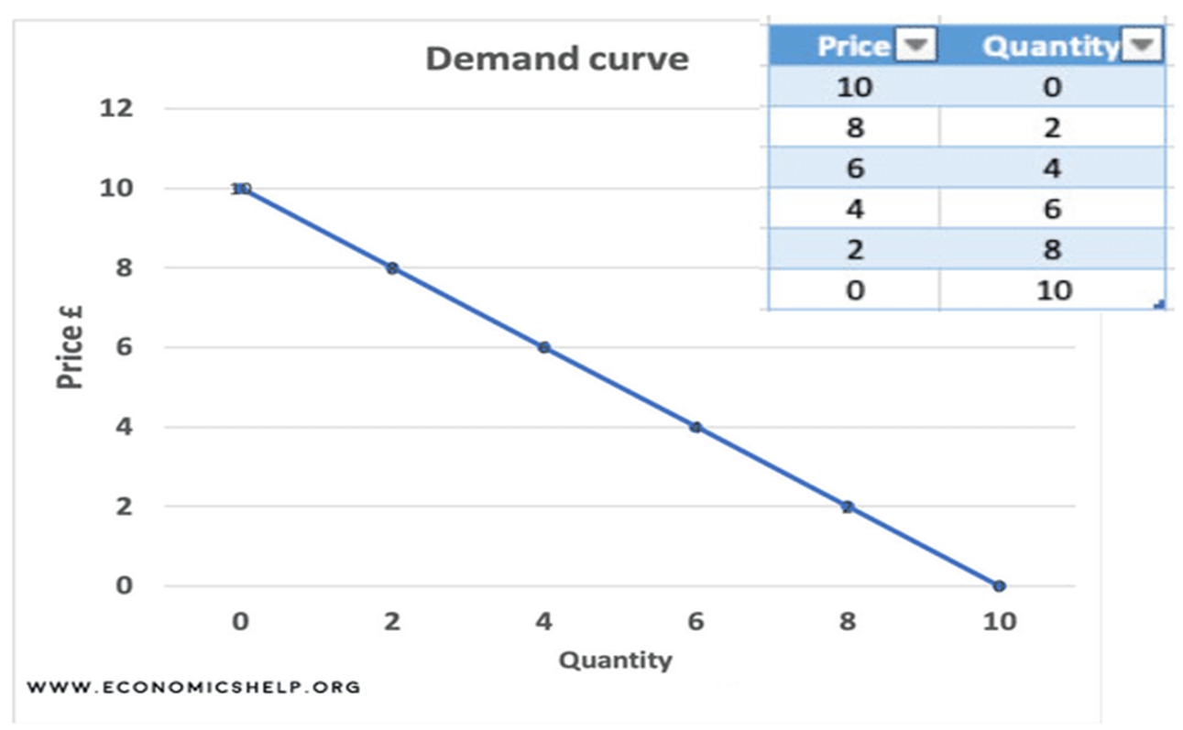
Demand curve
This results in a downward sloping demand curve.
Movements along the demand curve are therefore caused by changes in price.
Q – How much is a can of pepsi?

Slide 7
Activity 2 - YouTube video’s
https://www.youtube.com/watch?v=kUPm2tMCbGE
https://www.youtube.com/watch?v=QvGLcCTXk9o

Slide 8
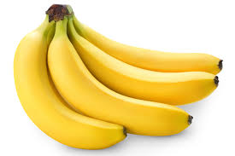
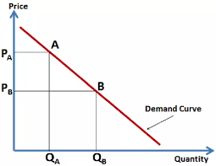
Activity 3
Task:
Draw a demand curve for a banana – Using graph paper
You will need to add:
Price 1 – 50p, Price 2 – 75p, Price 3 – £1.00, Price 4 - £1.25
Quantity 1 – 4, Quantity 2 – 3 , Quantity 3 – 2, Quantity 4 – 1
Time: 10 mins

Slide 9
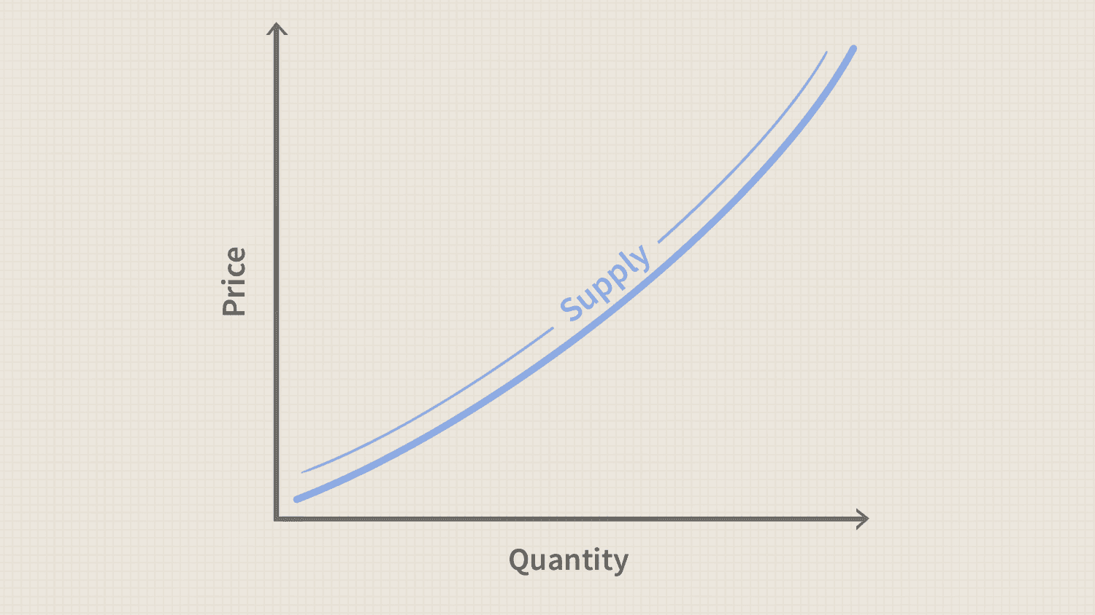
Activity 4
Task: (A3 paper and pens)
What is supply ?
2. What is the law of supply?
3. Draw a supply curve? – Is it upward or downward sloping?
Time: 10 mins

Slide 10
Supply (Businesses)
Supply is the amount of a product which suppliers will offer to the market at a given price.
As the price of an item goes up, suppliers will attempt to maximize their profits by increasing the quantity offered for sale.
Q – Why do you supply goods and services, to make a ….?

Slide 11
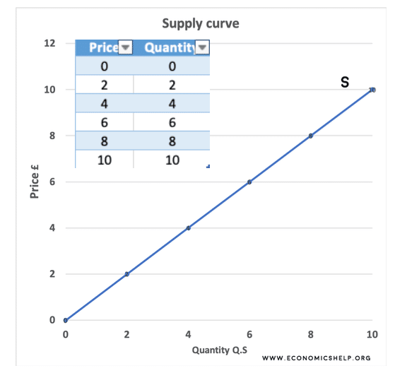
The law of supply
This means that the lower the price, the lower the quantity supplied; and the higher the price, the higher the quantity supplied.
Q – Why do you supply less as the price decreases?

Slide 12
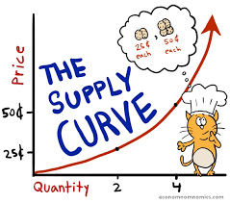
Supply
As price increases, the profit motive attracts new resources to supply and the higher price allows less efficient producers to make a profit.
So as price increases, supply increases.

Slide 13
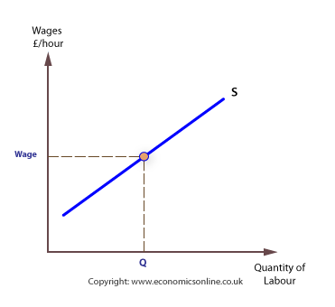

Slide 14
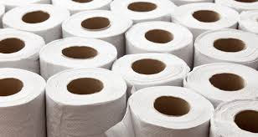
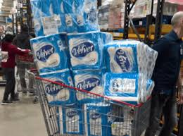
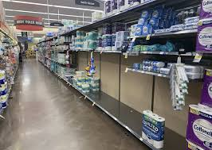
Activity 4 - YouTube video
Supply:
https://www.youtube.com/watch?v=nKvrbOq1OfI
Toilet paper: https://www.youtube.com/watch?v=qyiDDPvyN_I
Q – When the price of oil is high, why is it attractive to
Less efficient producers?
Q – What happened to the supply of face masks, hand sanitisers, toilet paper during Covid-19?

Slide 15
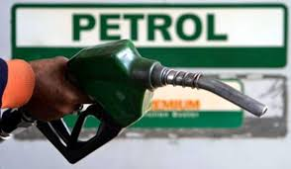
Activity 5
Task:
1. Draw a supply curve for petrol – Using graph paper
2. You will need to add:
Price 1 – 102p, Price 2 – 104p, Price 3 – 106p, Price 4 - £125p
Quantity 1 – 100 barrels, Quantity 2 – 200 barrels , Quantity 3 – 300
barrels, Quantity 4 – 400 barrels
Time: 10 mins

Slide 16
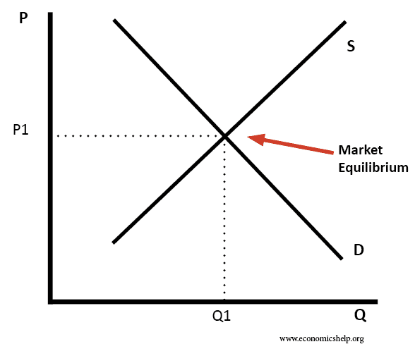
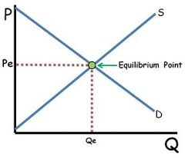
Equilibrium
Where the demand curve and the supply curve intersect, we have a point where the quantity that consumers are willing to purchase matches the quantity that suppliers are willing to supply at a given price.
This point is known as the market equilibrium.

Slide 17
Equilibrium
From the market equilibrium we can derive market price and market quantity. This market equilibrium is not fixed; it is likely to change over time due to changes in the patterns of demand and supply.
Q – How did Covid-19 impact the equilibrium price of petrol?

Slide 18
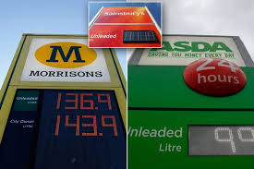
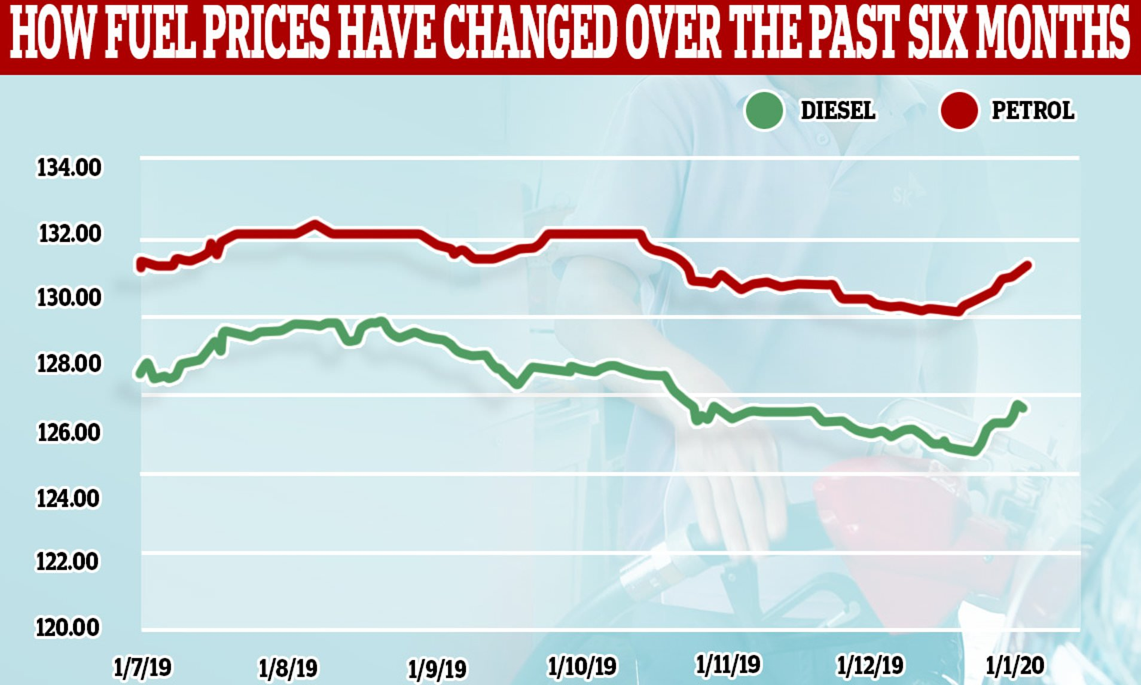
Activity 6 - YouTube video’s
Coronavirus: oil price collapses as demand falls further - BBC News
https://www.youtube.com/watch?v=ELMd5SUqDMI(Finish – 1.45)
Petrol prices could continue to get cheaper | Nine News Australia
https://www.youtube.com/watch?v=ZTcFRtjND-Q

Slide 19
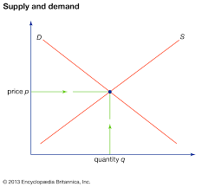
Shifts in demand and supply
As well as price there are a number of other factors which affect the demand and supply for a product.
Whereas a change in price will cause a movement up or down the demand and supply curves, other factors might cause the curves to shift. This means that more or less of a product will be demanded or supplied at any given price.
Q – When the price changes does this cause the curve to shift?

Slide 20
Shifts in the demand curve
The demand curve can shift outward (to the right) or inward (to the left). If the demand curve shifts out, this means that more is demanded at each price level.
This increase in demand is shown by the shift to a new demand curve, D2 in the diagram.
Q – What increased in demand due to Covid-19?

Slide 22
An inward shift to a new curve at D3 indicates a decrease in demand – this indicates that less is demanded at each price level.
Q – What increased in demand due to Covid-19?

Slide 23
Activity 7
Research task:
Your task is to research factors that impacted demand during the
Covid-19 pandemic.
THINK – Petrol, Toilet paper, Hand sanitiser, food.
You need to find as many examples as you can
Time: 20 mins – 10 mins research/ 10 mins discussion

Slide 24
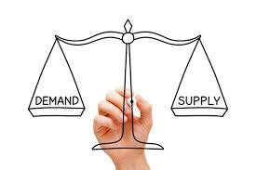
Factors that affect demand
STIGCAP FACTORS (NON PRICE)
Substitute goods
Tastes and fashion
Income
Government legislation
Complimentary goods
Anticipation of a shortage/ advertising
Population

Slide 25
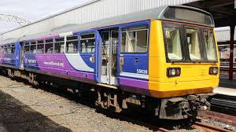
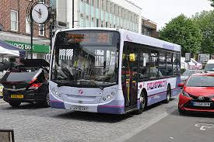
Substitute goods
A change in the price of substitute goods will also shift the demand curve. A substitute is a good used instead of another good.
For example, if train fares increase some people will switch to private transport and travel by car. This may lead to an increase in the demand for petrol, shifting the demand curve for petrol to the right.
Q – How did you travel to college today? Why?

Slide 26
If the price of airline tickets were to increase, then it is likely that demand for holidays at home in the UK would increase.
Q – Why is the demand for staycations currently increasing?
Q – Who is price sensitive when booking a holiday?

Slide 27
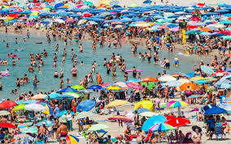
Activity 8 – YouTube video
UK staycations in huge demand
https://www.youtube.com/watch?v=p8I7PCNC3QU

Slide 28
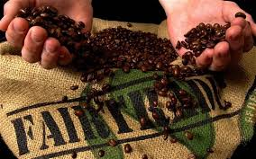
Tastes or fashion
A change in tastes and fashion can also shift the demand curve.
If goods become more fashionable the demand curve shifts to the right, increasing demand at all price levels.
If goods go out of fashion, the demand curve shifts to the left.
Q – What goods are currently in/ out of fashion?

Slide 29
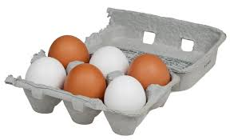
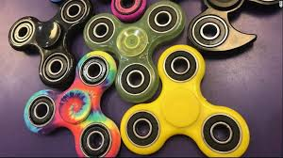
Currently fair trade goods are fashionable therefore you would expect the demand for fair trade goods the increase.
Q – What can make goods or services more fashionable?

Slide 30
Income
With more disposable income people buy more of the things they want. So as incomes increase, the demand for cars, holidays, consumer electronics etc. also increases. (Luxury goods)
A fall in incomes will cause the demand curve to shift inwards
and to the left – demand decreases.
Q – What happens to the demand for inferior goods as you income decrease?

Slide 31
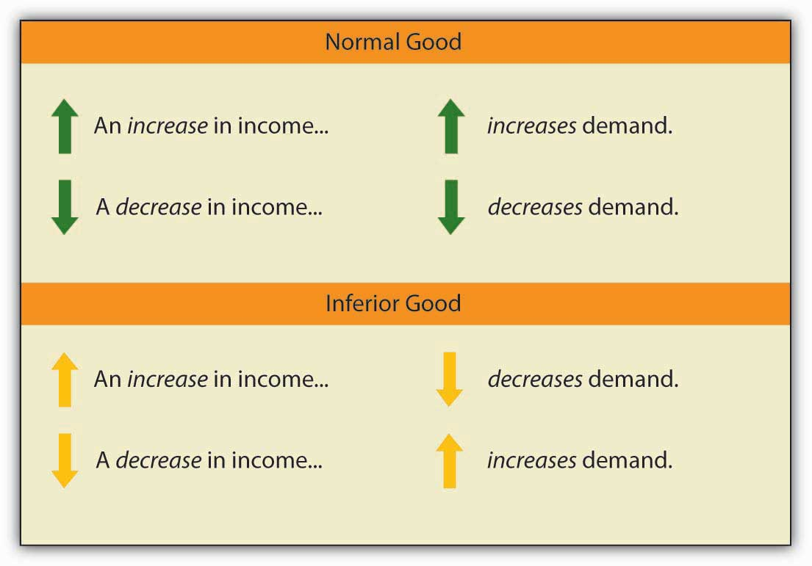
Activity 9 – YouTube video
What are normal goods
https://www.youtube.com/watch?v=BSNo6Nn_azo
What are inferior goods
https://www.youtube.com/watch?v=qFNiYv3Nupw
Q – How does income impact the demand for
these goods and services?

Slide 32
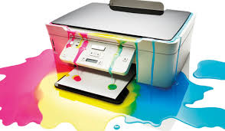
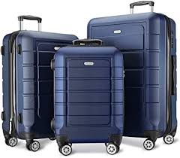
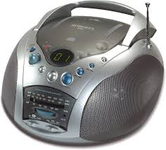
Compliment goods
Other factors which shift the demand curve include a change in the price of other goods:
Complimentary goods are those used alongside another good. For example, if demand for holidays increases, demand for luggage or perhaps suntan lotion will also increase.
Another example is that if the price
of cars drops then you would expect
the demand for petrol to increase.
Q – Can you think of any other examples?

Slide 33
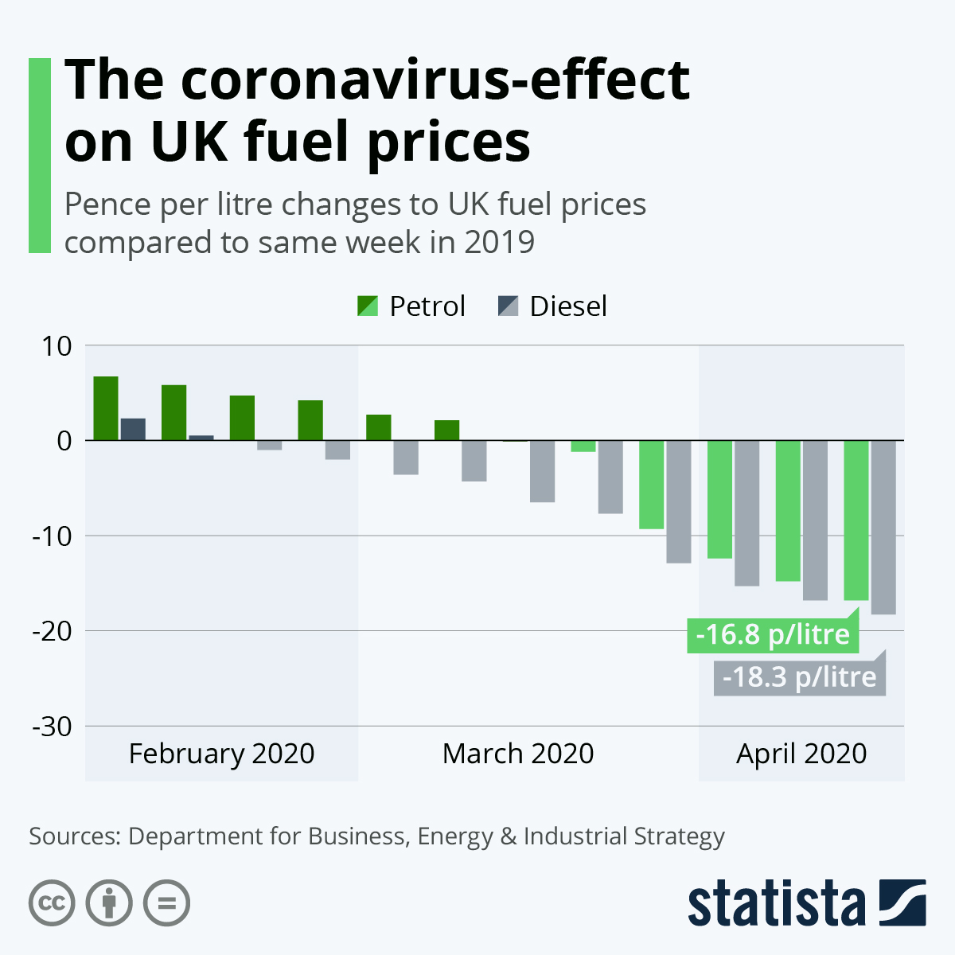
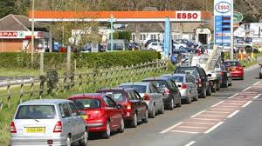
Anticipation of a shortage
If consumers anticipate a shortage then the demand for this
Product will increase.
For example :
If there was anticipation of a shortage for petrol you would expect
To see ques outside all petrol stations, therefore the demand would
Increase.
If there was anticipation of a shortage of milk because a lot of cows
Has died from a disease, then you would expect the demand for
Milk to rise.

Slide 34
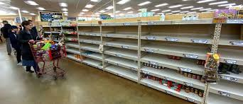
Activity 8 - YouTube video
UK petrol panic
https://www.youtube.com/watch?v=PlPH2liD46o
UK food panic
https://www.youtube.com/watch?v=wutVHwbsh70

Slide 35
Population
Changes in population will also affect demand.
The UK has an ageing population
with those of retirement age
forming a larger proportion of
the population.
This has resulted in an increase in demand for retirement homes, stair lifts and numerous other products that are used by the elderly.
Q – Do we have a lot of migration in the U.K?
Q – How does this impact demand?

Slide 36
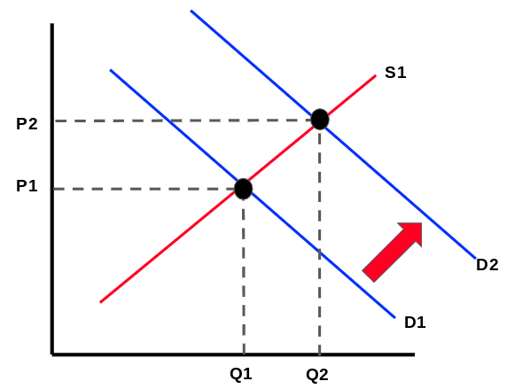
The effect on equilibrium price of a change in demand
The diagram shows a shift outwards of the demand curve (caused by perhaps increasing incomes or the increasing price of the substitute good).Initially at market equilibrium we have price P and quantity Q.
A new equilibrium is created where D1 cuts the original supply curve. Price rises to P1 and quantity demanded and supplied expands to Q1 .
Q – Why has the price and quantity increased?

Slide 38
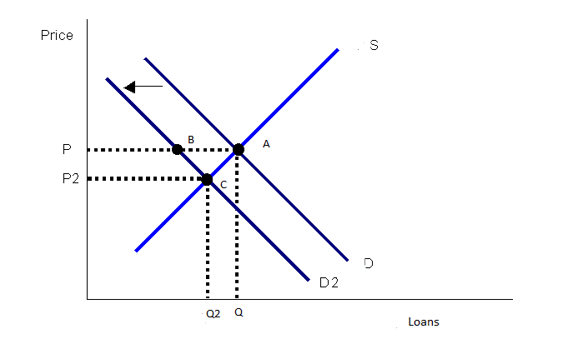
The effect on equilibrium price of a change in demand
In this diagram we see a shift to the left of the demand curve (perhaps caused by a fall in price of a substitute). Again we start with equilibrium with price P and quantity Q. After the shift in demand curve we have a new equilibrium with price P1 and quantity Q1.
The impact of the shift in of the demand curve has been to reduce price and to cause a contraction in the quantity demanded and supplied.
Q – Why has the price/ quantity supplied been reduced?

Slide 40
Activity 9 - YouTube video
Shifting demand and supply
https://www.youtube.com/watch?v=V0tIOqU7m-c

Slide 41
Activity 10 – Was you listening?
Task:
Answer the demand/ supply Kahoot quiz questions.
Time: 10 mins

Slide 42
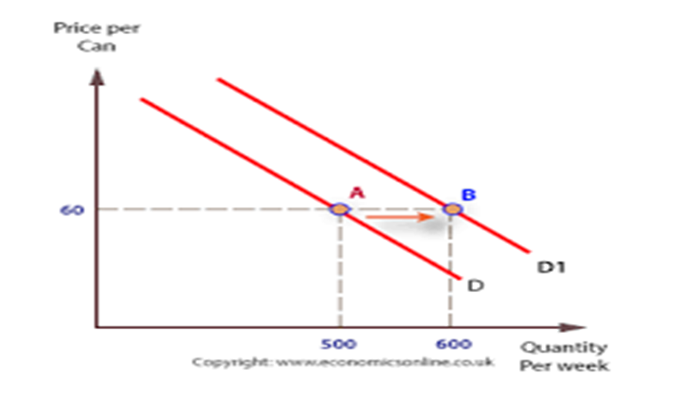
Activity 11
Task :
Shifts in demand – Past paper questions
1. 4x4 vehicles
2. Baked Beans
Extension task - Welsh rugby shirts
Time: 20 mins

Slide 43
Demand and supply - Aims and objectives
Discuss the definition of demand and the law.
Explain the law of demand and show a demand curve.
Show YouTube videos to help explain the law of demand.
Discuss in groups the definition of supply and the law.
Explain the law of supply and show a supply curve.
Show how to calculate the market equilibrium price.
Research factors that have recently impacted demand.
Describe how the STIGCAP factors affect demand. curve.
Show a YouTube video analysing the factors that affect the demand curve.
Examine and evaluate how the STICAPEW factors
affect demand by completing an exam question.
Answer Kahoot quiz questions on demand and supply.

