Slide 1
Supply/ demand – Supply shifts
Discuss the law of demand as a group.
Explain the law of supply and recap a supply curve example.
Draw a supply curve with a positive and negative shift
Analyse the factors that affect supply, with real world examples.
Show a YouTube video’s supporting the factors that affect supply.
Answer the Kahoot quiz questions on supply and demand as a group.
Read an article to extend your knowledge, answering buzzer quiz questions.
Complete past paper questions on supply.
Examine and evaluate the COPING factors that affect supply, providing your own examples.

Slide 2
Activity 1
Task: (A3 paper and pens)
What is demand?
2. What is the law of demand?
3. Draw a demand curve.
4. Is it upward/ downward sloping?
5. Draw a positive shift in demand for holidays due to an increase in income.
6. Draw a negative shift in demand for petrol due to Covid-19.
Time: 10 mins and 10 mins discussion

Slide 3
Activity 2
Task: (A3 paper and pens)
What is supply?
2. What is the law of supply?
3. Draw a supply curve.
4. Is it upward/ downward sloping?
5. What factors cause supply to shift positively or negatively?
Time: 10 mins and 10 mins discussion

Slide 4
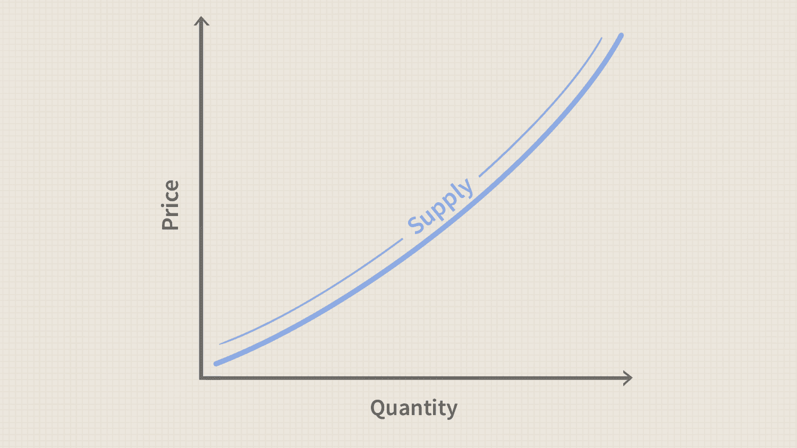
Supply (Businesses)
Supply is the amount of a product which suppliers will offer to the market at a given price.
As the price of an item goes up, suppliers will attempt to maximize their profits by increasing the quantity offered for sale.
Q – Why do you supply goods and services, to make a ….?

Slide 5
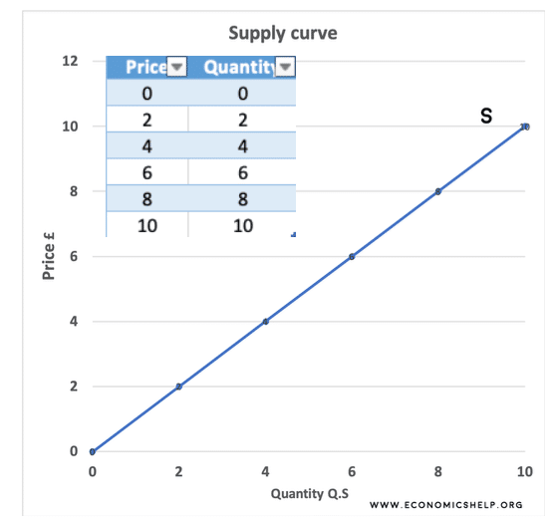
The law of supply
This means that the lower the price, the lower the quantity supplied; and the higher the price, the higher the quantity supplied.
Q – Why do you supply less as the price decreases?

Slide 6
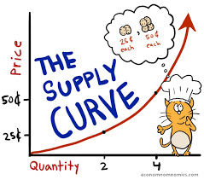
Supply
As price increases, the profit motive attracts new resources to supply and the higher price allows less efficient producers to make a profit.
So as price increases, supply increases.

Slide 7
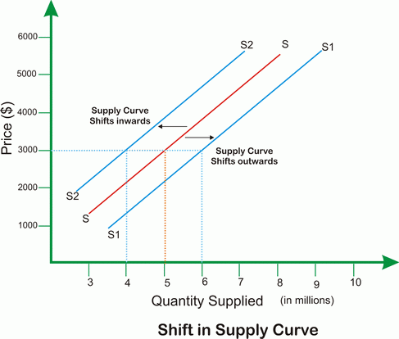
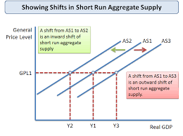
Shifts in the supply curve
Like demand, supply can also change – independent of any change in price.
Supply at each price level can increase (shift outwards to S1) or the amount supplied at each price level can decrease (shift inwards to S2)

Slide 8
Q – Does the price change?
Q – Could the price change in reaction – to increase/ decrease demand?

Slide 9
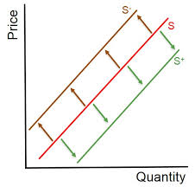
Activity 3 – YouTube video
Shifts in supply – Examples
https://www.youtube.com/watch?v=5iyCwbvJc_U

Slide 10
Factors that affect supply
CCCIG FACTORS (Non price)
Costs of production
Competition
Climate
Introduction of new technology
Government influences
Q – Are there any other factors that impact supply?

Slide 11
Cost of production
One of the most important factors that changes supply, independent of any change in price, is a change in costs of production.
If producers’ costs fall resulting from a factor such as a fall in the price of raw materials or cost of labour, this will increase supply.
Q – How does the cost of labour differ in various countries?

Slide 12
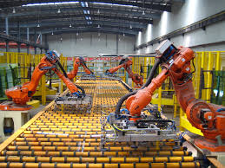
Cost of production
The factor of cheaper costs of the production shifting the supply curve outwards and to the right. Now at each price level more is supplied.
Rising costs will have the opposite effect and shift the supply curve inwards and to the left.
Q – How can you reduce your production costs?
Q – Why are costs of production high in the U.K?

Slide 13
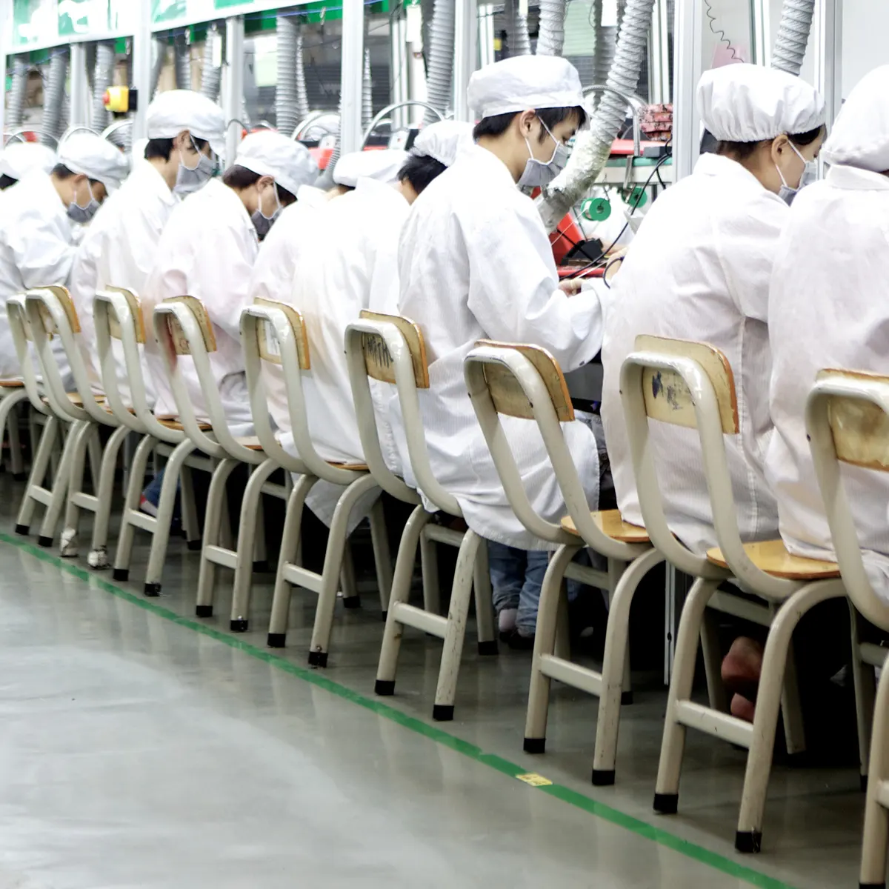
Activity 3 – YouTube video
Undercover in a Chinese iPhone factory
https://www.youtube.com/watch?v=5ItLIywwepY
Q – Did you know this?
Q – Will you still purchase an IPhone?
Q – Why are they treating workers in this way?

Slide 14
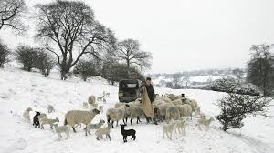
Climate
Weather can have a significant impact on the supply of agricultural products.
A good harvest – this again shifts the supply curve outwards and to the right. Bad weather, of course, has the opposite effect.
Q – What happened to the lamb’s in 2019?
Q – How does a good summer impact supply?

Slide 15
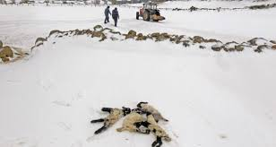
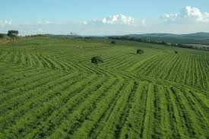
Climate
If the a snow storm hit the farms of the U.K and destroyed most of the lambs. Supply of lambs would be limited.
If favourable weather hit the Brazil for example then it could produce a larger Harvest of Coffee Increasing the supply for coffee.
Q – Can you provide any other examples?

Slide 16
Competition
If the number of firms in the market place increases you would expect supply for each individual firm to decrease.
On the other hand as the number of firms decreases you would
expect the remaining firms to supply more products.
Q – What would be the impact if a Costa opened at the college?
Q – What was the impact when a new competitor joined the market?

Slide 17
If the number of firms in the organic food market increased you would expect each company to supply less of each product. This would cause the supply curve to shift to the left (inwards).
Q – Could you provide your own example?

Slide 18
Introduction of new technology
Introduction of new technology, especially in production techniques also increases supply. This increase in productivity shifts the supply curve outwards and to the right.
Q – Can all businesses afford to introduce new technology?
Q – Could you provide any examples?

Slide 19
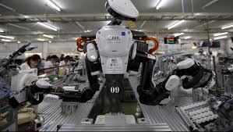
Activity 4 – YouTube video
Top 5 manufacturing smart technologies in 2019
https://www.youtube.com/watch?v=m7vOirCJmC8
Amazon Go
ttps://www.youtube.com/watch?v=NrmMk1Myrxc

Slide 20
Government influences - taxation
Legislation can also have a significant impact on the supply of some products. Increasingly businesses find their costs are increasing because they have to comply with new anti-pollution legislation introduced by the government.
This shifts the supply curve inwards and to the left. When the government imposes a tax on a good or service, this too will cause the supply curve to shift to the left.
Q – Can you think of any examples?

Slide 21
Activity 5 – YouTube video
The sugar tax explained
https://www.youtube.com/watch?v=DQQXtqQfMf8
Q – How has this impacted the supply of
Sugary drinks? – Look in the vending machine!

Slide 22
Government influences - subsidies
Government will also offer subsides for specific products to try and make sure that they are still supplied.
The government will subsidies the price of milk. Therefore you would expect the supply of milk to rise. The government offer subsidies to, many farmers receive between £2.4bn and £3bn in subsidies from the EU each year. (CAP)
Q – What other subsidies are the government offering?

Slide 23
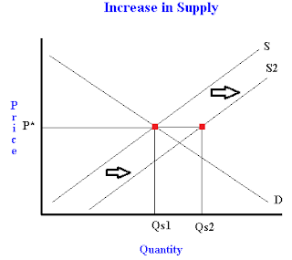
The effect on equilibrium price of a change in supply
The diagram shows a shift outwards to the right of the supply curve (S2) (perhaps caused by falling costs). Initially at market equilibrium we have price P and quantity Q.
The shift outwards results in a fall in price to P2 and an increased quantity demanded and supplied at Q2.
Q – Why has the price/ quantity decreased?

Slide 24
Q – Does the price change initially or in reaction?

Slide 25
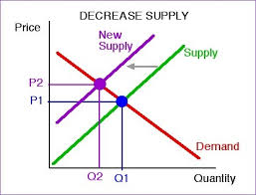
The diagram also shows a shift inward of the supply curve (S1) (perhaps caused by a bad harvest). Initially at market equilibrium we have price P and quantity Q.
The shift in the supply curve to the left results in an increase in price to P1, and fall in quantity demanded and supplied to Q1.
Q – Why does the price increase/ the quantity demanded fall?

Slide 26
Q – Why is the supply curve upward sloping?

Slide 27
Activity 5
Task:
1. Read the Supply and Demand article – Highlight the key points.
Use to further your knowledge.
2. Buzzer quiz questions based on the article.
Time: 10 mins to Read – 5 mins Buzzer quiz

Slide 28
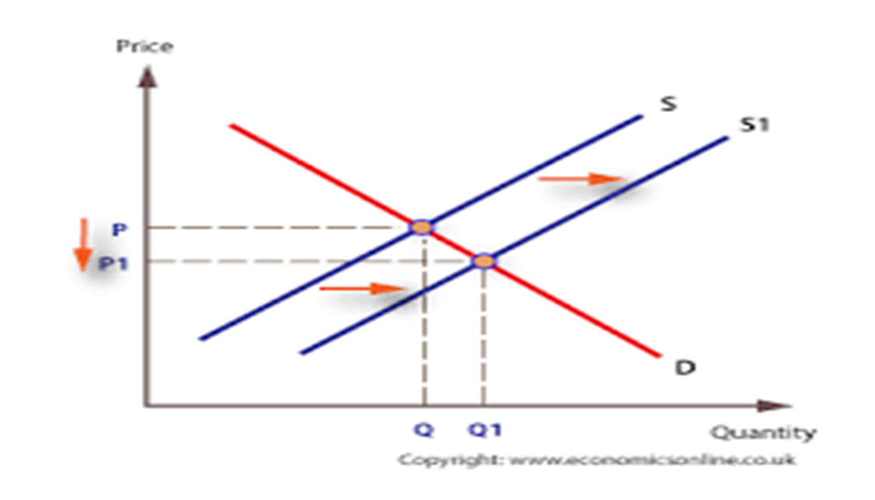
Activity 6
Task :
Exam questions – Shift supply.
Task - Positive and negative shifts.
Time: 20 mins

Slide 29
Activity 7
Task:
Your task is to complete the Kahoot quiz questions on
supply and demand.
Time: 15 mins

Slide 30
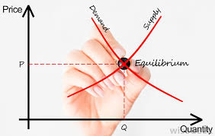
Activity 8/ Homework
Task :
Your task is to examine and evaluate the factors that affect supply and demand.
YOU NEED TO ADD YOUR OWN EXAMPLES FOR EACH
Time: 20 mins (Ball questions)

Slide 31
Supply/ demand – Supply shifts
Discuss the law of demand as a group.
Explain the law of supply and recap a supply curve example.
Draw a supply curve with a positive and negative shift
Analyse the factors that affect supply, with real world examples.
Show a YouTube video’s supporting the factors that affect supply.
Answer the Kahoot quiz questions on supply and demand as a group.
Read an article to extend your knowledge, answering buzzer quiz questions.
Complete past paper questions on supply.
Examine and evaluate the COPING factors that affect supply, providing your own examples.

