Slide 1
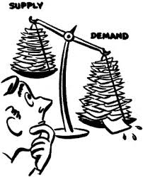
Elasticity - Aims and objectives
Discuss in groups using A3 paper and pens the factors that affect supply and demand.
Express on a graph what happens to the equilibrium price when supply and demand shifts, using the scenarios provided.
Show a YouTube video – Supply and demand crash course.
Analyse the impact of price elastic and inelastic goods on supply and demand.
Arrange the price elastic and price inelastic example cards.
Discuss income elasticity of demand as a group.
Complete the supply and demand multiple choice task.
Answer past paper questions on elasticity of demand.

Slide 2
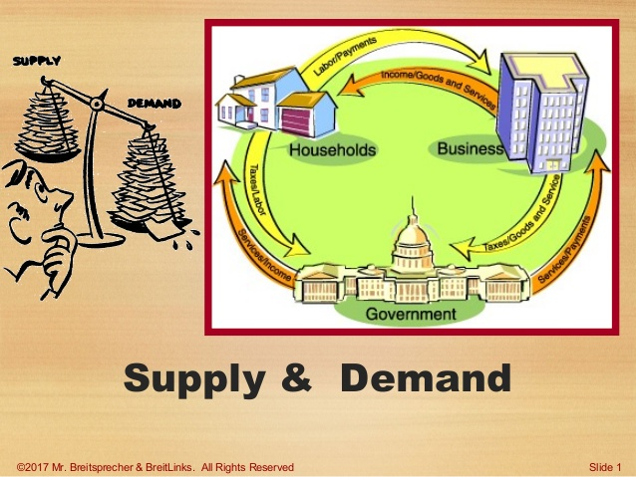
Activity 1
Task: A3 paper and pens – (Group discussion)
What is the law of demand – Draw a demand curve?
2. What are the factors that affect demand? (Include examples)
3. What is the law of supply – Draw a supply curve?
4. What are the factors that affect supply ? (Include examples)
Time: 15 mins and 5 mins discussion.

Slide 3
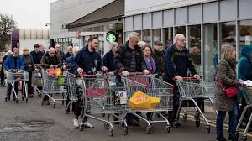
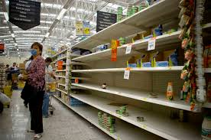
Activity 2 - Demand example
Task:
Due to an unexpected change in the market (Anticipation of a shortage due to Covid-19), the demand for bread and canned goods has increased.
Covid-19 – Food shortages
https://www.youtube.com/watch?v=wutVHwbsh70
Covid-19 – Stocking up on food
https://www.youtube.com/watch?v=t7Hm23Lhgtg

Slide 4
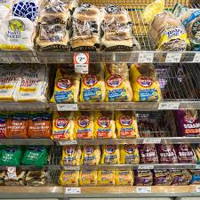
Activity 2 - Demand example
Task:
Express on the graph - What would you expect to happen to the demand curve, price and quantity?
2. Explain in your own words - What would you expect to happen to the demand curve, price and quantity?
Time: 10 mins - DRAW IN YOUR BOOKS!

Slide 5
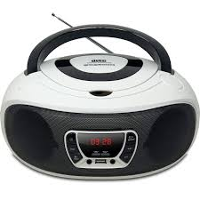
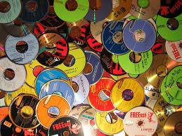
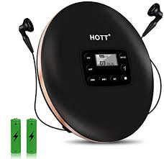
Activity 3 - Demand example
Task:
The demand for CD players has decreased (Due to changes in tastes and fashion/ technology), therefore the demand for CD’s has decreased.
1. Express on the graph - What would you expect to happen to the demand curve, price and quantity?
2. Explain in your own words - What would you expect to happen to the demand curve, price and quantity?
Time: 10 mins - DRAW IN YOUR BOOKS!

Slide 6
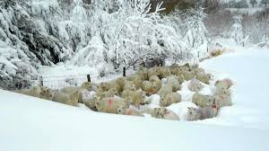
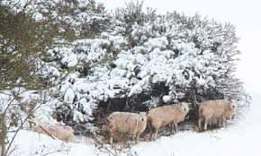
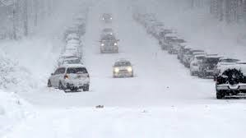
Activity 4 - Supply example
Task:
The supply of welsh lamb has decreased (due to an unexpected change in the climate), a snow storm hitting Wales in the spring.
1. Express on the graph - What would you expect to happen to the demand curve, price and quantity?
2. Explain in your own words - What would you expect to happen to the demand curve, price and quantity?
Time: 10 mins - DRAW IN YOUR BOOKS!
DRAW ON BOARD

Slide 7
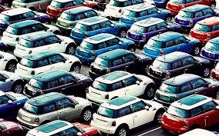
Activity 5 - Supply example
Task:
The supply of cars has increased due to a surplus of materials,
during the pandemic, less cars were produced leaving a surplus
In materials.
1. Express on the graph - What would you expect to happen to the demand curve, price and quantity?
2. Explain in your own words - What would you expect to happen to the demand curve, price and quantity?
Time: 10 mins - DRAW IN YOUR BOOKS!

Slide 8
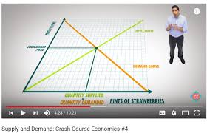
Activity 6 - YouTube video
Supply and demand crash course:
https://www.youtube.com/watch?v=g9aDizJpd_s

Slide 9
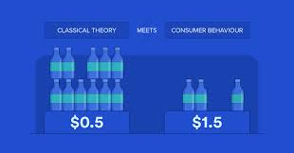
Concept of elasticity
Price elasticity of demand measures the responsiveness of demand to a change in price. Understanding price elasticity of demand is very important to business managers who need to know the impact of changes in price on likely levels of demand.
They need to know how sensitive the demand for their good or service is to a change in price.
Q – How is the demand for cigarettes, bread, milk impacted by a change in price?

Slide 10
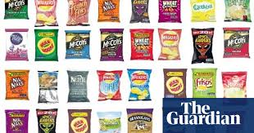
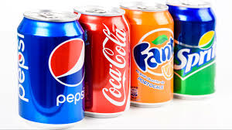
Price elastic
Price elastic/Price sensitive in markets approaching perfect competition, elasticity of demand is likely to be highly elastic – this means that a change in price will cause a more than proportional change in the quantity demanded.
Price goes up, demand falls dramatically. When price falls, the reverse happens. Why should people buy a higher priced good when a virtually identical good is immediately available at a lower price?
Q – Could you provide examples of price elastic goods?

Slide 11
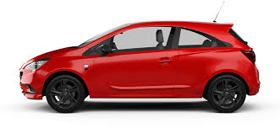
Price elastic
Given the conditions of near perfect competition, where goods are largely undifferentiated, this impact of the change in price on demand levels is quite predictable.
Q – What goods would you stop buying if the price increases?

Slide 12
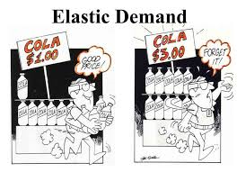
Elastic Demand

Slide 13
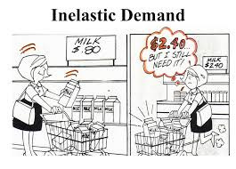
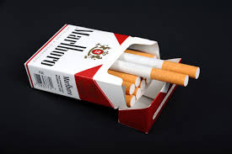
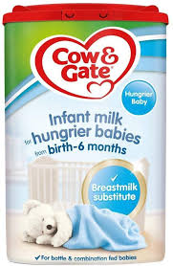
Price inelastic
Price inelastic/Price insensitive If a good has inelastic price elasticity of demand then a change in price causes a less than proportional change in the quantity demanded.
So if price goes up, demand falls just a little. If price goes
down demand increases just a little.
Q – Could you provide examples of price inelastic goods?

Slide 14
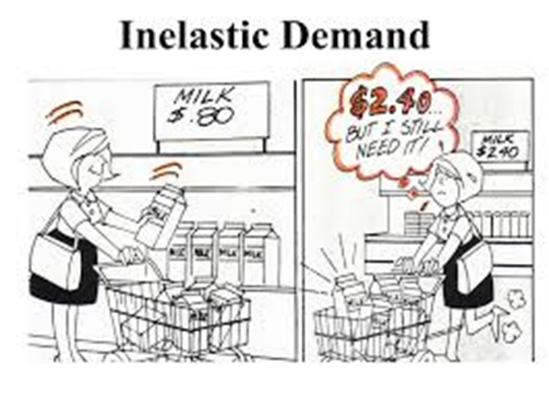

Slide 15
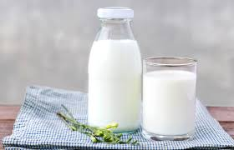
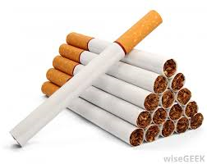
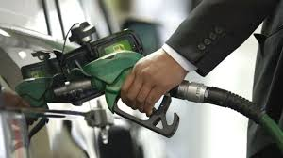
Price inelastic
Inelastic price elasticity of demand is likely to occur when the levels of competition are low, when there are a few substitutes, the goods are necessities or perhaps addictive.
In these circumstances the business involved has much more control over the price than companies in highly competitive markets.
Q – Which goods do you see as necessities or addictive?
Q – If the price increased would you continue to purchase?

Slide 17
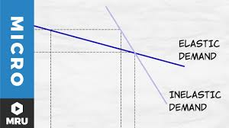
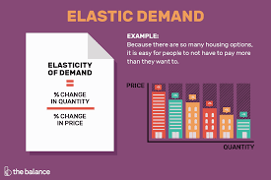
Activity 7 – YouTube video
Elasticity of demand:
https://www.youtube.com/watch?v=HHcblIxiAAk

Slide 18
Activity 7
Task:
Using the presentation – As a group – Arrange the price elastic
and price inelastic example cards.
You will need to provide reasons for your choice.
Time: 10 mins

Slide 19
Recognizing elasticity
Of course for many retailers and producers price elasticity of demand is likely to be somewhere between highly elastic/sensitive and highly inelastic/insensitive.
But knowing and understanding price elasticity of demand is important in decision-making, especially with regards to the marketing of goods.
Q – How does price elasticity impact marketing budgets?

Slide 20
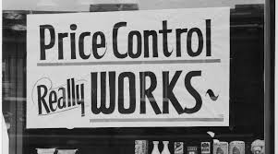
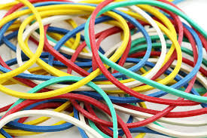
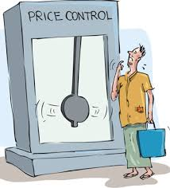
Elasticity objectives
The objective of most businesses would be to make the price elasticity of demand of their goods or services more inelastic.
This means that they have more control over their price, they are price makers and not price takers.
Q – Why would a business want to control their price?
Q – How else can businesses control the price?

Slide 21
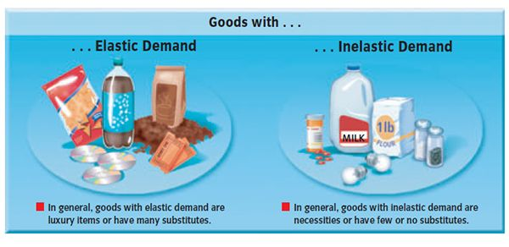
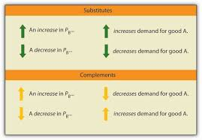
Price inelastic preferable
If price elasticity of demand is inelastic and increasing price causes a less than proportional fall in the quantity demanded, this means revenue would increase.
This is a much more preferable situation to a situation where price elasticity of demand is elastic and there is an increase in price which leads to a more than proportional fall in the quantity demanded, resulting in a fall in revenue.
Q – How can businesses make their good more price inelastic?

Slide 22
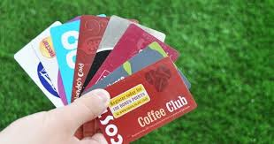
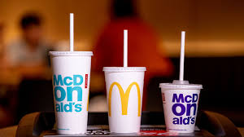
How can businesses make their goods more inelastic?
Businesses can make demand for their goods more price inelastic if they do the following:
• Encourage consumer loyalty;
• Reduce or restrict competition in the market;
• Increase brand value.
Q – What are businesses doing to increase brand value, customer loyalty and restrict competition?

Slide 23
Activity 8 - YouTube videos
Red bull space jump - https://www.youtube.com/watch?v=FHtvDA0W34I
Red bull Cliff diving https://www.youtube.com/watch?v=EkkeDqBOPJ0
John Lewis Christmas advert
https://www.youtube.com/watch?v=mNbSgMEZ_Tw
Q – How do these advertisements make their goods more
Price inelastic?

Slide 24
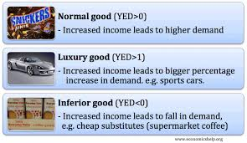
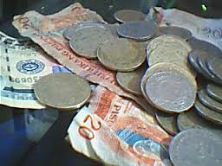
Income elasticity of demand
Income elasticity is the responsiveness of demand to changes in income.
Business managers like to look at the relationship between changing (increasing or falling) incomes and changing demand levels for different types of goods or services.
Q – When you have more disposable income – What do you buy more/ less of?

Slide 25
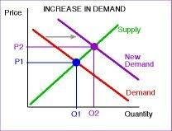
Generally real incomes increase over time (‘real’ means allowing for the impact of inflation), leading to increased wealth and rising demand for most, but not all, goods and services.
As people get richer they consume more, driving up demand for many goods and services.
Q – Do we have more or less to spend today, rather than 10 years ago?

Slide 26
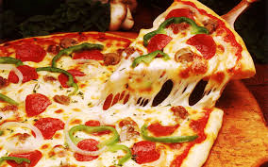
Income elasticity of demand
• Income elasticity of demand can be elastic: a change in income causes a more than proportional change in the quantity demanded. For example, a 5% increase in incomes leads to a 10% increase in demand for pizzas.
• Income elasticity of demand can be inelastic: a change in income causes a less than proportional change in the quantity demanded. For example, incomes fall by 4% but demand for toothpaste falls by just 2%.
Q – Would it fall at all?

Slide 27
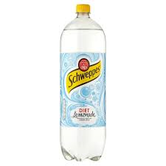
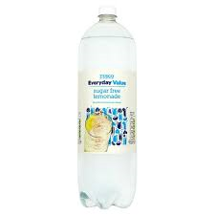
• Income elasticity of demand can also be negative when a rise in incomes causes a fall in demand.
For example, incomes increase by 6%, and this causes a 5% fall in demand for supermarkets’ own brand lemonade.
Q – What would you buy less of if you incomes increase?

Slide 28
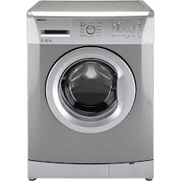
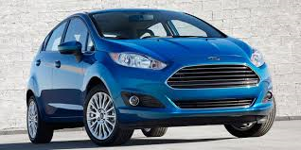
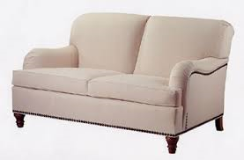
Normal goods
When real incomes of customers increase, the demand for normal goods responds as we might expect.
As people become better off they buy more of this type of product. The majority of everyday items fall into this category – for example, cars, furniture, washing machines etc.
Q – Do you have something needs changing at home, but you are saving/ waiting?

Slide 29
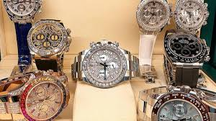
Luxury goods
Luxury goods also fall into the category of normal goods but tend to be more sensitive to changes in real income.
If incomes increase, demand for gym membership booms; if incomes fall many people quickly cancel their gym memberships in an attempt to save money.
Q – What would you buy more/ less of if you income increased?

Slide 30
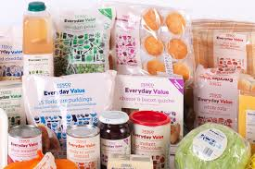
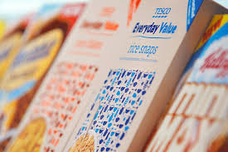
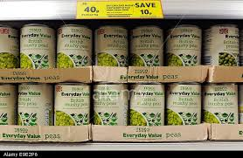
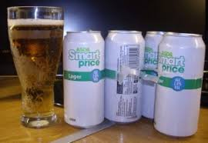
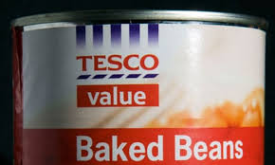
Inferior goods
Inferior goods are those goods that have negative income elasticity of demand – demand rises when real incomes fall.
Supermarket own-label products are a good example of inferior goods. During a recession, consumers may turn to such products in order to economise.
Q – Do you buy more of these as you income rises?

Slide 31
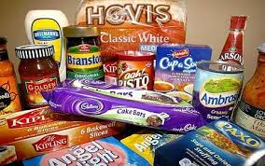
However, as incomes rise, they do not buy more of the own-label products but may switch to buy higher priced branded products instead.
Q – Who still buys value products anyway?

Slide 32
Activity 9
Task:
1. Supply and demand EQ price – Multiple choice task
2. Supply and demand – Practise
https://www.youtube.com/watch?v=9QSWLmyGpYc
Time: 15 mins

Slide 33
Activity 10
Task:
Supply and demand – Exam questions
Homework task
Time: 15 mins

Slide 34
Elasticity - Aims and objectives
Discuss in groups using A3 paper and pens the factors that affect supply and demand.
Express on a graph what happens to the equilibrium price when supply and demand shifts, using the scenarios provided.
Show a YouTube video – Supply and demand crash course.
Analyse the impact of price elastic and inelastic goods on supply and demand.
Arrange the price elastic and price inelastic example cards.
Discuss income elasticity of demand as a group.
Complete the supply and demand multiple choice task.
Answer past paper questions on elasticity of demand.

