Slide 1
Yr Iaith ar waith work welsh
Session 3
Dyddiau, misoedd, rhifau

Slide 2
Amcanion/Objectives
Re-cap on greetings
Able to say the time
Recognise and list days of the week.
Recognise and name months of the year
Uderstand how to speak and introduce different people.

Slide 3
Re-cap last week
Greetings
Numbers

Slide 4
Introduction activty
Go into your breakouts rooms and welcome eachother.
Using terms: BORE DA, PRYNHAWN DA, NOS DA
Sut mae? – da iawn/da diolch
Beth yw eich enw? - …..dw i.
Rydw I’n ….. mlwydd oed
Beth yw eich rhif ffÔn?

Slide 5
Telling the time
4
5
1
6
….o’r gloch - …O’clock
2
7
3
8

Slide 6
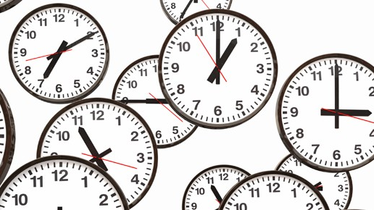
Asking the time
Faint o’r gloch ydy hi? – What’s the time?
This Photo by Unknown Author is licensed under CC BY-SA-NC

Slide 7
Answer
Mae hi’n…. O’r gloch–
It’s ….o’clock
This Photo by Unknown Author is licensed under CC BY-SA-NC

Slide 8
Task
In your teams take turns to ask the time and answer using a different number.

Slide 9
Dyddiau’r wythnos
Dydd = day
The word “dydd” always comes first e.g. Dydd Llun.

Slide 10
Dydd Llun
Monday

Slide 11
Dydd mawrth
tuesday

Slide 12
Dydd mercher
wednesday

Slide 13
Dydd iau
thursday

Slide 14
Dydd gwener
friday

Slide 15
Dydd sadwrn
saturday

Slide 16
Dydd sul
sunday

Slide 17
Re-cap
Dydd llun
Dydd Mawrth
Dydd mercher
Dydd iau
Dydd gwener
Dydd sadwrn
Dydd sul

Slide 18
Task
Place the days of the week in order starting with Sunday.

Slide 19
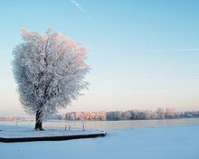
Misoedd y flwyddyn/Months of the year
Ionawr - Janurary
MAWRTH - MARCH
cHWEFROR - FEBRUARY
This Photo by Unknown Author is licensed under CC BY-SA
This Photo by Unknown Author is licensed under CC BY-SA-NC

Slide 20
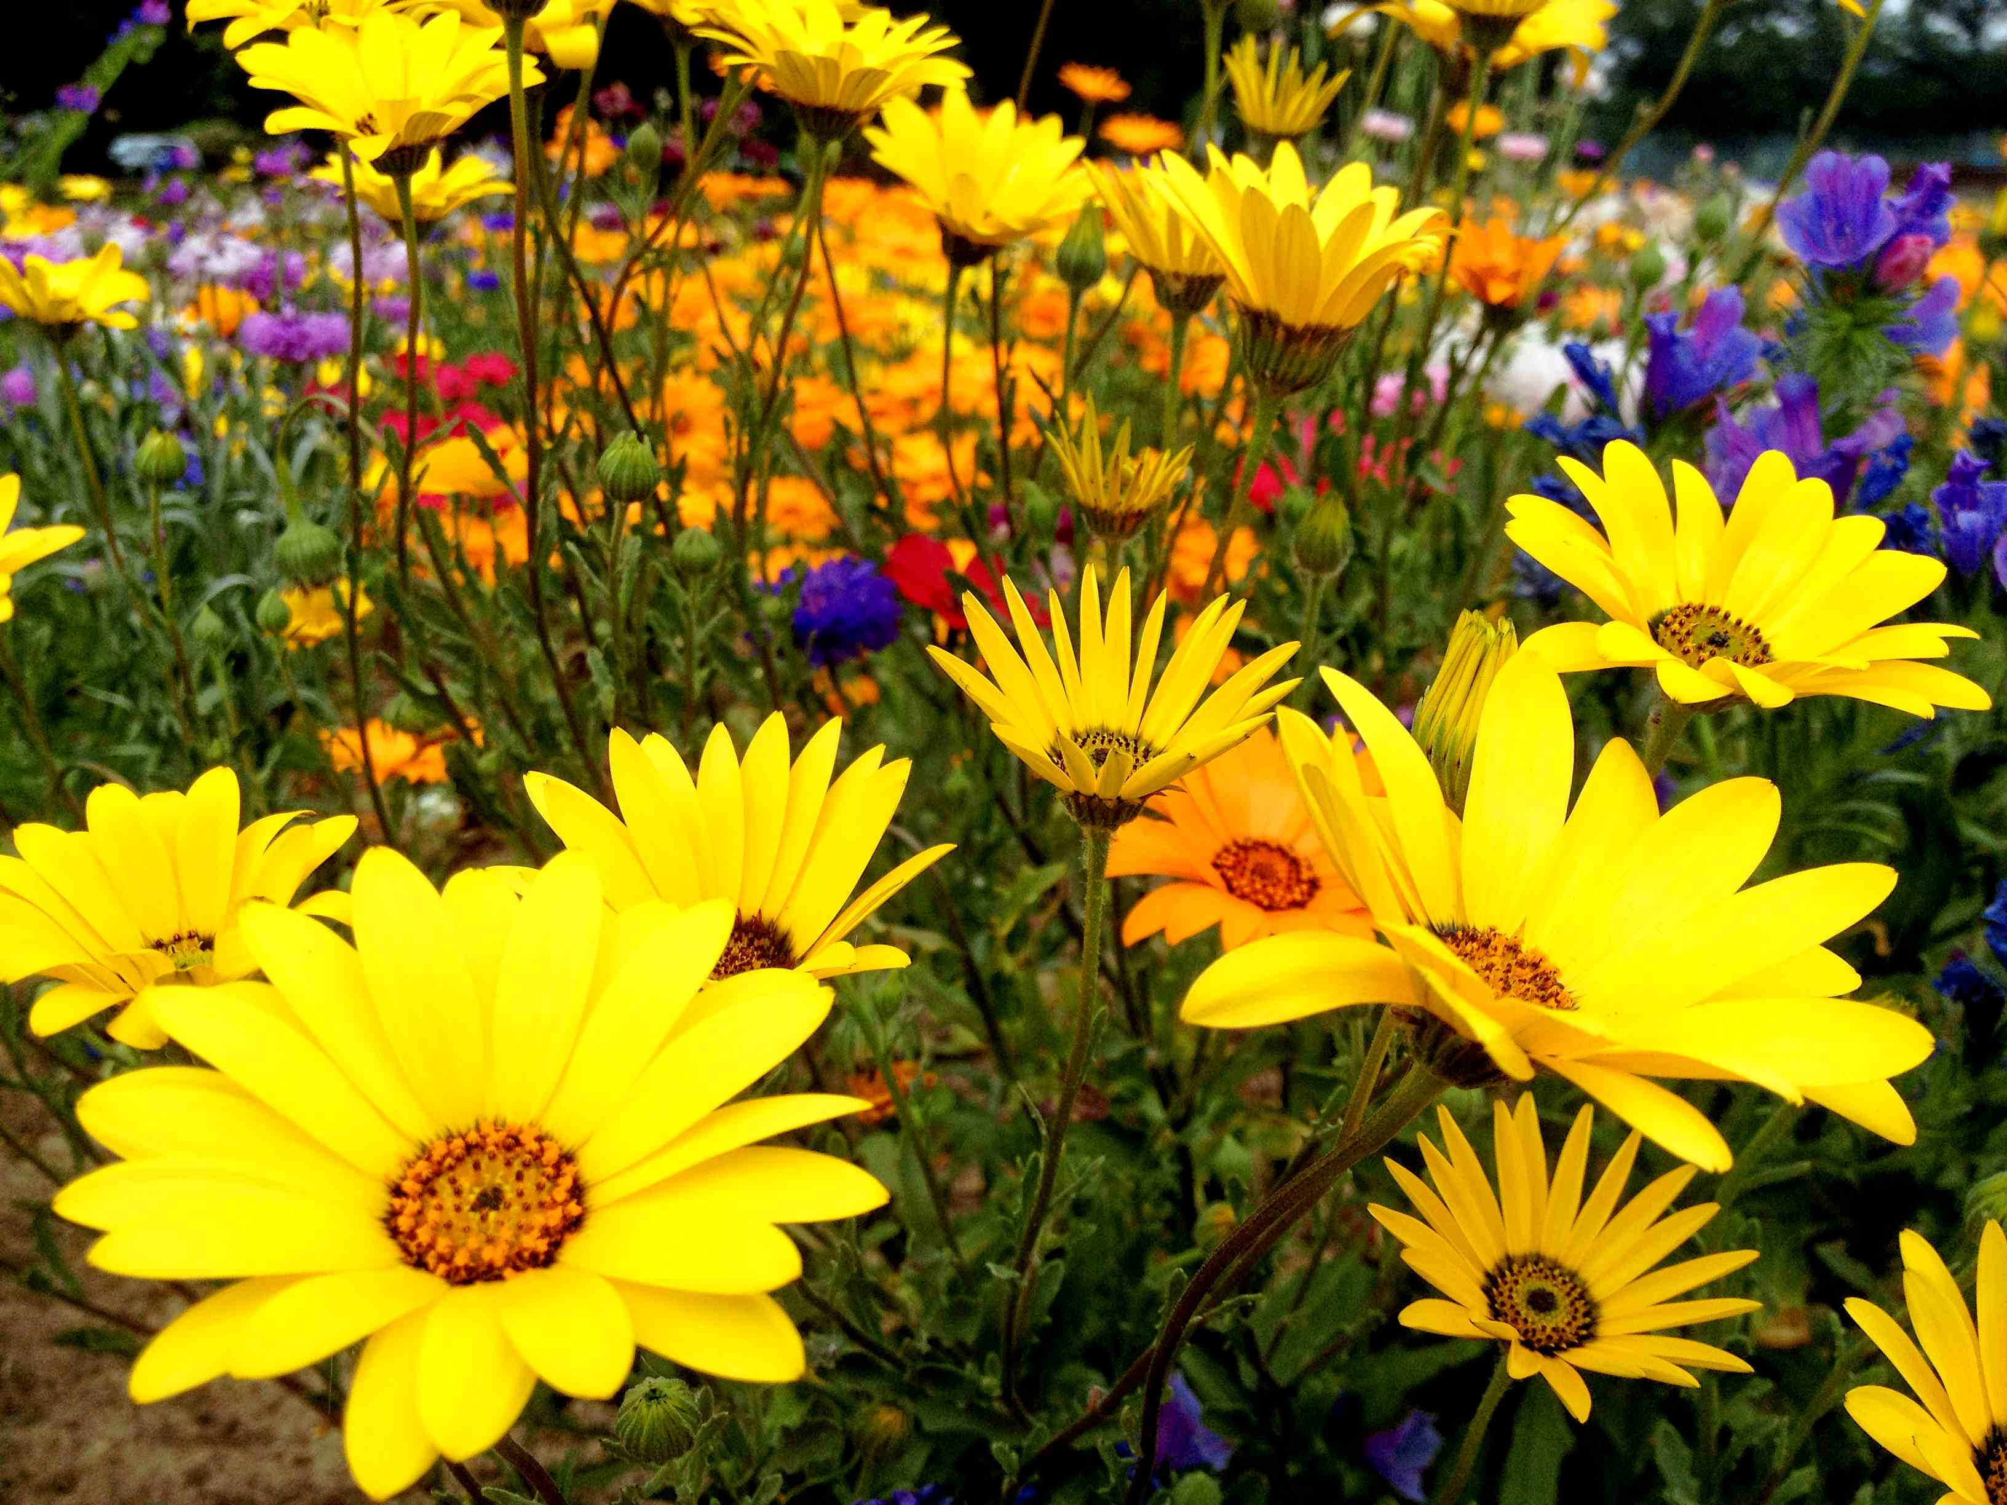
EBRILL - APRIL
MEHEFIN- jUNE
MAI- MAY
This Photo by Unknown Author is licensed under CC BY

Slide 21
GORFFENAF - JULY
mEDI - sEPTEMBER
AWST-AUGUST
This Photo by Unknown Author is licensed under CC BY-SA

Slide 22
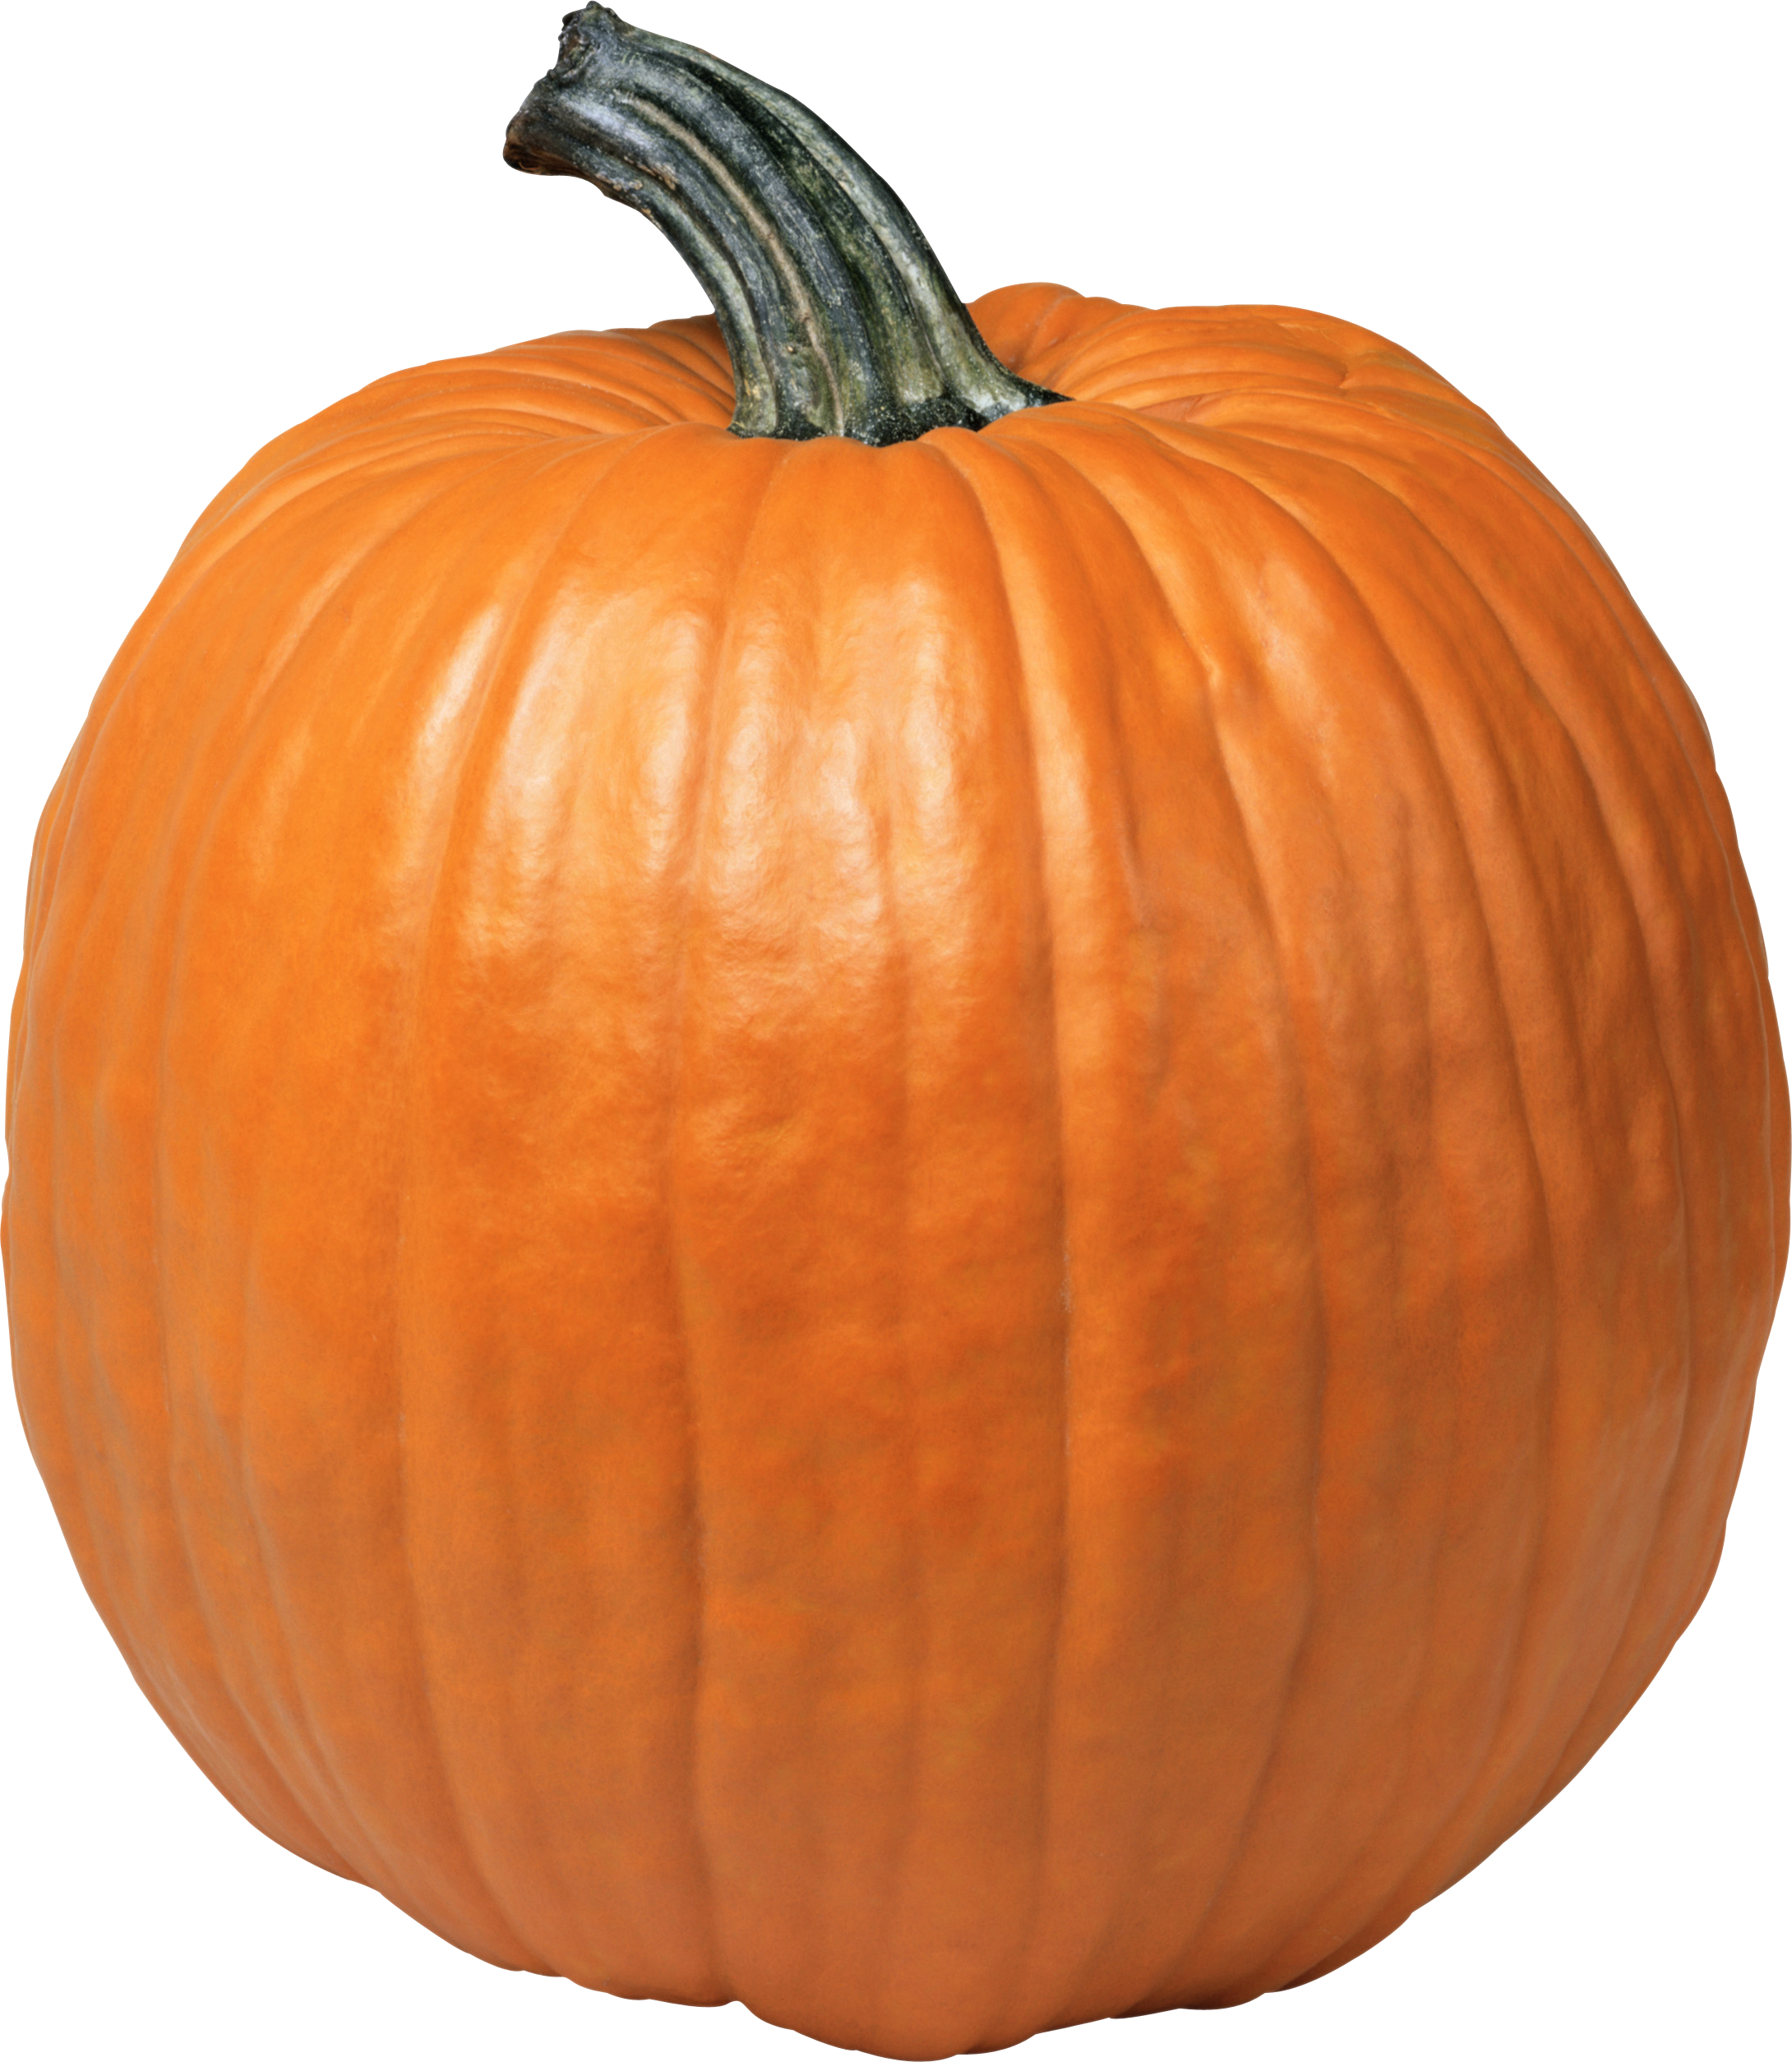
hYDREF - oCTOBER
Rhagfyr - december
Tachwedd - november
This Photo by Unknown Author is licensed under CC BY-NC
This Photo by Unknown Author is licensed under CC BY-NC-ND

Slide 23
Tasg/task
Match up the correct months of the year.

Slide 24
How to speak and introduce different people
Fi -me
Ti – you (informal)
Chi – you (formal)

Slide 25
Ni – us
Fe -him
Hi – her
Nhw – them

