Slide 1
Yr iaith ar waith work welsh
Session 4

Slide 2
Aim
By the end of the session you will be able to:
Talk a little bit about the weather
explain that your learning welsh
Objective
Provide information to customers orally in a familiar situation, consistently using relevant Welsh vocabulary and phrases correctly
Form and use a variety of relevant and standard Welsh questions when responding to a customer's request

Slide 3
Let’s re-cap on what we have learnt so far
Who can tell me the date in full today?
How can we welcome everyone to the session?
Who can introduce themselves to the class?
What time does our session start?
What time does our session end?

Slide 4
Listen to this conversation.
Take notes of what is being said.
Can you put the conversation in the correct order?
https://dysgucymraeg.cymru/dysgu/adnoddau-digidol/mynediad/ Helo sut dych chi – sgwrs cyntaf

Slide 5
Y tywydd / The weather
Mae angen defnyddio ‘hi’ pan dyn ni’n siarad am y tywydd:
We use the feminine form when we talk about the weather:
Mae hi’n heulog = It’s sunny
Sut mae’r tywydd?
How is the weather?

Slide 6
Y tywydd / The weather
This Photo by Unknown Author is licensed under CC BY
This Photo by Unknown Author is licensed under CC BY-SA
Mae hi’n braf
It’s fine
Mae hi’n heulog
It’s sunny
Mae hi’n dwym
It’s warm
Mae hi’n oer
It’s cold
This Photo by Unknown Author is licensed under CC BY-SA-NC

Slide 7
Y tywydd / The weather
This Photo by Unknown Author is licensed under CC BY-SA
This Photo by Unknown Author is licensed under CC BY-SA
This Photo by Unknown Author is licensed under CC BY-SA
Mae hi’n wyntog
It’s windy
Mae hi’n stormus
It’s stormy
Mae hi’n gymylog
It’s cloudy
Mae hi’n bwrw glaw
It’s raining

Slide 8
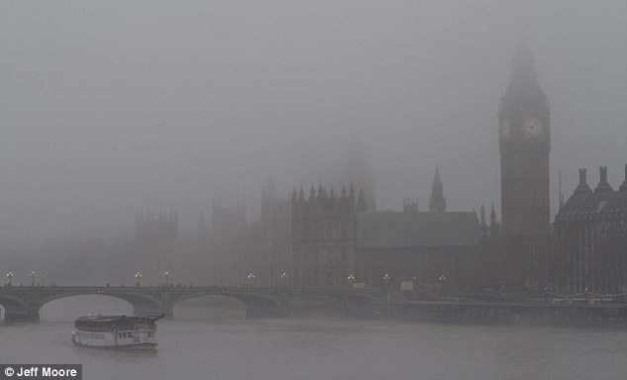
Y tywydd / The weather
Mae hi’n braf - It’s fine
Mae hi’n heulog - It’s sunny
Mae hi’n dwym - It’s warm
Mae hi’n oer - It’s cold
Mae hi’n wyntog - It’s windy
Mae hi’n stormus - It’s stormy
Mae hi’n gymylog - It’s cloudy
Mae hi’n bwrw glaw - It’s raining
Mae hi’n bwrw eira - It’s snowing Mae hi’n ddiflas - It’s miserable
This Photo by Unknown Author is licensed under CC BY-SA
Mae hi’n bwrw eira
It’s snowing
Mae hi’n ddiflas
It’s miserable

Slide 9
Tasg sain 1 / Audio task1
Pa un o’r geiriau hyn sy DDIM yn y ddeialog?
Which one of these words are NOT In the dialogue?
Braf
Twym
Diflas
Oer
Niwlog
bwrw eira
Cymylog
Gwyntog
bwrw glaw
http://www.telesgop.co.uk/clicclonc/SEW/U-03/unit3-a.html

Slide 10
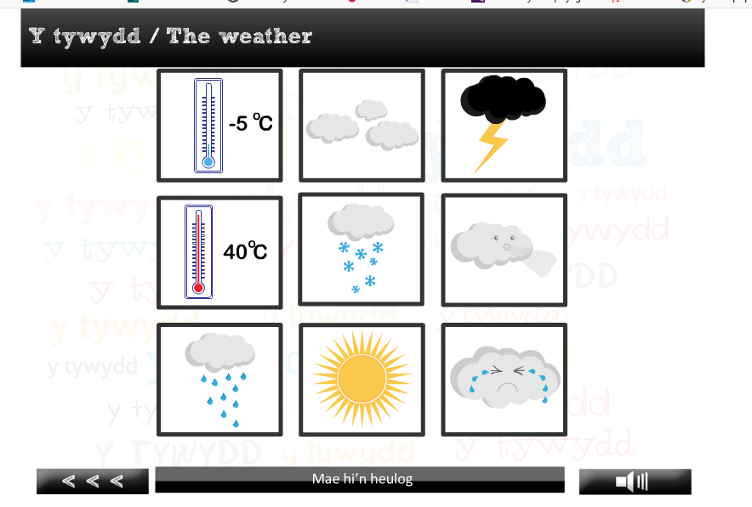
Loto game
http://www.telesgop.co.uk/clicclonc/games/swansea/unit_3/unit_3_ex1(lotto).swf

Slide 11
Tasg unigol/individual task
Can you find the translations to these weather descriptions:
Wet
Dry
calm
Misty
Icy
Freezing
Hail stones
Thunder and lightening

Slide 12
Cwetiwwn/question
This Photo by Unknown Author is licensed under CC BY-SA-NC
Ydy, mae hi’n braf
Yes, it’s fine
Ydy hi’n braf?
Is it fine?
Nac ydy, so hi’n braf
No, it’s not fine

Slide 13
Weithiau dyn ni’n dweud “dyw hi ddim…”
We sometimes say “it’s not…”
Dyw hi ddim yn braf
It's not fine
Nac ydy
No it’s not

Slide 14
I sôn am y tywydd ddoe, dyn ni’n defnyddio ‘oedd’’.
To talk about the weather yesterday we use ‘oedd’.
Roedd hi’n braf ddoe.
It was fine yesterday.
Oedd.
It was.

Slide 15
I sôn am y tywydd yfory, dyn ni’n defnyddio ‘bydd’’.
To talk about the weather tomorrow we use ‘bydd’.
Bydd hi’n oer yfory.
It will be cold tomorrow.
Bydd.
It will.

Slide 16
Fydd hi ddim yn dwym.
It won't be warm.
Na fydd.
It won’t be.
Fydd hi'n sych?
Will it be dry?
Bydd.
It will.

Slide 17
Group Task In breakout rooms
Tasg sain 2/ Audiotask2
Llenwch y bylchau.
Fill the gaps.
1. Roedd hi'n ________ ddoe.
2. Mae hi'n ________ ac yn ________ yng Nghaerdydd.
3. Mae hi'n ________ yn y Gogledd.
4. Mae hi'n ________ ________ yn Sir Fôn.
5. Bydd hi'n ________ yn y De yfory.
6. Bydd hi'n ________ ac yn ________ yn Eryri yfory.
7. Efallai bydd hi'n ________ ________.
8. Dros ypenwythnos bydd hi'n ________.
http://www.telesgop.co.uk/clicclonc/SEW/U-03/unit3-a2.html

Slide 18
Be able to explain that your learning welsh
Dw i’n dysgu Cymraeg – I’m learning welsh
Dysgwr dw i – I’m a learner

Slide 19
Dw i’n siarad tipyn bach – I can speak a little bit
Dw i’n deall– I understand
Eto plîs – repeat please
Yn araf plîs – slowly please

Slide 20
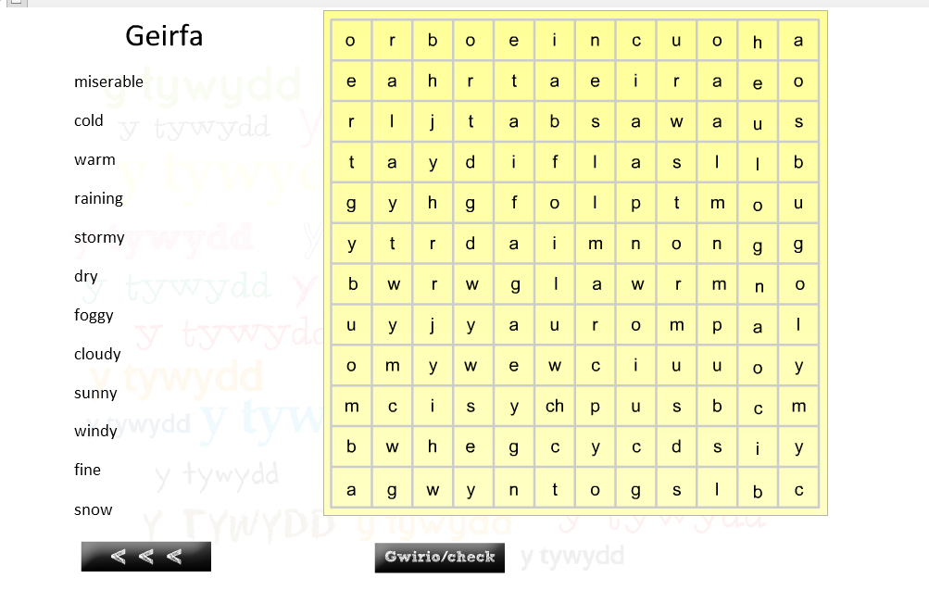
Chwilair/wordsearch
Follow the link to complete the wordsearch
http://www.telesgop.co.uk/clicclonc/games/swansea/unit_3/unit_3_ex3(wdSch).swf
Once complete screen shot your completed wordsearch

Slide 21
Aim
What have we learnt?
By the end of the session you will be able to:
Talk a little bit about the weather
explain that your learning welsh
Objective
Provide information to customers orally in a familiar situation, consistently using relevant Welsh vocabulary and phrases correctly
Form and use a variety of relevant and standard Welsh questions when responding to a customer's request
This Photo by Unknown Author is licensed under CC BY

Slide 22
Tro nesaf / Next session
Learn job titles in the social care sector are in welsh
Learn what some service user groups are in welsh
Discuss some conditions specifically relating to social care

