Slide 1




Persuasive Texts
Sam Crookes 2020

Slide 2
General features of persuasive texts.
Rhetorical questions Groups of three
Attention grabbing (large/ bold text, colour, images etc)
Emotive vocabulary Alliteration Emphasis
Repetition Addressing the audience directly
Imperatives Use of question / exclamation marks
Imagery (metaphors and similes)

Slide 3
There are 2 main types of persuasive text. Can you describe them? What might they try to persuade someone to do?
Type 1 – texts that try to make you spend money…
E.g. advertisements for: products / services / charities
Type 2 – texts that try to make you think and / or act a certain way…
E.g. articles on: climate change / politics / veganism

Slide 4
Features of advertisements Q: which of these are layout features and which are language features?
Large text Few words
Images
Emotive words
Slogans Colours
Logos Bold text
Question marks / Exclamation marks

Slide 5
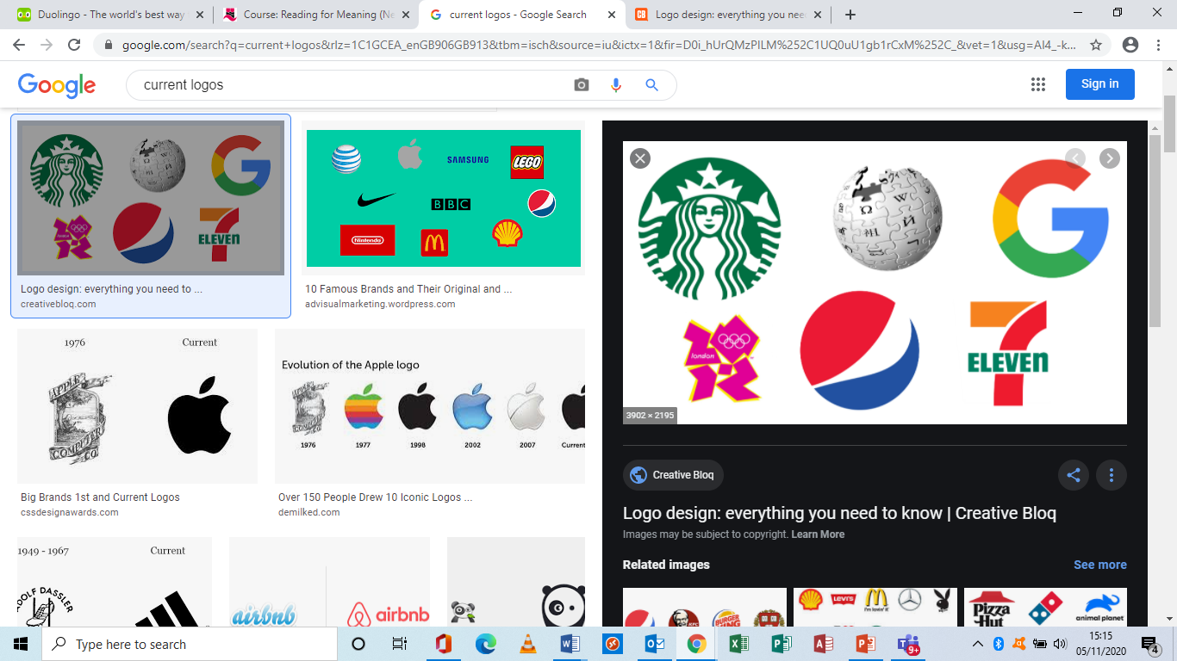
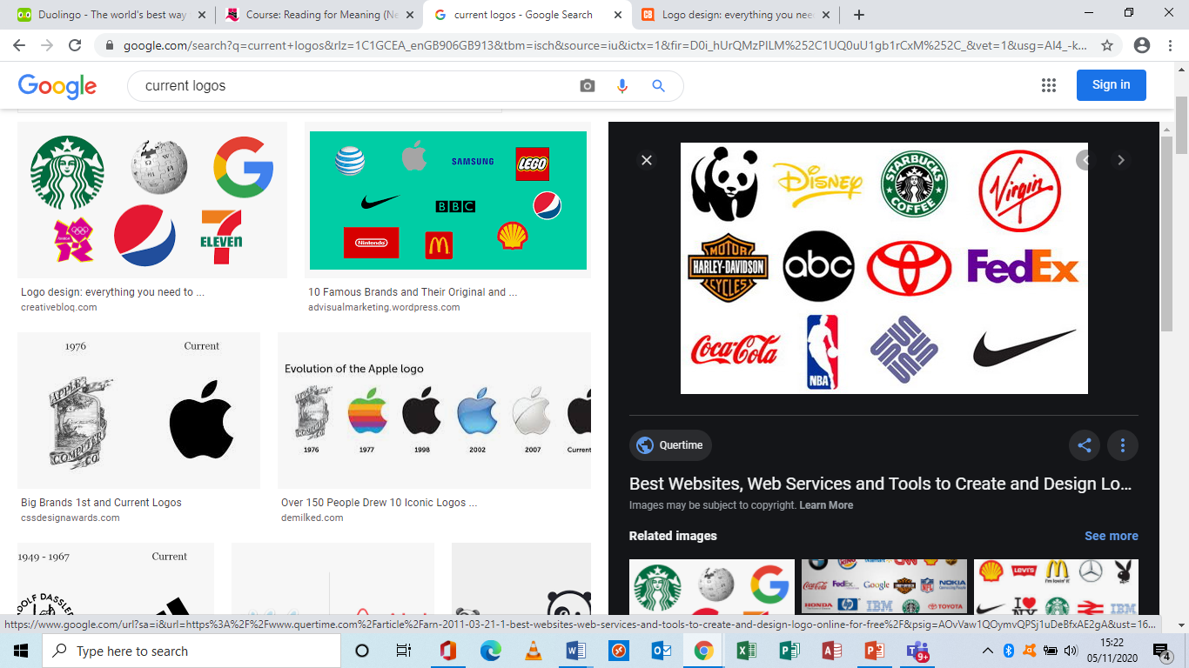

The power of logos and slogans… Can you name the product / service?
‘Have a break have a …………….. ‘ (biscuit)
‘A ……… a day helps you work rest and play’ (chocolate)
‘No more tears’ (toiletry) ‘Every little helps’ (shop)
‘ I’m loving it’ (food outlet) ‘Finger lickin’ good’ (food outlet)
‘Fly better’ (airline)

Slide 6
Language features of articles / speeches etc.
Rhetorical questions Groups of three
Emotive vocabulary Alliteration
Repetition Addressing the audience directly
Imperatives Emphasis
Imagery (metaphors and similes)

