Slide 1
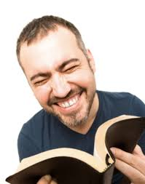
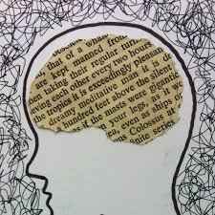
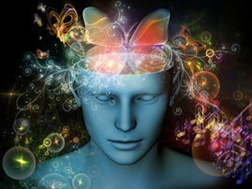

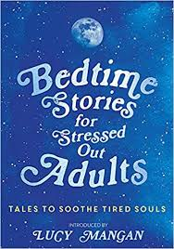
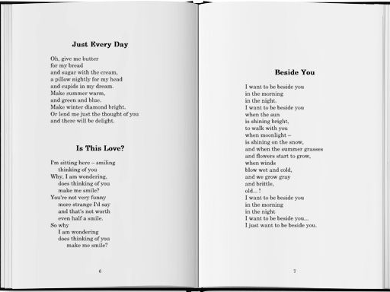

Texts that entertain
Types and features
Sam Crookes (2020) including some adaptions from: ‘Literacy Ideas’.

Slide 2
Poetry and lyrics
Language features
Use of rhyme, rhythm, and various literary devices
Language that appeals to the senses / emotions is often used
Imagery is used to paint pictures in the readers’ minds
The sounds and meanings of language are played with.
Layout features
Often lines are written to show the rhythm
Do not follow the usual rules of grammar

Slide 3
Examples of poems / lyrics
November By Maggie Dietz
Show's over, folks. And didn't October do
A bang-up job? Crisp breezes, full-throated cries
Of migrating geese, low-floating coral moon.
Nothing left but fool's gold in the trees.
Did I love it enough, the full-throttle foliage,
While it lasted? Was I dazzled? The bees
I Am a Rock
Simon & Garfunkel
A winter's day
In a deep and dark December
I am alone
Gazing from my window to the streets below
On a freshly fallen silent shroud of snow
I am a rock, I am an island
I've built walls
A fortress deep and mighty
That none may penetrate
I have no need of friendship
Friendship causes pain
It's laughter and it's loving I disdain
I am a rock, I am an island

Slide 4
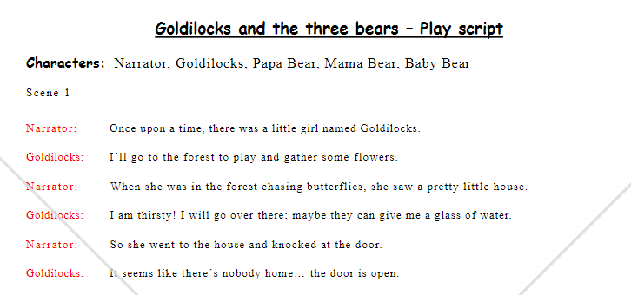
Plays
Story related largely through the use of dialogue with page showing name of character and the words they speak
Organisational information included such as set descriptions and stage directions

Slide 5
Short stories and novels.
Most often written in the past tense
Most often uses the third or first person perspective
Characters are often recognisably human in their motivations and actions
Language is used creatively to paint a picture in the reader’s mind
Uses metaphors to help create feelings / mental pictures
Uses a wide range of punctuation – especially speech marks for speech.

Slide 6
Look at the following examples. What techniques can you see?
Think about:
Is it in the 1st or 3rd person? What effect does this have?
Does it contain metaphors? What are they?
Does it use only short to the point sentences, or does it contain longer more descriptive ones?
What other language features can you see?

Slide 7
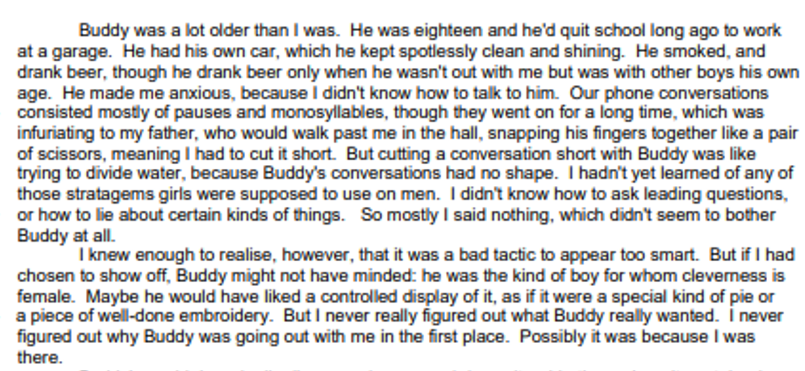

Slide 8
Frodo halted for a moment, looking back. Elrond was in his chair and the fire was on his face like summer-light upon the trees. Near him sat the Lady Arwen. To his surprise Frodo saw that Aragorn stood beside her; his dark cloak was thrown back, and he seemed to be clad in elven-mail, and a star shone on his breast. They spoke together, and then suddenly it seemed to Frodo that Arwen turned towards him, and the light of her eyes fell on him from afar and pierced his heart.
He stood still enchanted, while the sweet syllables of the elvish song fell like clear jewels of blended word and melody. ‘It is a song to Elbereth,’ said Bilbo. 'They will sing that, and other songs of the Blessed Realm, many times tonight. Come on!’
—J.R.R. Tolkien, The Lord of the Rings: The Fellowship of the Ring, “Many Meetings”

