Slide 1
Iaith ar waith
Sesiwn 7/8
Iechyd a Gofal/Health and Social

Slide 2
Aim
By the end of the session you will be able to:
Ask how people are feeling
Recognise and name Ailments and Illnesses
Examinations
Objective
Provide information to customers orally in a familiar situation, consistently using relevant Welsh vocabulary and phrases correctly
Form and use a variety of relevant and standard Welsh questions when responding to a customer's request

Slide 3
Let’s re-cap on what we have learnt so far:
Who can tell me the date in full today?
How can we welcome everyone to the session?
What’s the weather like today?
Who can introduce themselves to the class?
What time does our session start?
What time does our session end?

Slide 4
Dych chi eisiau?
Ble mae eich…?
Dych chi eisiau mynd i …?
Dych chi gallu symud…?

Slide 5
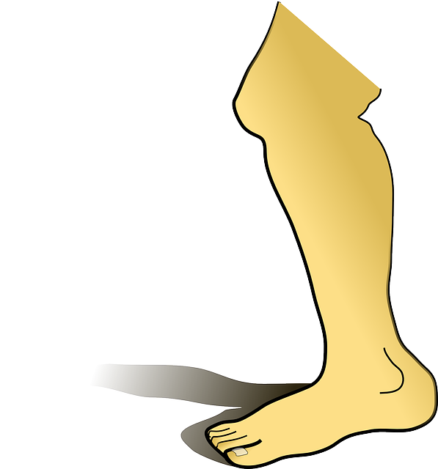
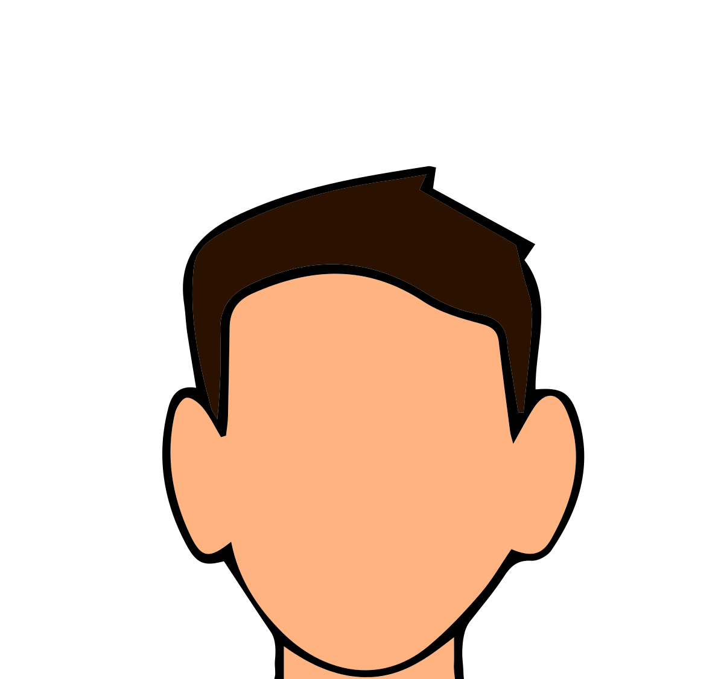
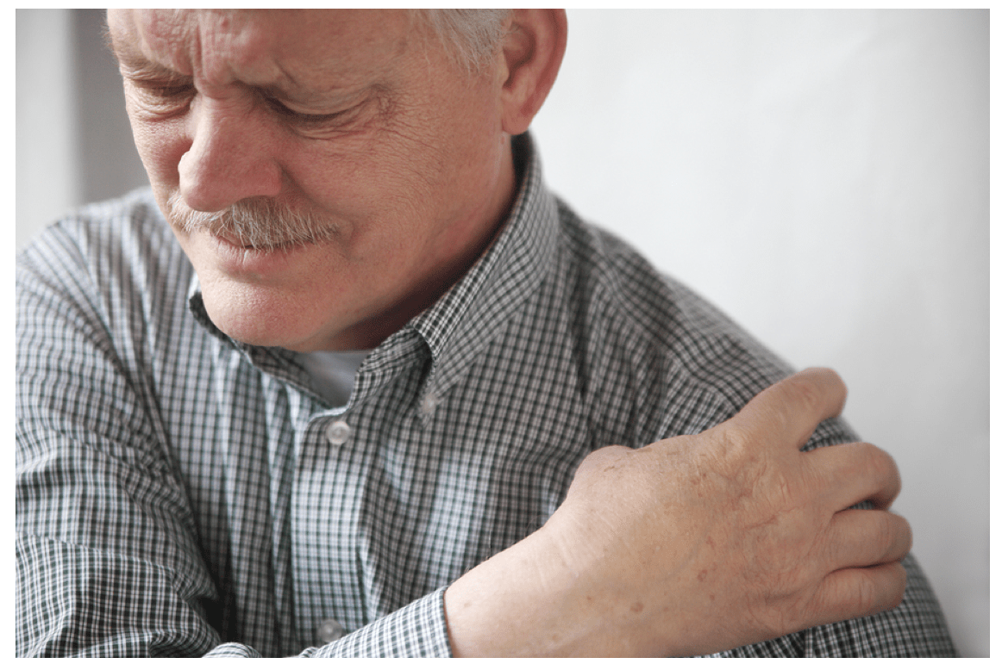
Eich - Your
This Photo by Unknown Author is licensed under CC BY-SA
braich
arm
coes
leg
pen
head
troed
foot
cefn
back
ysgwydd
shoulder
This Photo by Unknown Author is licensed under CC BY
This Photo by Unknown Author is licensed under CC BY-ND

Slide 6
How are you feeling?
Sut dych chi’n teimlo?

Slide 7
rESPONSE
Iawn, diolch
Da iawn, diolch
Mewn poen
Yn dost
Ddim yn dda iawn

Slide 8
What’s wrong?
Beth sy’n bod?

Slide 9
Ers pryd dych chi wedi teimlo’n dost?
Since when have you been feeling ill?
Ers pryd dych chi mewn poen?
Since when have you been in pain?
Ble mae’r poen?
Where’s the pain?

Slide 10
Atebion / answers
Mae pen tost gyda fi | I have a headache
Mae bola tost gyda fi | I have a bad stomach
Mae alergedd gyda fi | I have allergies
Mae gwres gyda fi | I have a temperature
Mae poen yn fy… | I have pain in my…

Slide 11
Activity
https://dysgucymraeg.cymru/cymraeg-gwaith/cyrsiau-cymraeg-gwaith/sector-gofal-rhan-2/

Slide 12
Teams activity
In your teams groups discuss illnesses and ailments that you may come across when caring for people.
Once you’ve created a list, use the dictionaries that have been recommended and apps to find translations for these words.
Place the illnesses/ailments into the relevant sentences.
Mae ……………………… gyda fi. I have……………………………
Mae poen yn fy ………………………. I have pain in my ………………………………….
Dw I wedi anafu fy …………………………………. I have hurt my ……………………………………
Dw I methu symud fy ………………………………… I can’t move my ………………………………………….
Dw I’n gweld yn anodd i ……………………………… I’m finding in hard to ………………………………………………………

Slide 13
Task
Research and revise the answers to the questions.

