Slide 1
International Tourism

Slide 2
Definition of International Tourism…
The international tourist industry of a country may be defined as the sum of domestic activities that directly support the consumption of goods and services of foreign tourists in the country.
- Source: United Nations, 1999, "Handbook of Input-Output Table Compilation and Analysis", Studies in Methods: Handbook of National Accounts, Series F, No. 74, UN, New York, p. 211.

Slide 3
Areas of International Tourism
Political:- Certain events can affect the Tourism Industry, such as terrorist attacks. Countries will try to improve that image by means of politics and media.
Economical:- Tourism is labour intensive industry. Employs a higher percentage of women. The growth of ethical tourism has been a key recent feature + volunteerism.
Social:- The growing role of social media in tourism has been increasingly an emerging research topic. Social media plays a significant role in many aspects of tourism, especially in information search and decision-making behaviours, tourism promotion and in focusing on best practices for interacting with consumers.
Technological:-
Wifi On Flights
Mobile Boarding Passes
Online Flight Check-in
Online Booking

Slide 4
Internal and External Customers
Internal:- An internal customer is someone who has a relationship with your company, though the person may or may not purchase the product. It is often a person who works within the company, such as general employees and managers.
External:- An external customer is a person who is not directly connected to your organization other than by purchasing your product or service.

Slide 5
Types of Tourists
Definition of a tourist: Someone who visits a place for pleasure and interest, usually on holiday.
Here are some examples of the “Main” types of tourists:
Leisure tourist
Business tourist
Dark tourist
VFR
Culture Vulture
Adrenalin junkie/ Adventure tourist
The different types of tourists are: Event tourist, Eco Tourist, Medical/Health tourist, Special Interest Tourist (SIT), Education tourist, Gap year tourist, Religious tourist, Agritourist and Back packer.
In the ever developing tourism industry there are different types of target markets/ tourists are introduced each day depending on their interests and status as an example people are beginning to look at elderly people, couples, singles and youngsters as different tourist groups based on their interests such as cruise trips, romantic getaways, self exploration and partying with friends.
Notes:
Leisure tourist: Someone who just wants to leave their usual environment to get away from work, stress, family or friends to relax and experience the local attractions.
Business tourist: Someone who travels for work purposes such as meetings, excursions or exhibitions and is getting payed for working away from their work place or home.
Eco tourist: Someone who goes on holidays designed in a way that the tourist is close to the environment, causes a minimal amount of damage to the environment, takes art in activities helping the environment and some of the money they pay for the different components of the holiday goes to protect and help the local environment and animals.
VFR: Someone who travels to visit their friends and relatives or to attend special events such as weddings, funerals, birthday parties, also in some cases people visit their friends and relatives so they can use their home as accommodation whilst they are travelling for other purposes too.
Adrenalin junkie/ Adventure tourist: Someone who travels for the thrill of it and takes part in dangerous, physical activities such as climbing the Mount Everest or scuba diving with sharks or travels for cultural exchange.
There are many more types of tourists such as: Dark tourist, Event tourist, Medical/Health tourist, Special Interest Tourist (SIT), Education tourist, Gap year tourist, Religious tourist, Agritourist, Culture tourist and Back packer.
In the ever developing tourism industry there are different types of target markets/ tourists are introduced each day depending on their interests and status as an example people are beginning to look at elderly people, couples, singles and youngsters as different tourist groups based on their interests such as cruise trips, romantic getaways, self exploration and partying with friends.

Slide 6
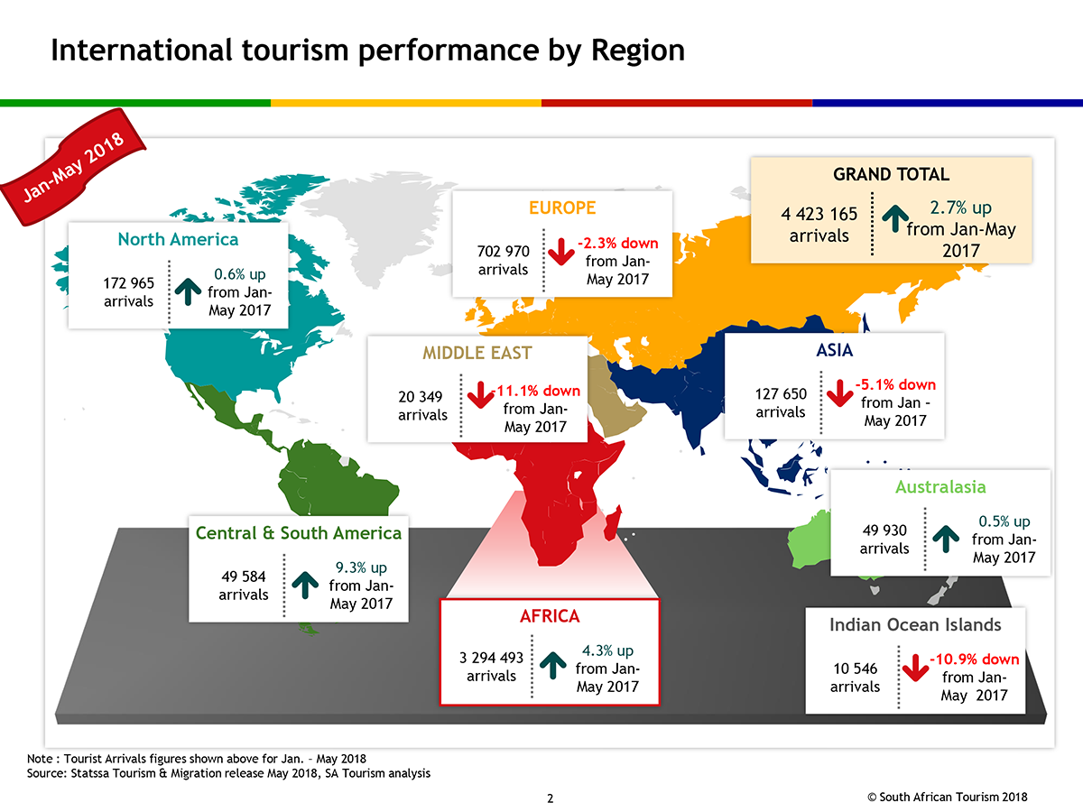
Statistics
International tourism arrivals has grown over 1.3 billion from 2016 to 2017, with a 6.8% rise.
The two largest regions that had the highest growth with arrivals are Africa with 9% and Europe with 8%

Slide 7
Post-war developments of travel and tourism
Since the Second World War, which ended in 1945, the worldwide travel and tourism industry had grown so much that it is considered as the largest industry in the world. In the past 60 years the developments of the industry has been shaped by a number of factors. These factors can be divided into four categories, which are:
Changing socio-economic conditions
Developing technology
Product technology
Changing consumer needs

Slide 8
1. Changing Socio-economic conditions
This is the term given to the combination of social and economic factors. These factors have contributed to the growth of the travel and tourism industry since the Second World War. Leisure time has increased greatly in the past amount of years for people in the UK. One of the reasons for its increase is the introduction of paid holidays. Now people feel at ease to go on holiday without of being short for money when they come home. These paid holidays have increased seaside holidays significantly such as Brighton, Blackpool or Benidorm.

Slide 9
2. Developing technology
Transport has improved greatly in the past number of years.
Aircraft, ships and trains can all carry large numbers of passengers safely and quickly to their destinations. Technological advances in aircraft design after the Second World War meant that air travel became available as a means of mass transport from the 1970s.
The rise of car ownership has been the greatest single transport feature that has promoted increased demand for domestic tourists.
A vast number of technological developments within transport have influenced the development of the travel and tourism industry from the 1950s to the present day including the creation of the Euro tunnel.

Slide 10
3. Product development
There are always going to be new products developing in the travel and tourism industry in order to meet consumer demands. The development of the tourism market has been mostly due to the ability to introduce travel products and services for domestic, inbound and outbound tourists.
1. Package Holidays
The development of package holidays had a great impact in tourism development. All tour operators now sell package tours which are all inclusive, which means accommodation, transfer, meals are all included in the deals. The tour operators buys the package in bulk so they can sell to customers at a cheap price which attracts customers to take a holiday.

Slide 11
2. Theme Parks
Theme Parks have been created in almost every countries of the world to attract tourists. These are the amusement parks where many rides are installed and lots of attractions are made to entertain a large group of people. Examples include Thorpe Park and Alton Towers in UK or Disney Land in Paris and Florida.

Slide 12
3. Introduction of Holiday camps
Holiday parks like Pontins and Butlins led to a big growth in the tourism industry. In the holiday camps holidaymakers pay for their accommodation and also can go for full board, half board or self catering.
4. Low cost Airlines
In the last few decades low cost airlines contributed hugely in the development of tourism. Low cost airlines like Ryan Air, Easy Jet made it easy for tourists to travel for very cheap prices.
5. Long Haul Destinations
The possibility of taking a long haul flights made it very attractive for tourists to go far away form home. People can go from one part of the world to another part in couple of hours and explore the world which gives them immense pleasure.

Slide 13
Domestic Tourism
Domestic tourism is the travelling of people around their own country and staying within its boundaries. Domestic tourism was popular in the 1960s and 1970s. Although the peak has fallen you will find it still to be popular among families. It is still popular because of the number of short stay holidays being taken in the UK, for reasons like business or visiting family. The domestic market has improved; people are offering things like new exciting attractions such as Blackpool.

Slide 14
Outbound tourism
When you go to book a holiday you have a large range of them to choose from this is all about demands and expectations, these tend to change, as you get older. There are all different types of holidays from adventure to wine tasting. Some people when going on a lot of holidays to sundrenched resorts tend to get beach boredom, so they tend to go for something different. But then other people like to sit on a beach all day. To get a holiday to suit you they sub-divide into these categories:
Season
Transport
Length
Distance
This is how they get the right deal for you.
The most popular since 1970s is the inclusive tour by air, lasting more than four nights, taken in the summer to short haul destinations such as Spain. Also the industry is continually developing new products and services to cater for all markets.
Today’s travel and tourism industry has evolved over the relatively short period since the end of the Second World War has a number of features that reflect the highly dynamic and competitive nature of the business.
The industry can be divided into two groups
- Commercial
- Non-commercial

Slide 15
Public, Private and Voluntary Bodies
Public:- Public sector organisations are funded by the national and local government. The aim of the public sector is to educate, inform and provide a service to its customers. DCMS (Department of culture, media and sport). Some examples of Public sector organisations are:
Museums
Visitor information Centres
National gallery
Regional development organisations

Slide 16
Public, Private and Voluntary Bodies
Private:- Most travel and tourism businesses belong to the private sector. The main objective of private sector organisations is to make profit. Tourism is said to be the world's largest employer, and in the UK 10% of the employment is in the tourism sector. Some examples of Private sector organisations are:
Thomas Cook
Alton Towers
Holiday inn
Virgin Trains
British Airways
London Eye

Slide 17
Public, Private and Voluntary Bodies
Voluntary:- Voluntary sector organisations are often charities or trusts. They are funded mainly through their members, entrance fees to attractions, fundraising and donations. The aims of voluntary sector organisations are to preserve, protect and promote their cause. They are usually staffed by a mixture of paid managers, workers and volunteers. Some examples of Voluntary sector organisations are:
The National trust
Tourism concern
Friends of Williamson's
The Sealed knot

