Slide 1
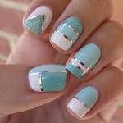
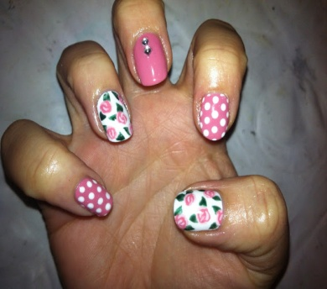
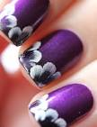
Nail Art Products
Nail Art Products

Slide 2
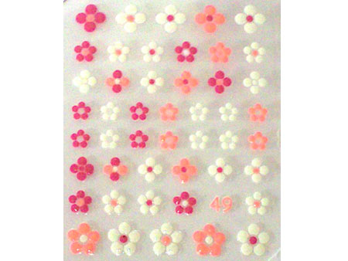
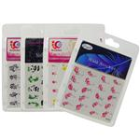
Transfers
These are designs or images that create an instant effect on the nails. They are very simple to apply but look very effective.
There are 2 different types of transfers:
1. Water release
2. Self-adhesive

Slide 3
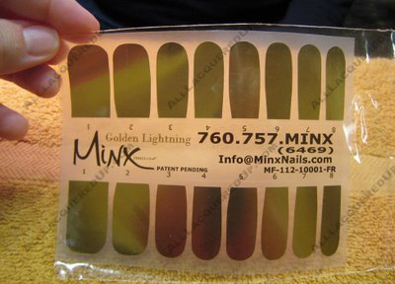
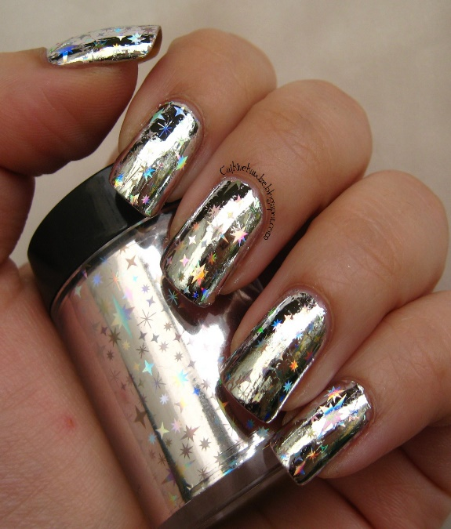
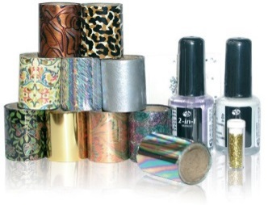
Foils
Foiling is almost instant nail art, some foils have designs on them and just need applying to a painted nail.
Foils are applied to the adhesive on the nail and can have spectacular results.
A sealer is needed on top of the foils to keep them intact.

Slide 4
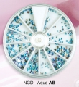
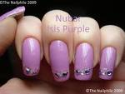
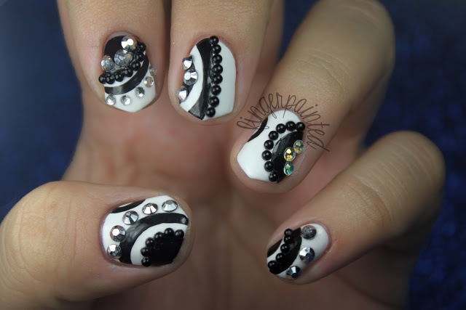
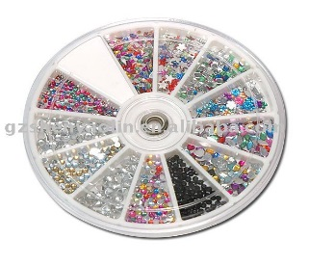
Rhinestones and Gems
These are one of the most popular products. They come is different designs and colours. They can create effects and designs, or can be used alone to add ‘bling’ to the nail.

Slide 5
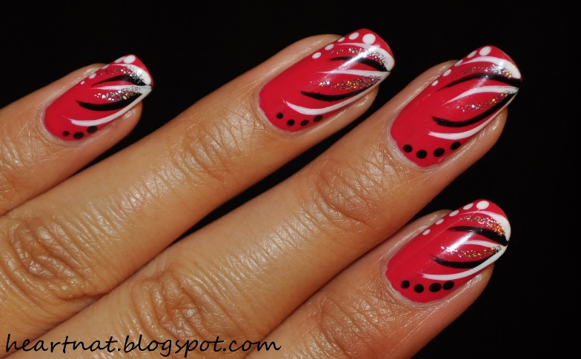
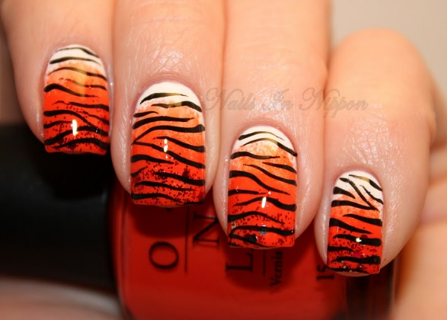
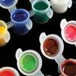
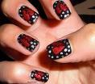
Nail Art Paints
The main paints used: Specialised water –based acrylic paints.
Water based paints have the advantage that if you made a mistake it can be easily repaired.
There are many different designs that can be created, and there are different tools and brushes that create them.

Slide 6
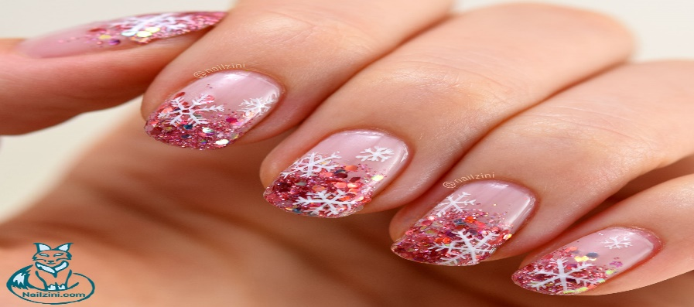
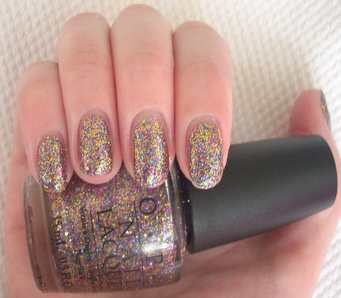
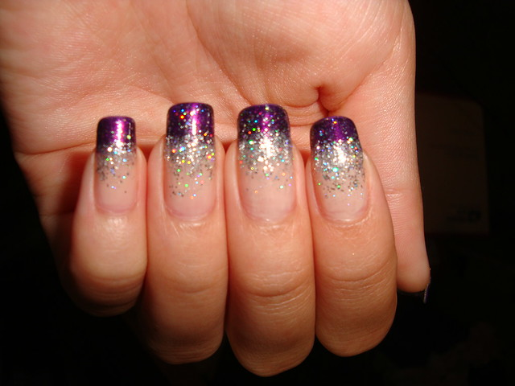
Glitter polish and dust
Glitter polishes and glitter dust are a versatile range of products to create or enhance nail art.
Glitter polishes can be applied straight from the bottle and to the whole nail.
Glitter dusts can be used to create more specific designs by picking up the dust with a brush or by the tip of a nail dipped into the pot to collect the dust only where the sealer is wet.

Slide 7
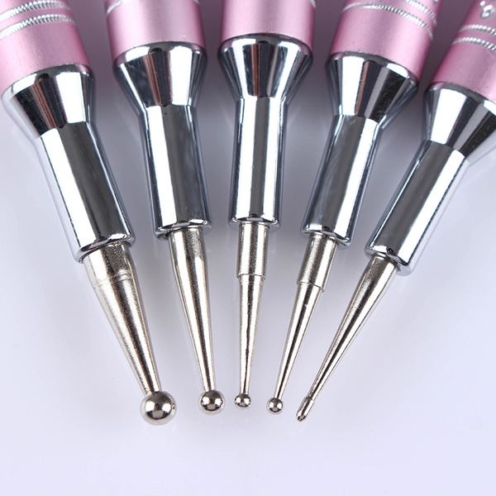
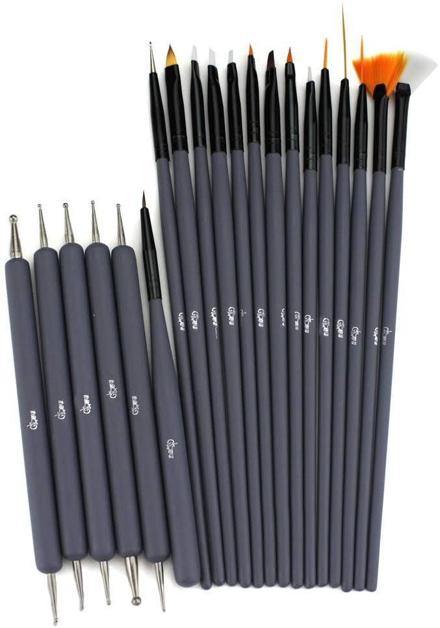
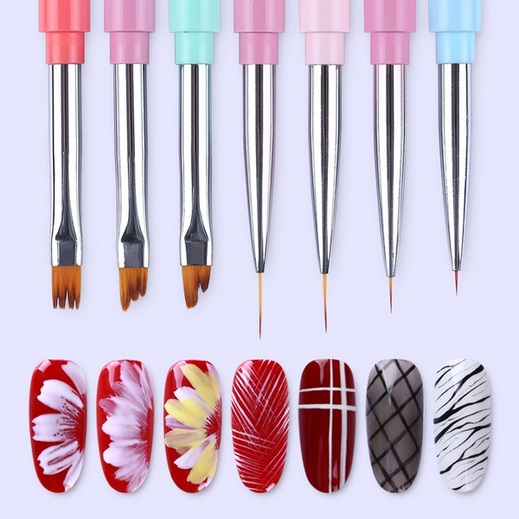
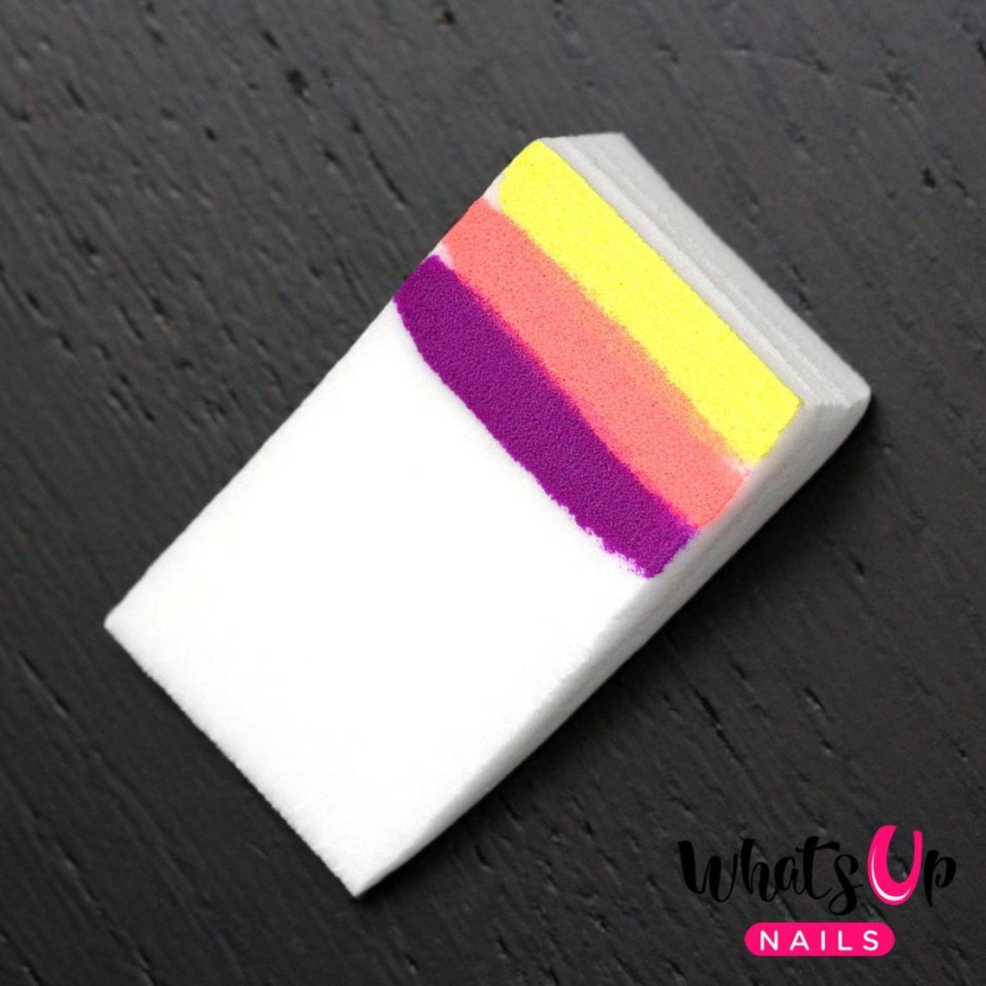
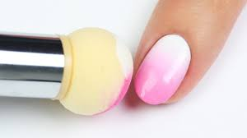
Nail Art Tools

Slide 8
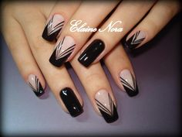
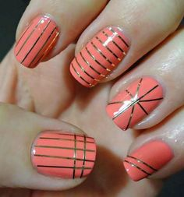
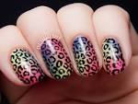
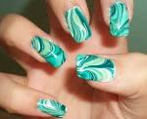
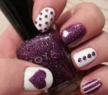
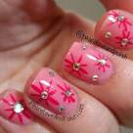
Designs

Slide 9
Nail art tutorials.
https://m.youtube.com/watch?v=9If1mckU5vY
Water marbling - https://m.youtube.com/watch?v=rp79DxUldpI

Slide 10
Preparing the nail for Nail Art
Check the nail shape of all nails and ensure the edges have been bevelled.
Ensure you 'squeak' the nail fully, this will ensure no oil or product residue is on the nail.
Preparing the nail correctly will ensure the nail art lasts and the finish is professional.

Slide 11
Factors to consider
Clients choice
Nail length, strength and shape
Occasion
Skin colour
Outfit colour
Time allocation
Price
SKin and nail conditions
Fashion trends
CUltural factors

Slide 12
Products and basic techniques
for Nail Art
Products
Base coat, nail art paints, coloured enamels, stick-on transfers, glitter polishes, flat shapes, gemstones, non-acetone nail varnish remover, topcoat.
Techniques
Transfer application, rhinestones, stripping tapes, flat stones, animal designs, stick-on transfers, water marbling, brush designs, dotting tool designs, nail jewellery.

