Slide 1
What is Digital Literacy?

Slide 2
Definitions
Digital literacy is about behaviour, attitude, skills, knowledge and experience in the use of digital technology and tools.
Digital literacy refers to a particular set of competencies that allow you to function and participate fully in a digital world.

Slide 3
The 3 Ts
Technologies – Devices, e.g. mobile phone, tablet, laptop, digital camera, etc.
Tools – Software, e.g. PowerPoint, Word, Excel, Google, etc.
Techniques – Software features, e.g. Templates, Animation, Transitions, Borders, etc.

Slide 4
Why learn Digital Literacy Skills?
Learners, nowadays, are generally considered to be digital natives; able to use technology effectively and easily. However, it is equally important to be digital citizens.
A digital citizen acts appropriately and ethically in an online environment. They must be able to resolve conflicts, source material ethically and interact with the wider world in a responsible manner.
The development of digital literacy skills enables learners to demonstrate a proficiency required by employers and next-stage educators.

Slide 5
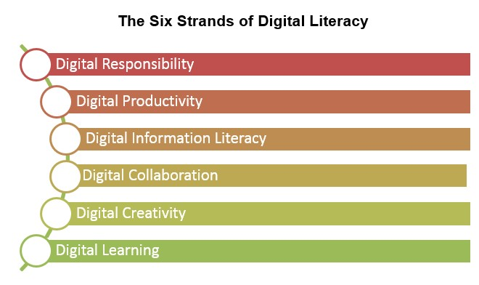
The 6 Strands of Digital Literacy
Notes:
Digital Responsibility: Knowing how to stay safe and act appropriately online
⇒ Digital Productivity: Knowing which technologies, (e.g. mobile phone), tools (e.g. Microsoft PowerPoint) and techniques (e.g. slide transitions) to use and how to organise, share and protect digital information
⇒ Digital Information Literacy: Being able to find, critically evaluate and use digital information safely
⇒ Digital Collaboration: Sharing knowledge and collaborating with others to complete tasks and solve problems
⇒ Digital Creativity: Being able to use digital media to complete tasks, generate content and develop opportunities
⇒ Digital Learning: Understanding how technology can extend learning opportunities

