Slide 1

第1周第3 天 教师培训
Day 3 Week 1 Teacher Training

Slide 2
Lesson Planning / 教案

Slide 3
Prynhawn da
下午好 (Xiàwǔ hǎo)
Good afternoon

Slide 4
At the end of today’s session you will be able to:
在今天的课程结束时，你将能够：
Define the term ‘learning objectives’定义“学习目标”这个术语
Explain the difference between learning objectives and aims/goals
解释学习目标和目的的区别
Examine Bloom’s compare with Anderson & Krathwohl’s
与安德森和Krathwohl比较，检视布卢姆方法
Evaluate some learning objectives and determine their strengths & weaknesses
评估一些学习目标并确定它们的优点和弱点。

Slide 5

Planning & preparation计划和准备
What are the four major elements involved in planning a lesson ?
^{计划一节课的四个主要元素是什么？}
(10 minutes - On ShowMe Boards^{© )}
^{（10分钟--在展示板上）}

Slide 6
Four major elements 四个重要元素
Deciding on educational objectives 决定教育目标
Selecting and scripting a lesson 选择并编写课程脚本
Preparing the material and resources to be used
准备要使用的材料和资源
Decide how to assess students’ progress 决定如何评估学生的进步
        (Butt 2006, Skowron 2006, Tileston 2004)

Slide 7
Different types of Lesson Plan 不同类型的教案

Slide 8
5 Minute Lesson Plan 5分钟教案

Slide 9
Visual lesson 5 minute lesson plan 视图化5分钟教案

Slide 10
What are learning objectives ?
什么是学习目标？

Slide 11
Learning Objectives 学习目标
Objectives are statements which describe what the learner is expected to achieve as a result of instruction.
目标是描述学习者在教学中期望达到的成果的陈述。
Because they direct attention to the student and the types of behaviours they should exhibit, sometimes these statements are called “behavioural” objectives.
因为这些陈述将注意力引向学生和他们应该表现出的行为类型，
所以有时这些陈述被称为“行为”目标。

Slide 12
Why bother with learning objectives ?
为什么要为学习目标费心?

Slide 13
Purposes of Objectives 目标的作用
By knowing where you intend to go, you increase the chances of you and the learner ending up there
通过了解你的目标，你和学习者最终达到目标的几率就会增加
Guides the teacher relative to the planning of instruction, delivery of instruction and evaluation of student achievement.
指导教师的教学计划制定、教学实施和学生成绩评估。
Guides the learner; helps him/her focus and set priorities
引导学习者：帮助他/她集中注意力，设定优先次序
Allows for analysis in terms of the levels of teaching and learning
可以对教与学的水平做出分析

Slide 14
Learning Objective 学习目标
Definition 定义
A statement in specific and measurable terms that describes what the learner will know or be able to do as a result of engaging in a learning activity.
一种具体的、可衡量的表述，它描述学习者通过参与一项学习活
动将会知道或能够做什么。
Example 举例
Students will list three characteristics that make the family doctor distinctive from other specialists in the health care system.
学生们将列出家庭医生区别于其他医疗保健系统专家的三个特点。

Slide 15
Magic Triangle 魅力三角
Objectives目标
Learning
学习
Activities
Evaluation
评估

Slide 16
Learning Objective Domains 学习目标范围
Cognitive (knowing) 认知(了解)
Psychomotor (doing) 心理运动(做)
Affective (feeling) 情感(感觉)

Slide 17
Describe Learning 描述学习
Three Domains of Learning
  cognitive (intellectual abilities) Knowing
  认知的(智力能力)知道
  affective (attitudes, values, interests) Feeling
  情感的(态度、价值、兴趣)感觉
  psychomotor (muscular action,dexterity) Doing
心理运动(肌肉运动，灵巧)做
Bloom’s (& others) Taxonomy 布鲁姆 (与其他人)的分类
  1956: a shared vocabulary & “ahead of its time”
  1956年:共享词汇和“超前于时代”

Slide 18
Bloom’s Taxonomy of Educational Objectives
布鲁姆教育目标分类
For the
Cognitive
Domain
Evaluate 评价
judge, critique, justify,
verify, assess, recommend
Synthesize 综合
create, construct, design,
improve, produce, propose
Analyze 分析
compare, contrast, classify, categorize, derive, model
Apply 应用
calculate, solve,
determine, apply
Comprehend 理解
explain, paraphrase
Remember 记住
list, recite

Slide 19
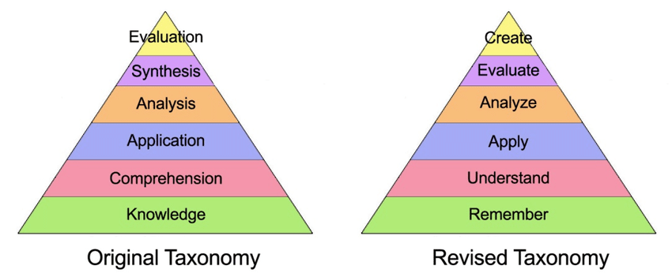
Bloom revised in 2002 – Lorin Anderson & David Krathwohl.
布卢姆在2002年修订--Lorin Anderson & David Krathwohl.

Slide 20
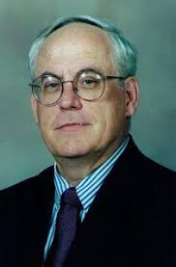
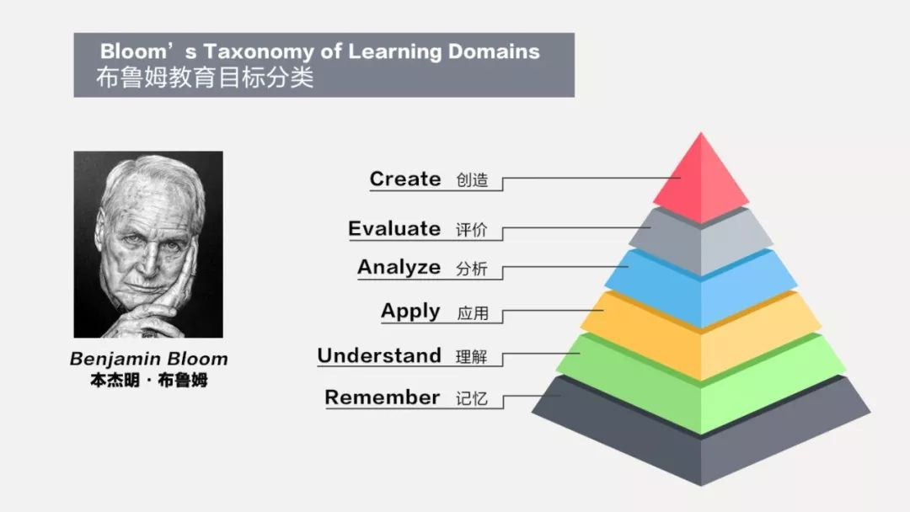

Bloom revised in 2002 – Lorin Anderson & David Krathwohl.
布卢姆在2002年修订--Lorin Anderson & David Krathwohl.
Lorin Anderson
David Krathwohl

Slide 21
Bloom revised in 2002 – Lorin Anderson & David Krathwohl.
布卢姆在2002年修订--Lorin Anderson & David Krathwohl.
Lorin Anderson
Why ? /
David Krathwohl

Slide 22
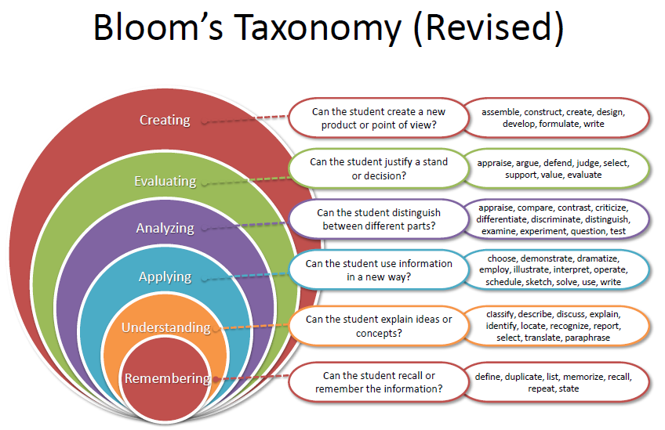

Slide 23
Students will operate at the level we expect them to, if:
学生的操作将达到我们期望的水平，如果：
Communicate these expectations 沟通这些期望
Use activities & teaching strategies that support expectations 采用支持期望的活动,教学策略
Assess and evaluate performance 对表现进行测评
Learning Objectives 学习目标

Slide 24
Writing Learning Objectives 写下学习目标
Start with action verbs
That can be observed and measured
  Avoid: 避免
    Understand, know, be aware, appreciate 理解，了解，意识到，欣赏
  Use: 使用
    Describe, construct, calculate, determine, list
    描述，构造，计算，确定，列出
Use complete and simple sentences 使用完整和简单的句子
  Verb = process or behavior 动词=过程或行为
  Noun = knowledge to acquire or construct 名词=获取或构建的知识

Slide 25
Knowledge Verbs (1st level) 知识动词(一级)
Remembering 记住
Define 定义
Memorise 记忆
List 列表
Recall 回忆
Repeat 重复
Relate 关联
Name 命名
Repeat 重复

Slide 26
Comprehension Verbs (2nd level) 理解动词(二级)
Understanding 理解
• Restate 重新叙述
• Discuss 讨论
• Describe 描述
• Identify 确定
• Locate 定位
• Report 报告
• Explain 说明
• Express 表达
• Recognise 认可
• Review 回顾

Slide 27
Application Verbs (3rd level) 应用动词(第3级)
Applying 应用
• Translate 翻译
• Interpret 说明
• Apply 应用
• Practice 练习
• Illustrate 阐明
• Operate 操作
• Demonstrate 展示
• Dramatize 编写剧本
• Sketch 素描
• Employ 雇用
• Schedule 安排
• Use 使用

Slide 28
Analysis Verbs (4th level) 分析动词(第4级)
Analysing 分析
• Distinguish 区分
• Differentiate 区别
• Appraise 评价
• Analyze 分析
• Calculate 计算
• Criticize 批评
• Compare 比较
• Contrast 对照
• Examine 检查
• Test 测试
• Relate 关联
• Experiment 试验

Slide 29
Evaluation Verbs (5th level) 评价动词(第5级)
Evaluating 评价
• Judge 判断
• Appraise 评价
• Evaluate 评估
• Revise 修正
• Score 得分
• Select 选择
• Measure 衡量
• Value 评价
• Estimate 估计
• Choose 选择
• Compute 计算
• Assess 评估

Slide 30
Synthesis Verbs (6th level) 综合动词(第6级)
Creating 创造
Compose 构成
Plan 计划
Propose 建议
Design 设计
Assemble 组装
Create 创造
Prepare 准备
Formulate 制定
Organise 组织
Manage 管理
Construct 构造
Set-up 建立

Slide 31
Group Activity 小组活动
Go back to your learning objective previously written and with your neighbor:
  Determine what level of learning this objective met.
  确定这个目标所达到的学习水平层级。
  Try to re-state it to increase its level.
  试着重新陈述来提高它的级别。
  Be ready to present the results of this exercise to the entire group.
  准备好向整个小组介绍这项练习的结果。
7 minutes. 7分钟

Slide 32
Learning objectives shift us away from what we as teachers are covering towards what our students are learning. 学习目标使我们从老师的讲授转向学生的学习。
In Summary 总结
Use learning objectives to set up a class where higher levels of thinking are taught, learned, practiced, evaluated, and assessed.
学习目标建立了一个能讲授、学习、练习、评价和测评更高层次思维的课堂。

Slide 33


Slide 34

Task 1 任务1
请上传包含学习目标的课程计划
Please upload a lesson plan with learning objectives to Moodle

