Slide 1
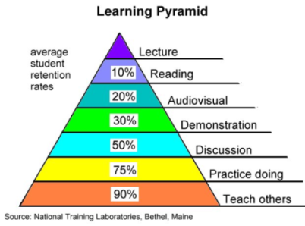
Guidance for completion of the
Long Lesson Plan
Session number
Cross reference the session number to
the scheme of work for the unit/subject.
Start and end time:
Put in the start time and the end time of the session.
Starter & review
Use an activity to review the learning that has taken place to date and put this session in context. A starter exercise engages the students, activates prior knowledge and provides a clear focus on the learning to create a purposeful atmosphere.
Date
Put in the date the session will take place.
Room number
Indicate the room the session is taking place in.
Course
E.g. Extended Diploma in Performing Arts
Unit/subject
E.g. Unit 1 – Health and Safety
Objectives of this session
An objective is a clear statement of something that needs to be completed over a period of time.
Assessment that learning has taken place
Indicate the activities /methods you will use to assess learning has taken place.
Key words
List the main ‘key words’ in this session and communicate these to the students – it will allow them to find the information they require around the topic faster.
Resources
For each activity, provide a list of resources (above and beyond what would normally be available for your session).
Activities
A series of logical activities to enable the students to achieve the learning objectives. The focus must be on what the learners are actually doing with the knowledge, skills and competencies they are acquiring because learning does not occur through just listening, actions are also required.
Cross cutting themes in this session
If you naturally cover some elements of cross cutting themes during an activity, provide information on the content you will cover.
5 cross cutting themes:
Literacy and numeracy
Equality and diversity
Education for sustainable development and global citizenship (ESDGC)
Welsh language and culture
Enterprise and employability
Time
Indicate how long each activity will take.
Homework or out of the classroom activities
Indicate homework tasks or extension activities for the students.
Plenary & look forward
A short activity to wind up the session, to summarise the main learning points and to note progress against the achievement of the session objectives. Look forward to the next session and its content and key words.
Evaluation of the session
Answer the questions reflecting on the success of the session.

