Slide 1

Introduction to Day 6
第6天简介

Slide 2


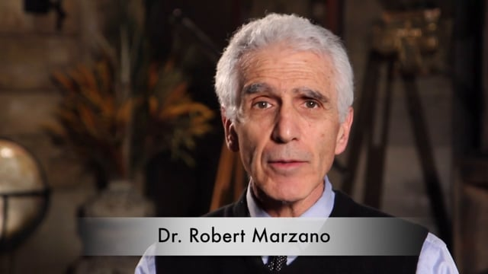
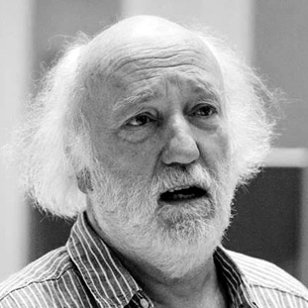
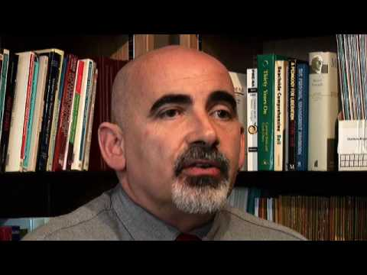
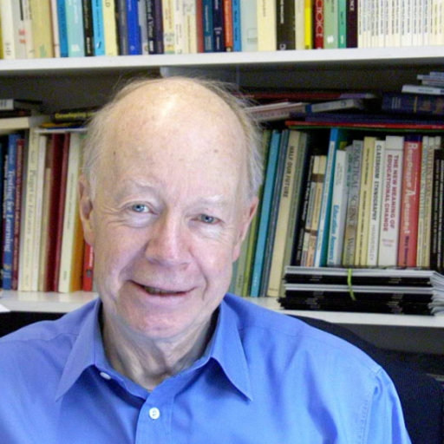

Slide 3
Notes:
Paint

Slide 4

Notes:
Paint

Slide 5
Notes:
Paint

Slide 6
At the end of tomorrows session you will be able to:
在明天的会话结束时，您将能够：
Define the term ‘Assessment for Learning’(AfL)
定义术语"学习评估"（AfL）
Explain the difference between ‘Assessment for Learning’ and ‘Assessment of Learning’
解释"学习评估"和"学习评估"之间的区别
Discuss the major aspects of Assessment for Learning
讨论学习评估的主要方面
Examine the work of Professor Dylan Wiliam and Professor Paul Black
考察迪伦·维利亚姆教授和保罗·布莱克教授的工作
Analyse the evidence from Robert Marzano and John Hattie which supports AfL
分析罗伯特·马尔扎诺和约翰·哈蒂的证据，他们支持非洲发展
Create lesson plans that incorporate “Assessment for Learning”
创建包含"学习评估"的课程计划

