Slide 1
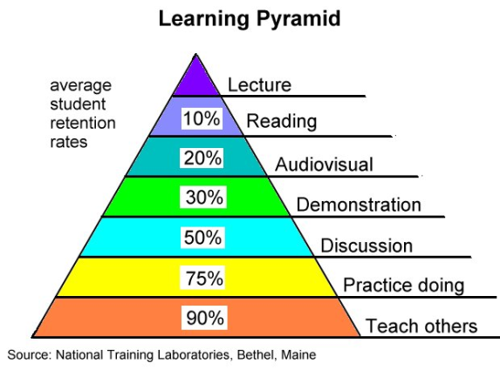
Guidance for completion of the
5 Minute Lesson Plan
Cross reference the session number to the scheme of work for the unit/subject
List the main ‘key words’ in this session and communicate these to the students – it will allow them to find the information they require around the topic faster.
Date needs to be in the format: 01/01/2015
E.g. Extended Diploma in Performing Arts
E.g. Unit 1 – Health and Safety
Provide a list of specific resources (above and beyond what would normally be available for your session).
An objective is a clear statement of something that needs to be completed over a period of time.
Use an activity to review the learning that has taken place to date and to put this session in context.
Follow this by a starter exercise to engage the students, to activate prior knowledge and provide a clear focus on the learning to create a purposeful atmosphere.
A series of logical activities to enable the students to achieve the learning objectives. The focus must be on what the learners are actually doing with the knowledge, skills and competencies they are acquiring because learning does not occur through just listening, actions are also required.
A short activity to wind up the session, to summarise the main learning points and to note progress against the achievement of the session objectives. Look forward to the next session and its content and key words.
5 cross cutting themes:
Literacy and numeracy
Equality and diversity
Education for sustainable development and global citizenship (ESDGC)
Welsh language and culture
Enterprise and employability
If you naturally cover some elements of cross cutting themes during this session, please provide some detail about the content you will explore.

