Slide 1
The learning Environment
What makes a good learning environment?

Slide 2
WHAT IS THIS?
What do we mean?
What is the learning environment?
We know the learning environment must meet the needs of the student….

Slide 3
Maslowes idea – his triangle

Slide 4
So how does this fit into the environment
Basic needs – survival students need to have food rest at their work place
Safe in their environment – Secure in their relationship with each other and the teacher
The need to feel they belong
Self esteem and confidence
Reaching potential

Slide 5
Complete your triangle

Slide 6
The Physical and Emotional environment
PHYSICAL ENVIRONMENT
This means all the elements that ensure the safety and stimulation of the student – safe and stimulates interest
EMOTIONAL ENVIRONMENT
This refers to all that is emotive within the environment-how they are treated, supported, cared for
The teacher
Other peers/students
The environment

Slide 7
THE ENVIRONMENT – The third teacher
An environment must be:
SAFE
HEALTHY
STIMULATING
HYGIENIC
CARING

Slide 9
Interpersonal interactions. ...
Physical environment. ...
Program support structure. ...
Professional and stable teacher workforce. ...
Effective leadership. ...
Age-appropriate curriculum. ...
Comprehensive family engagement activities.

Slide 10
Making the most of your environment
How is your classroom organised
Think about how groups can form together
What about the features and displays in your environment.

Slide 11
Our world our classrrom
We live in a world surrounded by images of every kind – we are meant to absorb these images. This is the intention of every poster or advertisement.
Can you think of some?
These images are set to mean something.. They work by providing the same image selling the same thing… in other words we absorb these images.

Slide 14
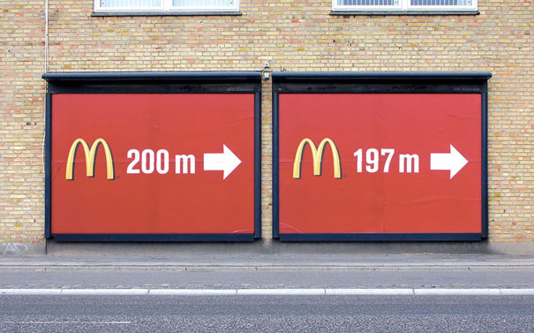

Slide 19
OSMOSIS
In other words:
We absorb what is around us maybe unconsciously, and gradually.
Our surroundings are important-our environment the working area can be the third teacher.

Slide 20
LANGUAGE form and function
As a child we absorb our native language by being part of it.
By 3 years of age we have already acquired a working language of communication.
Who taught us? How did they teach us?

Slide 21
BRUNER v CHOMSKY
2 theorists with 2 different perspectives on language development in children
Jerome BRUNER believes it is very much the environment that we live in that supports our language acquisition
Naom CHOMSKY believes we have an innate device in our brains that makes it a natural process.
We now believe it is a combination of both.

Slide 22
OUR EVIRONMENT – the teacher
‘The environment then… is the hidden teacher
Through osmosis we absorb the environment.
We can conclude that the environment needs to be richly stimulating, thought provoking, questioning, clear, and well organised.
Think of your environment list what is in your environment

Slide 23
THE PHYSICAL ENVIRONEMNT
Whats there?
Physical utilities – what have you got for students comfort and safety?

Slide 24
DISPLAY
If we absorb what is around us it is important that classrooms reflect what we want to teach.
Look at the following slides, think about what you have seen to ensure it is a rich environment

Slide 25
A STIMULATING ENVIRONMENT
It is important you create a stimulating environment for your students.
THE ENVIRONMENT IS THE
THIRD TEACHER

Slide 26
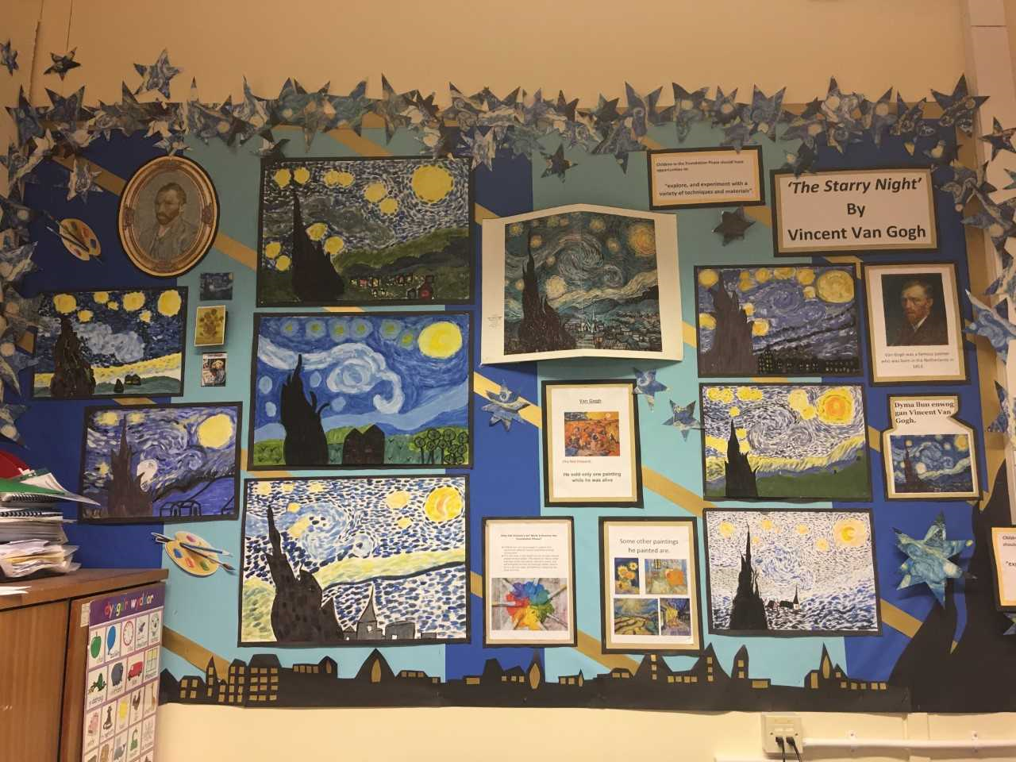

Slide 27
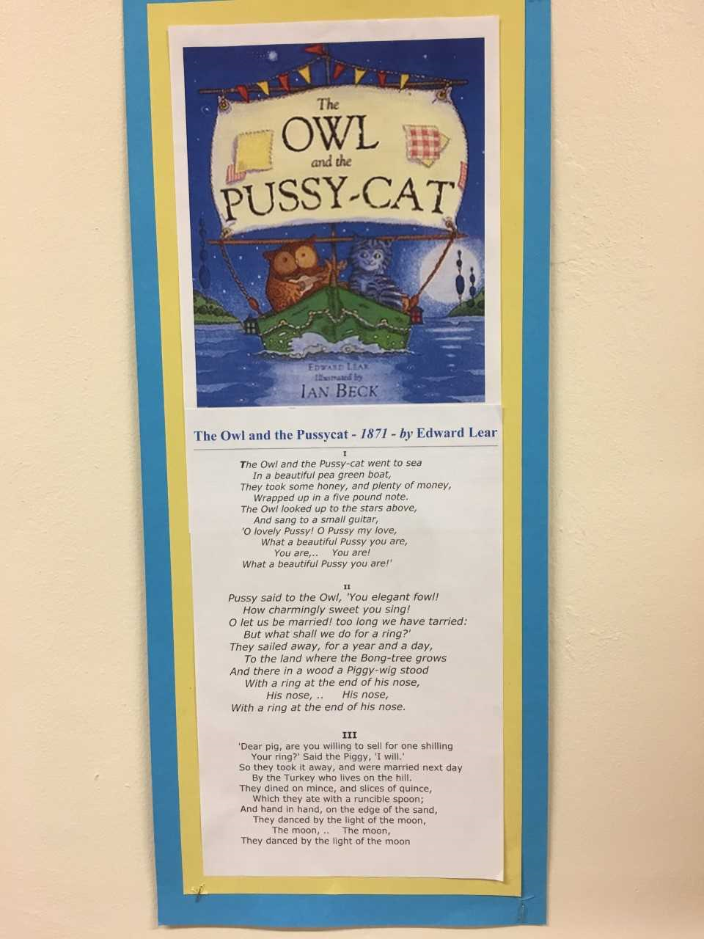

Slide 28
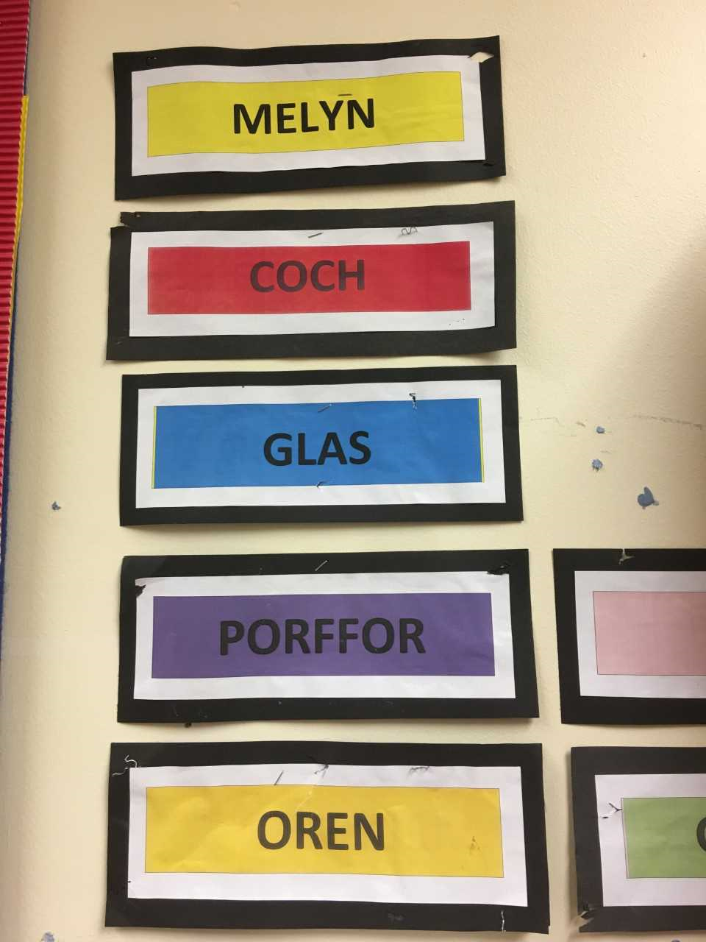

Slide 29
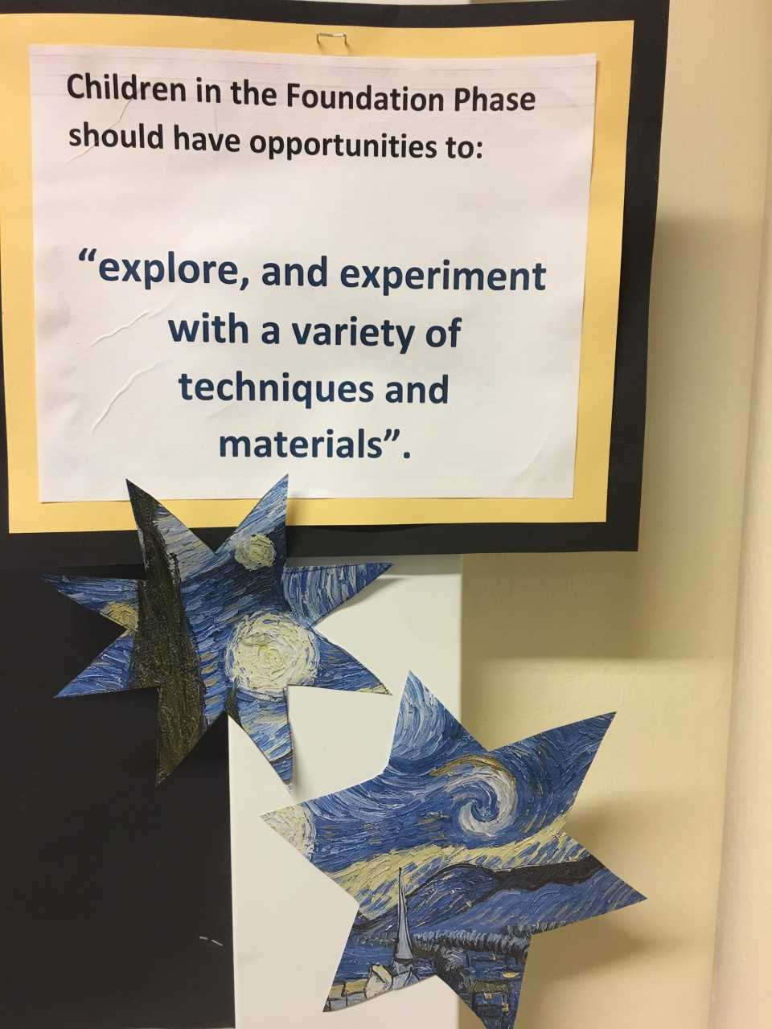

Slide 30
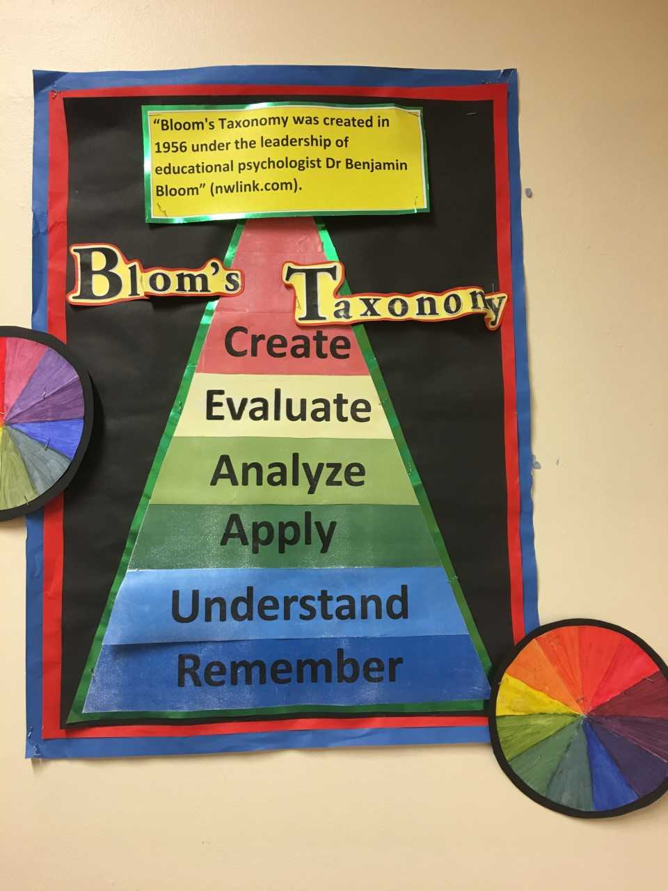

Slide 32
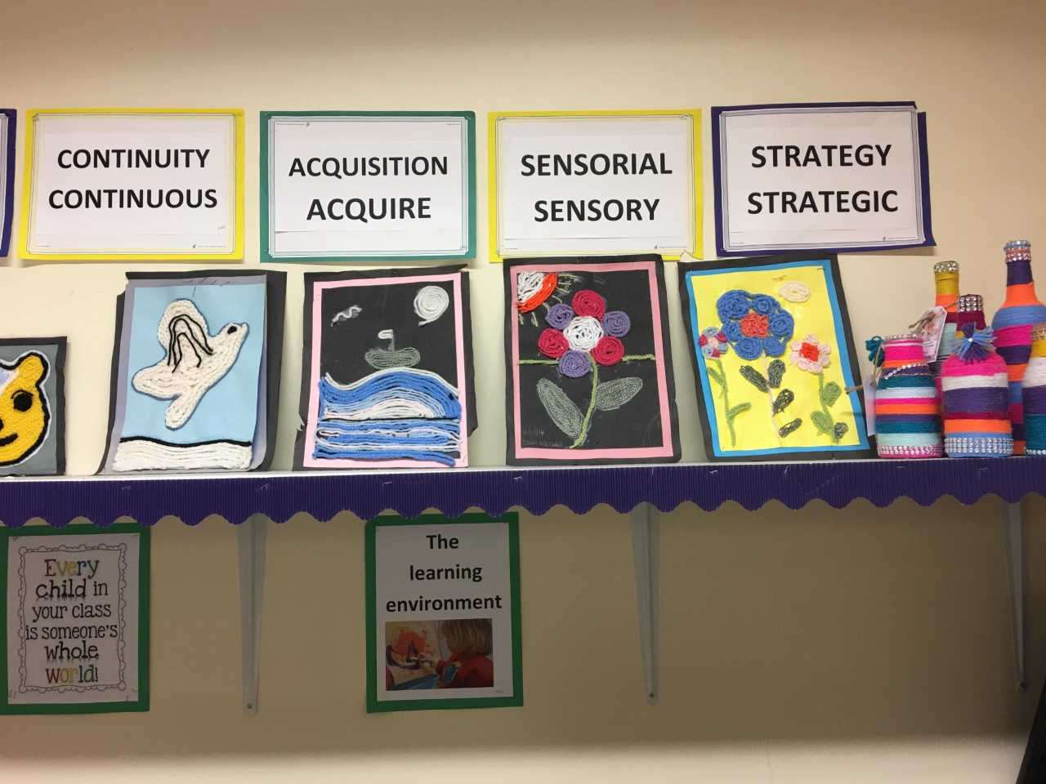

Slide 33
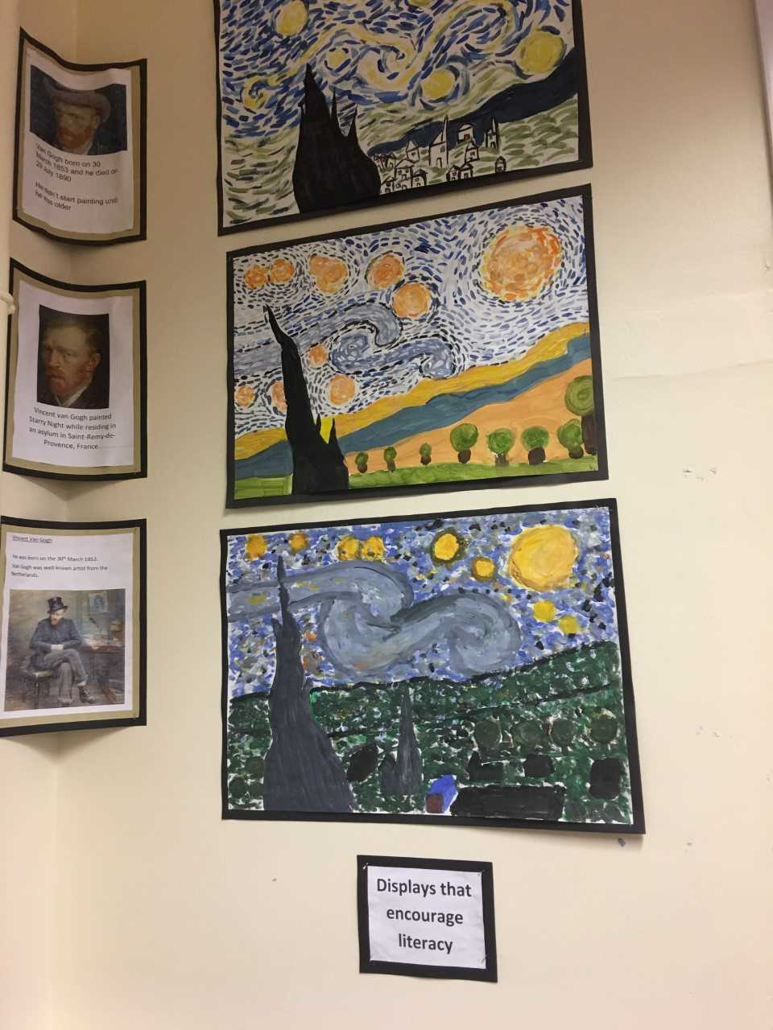

Slide 34
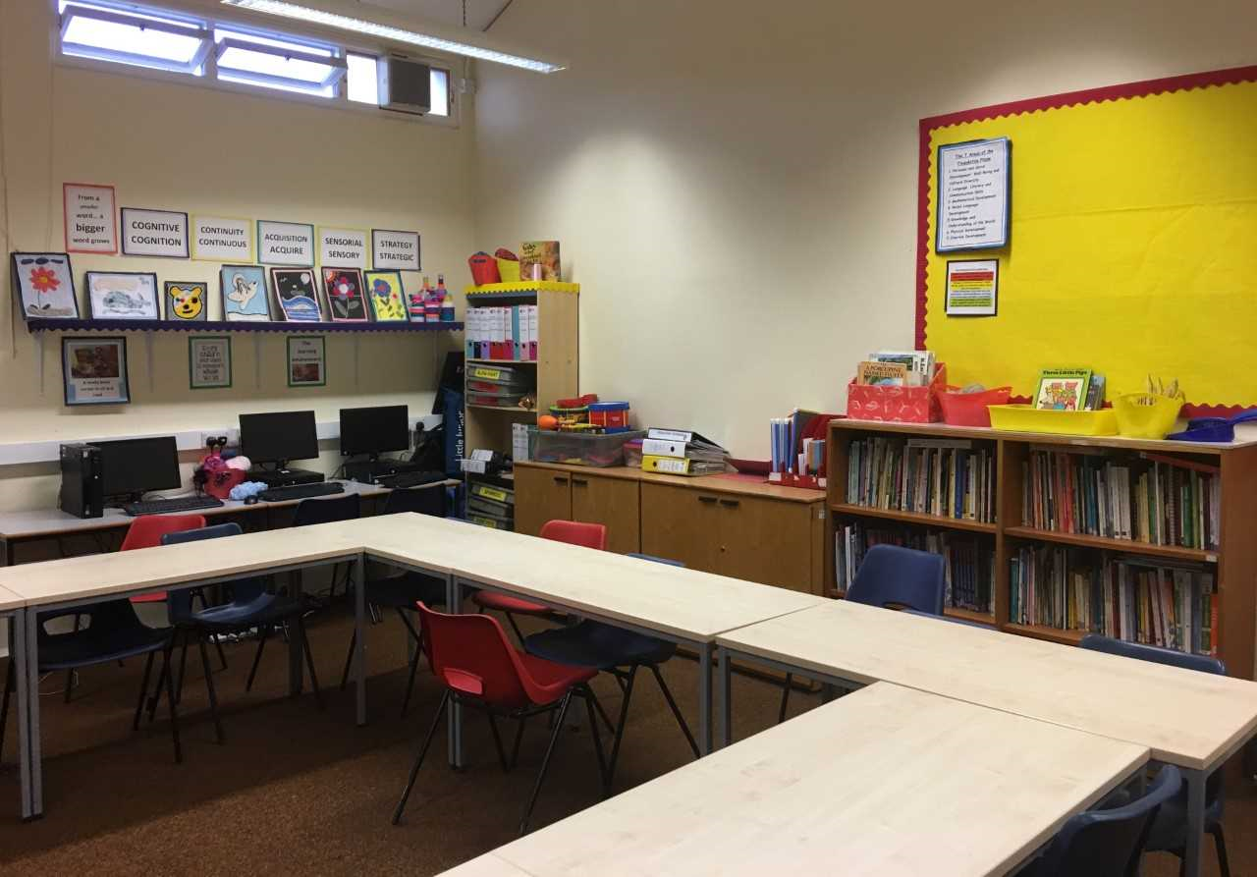

Slide 35
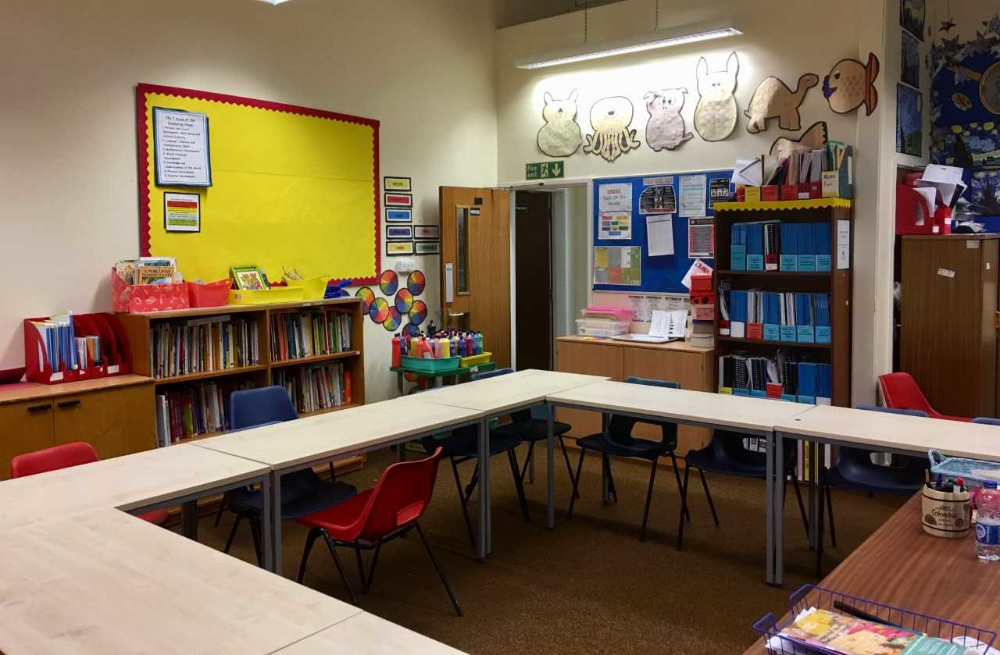

Slide 36
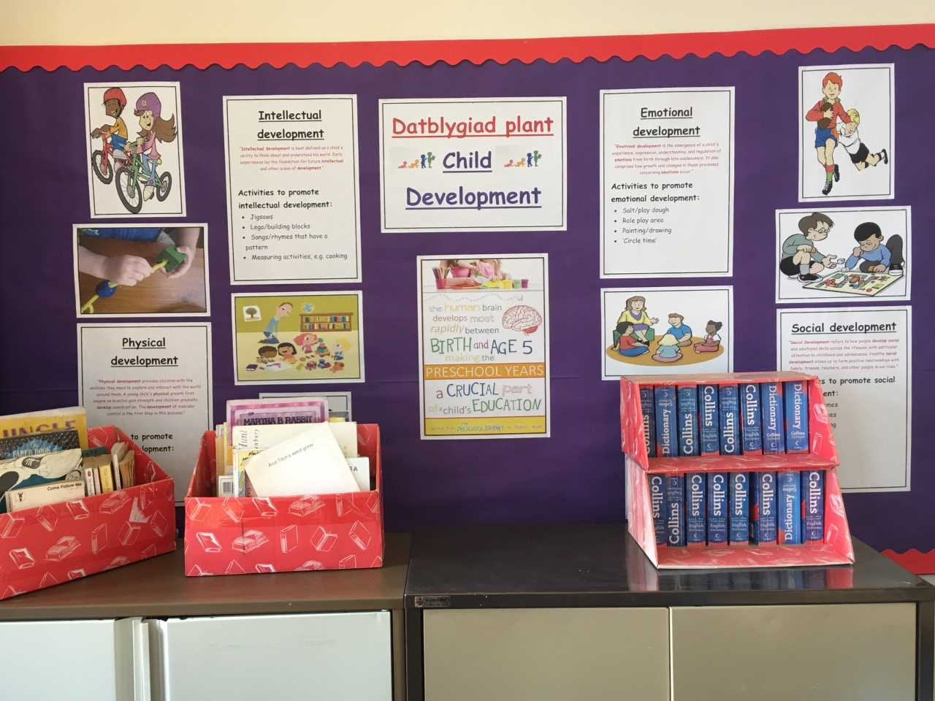

Slide 37
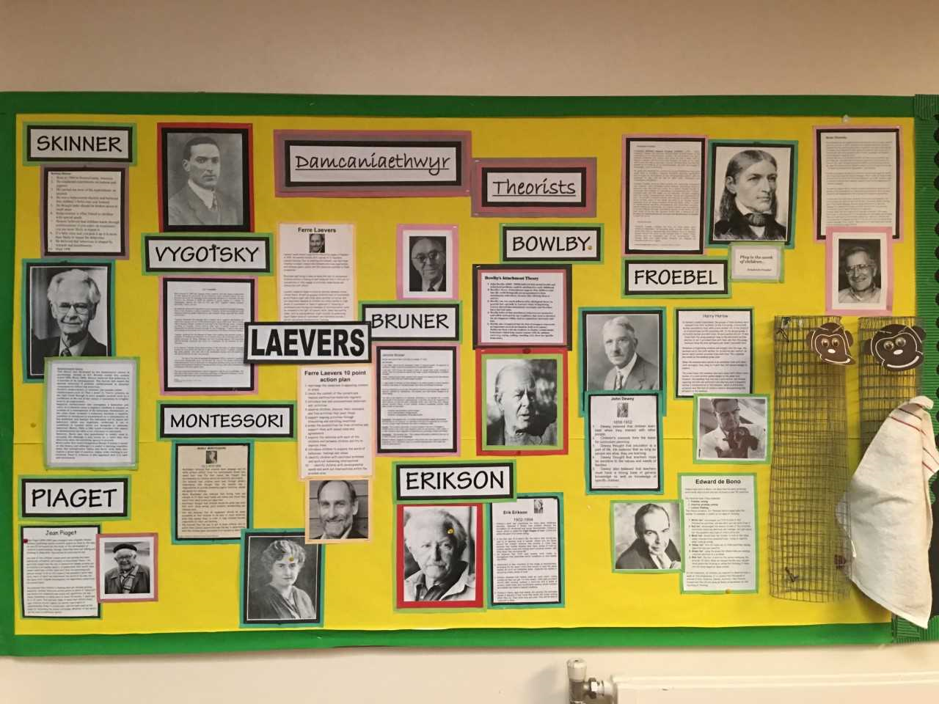

Slide 38
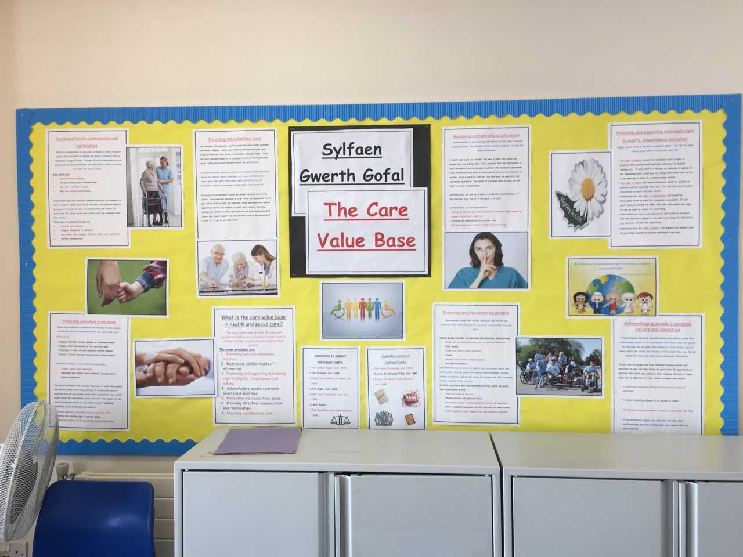

Slide 39
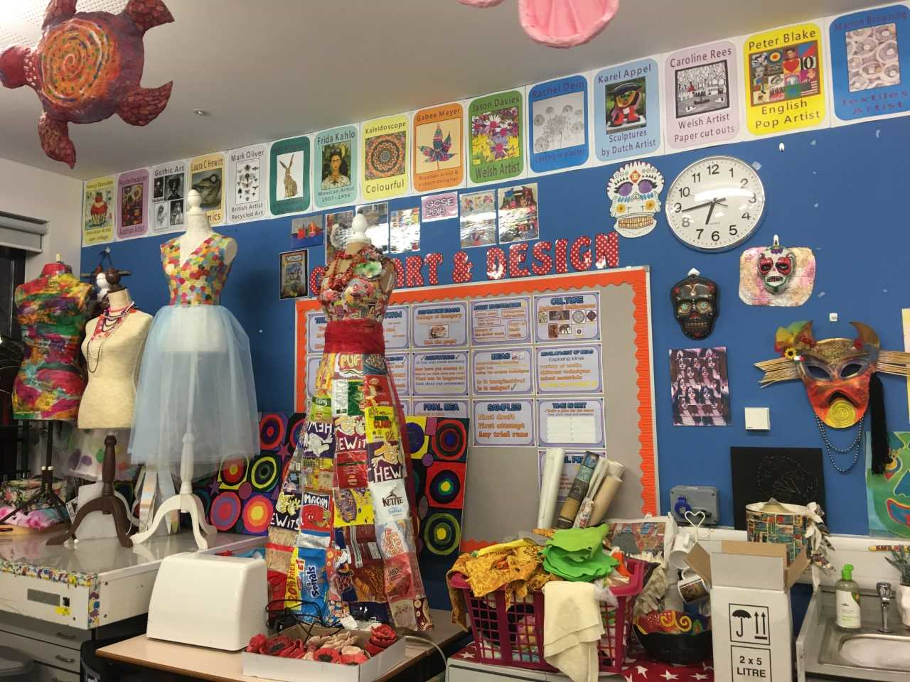

Slide 40
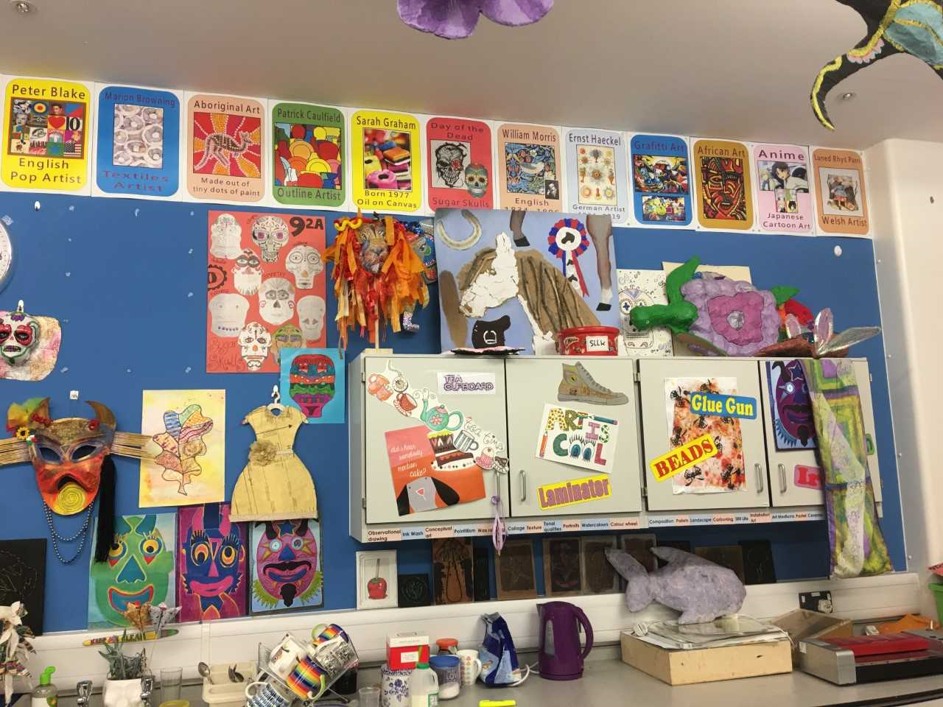

Slide 41
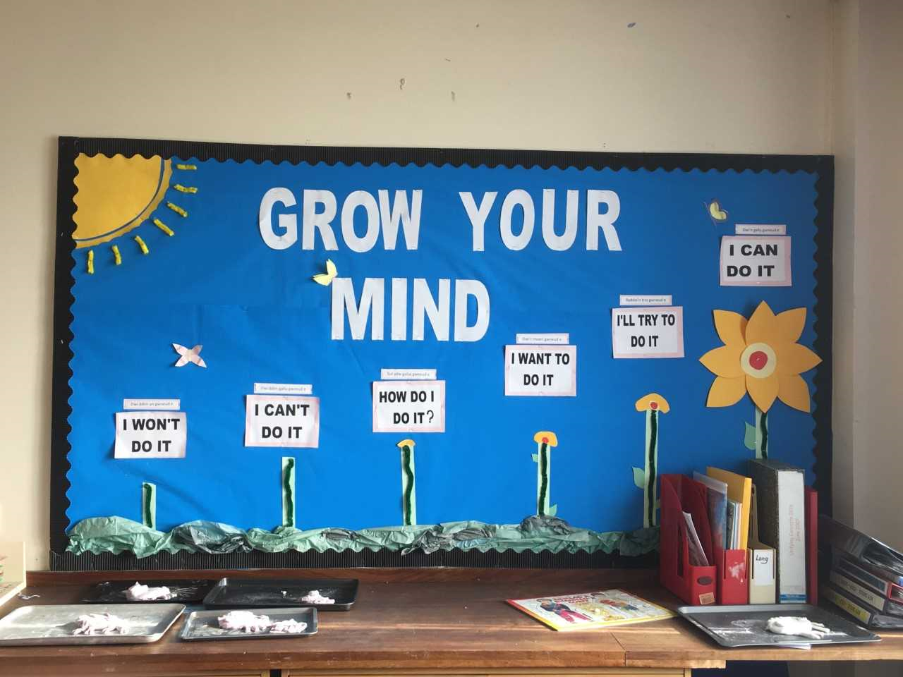

Slide 42
Rich displays
Be informative
Large print to be able to read clearly
Students work
Colour reflect the topic
Neath
Follow rules of display, mounting and arranging

