Slide 1
Croeso / Welcome / 欢迎 March 2019

Slide 2
Introduction
Teacher Training Team
Marion Rhodes
Tony Burgoyne

Slide 3
Ground rules
ring
ring
ring
ring
ring
ring
ring
ring
Please…
switch off your mobile phone or put on silent
ring
ring
ring
ring
ring
ring
Notes:
Ground rules for this group should be discussed and agreed at this point. A general discussion of ground rules will follow the next icebreaker activity.
Flip chart the participants’ responses. Ensure that you use blue or black marker pens to demonstrate good practice, and explain that blue and black are the best colours for visibility.
You may find that the group are quiet at this point. This is natural as they haven’t taken part in an icebreaker yet. They will be more vocal after Activity 1.

Slide 4
You decide
Lets make up our own Group/Ground Rules
Can you all write down what you think are the most important rules in your class/lesson, the top 3
Share with your table
Decide on the most important one
All groups to share their finding using white boards

Slide 5
Listen and concentrate when others are talking or presenting
Be respectful to all.
Come to class prepared.
Do your best.
Have a winning attitude.
Have fun and learn!
Ask if you need guidance or more understanding

Slide 6
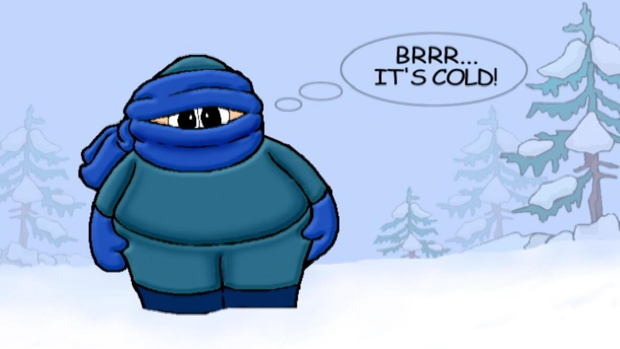
Icebreakers
It’s always good when you first meet a new group to start the session by enabling your participants to get to know each other and
Break the ice
Notes:
Explain to the participants that they will need to choose an appropriate icebreaker with their own groups, and that the type of icebreaker they choose should vary depending on their own participants.
Encourage the participants to research icebreakers in their own time, using the internet.
Participants do not need to use an icebreaker as part of their delivered session on day two.

Slide 7
Icebreakers
There are many different types of icebreaker available
The type of icebreaker you choose to carry out with your participants may vary. We are going to ask you to complete a task, then lets work it out Who's Who.
Draw or write on a piece of paper 4 things about yourself?
1 Your favourite Animal
2 Your favourite Film/Book
3 One more thing about you that you think is important
4 Lastly draw a picture of you, in your most favourite place, that you like to be!!
Scrunch the paper into a ball the throw to the front
This should help you to relax and to feel more comfortable within the group
Notes:
Explain to the participants that they will need to choose an appropriate icebreaker with their own groups, and that the type of icebreaker they choose should vary depending on their own participants.
Encourage the participants to research icebreakers in their own time, using the internet.
Participants do not need to use an icebreaker as part of their delivered session on day two.

Slide 8
Summary of icebreakers
They Learn one another’s names and something about each other
They can prepare groups for communicating and working together
They can enliven people, both physically and mentally,
They can help both new and established groups to focus on tasks
They can help people to have fun and enjoy learning
Notes:
You could promote a brief discussion regarding participants’ previous experiences of icebreakers, if time permits.

Slide 10
SWOT Analyse

Slide 11
Summary of SWOT
Strengths
Weakness
Opportunities
Threats
Notes:
You could promote a brief discussion regarding participants’ previous experiences of icebreakers, if time permits.

