Slide 1
What is Reflection?
Learning from: Experience / Success / Mistakes
Self-awareness
Critical analysis
Making informed decisions
Honest / objective / constructive

Slide 2
Definitions
“Thoughtful deliberation” (Tickle, 1994)
“Learning from experience” (Spalding, 1998)
“systematic, critical and creative thinking about action with the intention of understanding its roots and processes” (Fish and Twinn,1997)

Slide 3
John Dewey (1933)
3 stage model:
Identify problem
Think about answers
Experiment

Slide 4
David Kolb (1984)
People learn from their experiences / mistakes
Concrete experience
Reflective observation
Abstract conceptualisation
Active experimentation

Slide 5
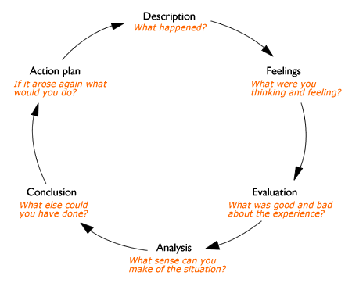
Graham Gibbs (1988)

