Slide 1
Day 6 Week 2 Teacher Training

Slide 2
Assessment for Learning

Slide 3
Prynhawn da
Good afternoon

Slide 4
At the end of today’s session you will be able to:
Define the term ‘Assessment for Learning’(AfL)
Explain the difference between ‘Assessment for Learning’ and ‘Assessment of Learning’
Discuss the major aspects of Assessment for Learning
Examine the work of Professor Dylan Wiliam and Professor Paul Black
Analyse the evidence from Robert Marzano and John Hattie which supports AfL
Create lesson plans that incorporate “Assessment for Learning”

Slide 5

Task 1 (5 min)
Discuss Summative and Formative assessment.
  What do you understand by these two types of assessment ?
  Think of examples of how you have used these assessments.
  Share with the group

Slide 6
Task 1 Summative Assessment
It is designed to provide evidence of achievement to parents, the students themselves and to outside groups e.g. employers, other educational institutions

Slide 7
Summative Assessment
Advanced Level Examination
College Scholastic Ability Test
Scholastic Assessment

Slide 8
Task 1 Formative Assessment
A wide variety of methods use to conduct in-process evaluations of student comprehension, learning needs, and academic progress during a lesson, unit, or course.

Slide 9
Task 1 Formative Assessment
Helps teachers identify concepts that students are struggling to understand, skills they are having difficulty acquiring, or learning standards they have not yet achieved so that adjustments can be made to lessons, instructional techniques, and academic support.

Slide 10
Assessment of Learning
The purpose of this kind of assessment is usually SUMMATIVE and is mostly done at the end of a task, unit of work etc.

Slide 11
Assessment of Learning
“Assessment of Learning is the assessment that becomes public and results in statements or symbols about how well students are learning.
It often contributes to pivotal decisions that will affect students’ futures.

Slide 12
Teachers’ Roles in Assessment of Learning
“Teachers have the responsibility of reporting student learning accurately and fairly, based on evidence obtained from a variety of contexts and applications.
processes that make it possible for students to proceed to next stage of education or employment

Slide 13
Teachers’ Roles in Assessment of Learning
a range of alternative mechanisms for assessing the same outcomes
public and defensible reference points for making judgements
transparent approaches to interpretation
descriptions of the assessment process
strategies for recourse in the event of disagreement about the decisions.

Slide 14

Assessment for Learning
The emphasis shifts from summative to FORMATIVE assessment in Assessment for Learning.

Slide 15
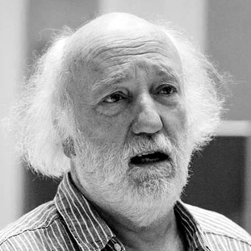
Feedback / Feedforward
goals
mission
medal
mission
medal
Medal
Mission

Slide 16
Assessment for Learning
Assessment for Learning happens during the learning, often more than once, rather than at the end.

Slide 17
Assessment for Learning
Students understand exactly what they are to learn, what is expected of them and are given feedback and advice on how to improve their work.

Slide 18
Assessment for Learning
“In Assessment for Learning, teachers use assessment as an investigable tool to find out as much as they can about what their students know and can do, and what confusions, preconceptions, or gaps they might have.

Slide 19
Assessment for Learning
The wide variety of information that teachers collect about students’ learning processes provides the basis for determining what they need to do next to move student learning forward.It provides the basis for providing descriptive feedback for students and deciding on groupings, instructional strategies, and resources.”

Slide 20
Teachers’ Roles in Assessment for Learning:
Assessment for learning occurs throughout the learning process. It is interactive, with teachers:

Slide 21
Teachers’ Roles in Assessment for Learning:
Aligning instruction
Identifying particular learning needs of students or groups
Selecting and adapting materials and resources
Creating differentiated teaching strategies and learning
Opportunities for helping individual students move forward in their learning
Providing immediate feedback and direction to students

Slide 22
Assessment for Learning
“Teachers also use assessment for learning to enhance students’ motivation and commitment to learning.
When teachers commit to learning as the focus of assessment, they change the classroom culture to one of student success.”

Slide 23
Assessment for Learning
Task: Think about when you use assessment for learning in your classroom. Is the kind of feedback you provide to students furthering their learning?
Discuss

Slide 24
Assessment for Learning
Through this process students are able to learn about themselves as learners and become aware of how they learn – become megacognitive (knowledge of one’s own thought processes).
Students reflect on their work on a regular basis, usually through self and peer assessment and decide (often with the help of the teacher, particularly in the early stages) what their next learning will be.
Assessment as learning helps students to take more responsibility for their own learning and monitoring future directions.

Slide 25
Assessment for Learning Feedback
“Complex skills, such as monitoring and self-regulation, become routine only when there is constant feedback and practice using the skills.
Effective feedback challenges ideas, introduces additional information, offers alternative interpretations, and creates conditions for self-reflection and review of ideas…

Slide 26
Assessment for Learning Feedback
If all feedback does is provide direction for what students need to do- that is, the feedback doesn’t refer to students’ own roles in moving forward to the next learning-they will perpetually ask questions like Is this right? Is this what you want?
Rather, feedback in assessment as learning encourages students to focus their attention on the task, rather than on getting the answer right. It provides them with ideas for adjusting, rethinking, and articulating their understanding, which will lead to another round of feedback and another extension of learning.”

Slide 27
Assessment for Learning
Think about when you use assessment as learning in your classroom. Do you encourage students to take risks associated with making their thinking visible?
Discuse

Slide 28
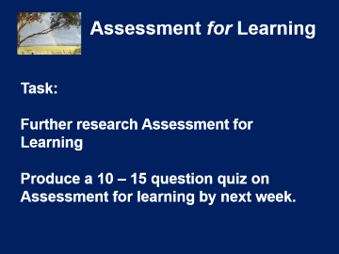
Assessment for Learning
Task:
Further research Assessment for Learning
Produce a 10 – 15 question quiz on Assessment for learning by next week.

Slide 29
Recap
Evidence Based Teaching

Slide 30
So how do we know what works ?
In education, about 150 different things have been tried to improve learning, 142 of them seem to work!
So we need some measure of effectiveness.

Slide 31


