Slide 1
Digital LEARNING/LITERACY across curriculum delivery

Slide 2
What is digital literacy?
The meaning of "digital literacy" has shifted over the years.
While there was a time when job candidates were encouraged to list "Proficient at Microsoft Word" on their CV, now such skills are considered standard.
This shift toward a technologically savvy workforce has permeated the classroom as well.
It makes sense to assume that the more digitally literate us teachers are, the more they'll employ these skills in the classroom, which will in turn foster a strong sense of digital citizenship in our students.
Notes:
http://www.teachhub.com/technology-classroom-what-digital-literacy

Slide 3
Why Digital Literacy (DL) Skills are important
Being digitally competent is essential for learning, work and active participation in society.
“More than 11 million people in the UK do not have basic digital skills. One out of every 11 completely avoids the internet.” (Lloyds Bank UK Consumer Digital Index, 2017)

Slide 4
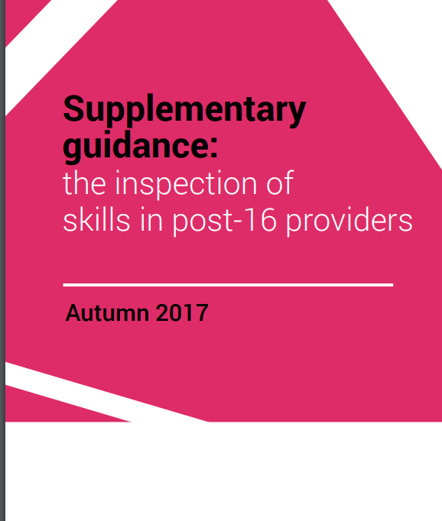
Estyn guidance sets out the way the inspectorate will conduct inspections of Further Education Colleges from September 2018.
Inspection Areas:
Standards
Wellbeing and attitudes to learning
Teaching and learning experiences
Care, support and guidance
Leadership and management
Includes:
How well the learners develop their literacy, numeracy and digital literacy in their main programme
“The acquisition of Digital Literacy skills and digital competencies should not primarily be predicated on rapidly changing technologies, but should focus on pedagogy, deeper skill development, transferability, and understanding, as well as potential application of these competencies.” (WAG)

Slide 5
Digital Competence Framework
The DCF has been developed to be inclusive of all learners aged 3 to 16-plus
The Framework encapsulates the skills that will help learners thrive in an increasingly digital world
There is no framework for HE, but the DCF gives us a benchmark to build upon
Link
Notes:
Further reading - https://learning.gov.wales/resources/browse-all/digital-competence-framework/?lang=en

Slide 6
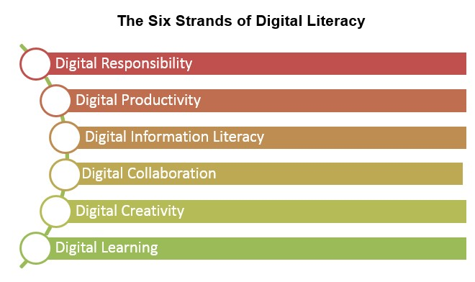
If you are a beginner, please access and complete the Moodle course “Digital Literacy Skills for Learners” as a Distance Learner
You can also use this Moodle course as a blended learning course, to improve your learners’ Digital Literacy skills and understanding of the six units/strands
Notes:
The Digital Literacy Skills qualifications (ESW and WBQ) consist of six units/strands:
Digital Responsibility - knowing how to stay safe and act appropriately online
Digital Productivity – knowing which technologies, tools and techniques to use and how to organise, share and protect digital information
Digital Information Literacy - being able to find, critically evaluate and use digital information safely
Digital Collaboration - sharing knowledge and collaborating with others to complete tasks and solve problems
Digital Creativity - Being able to use digital media to complete tasks, generate content and develop opportunities
Digital Learning – understanding how technology can extend learning opportunities

Slide 7
Whose responsibility is it to ensure students are digitally literate ?
Look back only 50 years and no one could have imagined a world in which a computer would sit in, or be part of, every workplace.
How times have changed.
The digital world offers tremendous benefits to us all. It provides platforms that allow us to connect and collaborate. It opens up opportunities to learn about new and important issues, and it empowers innovation in ways that were unimaginable just a few years ago.
Digital learning is a potential game changer for lecturers when it comes to boosting learning in the classroom. Today’s learners will enter a future workforce that requires skills such as critical thinking, creativity, problem-solving, collaboration and tech savviness. We know that, when used in ways that deepen learning, new technologies can help learners develop and practice these critical skills - and be better prepared for their futures.
Getting them ready for the global digital community is, in large part, up to us.
In the digital age, we, as lecturers, need to be flexible and adaptable to whatever gets tossed our way. New technologies are being developed every day that change not only how students learn, but how we teach.

Slide 8
In Summary…..
Digital transformation is not an easy one, and it does not happen overnight.
Nonetheless, it is critical that it becomes a natural part of teaching and learning
The aim is therefore to embed DL skills in learning and continuing professional practice in order to create a digitally literate, skilled and confident workforce and student body across NPTCG

