Slide 1
Make
A list of positive emotions
and
A list of negative emotions

Slide 2
Be aware of Emotional Intelligence in Mentoring / Coaching
Objectives:
Define Emotional Intelligence (EI)
Consider the EI Theory
Discuss the various elements of the Hay McBer model of EI
Identify own strengths and areas for development

Slide 3
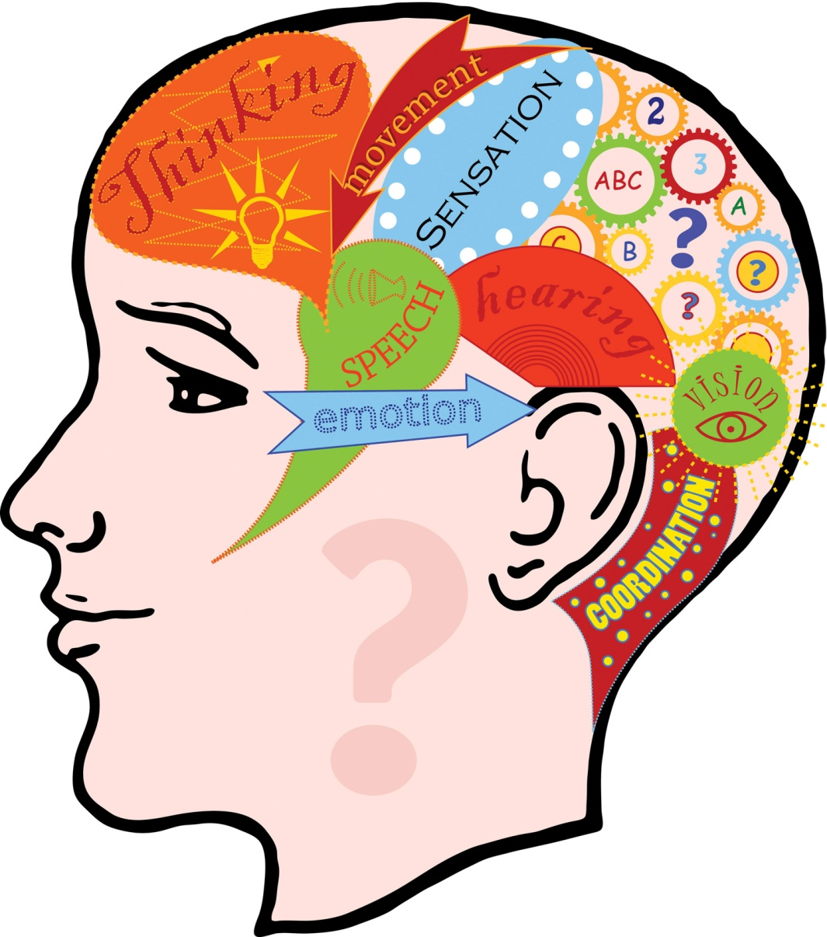
Emotional Intelligence

Slide 4
David Wechsler (1958) defined Emotional Intelligence as:
“ the aggregate or global capacity of the individual to act purposefully, to think rationally, and to deal effectively with his environment”
Cherniss, C (2000) Emotional Intelligence: What it is and Why it Matters. Available at http://www.businessballs.com/emotionalintelligenceexplanation.pdf (accessed 31/3/15)
Notes:
he referred to non-intellective as well as intellective elements, by which he meant affective, personal, and social factors
Robert Thorndike, to take another example, was writing about ìsocial intelligenceî in the late thirties (Thorndike & Stein, 1937). Unfortunately, the work of these early pioneers was largely forgotten or overlooked until 1983 when Howard Gardner began to write about ìmultiple intelligence.î Gardner (1983) proposed that ìintrapersonalî and ìinterpersonalî intelligences are as important as the type of intelligence typically measured by IQ and related tests.

Slide 5
Emotional Intelligence Theory (EQ - Emotional Quotient)
Relatively recent behavioural model, rising to prominence with Daniel Goleman's 1995 book called 'Emotional Intelligence'
EQ principles provide a new way to understand and assess people's behaviours, styles, attitudes, interpersonal skills, and potential
EQ shows the different capabilities people possess, and the fact that everybody has a value
The EQ concept argues that IQ, or conventional intelligence, is too narrow to assess how successful we are
Chapman (2000-2014) Emotional Intelligence Theory (EQ - Emotional Quotient). Available at http://www.businessballs.com/eq.htm (Accessed 31/3/15)
Notes:
The early Emotional Intelligence theory was originally developed during the 1970s and 80s by the work and writings of psychologists Howard Gardner, Peter Salovey and John 'Jack' Mayer.
Links strongly with concepts of love and spirituality: bringing compassion and humanity to work, and also to 'Multiple Intelligence' theory which illustrates and measures the range of capabilities people possess, and the fact that everybody has a value.
Success requires more than IQ (Intelligence Quotient), which has tended to be the traditional measure of intelligence, ignoring essential behavioural and character elements. We've all met people who are academically brilliant and yet are socially and inter-personally inept. And we know that despite possessing a high IQ rating, success does not automatically follow.
Different approaches and theoretical models have been developed for Emotional Intelligence. This summary article focuses chiefly on the Goleman interpretation. The work of Mayer, Salovey and David Caruso (Yale) is also very significant in the field of Emotional Intelligence, and will in due course be summarised here too.

Slide 6
Mayer and Salovey (1997) 4-part model
Perceiving and recognising emotions
Assimilating and using emotions
Understanding emotions
Managing emotions
Notes:
PERCEIVING EMOTION. The initial, most basic, area has to do with the nonverbal reception and expression of emotion. Evolutionary biologists and psychologists have pointed out that emotional expression evolved in animal species as a form of crucial social communication. Facial expressions such as happiness, sadness, anger, and fear, were universally recognizable in human beings. Emotions researchers, evolutionary biologists, specialists in nonverbal behavior, and others, have made tremendous inroads into understanding how human beings recognize and express emotions. The capacity to accurately perceive emotions in the face or voice of others provides a crucial starting point for more advanced understanding of emotions.
2. USING EMOTIONS TO FACILITATE THOUGHT. The second area appeared every bit as basic as the first. This was the capacity of the emotions to enter into and guide the cognitive system and promote thinking. For example, cognitive scientists pointed out that emotions prioritize thinking. In other words: something we respond to emotionally, is something that grabs our attention. Having a good system of emotional input, therefore, should helped direct thinking toward matters that are truly important. As a second example, a number of researchers have suggested that emotions are important for certain kinds of creativity to emerge. For example, both mood swings, and positive moods, have been implicated in the capacity to carry out creative thought.
3. UNDERSTANDING EMOTIONS. Emotions convey information: Happiness usually indicates a desire to join with other people; anger indicates a desire to attack or harm others; fear indicates a desire to escape, and so forth. Each emotion conveys its own pattern of possible messages, and actions associated with those messages. A message of anger, for example, may mean that the individual feels treated unfairly. The anger, in turn, might be associated with specific sets of possible actions: peacemaking, attacking, retribution and revenge-seeking, or withdrawal to seek calmness. Understanding emotional messages and the actions associated with them is one important aspect of this area of skill.
Once a person can identify such messages and potential actions, the capacity to reason with and about those emotional messages and actions becomes of importance as well. Fully understanding emotions, in other words, involves the comprehension of the meaning of emotions, coupled with the capacity to reason about those meanings. It is central to this group of emotionally intelligent skills.
(For a more advanced discussion of emotional information, see the section, "Similarities and Differences Between Emotional and Cognitive Information" in this article).
4. MANAGING EMOTIONS. Finally, emotions often can be managed. A person needs to understand emotions convey information. To the extent that it is under voluntary control, a person may want to remain open to emotional signals so long as they are not too painful, and block out those that are overwhelming. In between, within the person's emotional comfort zone, it becomes possible to regulate and manage one's own and others' emotions so as to promote one's own and others' personal and social goals. The means and methods for emotional self-regulation has become a topic of increasing research in this decade.
http://www.unh.edu/emotional_intelligence/index.html

Slide 7
https://www.youtube.com/watch?v=weuLejJdUu0

Slide 8
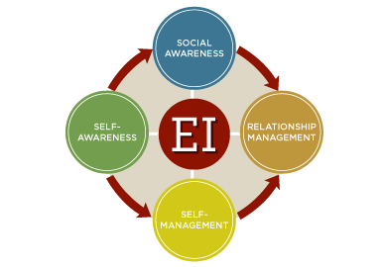

Slide 9
SELF-AWARENESS
Recognize own emotions and their effects
Know which emotions one is feeling and why
Realise the links between own feelings and what you think, do, and say
Have a guiding awareness of your values and goals
Know own strengths and limits
Be reflective, learning from experience
Be open to candid feedback, new perspectives, continuous learning, and self development
Able to show a sense of humour and perspective about yourself

Slide 10
SELF - MANAGEMENT
Self-control
Adaptability
Conscientiousness
Trustworthiness
Initiative
Drive to reach high standards

Slide 11
SOCIAL AWARENESS
Empathy: Sensing other’s feelings and perspective, and taking an active interest in their concerns.
Attentive to emotional cues and listen well
Show sensitivity and understand other’s perspectives
Help out based on understanding other people’s needs and feelings

Slide 12
RELATIONSHIP MANAGEMENT
Leadership
Influence
Developing others
Initiate and manage change
Effective communication

