Slide 1
The Differentiation Deviser
80 ways to differentiate, for use across the curriculum and the Key Stages.
Made by Mike Gershon – mikegershon@hotmail.com – with thanks to Ruth Sandler and www.geoffpetty.com

Slide 2
The Differentiation Deviser
Keywords Simple Language Keyword Display Images Keyword Discussion
Exemplify Keyword Context Antonyms Modelling Conversation New Words
Dictionary Champions Task Explanation Seating Plans Hot-Seating Students Teaching
Envoys Socratic Dialogue Confidence Indicators Expert Corner Helpers
Model Answers Photocopy Good Work By Outcome Open Activities Prior Knowledge
Stepped Activities Options Choices Extensions Wonder Wall
Group Work Pair Work Discussion Personal Experience Pace Yourself
Card Sorts Match Group Rank Buzz Groups Design Brief Worksheets
Visits and Visitors Student Presentations Case Studies Discovery Learning Experiments
Question Range Question Planning Justify Open and Closed Clarification
Challenging Questions Students Ask Questions Serial Questioning Thinking Time Individual Questioning
Assertive Questioning Task Mixture Task Mixture II Blooming Extensions Evaluate and Create
Blooming Questions Top Middle and Bottom AFL Listening Frame Modelling
Check Sheets Structure Guidelines Sentence Starters Writing Frame Planning Pro-Forma
Scrap Paper Bullet Points and Tables Individual Writing Challenge Different Media
Activity Stations Narrative Peer Research Talk To Me Humour
Made by Mike Gershon – mikegershon@hotmail.com

Slide 3
Keywords
Back to
the start
Language is integral to learning. Keywords are those words which are central to the topic you are teaching. Differentiate by:
Providing students with a glossary of key words.
Providing a list of key words and definitions which will be appropriate for the lesson.
Providing a list of key words and examples of how to use them in a sentence.

Slide 4
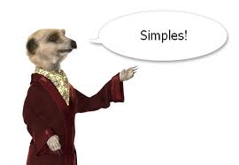
Simple Language
Back to
the start
The more complex the language you use, the less likely all your students will be able to access the meaning.
Differentiate by simplifying your language.
Consider the different places you might do this:
When speaking to the whole class.
When speaking to individuals
When writing comments.
On PowerPoint or IWB slides.
On hand-outs.
Simplifying does not mean dumbing down. It means making things clear and easy to understand.

Slide 5
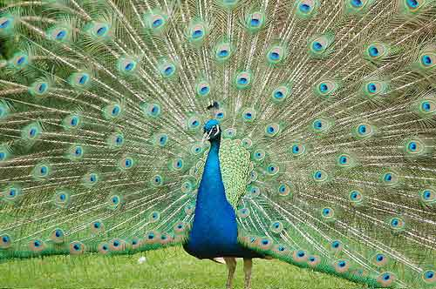
Keyword Display
Back to
the start
A good way to help students get to grips with keywords is to display them in your room. Here are five ways you might do this:
A list of keywords and definitions.
Keywords accompanied by relevant images.
Sentences in which the key words are being used.
Key words in a table with synonyms and antonyms.
Get your class to make collages or posters of keywords and display these.

Slide 6
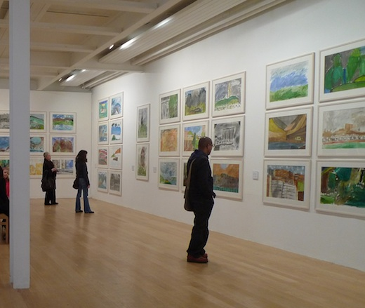
Images
Back to
the start
Images which connect to the words being used help all students to access the work.
You will notice that in this PowerPoint there is an image on every slide which connects to the strategy or technique.
Differentiate by including relevant images on any resources you make.
Use Google image search to find images quickly.
A further advantage of images is that they limit how much text you can include (and too much text is usually detrimental).

Slide 7
Keyword Discussion
Back to
the start
Before you ask students to use new keywords in their writing, encourage them to use them in discussion.
This will give students an opportunity to come to terms with the meaning of the keywords and how they can be used.
Mistakes made in speech are easier to learn from and quicker to rectify than mistakes made in writing.
They are also less damaging to the ego (not least because they disappear).

Slide 8
Keyword Context
Back to
the start
This links to the previous slide on exemplifying.
Providing context to keywords gives students something to grab hold of. It allows them to situate keywords within a wider framework.
Have a look at the picture to the left. You will notice that the different context surrounding the black circle affects how we see it (both are in fact identical).
Context has the same effect in relation to students’ understanding of keywords.

Slide 9
New Words
Back to
the start
Make a wall display to keep track of new words .
Appoint a ‘New-Word Spotter’ who’s job it is to identify when new words appear in the lesson. They should point these new words out and add them to the wall display.
Rotate the role so that a number of students are given an opportunity.
As to the wall display, you could use pieces of card pinned to the wall, a spare whiteboard, a cork board or you could print off the new words and stick them up using Blu-Tack.

Slide 10
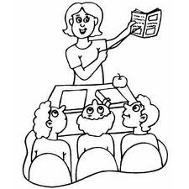
Task Explanation
Back to
the start
Think carefully about how you explain tasks in your lesson. The method I favour is as follows:
Clear, simple instructions on the board.
Pictures where appropriate to accompany instructions.
Verbal explanation accompanied by modelling.
Other options include:
Students who understand what is being asked explain the task to the whole class.
The teacher shows work produced by last year’s students (this will indicate how the end result of the task ought to look).
Provide a checklist either on the board or in a hand-out. Students then work through this, one item at a time.

Slide 11
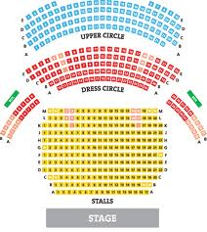
Seating Plans
Back to
the start
Use seating plans to differentiate by:
Placing students of differing abilities next to each other.
Sitting students next to each other where you feel one will have a positive influence on the other.
Setting up the room so that when you go into group work, the groups you want are already sat next to or near each other.
Placing students with certain skills next to students who need to develop those skills.

Slide 12
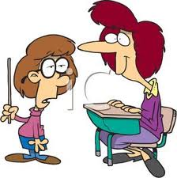
Students Teaching
Back to
the start
Create opportunities for students to take over the teaching. Here are three ways in which this might be done:
Ask a group of students to create a presentation or lesson segment on part of the topic. They then deliver this to the whole class.
Choose students who are particularly knowledgeable about the topic. Pair each of them with a group of their peers and ask them to lead some pre-prepared activities.
If it is appropriate, ask students who have personal experience of a topic to teach the rest of the class about this (for example in Religious Studies).

Slide 13
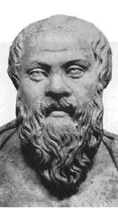
Socratic Dialogue
Back to
the start
Socrates was an philosopher in Ancient Greece. We know about him through the writings of Plato. He used to engage people in philosophical conversation. This involved challenging the arguments that people put forward and the concepts and assumptions on which these were based.
A Socratic dialogue in the classroom involves the teacher talking at length with a pupil about their ideas concerning a topic.
The teacher should ask questions and offer counter-examples. The purpose is to improve the quality of the student’s arguments and to encourage them to look more critically at their ideas.
Doing this with one or two students while the rest of the class listen is a good differentiation technique.

Slide 14
Expert Corner
Back to
the start
Ask for a student who feels they are an expert in the topic being studied.
This student is then asked to sit in a corner of the room. They should be given their own table and two chairs (one for them, one for the students who go up to them).
The class is set a task. They are informed that if anyone has any questions or concerns, they should head over to Expert’s Corner for help.
You might develop the activity by having two or three experts in different parts of the room.

Slide 15
Stepped Activities
Back to
the start
Stepped activities take students on a learning journey that gets progressively more challenging.
Plan for your lessons to include tasks which get increasingly complex or which require increasingly sophisticated thinking.
It is not necessary for all students to reach the top of the steps. Encourage them to keep working upwards, but if some reach a point that is causing them problems, let them stop there and work through it.
Stepped activities can be based on Bloom’s Taxonomy of educational activities. See my Bloom-Buster resource for ideas on how to use this.

Slide 16
Options
Back to
the start
Provide students with a range of options as to how they might access a task. For example:
Set students two questions they must answer and then provide them with a range of options to select from:
Write an essay.
Create an extended cartoon strip.
Make a poster advertising your answer.
Write a poem.
Come up with a short drama piece.
Draft a speech in which you put forward your point of view.
Create a song inspired by one of the questions.

Slide 17
Group Work
Back to
the start
Group work allows students to talk with one another and to share their understanding of the topic.
In turn, it can allow all members of a group the chance to develop their understanding. This comes through the discussion group work involves and the working-together which it entails.
Think carefully about the make-up of your groups. Mixed-ability is often best.
You may also likely to allocate roles to members of the groups so as to ensure that everybody knows what is expected of them.

Slide 18
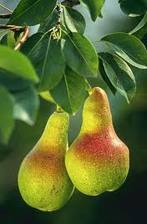
Pair Work
Back to
the start
Pair work allows students to discuss a question or task. This helps them to develop their understanding.
You might like to pair stronger and weaker students so that the former can help the latter to access what they might find difficult on their own.
Alternatively, you might want to pair two weaker students so that you can then work with them yourself. This will allow you to help them both make good progress.

Slide 19
Discussion
Back to
the start
Discussion helps students in the following ways (among others):
It allows them to explore a topic or an idea and to hear what others think.
It lets them articulate their own thoughts. This, in turn, helps them to form and refine those thoughts.
It gives them space in which to make mistakes and to clarify meaning – this is harder to do in writing.
It allows them to make use of a skill which they most are likely to be highly competent in (talking). This is less likely to be the case with writing.
It is an excellent precursor to writing, allowing students to prepare and develop their thoughts before committing them to paper.

Slide 20
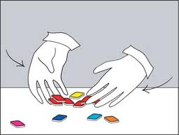
Matching, Grouping and Ranking
Back to
the start
Matching, grouping and ranking activities are good because they are accessible to all students.
At the same time, they invite different levels of thought. For example, a high-ability student may be able to give a detailed argument explaining their ranking of a set of items, while a lower-ability student may choose instead to refer to experience and comparisons.
The three activity types also invite a close examination of ideas and items through a concrete process. That is because the matching, grouping and ranking will either involve physical materials such as cards, or the writing down and rearranging of words.

Slide 21
Buzz Groups
Back to
the start
Buzz groups are simply small groups of two or three students formed impromptu to discuss a topic for a short period. In a pair it is almost impossible for a student to stay silent and once students have spoken "in private" they are much more likely to speak afterwards "in public" in the whole group.
Buzz groups are very useful to get things going. The sound of ten pairs buzzing is quite energising compared with one person speaking in a group of 20.
Buzzes can also tune students in to your subject matter and wind up their ideas; for example:
"To start off, let's buzz for five minutes on what your initial reactions were to the readings I set for this week's seminar. Off you go.“
Taken from - http://www.brookes.ac.uk/services/ocsd/teachingnews/archive/autumn04/tips_buzz.html

Slide 22
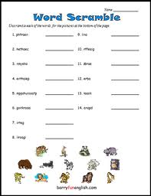
Worksheets
Back to
the start
Here are five ways you can use worksheets to differentiate:
Create a variety of worksheets in advance of the lesson. These should be aimed at various ability-levels in your class.
Use a number of worksheets akin to the model outline din the ‘Pace Yourself’ entry.
Create a range of worksheets which gradually increase in difficulty. Students then work their way through these, getting as far as they can.
Create worksheets which include open questions or tasks.
Create worksheets which provide students with various options or choices (see the ‘Options’ and ‘Choices’ slides).

Slide 23
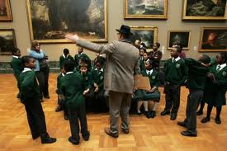
Visits and Visitors
Back to
the start
Visits and visitors are a great way of differentiating. They are engaging for students for the following reasons:
They are interactive.
They are unusual.
They are a change to the routine.
They bring learning alive.
They are different to most of what goes on in the classroom.
It is a good idea to plan work around a visit or visitor. This means:
You can prepare students so as to ensure they get the most out of it.
You can capture their learning afterwards and build on this.

Slide 24
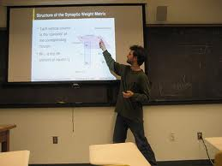
Student Presentations
Back to
the start
Divide the class into groups.
Give each group a topic to research or a question to answer.
Provide appropriate resources and ask the groups to create a presentation they will give to the whole class.
To avoid boring presentations, set students some ground rules. For example:
No reading off slides.
Make a hand-out.
Include one piece of drama.
Include one game or interactive element.
Include one discussion question (and then lead the discussion).

Slide 25
Question Planning
Back to
the start
Plan your questions in advance. The advantage of this is that you can set up a range of different questions which are specific to the topic and to your students.
You might like to keep a note of your questions so that you can use them when you teach the topic again.
If you feel you do not have time to plan questions, make use of categories and question types.
You can call on these during a lesson and create questions based on them. This will stop you falling back onto questions you have used previously or which do not move learning forwards. See other slides in this PowerPoint for useful question types and categories.

Slide 26
Open and Closed
Back to
the start
Think carefully about when to use open and closed questions.
As a rule I would generally favour open questions. This is because they allow students the opportunity to reason, to advance positions, to make claims and to think carefully about a topic.
Closed questions are more likely to see students attempting to guess the correct answer.
Use the word ‘might’ to open up your questions:
What is democracy?
What might democracy be?
Clearly there is greater scope for thinking and discussion in the second case then there is in the first.

Slide 27
Students Ask Questions
Back to
the start
Encourage your students to ask questions. There are many benefits to this, including:
Students can ask questions at the level with which they are comfortable.
Students can hear other people’s questions.
Students can observe how the teacher goes about answering questions.
The teacher can find out what areas students want to know about.
Students can find out information from the teacher’s responses.

Slide 28
Individual Questioning
Back to
the start
If you go and spend time with individual students then you are differentiating.
Even better is if you ask different individuals different questions.
These should take account of what those students know, where they are at and what your experience of them is.
In essence:
Create opportunities where you can go and work with individual students.
Tailor your questioning to the student with whom you are working.
Respond to what they say with further questions.

Slide 29
Blooming Extensions
Back to
the start
Use Bloom’s Taxonomy to create extension questions and tasks. Here are a list of words linked to the top three levels:
Analysis: Analyse, Appraise, Categorize, Compare, Contrast, Differentiate, Discriminate, Distinguish, Examine, Experiment, Explore, Investigate, Question, Research, Test.
Synthesis: Combine, Compose, Construct,
Create, Devise, Design Formulate, Hypothesise, Integrate, Merge, Organise, Plan, Propose, Synthesise, Unite.
Evaluate: Appraise, Argue, Assess, Critique, Defend, Evaluate, Examine, Grade,
Inspect, Judge, Justify, Rank, Rate,
Review, Value.

Slide 30
Evaluate and Create
Back to
the start
When setting extension tasks and extension questions, focus on asking students to evaluate and create.
These are the highest level skills in Bloom’s Taxonomy and they require the greatest degree of mastery over the material being studied.
In addition, when you are planning to include stepped activities or a mixture of tasks (see slides in this PowerPoint), use evaluate and create based activities as the end-points of the lesson.
Making these that which everything else is building up to will ensure the level of challenge gets progressively higher as the lesson progresses.

Slide 31
Blooming Questions
Back to
the start
Use Bloom’s Taxonomy to inform questioning throughout your lessons.
Here are a list of words linked to all six levels:
Knowledge: Arrange, Define, Describe, List, Match, Memorise, Name, Order, Quote, Recognise, Recall, Repeat Reproduce, Restate, Retain.
Comprehension: Characterise, Classify, Complete, Describe, Discuss, Establish, explain, Express, Identify, Illustrate, Recognise, Report, Relate, Sort, Translate.
Application: Apply, Calculate, Choose, Demonstrate, Dramatise, Employ, Implement, Interpret, Operate, Perform, Practise, Role-Play, Sketch, Solve, Suggest.
Analysis: Analyse, Appraise, Categorize, Compare, Contrast, Differentiate, Discriminate, Distinguish, Examine, Experiment, Explore, Investigate, Question, Research, Test.
Synthesis: Combine, Compose, Construct,
Create, Devise, Design Formulate, Hypothesise, Integrate, Merge, Organise, Plan, Propose, Synthesise, Unite.
Evaluate: Appraise, Argue, Assess, Critique, Defend, Evaluate, Examine, Grade,
Inspect, Judge, Justify, Rank, Rate,
Review, Value.

Slide 32
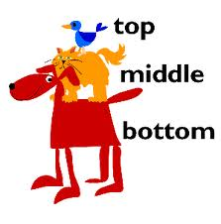
Top, Middle and Bottom
Back to
the start
When teaching mixed-ability classes we often teach to the ‘middle’.
To some extent this is inevitable. It is the safest position for ensuring that most of the students get what we are talking about.
It can be good to mix this up though. Try to teach to the ‘bottom’ and the ‘top’ at least a couple of a times a lesson.
Make a conscious effort to do this.
You might preface it by saying, ‘This might seem obvious but I just want to make it clear for you,’ or, ‘This next bit is a bit complicated, but stick with it, it’ll be worth it.’

Slide 33
Challenge
Back to
the start
Stretch and challenge your students by using my challenge toolkit:
http://www.tes.co.uk/teaching-resource/Challenge-Toolkit-6063318/

Slide 34
Humour
Back to
the start
Humour is a great way of motivating and engaging students as well as making all of them feel involved and included in the lesson.
Look for opportunities to use humour.
Search the web for jokes, even if they are bad ones, and don’t be afraid to laugh at yourself as well.

