Slide 1
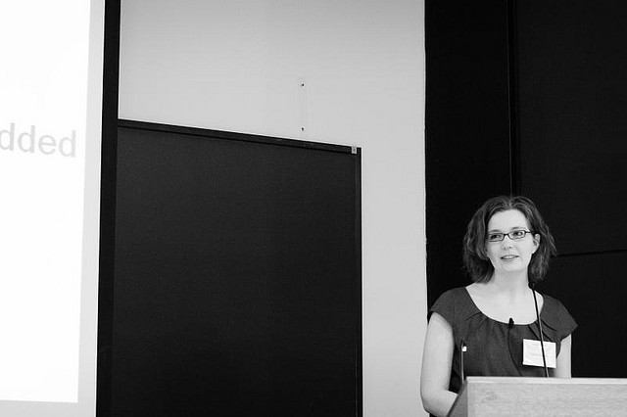
Presentation Skills

Slide 2
Aims and Objectives
To consider different ways to do a presentation
To know what makes an effective presentation
To understand how to structure a presentation
To consider audience participation
To know what to avoid
To understand the importance of preparation
To consider the impact of body language
To be aware of helpful resources

Slide 3
A New Idea…
Notes:
Emphasize the importance of using more images rather than wordy presentations and lots of notes.

Slide 4
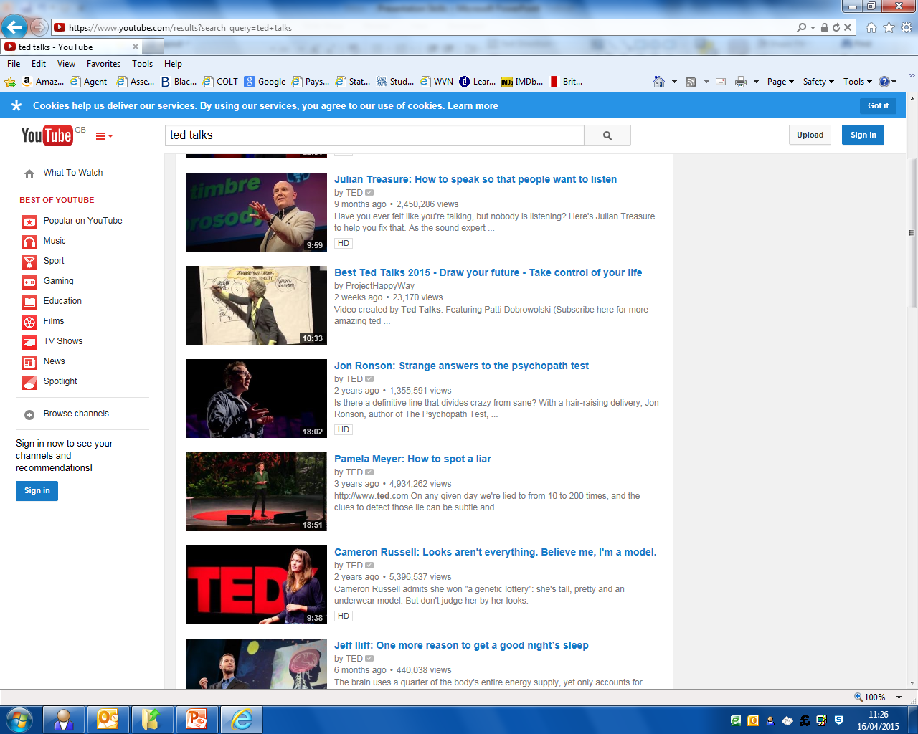
Key point!
Watch TED Talks
Notes:
Refer them to YouTube or https://www.ted.com/

Slide 5
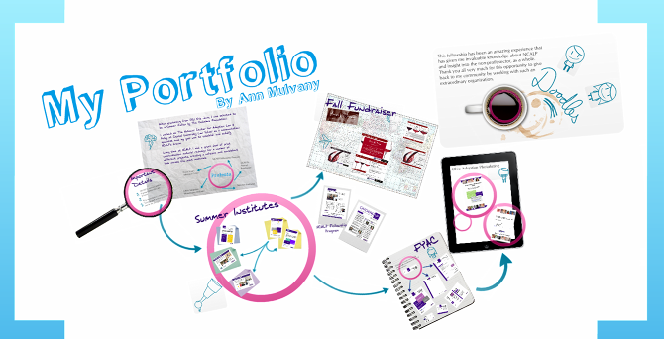
Prezi.com
Notes:
Refer them to https://prezi.com/ and explain how the presentation moves around

Slide 6
Effective Presentations
Olivia Mitchell
“People like a presenter they can relate to and they like a presenter who speaks from their own knowledge –rather than a script.”

Slide 7
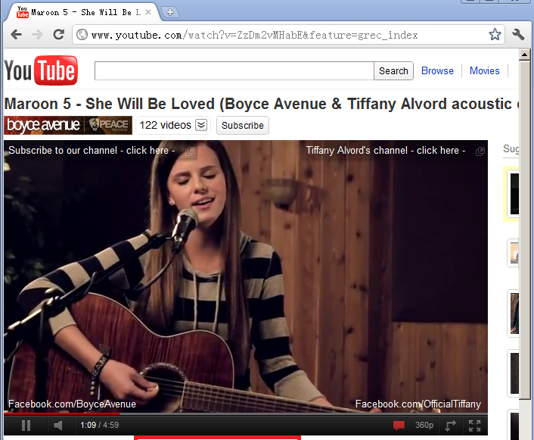
Effective Presentations
Notes:
Explain that including interesting video clips from YouTube can vary the pace of delivery

Slide 8
Structure Introduction
Presentation Quick Tip # 2
Use a Quote to Introduce a Topic
Notes:
This helps the structure of the presentation and can be inspiring and interesting.

Slide 9
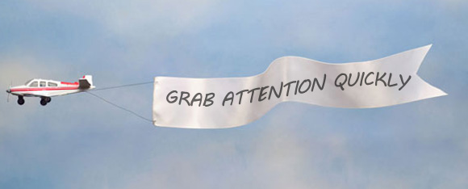
Structure Introduction

Slide 10
Structure Introduction
Notes:
Infographics are more visual and can quickly convey information to the audience

Slide 11
Shock
Notes:
Ask them to guess what the image is and explain that it is ankles. Shock can have quite an impact.

Slide 12
Can you think of a good presentation you have seen?
Discuss for 2 minutes then share!

Slide 13
Audience Participation
Notes:
Explain the importance in holding the audience’s interest.

Slide 14
Audience Participation
BE SO GOOD THEY CAN’T IGNORE YOU
~STEVE MARTIN

Slide 15
Audience Participation
Activities
Notes:
Suggestions for audience participation can be: icebreakers, activities, quizzes or asking for volunteers.

Slide 16
What to Avoid

Slide 17
Preparation
“All the great speakers were bad speakers at first.”
- Ralph Waldo Emerson

Slide 18
Preparation
“It usually takes me more than three weeks to prepare a good impromptu speech” –
Mark Twain
Notes:
Emphasise that talks are usually so well rehearsed that the speaker is confident and can be more spontaneous.

Slide 19
Body Language
38%
55%
Notes:
Emphasize the importance of appearance , including body language and confidence, in how a presenter comes across to the audience.

Slide 20
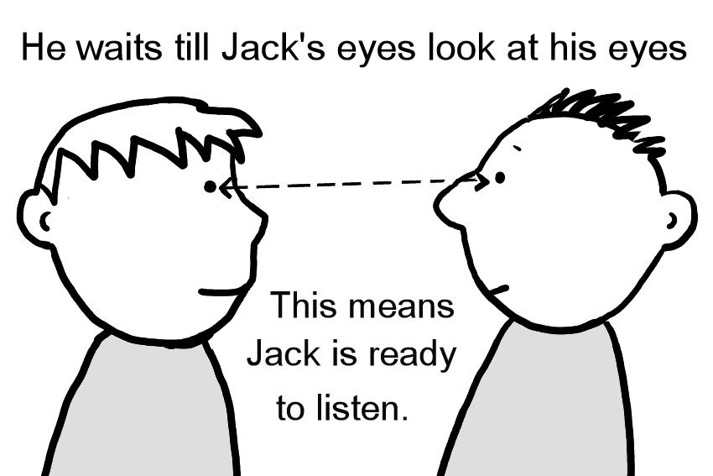
Body Language
He waits till Jack’s eyes look at his eyes
This means Jack is ready to listen

Slide 21
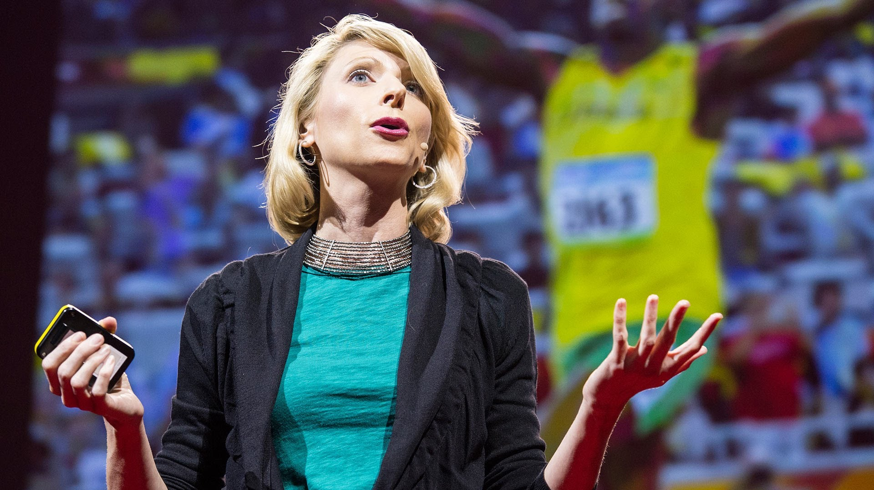
Body Language
Notes:
Discuss open body language, and why this speaker looks confident.

Slide 22
Body Language
KEEP
CALM
AND
STAY STILL
PLEASE
Notes:
No fidgetting.

Slide 23
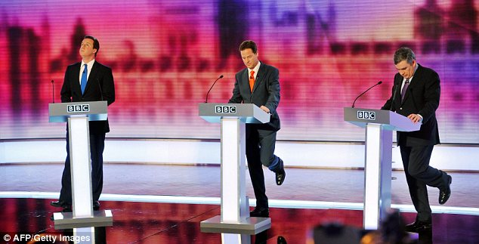
Notes:
Explore fidgety or closed body language; get audience feedback.

Slide 24
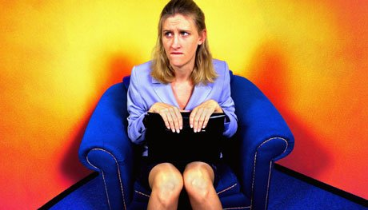
Do not read directly from your notes.
Keep eye contact with your audience
Notes:
Discuss the apparent low levels of confidence in these speakers. Ask audience for suggestions.

Slide 25
Recap
Use images, less text
prompts
Include videos/activities
20 minute chunks
Audience participation
Eye contact
Body language
Structure
Shock
Preparation
Exude confidence

Slide 26
Resources

Slide 27
Any Questions?

