Slide 1
Reflective Writing

Slide 2
Aims of this Session
To understand what is meant by reflective thinking
To know why writing reflectively is encouraged
To understand active learning
To be aware of various ways of writing reflectively
To know what resources we have in the library

Slide 3
What is reflective thinking?
Description
What has happened?
Feelings
What were you thinking and feeling?
Evaluation
What was good and bad about the experience?
Analysis
What else can you make of the situation?
Action Plan
If it arose again, what would you do?
Conclusion
What else could you have done?

Slide 4
Create!
Analyse Information
sort information into catagories
Understanding
Evaluate
Choose the best information
Apply to other situations
Remembering

Slide 6
This is taking the time to consider: How you learn What motivates you Whether your methods of studying are appropriate for you What blocks your progress What gaps you have in your knowledge How you feel about your learning
Reflective Writing
Cotrell, 2008

Slide 7
In Other Words…
Thoughts
Beliefs
Self-evaluation
Feelings
Discovery
Your identity
Self- awareness
Ethics
Being critical
Bolton, (2005)

Slide 8
Warning!
It will only work if you fully engage with the process, utilising it as a valid learning tool

Slide 9
It’s On-Going…
Concrete Experience
Doning/having an experience
Reflective Observation
Reviewing/reflecting on the experience
Abstract Conceptualisation
concluding/learning from the experience
Active Experimentation
Planning/trying out what you have learned
…and will ideally be continued throughout your professional development

Slide 10
Why Write Reflectively?
To enable self-evaluation and improvement of work
It’s individual and expressive
It encourages responsibility for our own learning
It keeps us questioning
Individuals can make sense of their own narrative and make discoveries though the very act of writing reflectively

Slide 11
Why Write Reflectively?
“Writing no longer merely “captures” reality, it helps “construct” it
(Plummer 2001, p. 171; cited in Bolton, 2005)
You direct and control the
direction of
your own learning

Slide 12
Format
This will depend on what the tutor wants:
It can be an assignment
A journal including images/art work
Art work on its own

Slide 13
So Why Learn Reflectively?

Slide 14
Reflective Assignments
Experience
Actions past/present
Observation
Documenting what happened
Reflection
Making sense, investigating, theorising
Planning
Making plans in order to take (further) action
Remember: Keep descriptions to a minimum

Slide 15
Have a Go…
You have five minutes to write reflectively about an aspect of your course and something you have learned
Remember to keep descriptions
to a minimum!

Slide 16
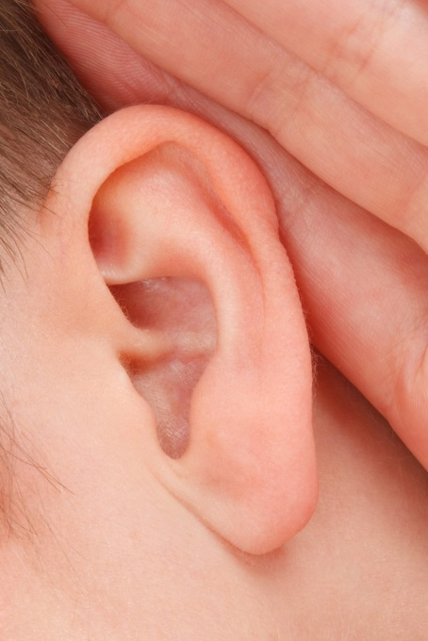
How did it go?
Anyone want to share?
Listen out for a reflective sentence!

Slide 17
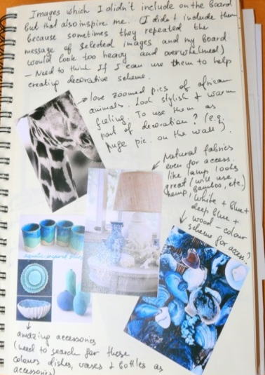
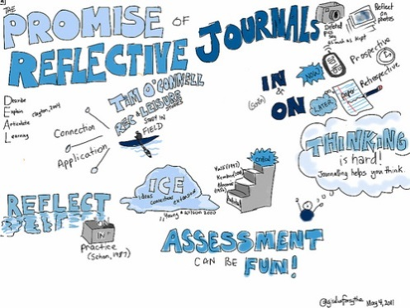
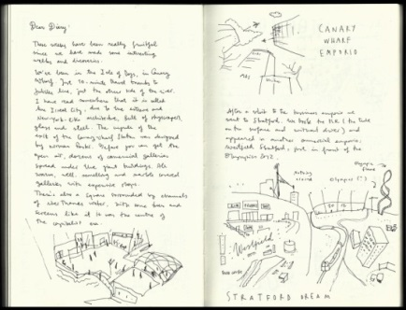
Reflective journals
These can be quite fun and creative!
A lot of courses require a journal, or reflective assignments to be written regularly
These can also be used to inform your assignments

Slide 18
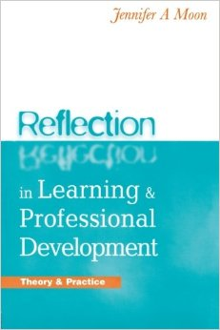
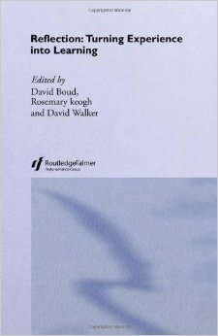
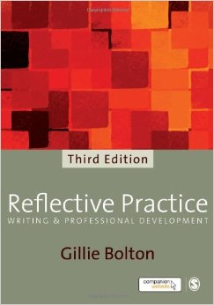
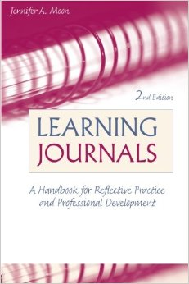
General Resources

Slide 19
Subject-Based Resources

Slide 20
Recap
Keep descriptions brief
Express feelings
Identify strengths and what needs to be improved
Be evaluative and plan changes Embrace the benefits of writing reflectively and engage with the process
Be creative and enjoy it!
Use reflection to direct and develop your learning

Slide 21
Any Questions?

