Slide 2
Definitions
Strengths – Factors that are likely to have a positive effect on (or be an enabler to) achieving the school’s objectives
Weaknesses – Factors that are likely to have a negative effect on (or be a barrier to) achieving the school’s objectives
Opportunities – External Factors that are likely to have a positive effect on achieving or exceeding the school’s objectives, or goals not previously considered
Threats – External Factors and conditions that are likely to have a negative effect on achieving the school’s objectives, or making the objective redundant or un-achievable

Slide 3
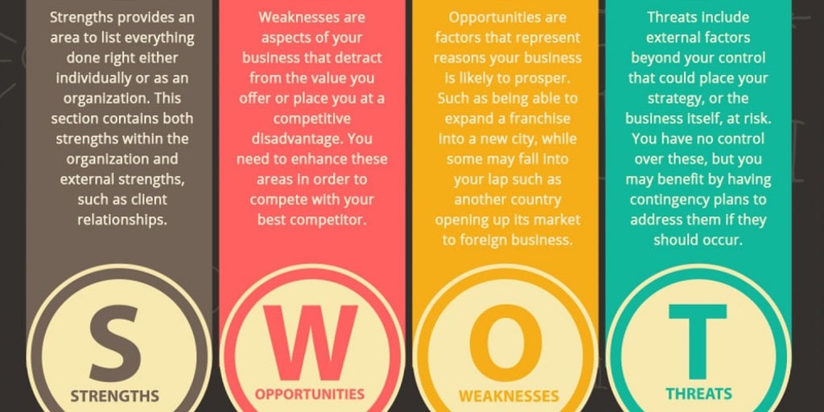

Slide 4
