Slide 1

Internal Verification

Slide 2

First…. What does this mean?
INTERNAL - it means ‘inside’
It relates to all things going on INSIDE
a corporation.
In Education this means the staff,
the teachers.
The INTERNAL TEACHERS ARE ..YOU
SIT (Super Intellegent Teachers)

Slide 3



VERIFICATION

Slide 4

To Check, to validate….
To check everything is correct! And standardised

Slide 5

STANDARD - STANDARDISATION
To make sure all work has standards.
Compare teachers marking – making sure it is the same standard.

Slide 6

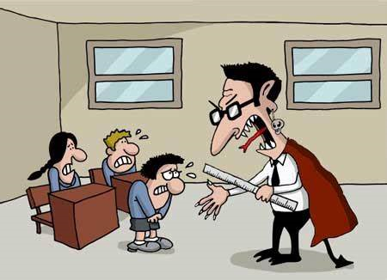
Both teachers mark in the same way towards the same set standards.
How will this teacher and this?...... mark?

Slide 7

STANDARDISED is about quality, and assuring that quality……EVERYWHERE!!!

Slide 8


What does THIS mean to you?

Slide 9


Slide 10

Did you expect this????

Slide 11




Everywhere you go…..

Slide 12

What if you had THIS….

Slide 13

Or this…

Slide 14
THERE IS NO STANDARD….
What happens?
You don’t know what to expect
It becomes worthless
It will have no meaning

Slide 15
INTERNAL VERIFICATION
Makes sure there are:
RECOGNISED STANDARDS
EVERYBODY IS WORKING TOWARDS THE SAME STANDARD
EVERYBODY MARKS WORK WITH THE SAME STANDARDS

Slide 16
What does this mean for the teacher….
Everybody works together
Arrangements scheduled to have meetings
In these meetings check everyones marking
Complete records of staff and students who have been I’Vd

Slide 17
THE PROCESS
Appoint Internal Verifiers
Check a sample of 5-7 students work from the same unit.
Check the marking and the standard of work.
Over a period sample all teachers marking
Record this process.

Slide 18
See sample
Can you work in groups and devise your own records…..
.

