Slide 1
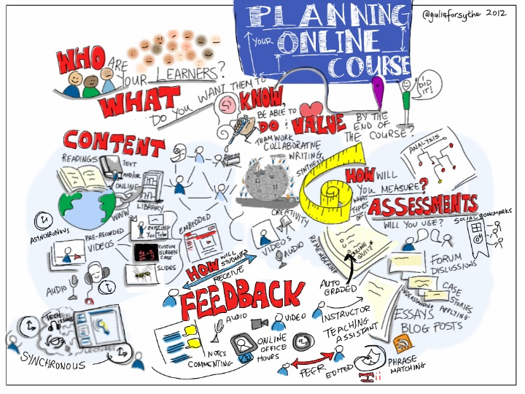
Planning and assessment
Planning for writing a scheme of work.

Slide 2
Aim To promote an understanding of writing a scheme of work. Objectives • To recognise the importance of schemes of work • To acknowledge the relationship between aims and objectives • To plan a scheme of work
Aim and Objective for this lesson

Slide 4
Programme structuring begins with a scheme of work • As you make decisions about the design of the programme and continue to review and develop your planning – • you are able to take into account new opportunities, resources and changing learner needs.
Programme Structuring

Slide 5
successful planning enables trainers to provide a coherent, relevant and engaging programme that promotes continuity in learning. • effective plans take many forms, but show clear objectives and how these will be achieved • adapting existing plans and using high-quality resources as starting points can save on planning time and support ongoing review of the programme • using ICT can make it much easier to share, re-use, copy and amend
When planning, many trainers work from
the following key points to help them plan
efficiently and effectively:

Slide 6
The most influential model of learning was presented by Kolb (1984). • This model is appropriate to the trainer and the learner as it sets out the stages of learning. • Remember, as a new trainer you are learning too! - how to plan and organise effective training that achieves the companies objectives
Kolb Cycle - Experimental Learning -The
trainer

Slide 7
Kolb’s learning cycle is separated into 4 stages. • It is envisaged that all trainers plan each stage in sequence. • However, that does not mean that each stage will take the same length of time.
Kolb’s Learning Cycle

Slide 8
1 The 'EXPERIENCE' – The practice under investigation Simply put ‘what needs to be learned 2 The 'REFLECTION ' - This relates to you initial impressions of what needs to be done It is the analytical phase where options are considered - the what, why ,where, when and how of training.
Kolb’s Learning Cycle

Slide 9
The ‘CONCEPTUALIZATION' - Here you include your plans for implementation or change PROCESS and the learning CONTENT of your course. The 'PLANNING' part of Kolb's learning cycle relates to: 'future decisions regarding the experience'. Here you draw together: • your initial reflections on the experience • your reflections on the learning process • your reflections on the learning content
Kolb’s Learning Cycle

Slide 10
A scheme of work in its broadest sense of the word is a long term plan to shows how training has been organised. • As a trainer decisions need to be made about what will be taught, which will rely on other forms of interactive materials and in which order they will be sequenced. • The trainer reviews the scheme regularly to check on progression through the course and to check that resources are available for what is being taught.
Schemes of Work- Long term planning

Slide 15
•Specific – are they clearly defined? •Measurable – can they be met? •Achievable – are they possible? •Realistic – do they relate to the aim? •Time bound – can they be met in the time?
Objectives should be SMART

Slide 16
The 14 P,s for effective planning
Purpose
Planning
Preparation
Patience
Punctuality
Presence
Passion
Pride
Personality
Politeness
Positiveness
Physical environment
Persistence
Professionalism

Slide 17
Proper Preparation and Planning Prevents a Pretty Poor Performance
Thought for the day
Remember the seven Ps

Slide 18
A systematic approach to training

Slide 20
.Check the environment in which you will be delivering your session (room, layout, facilities, health & safety) •Check the equipment: is it available, appropriate, working? •Check and rehearse your timings •Have a practice run through the delivery of the session •Allow time for questions •Add 5% extra time and have a Plan B in case anything goes wrong •Prepare a session plan with a clear aim
Planning and preparing sessions

Slide 22
Training resources should: • be simple and interesting • help participants understand the topic • help you to clarify and simplify the topic • help in promoting and maintaining interest • help the trainer but must not replace him/her
Designing resources

Slide 23
Design a simple activity to deliver
Activity

